Slide 1

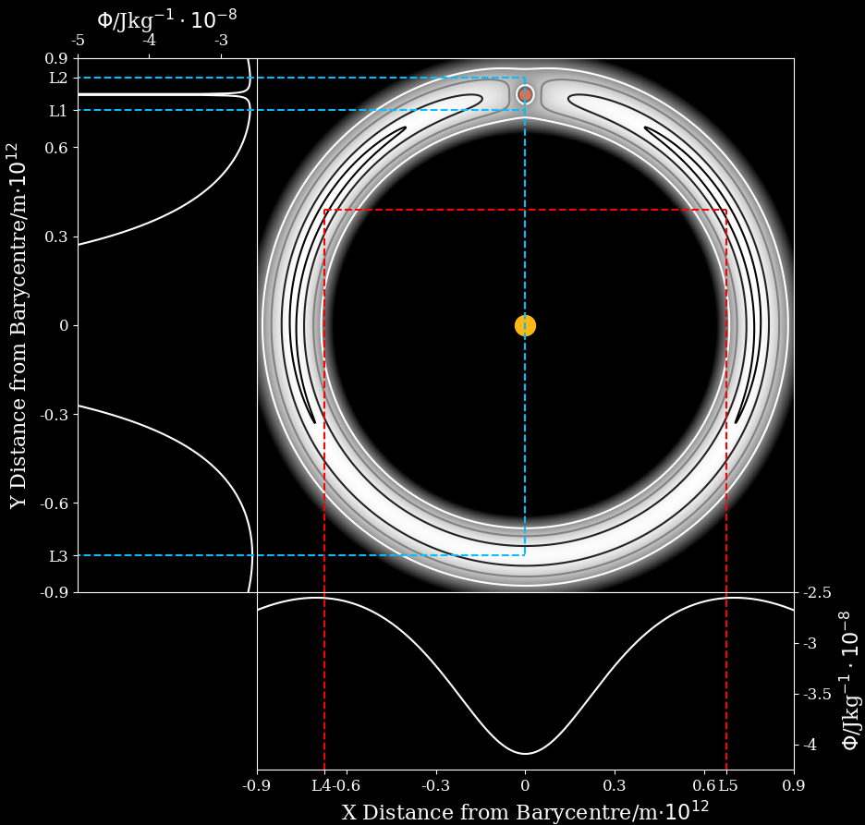


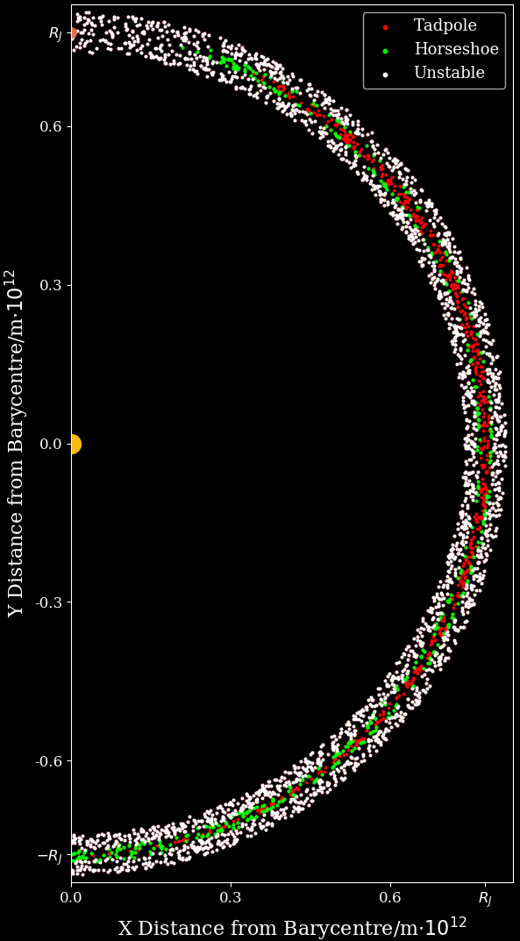
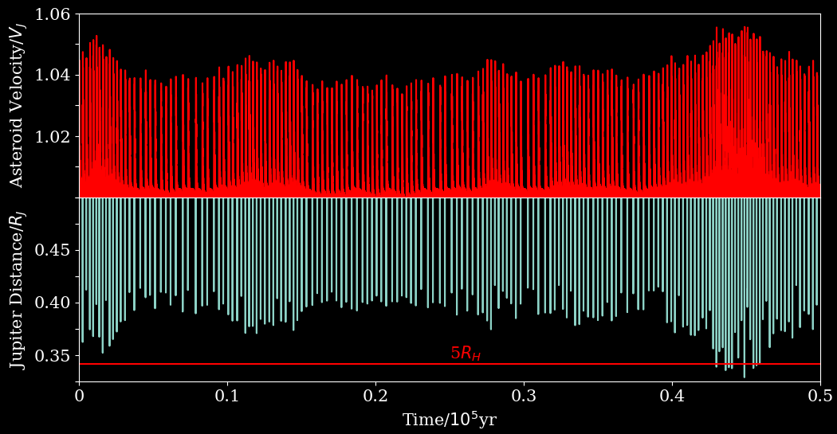


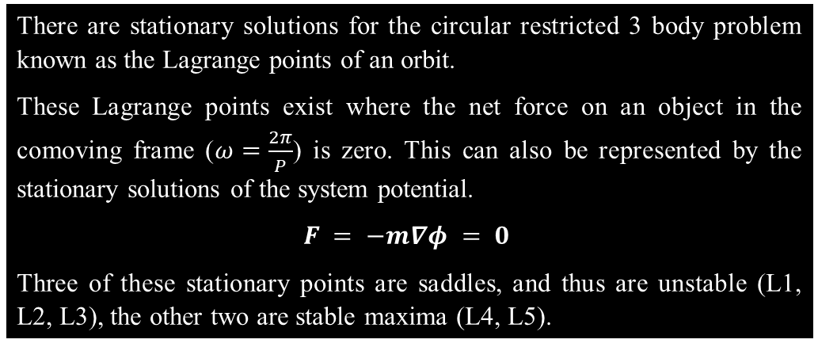
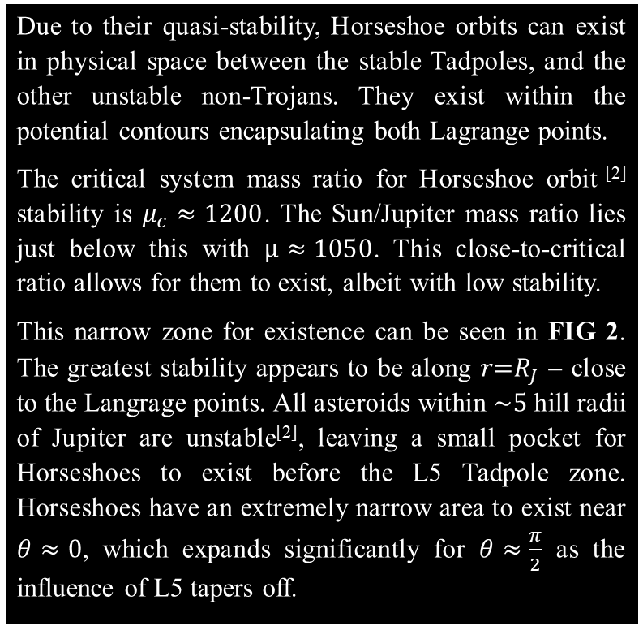
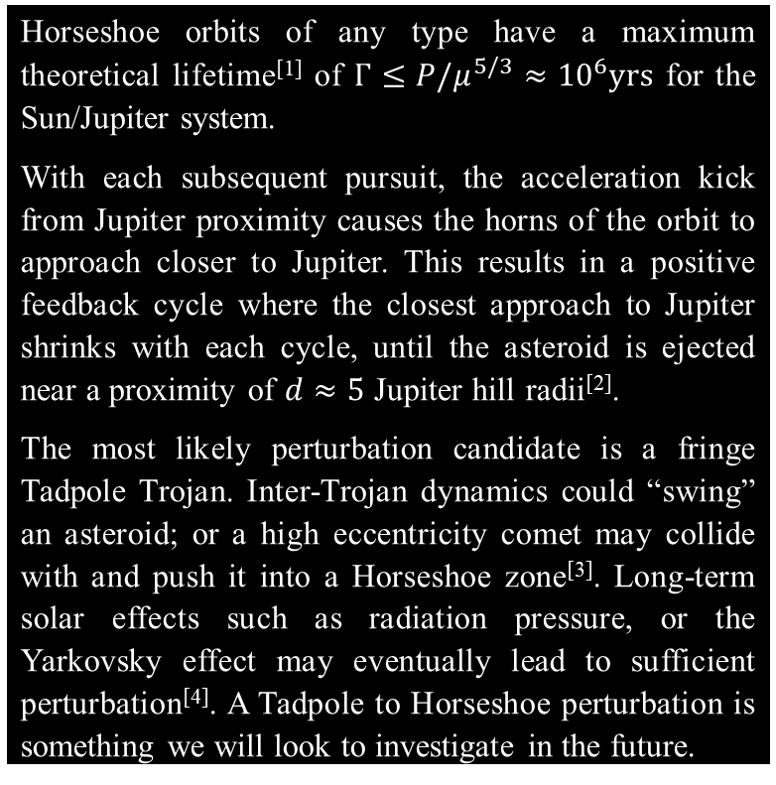
Trojan Horseshoe Orbits
Conor Diver Durham University
Lagrange Points
There are stationary solutions for the circular restricted 3 body problem known as the Lagrange points of an orbit.
These Lagrange points exist where the net force on an object in the comoving frame ($ω=\frac{2π}{P}$) is zero. This can also be represented by the stationary solutions of the system potential.
$$F = −m∇φ = 0$$
Three of these stationary points are saddles, and thus are unstable (L1, L2, L3), the other two are stable maxima (L4, L5).
Sun-Jupiter Trojans
In the Sun-Jupiter system asteroids at L4 and L5 closely following Jupiter in its orbit – these are known as the Trojans. There are two types:
TADPOLES orbit L4 or L5. They are extremely stable, and follow potential contours around either L4 or L5 – they draw out their namesake in a comoving frame with Jupiter. Their distance oscillations from Jupiter as they orbit L4/5 are low amplitude, and are of a constant period.
HORSESHOES orbit both L4 and L5. They are quasi-stable, and follow potential contours around both L4 and L5 in a horseshoe shape. They have a higher amplitude distance oscillation, with a more erratic period. They exist in a pursuit orbit with Jupiter – catching up decelerates them into a higher orbit with the
FIG 1 shows the potential contours of the Sun-Jupiter system in the comoving frame. The Lagrange points exist where the potential is at a maxima. The darkest contour is representative of a Tadpole. The adjacent contour is representative of a Horseshoe. They are closed equipotential contours which encapsulate one of L4/L5, or both, respectively.
sun, and getting caught accelerates them into a lower one. The orbit “wobble” in the comoving frame is due to the orbit shape not being exactly circular. Currently no Sun-Jupiter Trojan Horseshoe orbits exist^{[1]}.
Horseshoe Regions
Horseshoe Lifetime
Due to their quasi-stability, Horseshoe orbits can exist in physical space between the stable Tadpoles, and the other unstable non-Trojans. They exist within the potential contours encapsulating both Lagrange points.
The critical system mass ratio for Horseshoe orbit ^{[2]} stability is $μ_{c}≈1200$. The Sun/Jupiter mass ratio lies just below this with $μ≈1050$. This close-to-critical ratio allows for them to exist, albeit with low stability.
This narrow zone for existence can be seen in FIG 2. The greatest stability appears to be along $r\text{=}R_{J}$ – close to the Langrage points. All asteroids within $\sim 5$ hill radii of Jupiter are unstable^{[2]}, leaving a small pocket for Horseshoes to exist before the L5 Tadpole zone. Horseshoes have an extremely narrow area to exist near $θ≈0$, which expands significantly for $θ≈\frac{π}{2}$ as the influence of L5 tapers off.
Horseshoe orbits of any type have a maximum theoretical lifetime^{[1]} of $Γ≤P/μ^{5/3}≈{10}^{6}yrs$ for the Sun/Jupiter system.
With each subsequent pursuit, the acceleration kick from Jupiter proximity causes the horns of the orbit to approach closer to Jupiter. This results in a positive feedback cycle where the closest approach to Jupiter shrinks with each cycle, until the asteroid is ejected near a proximity of $d≈5$ Jupiter hill radii^{[2]}.
The most likely perturbation candidate is a fringe Tadpole Trojan. Inter-Trojan dynamics could “swing” an asteroid; or a high eccentricity comet may collide with and push it into a Horseshoe zone^{[3]}. Long-term solar effects such as radiation pressure, or the Yarkovsky effect may eventually lead to sufficient perturbation^{[4]}. A Tadpole to Horseshoe perturbation is something we will look to investigate in the future.
FIG 2 is a Monte Carlo simulation of $N≈2300$ asteroids with conditions $0.95R_{J}≤r≤\text{1.}05R_{J}$;$−\frac{π}{2}≤θ≤\frac{π}{2}$. Each dot represents the initial position of an asteroid generated with a “stable” velocity, which was then simulated over $\sim 340$yrs and subsequently classified as a Tadpole, Horseshoe, or Unstable asteroid. The Tadpoles and Horseshoes generally follow the previously described equipotential contours. Some Tadpoles extend further past the expected L5 influence zone, and the zone containing Horseshoes is narrower than expected. The system is symmetric about $y=0$, and hence L4 is identical to L5.
FIG 3 is a plot of Horseshoe velocity and distance from Jupiter of an asteroid $R=R_{J}$, $θ=1.15$ over 50,000 years with a timestep of 5000 seconds. As expected, higher velocity “kicks” from Jupiter happened at closer approaches. However, the positive feedback cycle is not as predicted – there appears to be long-term oscillations with gradually increasing peak velocities and closest approaches rather than a constantly increasing amplitude. The orbit also remains stable after crossing the predicted $\sim 5R_{H}$ threshold – albeit not by much. This could be due to the timestep being too long for the asteroid to be fully pulled away from its orbit by a close Jupiter approach. The plot also shows the feasibility of high stability Horseshoe orbits – further investigations with longer orbits with a more accurate timestep will allow for a better evaluation of the accuracy of the theoretical Horseshoe lifetime equation.
[1] R. Stacey & M. Connors, ‘A centenary survey of obits of co-orbitals of Jupiter’, Planetary and Space Science, March 2008. [2] M. Ćuk et al, ‘Long-Term Stability of Horseshoe Orbits’, MNRAS, August 2012. [3] D. Jewitt et al, ‘Jupiter’s outer satellites and Trojans’, Jupiter. The planet, satellites and magnetosphere, 2004. [4] S. Hellmich et al, ‘Influence of the Yarkovsky force on Jupiter Trojan asteroids’, Astronomy & Astrophysics, October 2019. This work made use of the Hamilton HPC service.

