Slide 1
CIS581 Project 4: Face Replacement
We will be implementing face replacement using MATLAB’s built in tools, some functions of our own, and 3rd party toolboxes.
Feature detection will mostly be done with toolboxes, we will write the blending and feature recognition functions ourselves

Slide 2
Feature Detection Plan
Using MATLAB’s pre-trained Viola-Jones functions, we will find faces and then the individual components of the face.
Using the positions of the individual eyes, nose, and mouth, we will reject incomplete or incorrect faces using the k-fan model of the face and calculate the appropriate transform to our target face.

Slide 3
Blending and Warping
We will warp using either TSP or a triangular mesh using the main face features as control points
Blending will be done using gaussian and laplacian pyramids.

Slide 4
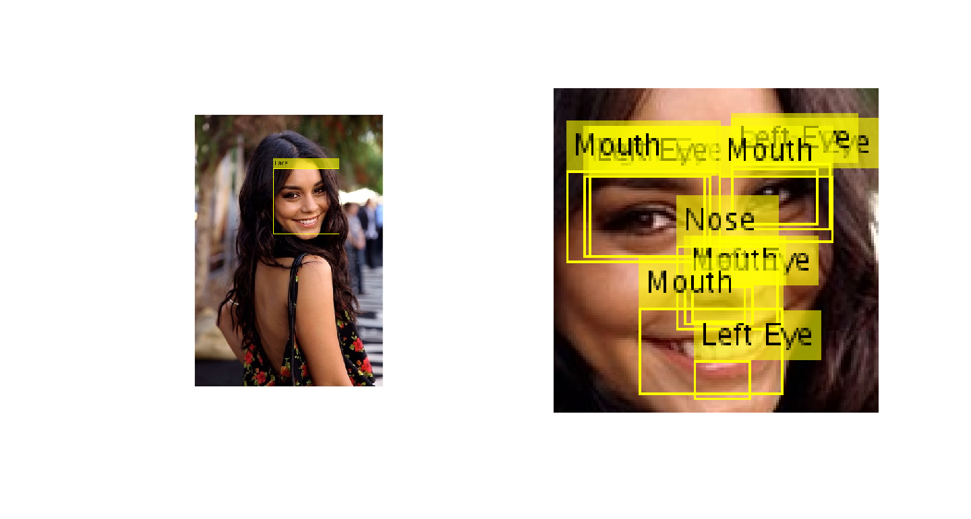
Face Detector Test

Slide 5
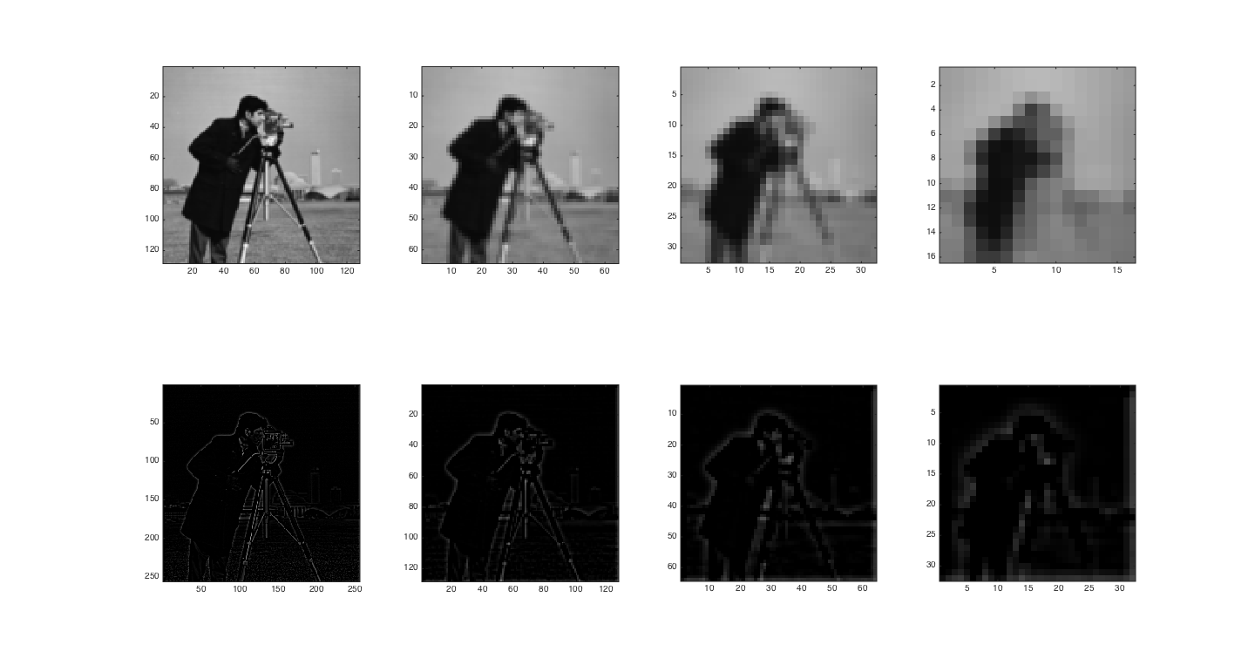
Pyramid Test

