Slide 1
MOUSE USING EYE TRACKING
PRESENTED BY:
ABEL VARGHIS MATHEWS (TVE21EC001)
AKSHAY V V (TVE21EC007)
ARJUN ANIL (TVE21EC015)
BRISTO C J (TVE21EC022)
GUIDED BY :
ASWINI S H
Assistant Professor
Dept. of Electronics and Communications College of Engineering Trivandrum

Slide 2
CONTENTS
Introduction
Objective
Principle
Components Used
Libraries Used
Block Diagram
Advantages
Disadvantages
Scope
References

Slide 3
INTRODUCTION
The growing adoption of hands-free technology has spotlighted a significant challenge: individuals with impaired hand control encounter difficulties in utilizing computers.
To remedy the same by attempting to create a stand alone product that tracks eye movement to accurately use features of mouse.

Slide 4
OBJECTIVE
Engineered a standalone eye-tracking product leveraging Raspberry Pi and OpenCV technology.
Utilized Mediapipe and PyAutoGUI libraries to develop robust eye-tracking algorithms.
Orchestrated the transmission of eye position data from the device to a PC for cursor control functionality

Slide 5
PRINCIPLE
Developing a mouse emulation system for individuals with disabilities, leveraging both hardware and software components.
Implementing an eye-tracking technology with a Raspberry Pi, allowing users to control the mouse pointer by tracking their eye movements.
Orchestrating the setup of a Raspberry Pi access point for seamless Wi-Fi connectivity with a laptop, enabling real-time visual capture and eye movement tracking using the Raspberry Pi camera.

Slide 6
COMPONENTS USED
Raspberry Pi: Leveraged as an access point for data transmission via TCP/IP to a PC. Utilizing Mediapipe library and OpenCV , extending its capabilities beyond basic computing tasks.
Raspberry Pi Camera: Integrated with Raspberry Pi boards, offering an affordable and versatile solution for capturing images and video. Enhanced Raspberry Pi projects with capabilities for photography, videography, surveillance, and computer vision applications.

Slide 7
LIBRARIES USED
Mediapipe library : Machine learning models for tasks such as object detection, pose estimation, facial recognition, and more.
PyAutoGUI library : A Python library facilitating cross-platform automation of mouse and keyboard interactions.

Slide 8
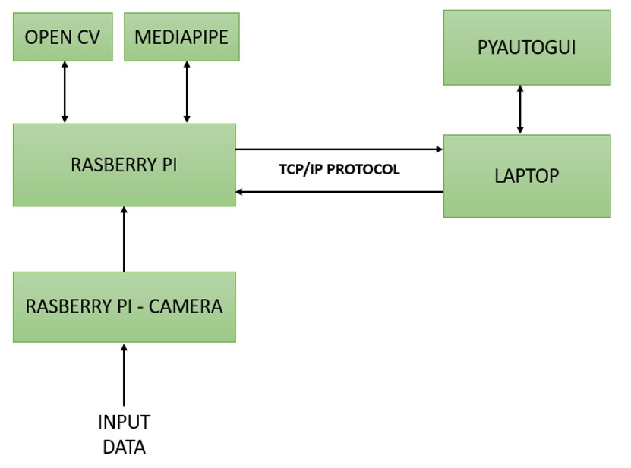
BLOCK DIAGRAM
FIGURE 1

Slide 9
ADVANTAGES
People with restricted hand movements or physical disabilities can now make use of this cursor with eye tracking to be able to perform normal functions as others in a PC.
The space for growth is very high as we can bring several upgrades such as left click and right click function, quick keyboard texting using eyes and even data handling using excel etc

Slide 10
DISADVANTAGES
Performance concern: Some individuals do not have complete control of their body movement and hence cannot efficiently make use of eye tracking using mouse emulsion.
Accuracy: However refined the code is, there will always be an amount of error when transferring data from a third party source(eyes) to use as the function of mouse cursor.

Slide 11
SCOPE
Beyond eye-tracking for PC mouse control, the same principle can drive innovation across diverse functions and applications:
Driving for the disabled- car control using eye emulation with AI as reference
Home Application system- integrating home control systems and spatial computing

Slide 12
REFERENCES
https://caot.in1touch.org/document/3879/OTNow_July_05.pdf#page=3
https://ieeexplore.ieee.org/abstract/document/1443150
https://www.youtube.com/watch?v=SHdvmbmjTTA&ab_channel=OVision
https://www.youtube.com/watch?v=kbdbZFT9NQI&ab_channel=Pysource

