Slide 1
Project Overview
This project explores aviation accident data to uncover patterns, causes, and safety insights.
The goal is to analyze trends and support safety-related decisions through data visualization.

Slide 2
Business Understanding
The aviation industry requires high safety standards. Understanding when, where, and why accidents occur is essential for preventing future incidents and improving protocols.

Slide 3
Data Understanding
The dataset contains 88,521 records of aviation accidents.
Key fields: date, year, location, weather condition, flight phase, purpose of flight, and injury counts.

Slide 4
Data Cleaning & Preparation
Missing values were handled.
Columns like 'year' were extracted from dates.
Irrelevant or highly incomplete columns were removed.
A clean version of the dataset was saved and used for analysis.

Slide 5
Univariate & Bivariate Analysis
• Accidents peaked in the 1980s and 1990s.
• Most accidents occurred under VMC (visual weather).
• Personal flights and cruise phases were highly represented.
• Fatalities varied with flight phase and weather conditions.

Slide 6
Multivariate Analysis
We examined the relationship between fatal, serious, and minor injuries.
Bubble and scatter plots revealed correlations across weather conditions.
Pair plots showed that most incidents involved few injuries.

Slide 7
Missing data
• Unknown Weather/Phase Issues
Missing weather or flight phase data limits analysis
Standardize and enforce better accident reporting.

Slide 8
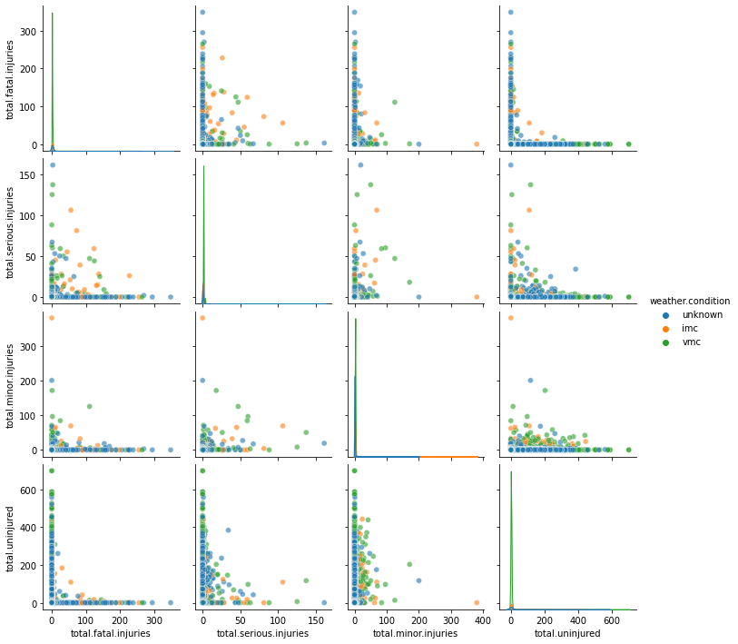
Green = unknown

Slide 9
Key Insight : Flight Phase & Fatalities
Fatal injuries are highest during 'cruise' and 'approach' phases.
Recommendation: Enhance safety measures during these critical phases.

Slide 10
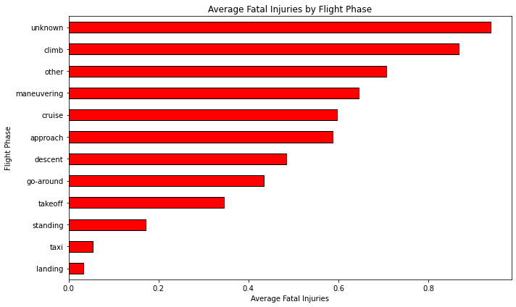
horizontal bar graph

Slide 11
Key Insight : Weather vs Injuries
VMC accounts for the most fatal injuries, indicating that visibility does not always prevent accidents.
Recommendation: Reinforce pilot training even in good weather.

Slide 12
Weather preparedness
Improve Weather Preparedness and Training
Enhance training for IMC conditions and update aircraft weather instruments.

Slide 13
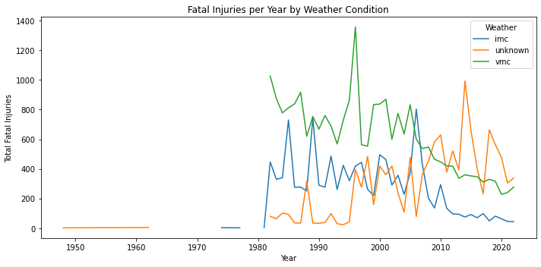
line graph

Slide 14
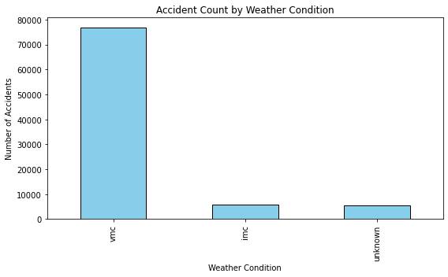
Weather conditions vs no injuries

Slide 15
Key Insight : Country Trends
Brazil and Canada had the highest average fatal injuries.
Recommendation: Investigate regional aviation regulations and safety standards.

Slide 16
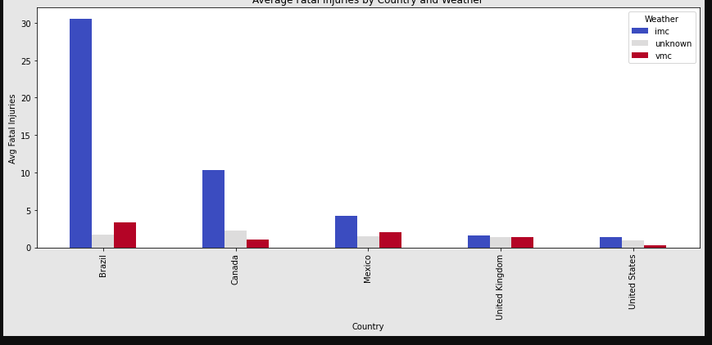
Top 5 Countries by accident count

Slide 17
Safety
Prioritize Safety in Cruise and Maneuvering
Safety focus shouldn't only be on takeoff and landing—cruise procedures also need reinforcement.

Slide 18
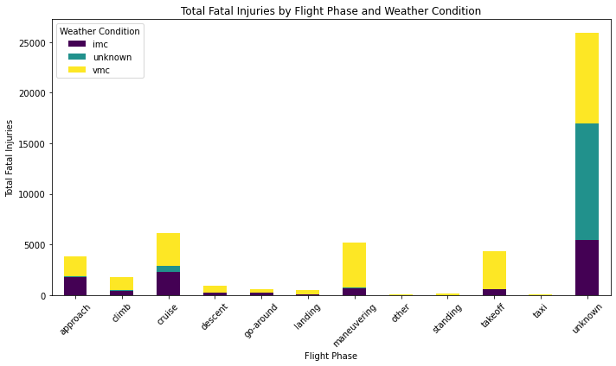
Flight phase

Slide 19
Thank You
Questions?
Alvin Kipleting
https://www.linkedin.com/in/alvin-limo-12b157277?utm_source=share&utm_campaign=share_via&utm_content=profile&utm_medium=android_app

