Slide 1
Where we are (TL;DR)
• Scaled-MAPE grid campaign COMPLETE for the 4 core lead times: 2,880 jobs
– 4 lead times x 4 rotations x 3 activations x 3 layer counts x 5 widths x 4 dropout rates
• 17-lead-time extension (3-114 h) running now, one lead time at a time
• Repetition pilots done: shard 1/11/21/31 @ 10 reps (one per lead time)
• Next gate: rank-stability analysis decides whether 3 reps suffice for Phase-1 screening
Notes:
[slide id 1] Where we are (TL;DR)
shapes: esb:id:1 (title), esb:body
StandardScaler fit on train only, persisted per model. The 17-LT campaign runs sequentially per lead time so per-LT analysis can start midway.

Slide 2
Data prep & lead-time FAQ
• Normalization: StandardScaler fit on TRAINING years only (no leakage); scaler persisted as .joblib next to each model
– pre-refactor ESB pipeline had NO scaling at all
• Gaps: rows with NaN / -999 dropped after lagged columns are built; no imputation
• Lead times: all 21 — the full 6-hourly ladder 3 h to 120 h (12/48/96/120 ran first)
• Tuning results? Yes, interim: full 4-LT grid trained; pilots analyzed (slide 5)
• Live data feed: operational-deployment question, out of scope for this update
Notes:
[slide id 1b] Data prep & lead-time FAQ
shapes: esb:id:1b (title), esb:body
Coworker FAQ slide. Live feed answer: the operational system feeds the persisted scaler + model the same lagged-column layout used in training.

Slide 3
Why repetitions matter (the problem)
• A single run's validation score is a draw from a distribution: weight init, shuffling, GPU nondeterminism
• 1-rep rankings risk selecting noise: seed choice alone shifts accuracy by amounts comparable to published improvements (Picard [3]; Bouthillier [1])
• Budget reality: 2,880 jobs x 10 reps ~ multi-week compute
• Goal: the CHEAPEST rep count that preserves the ranking, not the most statistically pure one
Notes:
[slide id 2] Why repetitions matter (the problem)
shapes: esb:id:2 (title), esb:body

Slide 4
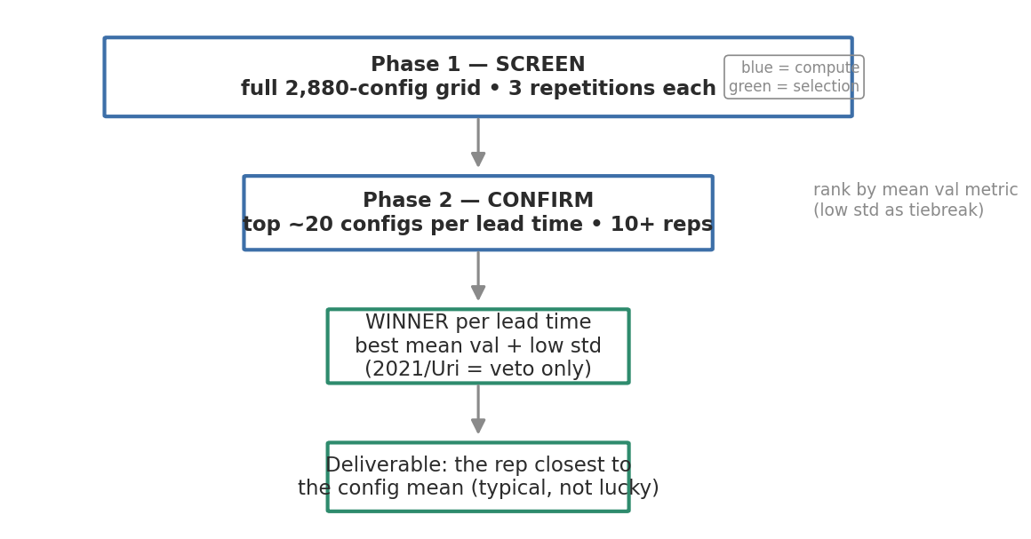
Phased tuning plan (the design)
• Phase 1 — screen the full 2,880-config grid at 3 repetitions; rank by mean val metric (low std as tiebreak)
• Phase 2 — confirm top ~10-20 configs per lead time at 10+ repetitions
• Winner per lead time: best mean val + low std; 2021 (Uri) used as VETO only
• Deliverable: the repetition closest to the config's mean (a typical model, not a lucky one)
• Screen-then-confirm mirrors successive halving / Hyperband [4]; mean±std reporting follows Show Your Work [2]
Notes:
[slide id 3] Phased tuning plan (the design)
shapes: esb:id:3 (title), esb:body, esb:image:0 (funnel_phases.png)
2021 is out-of-distribution; ranking on it would tune to one anomalous event. Diagram from scripts/make_deck_visuals.py (matplotlib version of the doc's mermaid).

Slide 5
Rank-stability pilots (does 3 reps suffice?)
• Question: does the top-10 list at 3 reps match the list at 10-15 reps?
• Design: one pilot shard per lead time — shard 1 (LT12, 15 reps); 11/21/31 (LT48/96/120, 10 reps)
– ~10 h of compute instead of ~50 h for whole-grid repetition
• Statistics per shard: top-10 overlap + Spearman rank correlation, k-rep vs all-rep ranking [1,2]
• Decision rule: high overlap + high Spearman on ALL lead times -> 3-rep Phase 1; else raise reps
Notes:
[slide id 4] Rank-stability pilots (does 3 reps suffice?)
shapes: esb:id:4 (title), esb:body

Slide 6
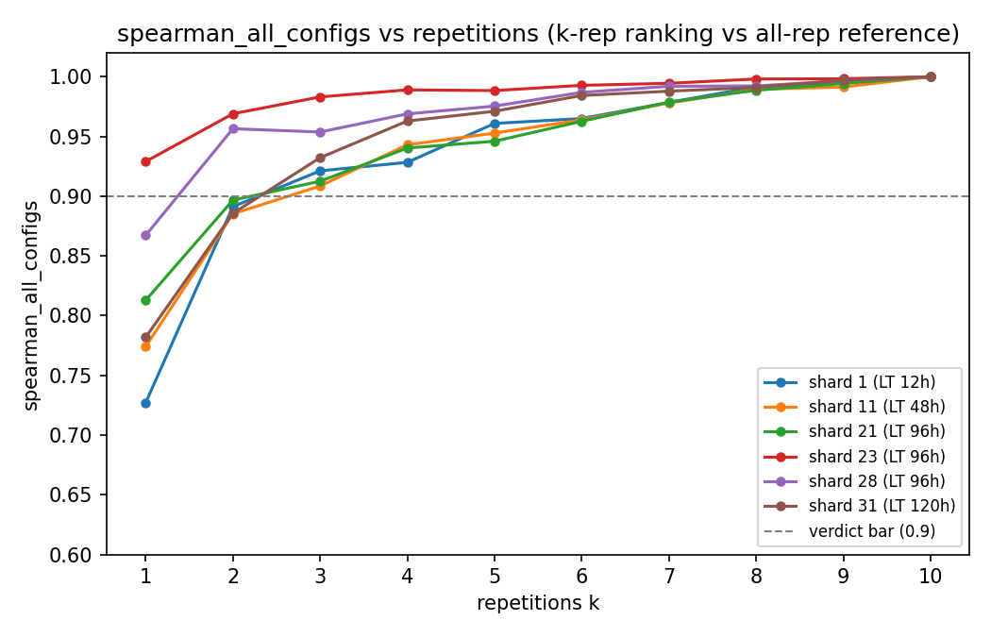
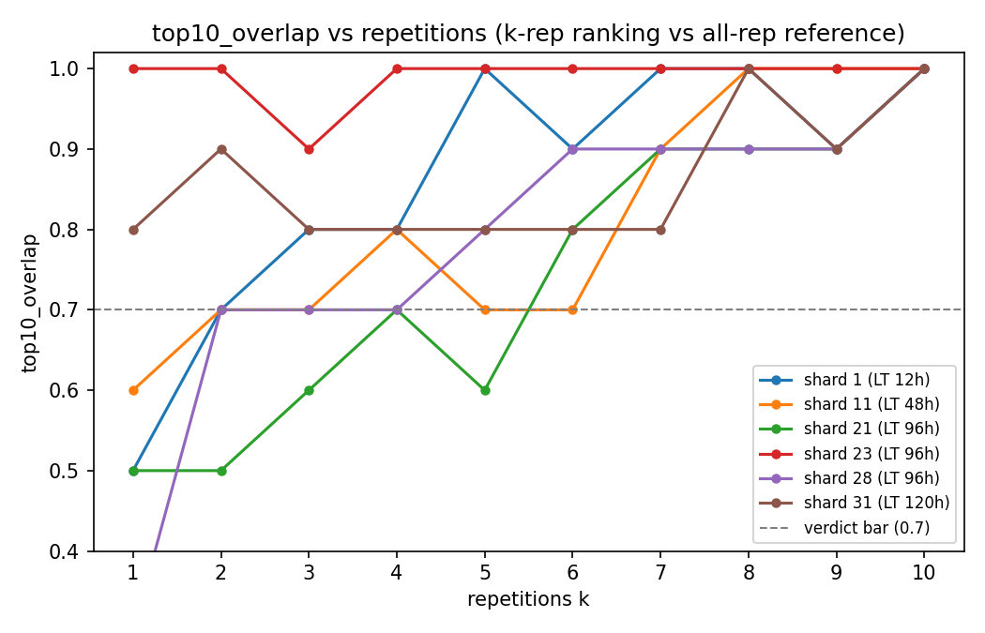
Interim results: rank stability (mid-experiment, not final)
reps k | top-10 overlap (LT12/48/96/120) | Spearman (worst shard)
1 | 0.5 / 0.6 / 0.5 / 0.8 | 0.73
3 | 0.8 / 0.7 / 0.6 / 0.8 | 0.91
4 | 0.8 / 0.8 / 0.7 / 0.8 | 0.93
• Global ordering stabilizes fast: Spearman >= 0.90 on every shard by 3 reps
• Top-10 MEMBERSHIP is the noisy part; strict bar (>=70% overlap + Sp>=0.9 everywhere) first met at k = 4
• Recommendation: screen at 3 reps, carry the TOP-20 forward — the cheap phase must not lose survivors, it needn't order them [4]
• Metric agreement: val_mape vs val_mae top-20 overlap 95-100%, Sp >= 0.98 — metric choice is a non-issue
Notes:
[slide id 5] Interim results: rank stability (mid-experiment, not final)
shapes: esb:id:5 (title), esb:table, esb:body, esb:image:0 (stability_spearman_all_configs.png), esb:image:1 (stability_top10_overlap.png)
rerun-to-refresh: python scripts/tuning_tests/run_all_tests.py --shards 1 11 21 23 28 31 --max-reps 10 --out-dir results/tuning_tests_phase1
Caveats: (a) k = max row is trivially 1.0 and high-k rows share most data with the reference — only low-k rows carry evidential weight; (b) shards are contiguous activation-biased slices; selu + rotations 1-3 blind spot is being closed by shards 23/28 — RE-CHECK these numbers after rerunning the tests.

Slide 7
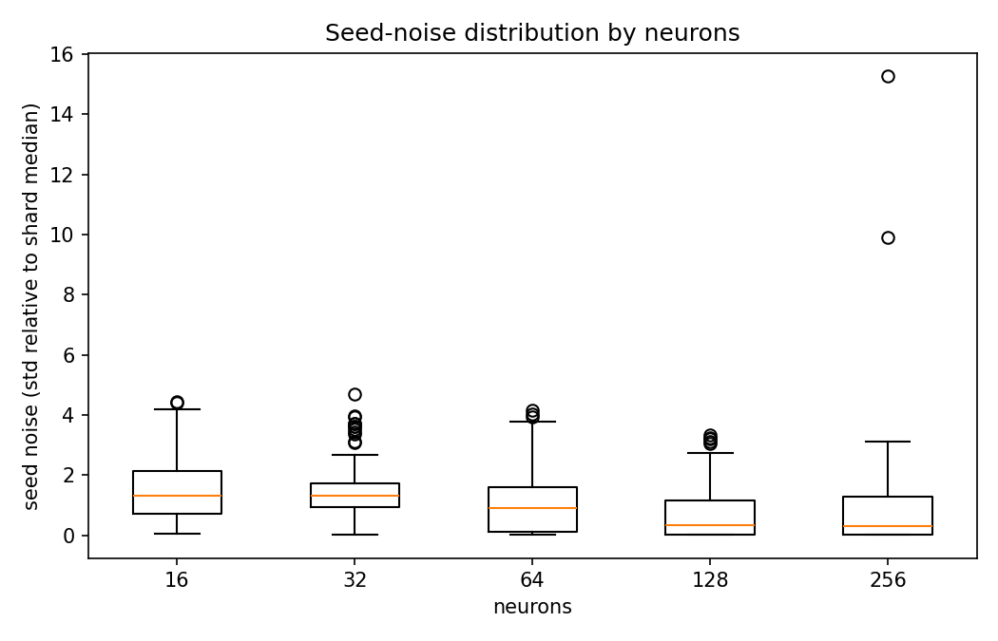
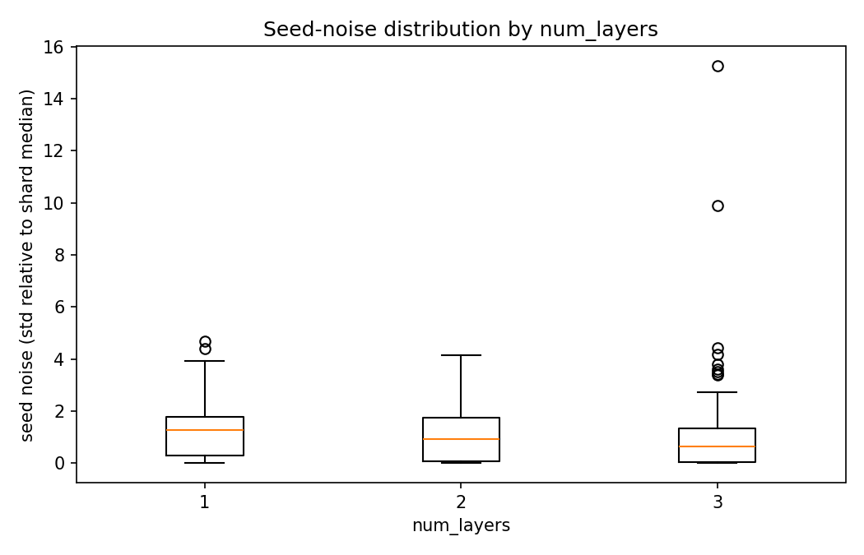
Interim results: seed-noise heterogeneity
• Noise varies mainly with model SIZE: 128/256-neuron configs ~10x steadier than 16/32; 3-layer steadier than 1-layer
• The likely winners are the most rankable configs — slide 5's table is pessimistic about the top of the leaderboard
• Activation and dropout effects are small
• Pilot blind spot (selu + rotations 1-3) closed by shards 23/28 — rerun confirms/updates this slide
Notes:
[slide id 5b] Interim results: seed-noise heterogeneity
shapes: esb:id:5b (title), esb:body, esb:image:0 (box_neurons.png), esb:image:1 (box_num_layers.png)
rerun-to-refresh: python scripts/tuning_tests/run_all_tests.py --shards 1 11 21 23 28 31 --max-reps 10 --out-dir results/tuning_tests_phase1
Box charts: seed-noise (rel_std) by hyperparameter value. Companion scatter_<param>.png charts (config mean vs std) are in the same folder if a quality-vs-stability view is asked for.

Slide 8
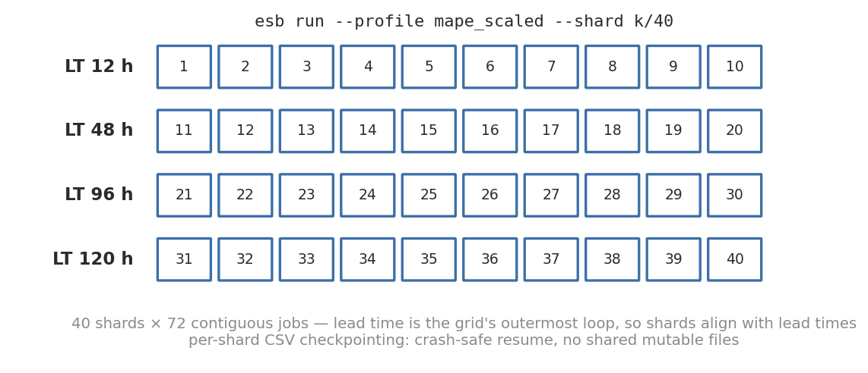
Campaign mechanics (sharding + resume)
• 40 shards x 72 contiguous jobs; lead time is the outermost grid loop, so shards align with lead times
– shards 1-10 = LT12, 11-20 = LT48, 21-30 = LT96, 31-40 = LT120
• One command per shard: esb run --profile mape_scaled --shard k/40
• Per-shard CSV checkpointing: crash-safe resume, skip completed jobs, per-job duration_sec
• esb status: cross-checks CSVs vs on-disk artifacts; ETA from MEDIAN per-job duration (old span method was inflated 15-45x by idle gaps)
Notes:
[slide id 6] Campaign mechanics (sharding + resume)
shapes: esb:id:6 (title), esb:body, esb:image:0 (sharding_map.png)

Slide 9
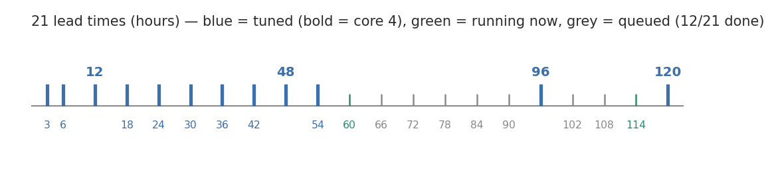
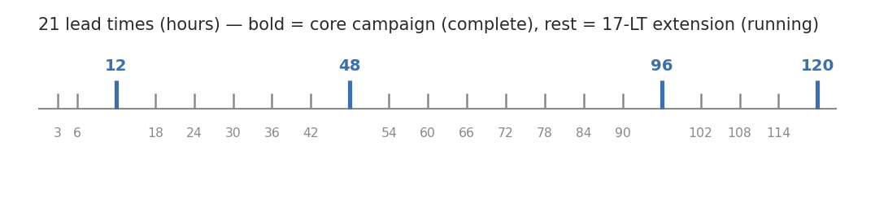
The 17-lead-time extension
• Core campaign covered LT 12/48/96/120; operations want the full ladder (17 more lead times)
• Same grid otherwise: 720 configs per lead time
• Own profile (mape_scaled_17lt) and own output directory — shard bookkeeping can't collide with the core campaign
• Running one lead time to completion at a time, so per-LT analysis starts as each finishes
Notes:
[slide id 7] The 17-lead-time extension
shapes: esb:id:7 (title), esb:body, esb:image:0 (leadtime_ladder.png)

Slide 10
Infrastructure recap (what got built)
• esb CLI: run (profiles, sharding, resume) / status (progress + artifact cross-check + ETA) / gui (schema-driven form) / help
• Pipeline stages, low coupling: data prep -> scaling (train-only fit, persisted .joblib) -> training -> metrics
• Loud failures on misconfiguration (e.g. mixed-shard-denominator guard)
• Philosophy: one command, one named profile, smart defaults, loud failures — complexity lives in the code, not the operator
Notes:
[slide id 8] Infrastructure recap (what got built)
shapes: esb:id:8 (title), esb:body

Slide 11
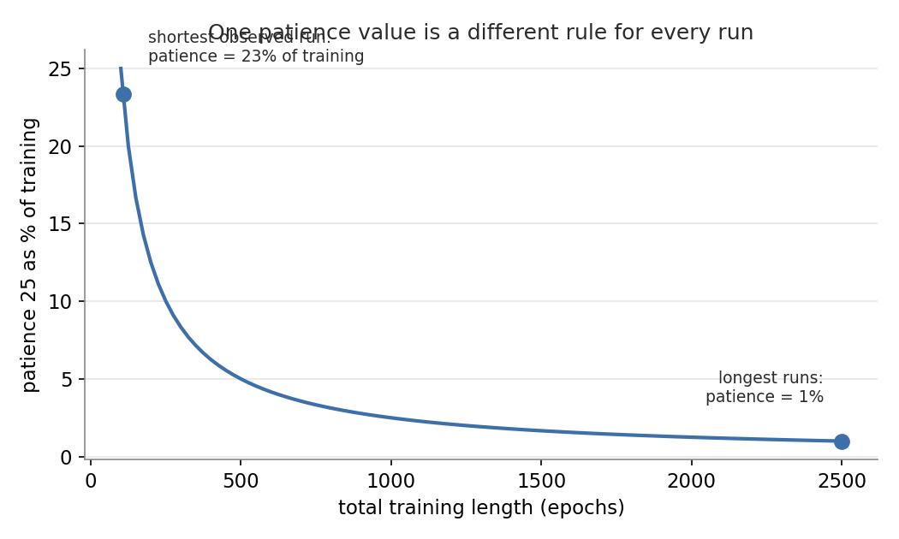
Phase-2 side experiment: early-stopping calibration
• Current: early_stop_patience=25, lr_reducer_patience=15, min_delta=0.001
• Patience is denominated in epochs and there is no universal value (Prechelt [5])
• Training lengths span ~100 to 2,000+ epochs — patience 25 is ~25% of one run, ~1% of another
• Suspect: min_delta=0.001 vs MAPE ~47 is 0.002% — 'any improvement counts', noise keeps resetting the counter
• Plan: DO NOT touch mid-campaign; Phase 2 retrains top configs at patience 25 vs ~100 + larger min_delta
• Epochs ~40 ms: extra patience is cheap, the asymmetric risk favors patience
Notes:
[slide id 9] Phase-2 side experiment: early-stopping calibration
shapes: esb:id:9 (title), esb:body, esb:image:0 (patience_fraction.png)

Slide 12
Next steps
• 1. Per-activation seed-noise check on pilot data (closes slide-5 caveat b)
• 2. Lock Phase-1 rep count (working answer: 3 reps + top-20 cut)
• 3. Complete the 17-LT screen; run Phase 2 (top ~10-20/LT at 10+ reps)
• 4. Phase-2 side experiment: early-stopping patience / min_delta calibration
• 5. Select winners (mean val + std, 2021 veto); hand over the rep closest to the config mean per lead time
Notes:
[slide id 10] Next steps
shapes: esb:id:10 (title), esb:body

Slide 13
Discussion: training/serving skew (one theme, three instances)
• Theme: does the model see the same distribution live that it saw in training? Every prep gap = silent extrapolation
• 1. Station outages — mask a station's columns in the test set and re-score (no retraining): graceful degradation or collapse?
• 2. Outlier filtering — if training drops >3.5-sigma readings but live doesn't, inference sees a distribution training never saw — and extremes ARE the cold-stunning events
• 3. Gap-filling causality — any fill using a future window is impossible live; operational gap handling must be past-only
Notes:
[slide id 11] Discussion: training/serving skew (one theme, three instances)
shapes: esb:id:11 (title), esb:body

Slide 14
References
• [1] Bouthillier et al., Accounting for Variance in ML Benchmarks, MLSys 2021
• [2] Dodge et al., Show Your Work: Improved Reporting of Experimental Results, EMNLP 2019
• [3] Picard, torch.manual_seed(3407) is all you need, arXiv:2109.08203, 2021
• [4] Li et al., Hyperband, JMLR 18(185), 2018
• [5] Prechelt, Early Stopping — But When?, Neural Networks: Tricks of the Trade, 1998/2012
Notes:
[slide id refs] References
shapes: esb:id:refs (title), esb:body

Slide 15
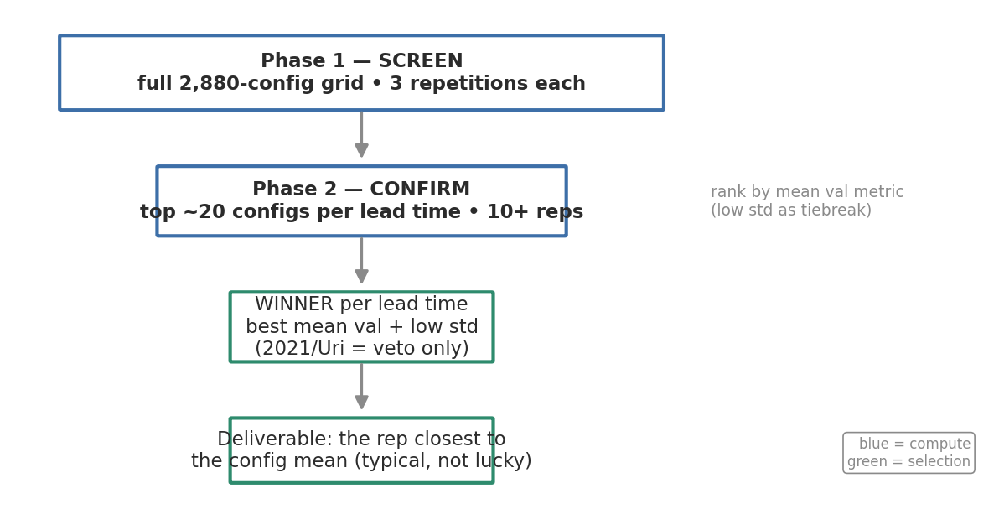
Phased tuning plan (the design) — v2 visual
• Phase 1 — screen the full 2,880-config grid at 3 repetitions; rank by mean val metric (low std as tiebreak)
• Phase 2 — confirm top ~10-20 configs per lead time at 10+ repetitions
• Winner per lead time: best mean val + low std; 2021 (Uri) used as VETO only
• Deliverable: the repetition closest to the config's mean (a typical model, not a lucky one)
• Screen-then-confirm mirrors successive halving / Hyperband [4]; mean±std reporting follows Show Your Work [2]

