Slide 1

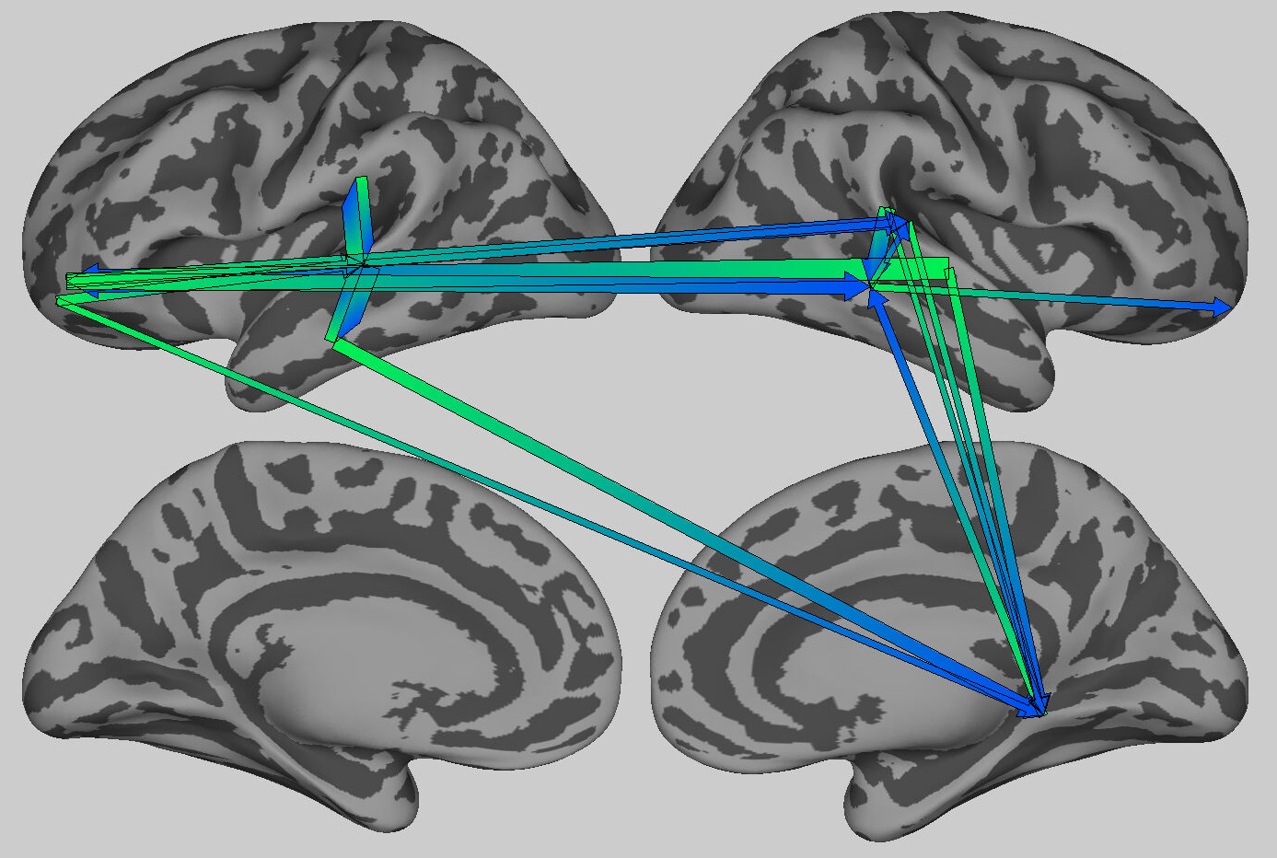
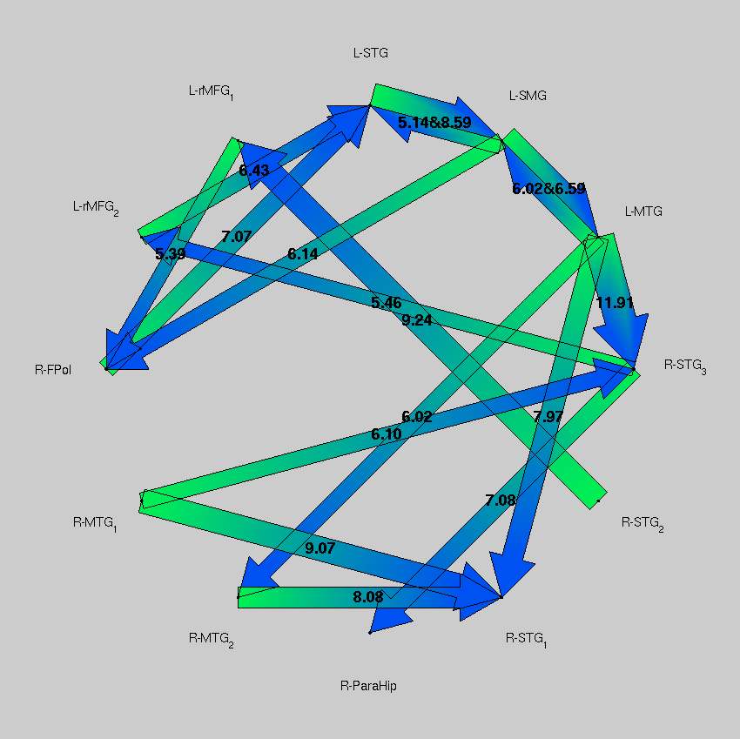
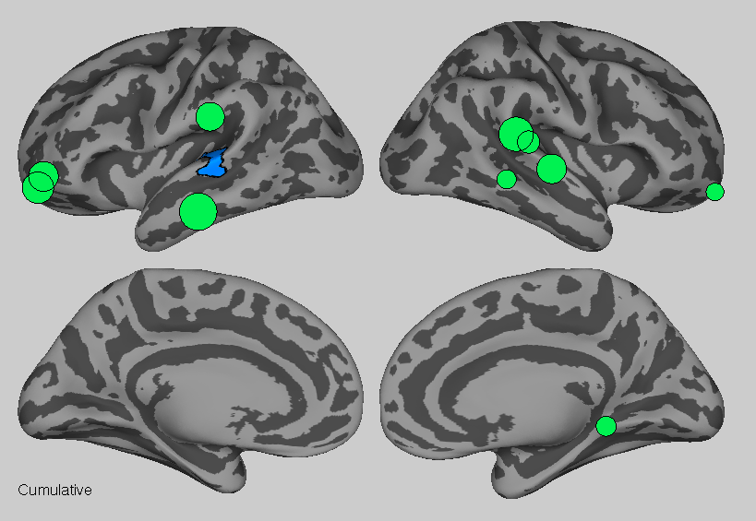

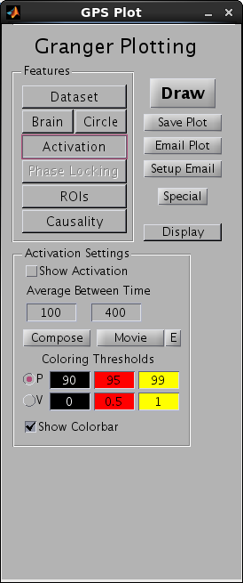
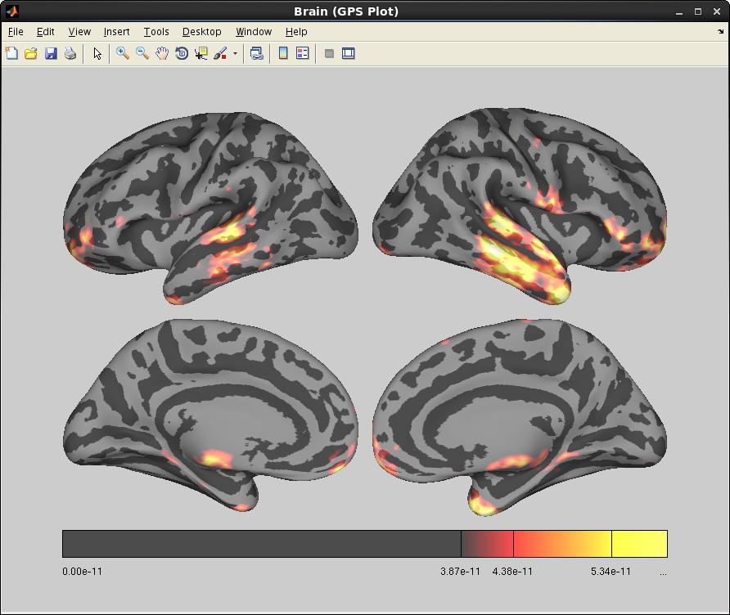
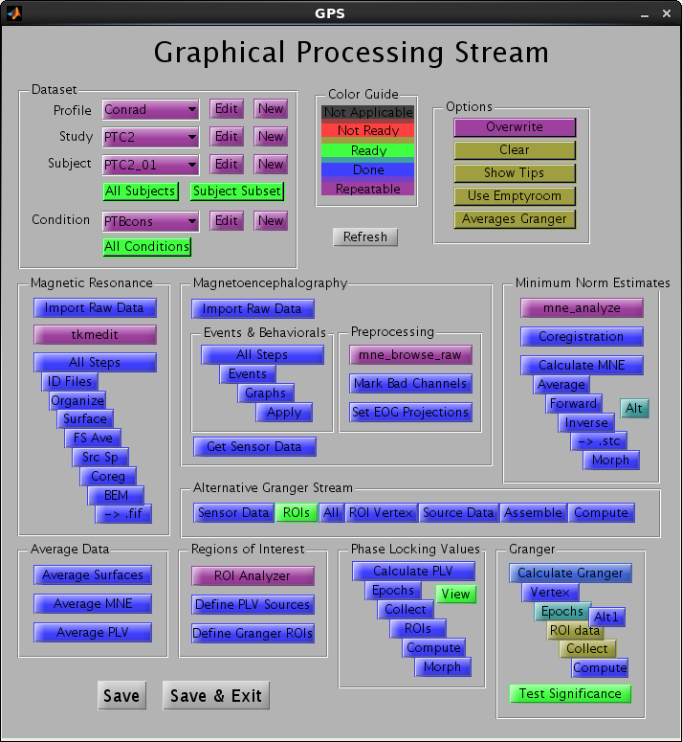
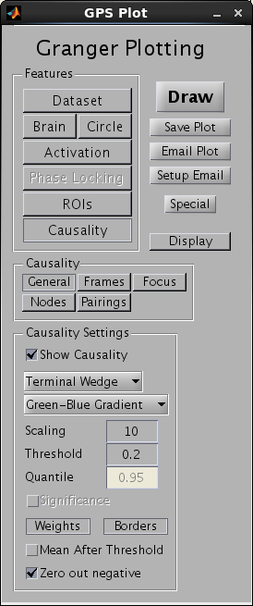
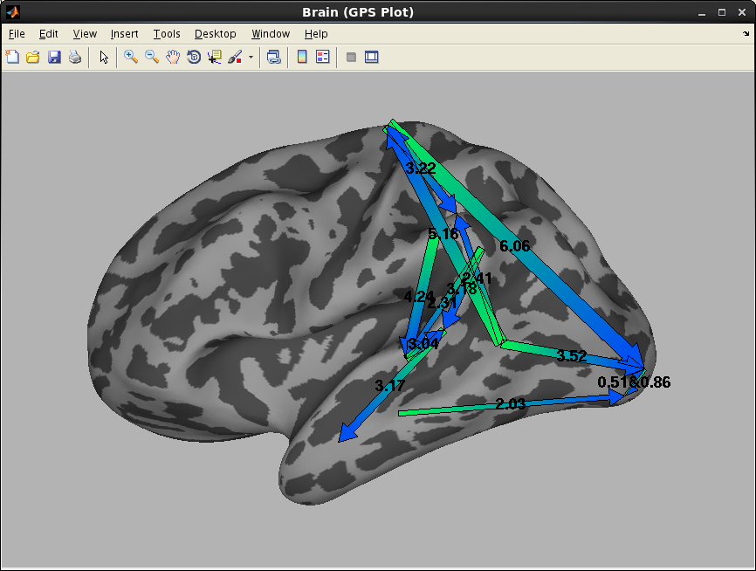
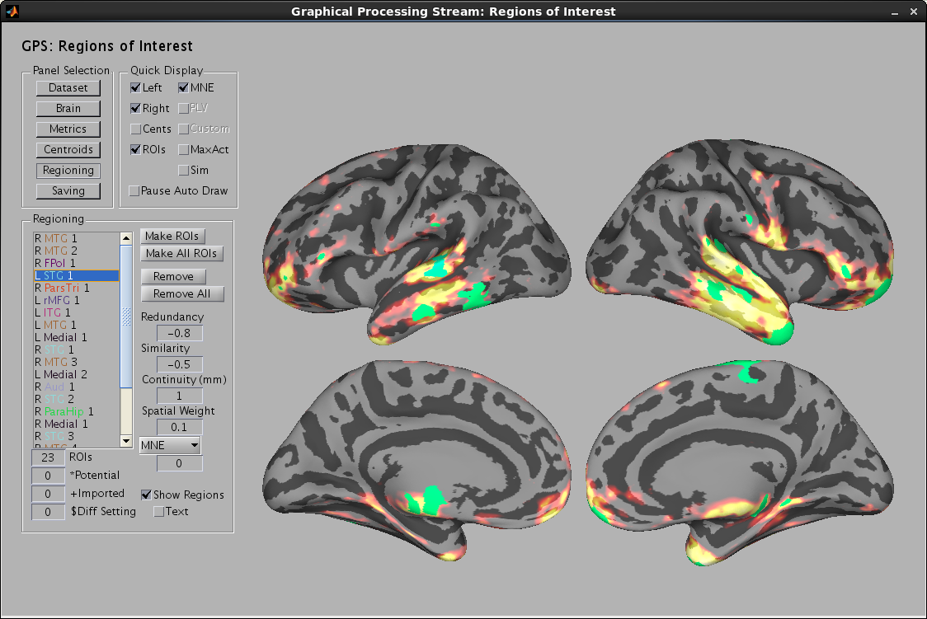
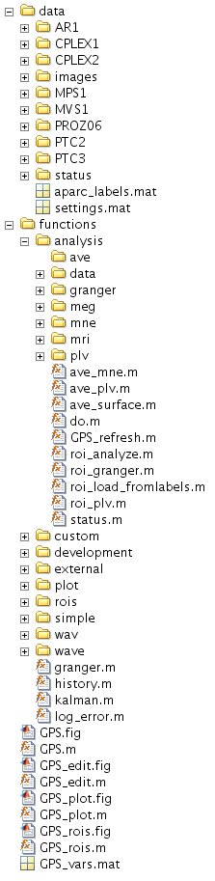
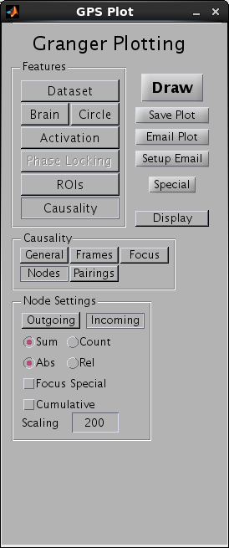
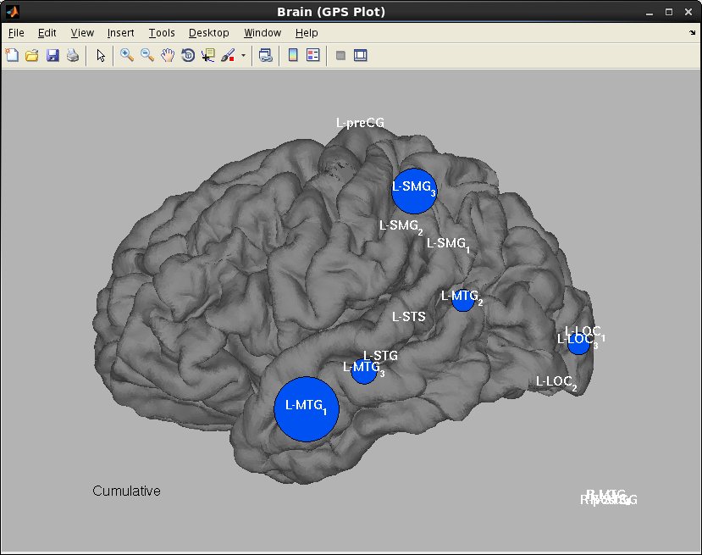
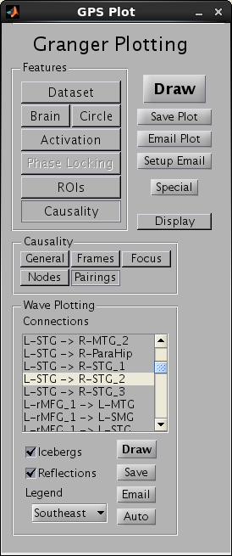
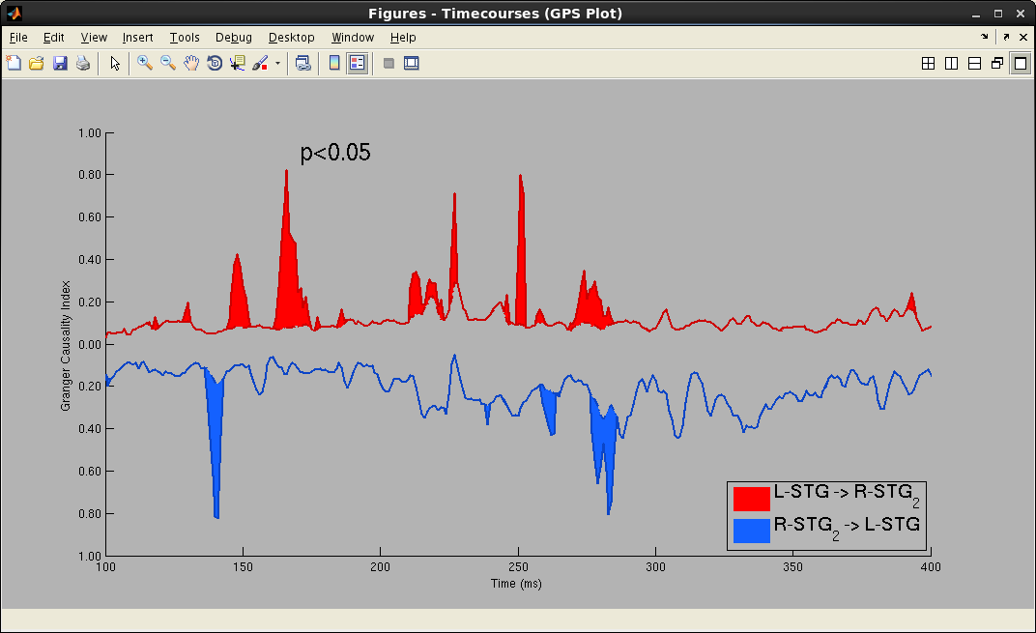
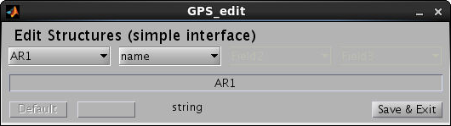



A graphic user interface-based automated processing stream for Granger analysis of source space reconstructions of MEG/EEG data
A. Conrad Nied, Seppo Ahlfors, David W. Gow Jr.
Granger Processing Stream
ROI Creation and Dynamic Visualization
Kalman-filter based Granger analysis
Intuitive: Graphic user interface (GUI) allows non-programmers to perform sophisticated effective connectivity analyses of MEG data without extensive training
Source-space analysis: Source space reconstructions of brain activity based on MRI-constrained MEG/EEG data
Effective connectivity: Continuous measures of Granger causality for large networks using time-varying models generated using Kalman filter techniques
Automated: Optimized to require minimal user input.
Flexible: Menu-driven interface provides interactive algorithm-driven ROI identification and exploratory analysis and visualization of Granger causality and graph theoretic analyses of effective connectivity
Built in Matlab on top of widely available MNE and Freesurfer analysis packages
Granger causality analysis is a measure of directed statistical causality based on the premise that causes precede and uniquely predict their immediate effects
Does not require the specification of an a priori model
The use of time-varying Kalman-filter based multivariate modeling allows the analysis of non-stationary signals without transformation or windowing techniques that limit the number of ROIs that can be included
Provides a continuous measure of spontaneous causal effect size in the form of a time varying partial Granger causation index (tvpGCI)
Statistical significance calculated independently at each timepoint and comparison based on a bootstrapping technique
Scan the QR code above with your smartphone or go to http://www.youtube.com/playlist?list=PL044EEBC1FB091DCC to view videos produced by GPS illustrating Granger causality and demonstrating the ROI selection process.
Analysis/Visualization
Region of Interest (ROI) Identification
Automation
Visualization of MNE activation or phase locking to a specified reference ROI over inflated or pial surface
Granger analysis requires modeling the predicted future value of one variable based on all non-redundant, potentially causal signals (ROIs). The GUI can create the ROIs automatically, or with user intervention.
ROI centroids are identified based on peaks in MNE activation, phase locking to a reference ROI, or a weighted combination of both
ROIs are grown from these centroids based on adjacency and wave similarity (mean difference between standardized waves (- mean, / stdev)
Redundant ROIs are identified and rejected based on the above similarity comparison
Automatic parcellation is used to label all ROIs based on centroid location
See video above for a review of the process
All processing steps are fully automated with the exception of necessarily manual preprocessing and parameterization steps, streamlined to reduce workload
Granger causation arrows
Primary graphical user interface
File Management
Identifying processing hubs by ROI input
Data is broken down into 3 categories:
Parameters: Study, condition, and subject analysis specifications are saved in the GUI’s main directory
Functions: Routines used to perform the analysis. This includes wrapper functions that refer to the Freesurfer and MNE toolboxes
Analysis: Raw signal data, reconstructions of activity, and Granger analyses and visualizations
Each of these types of data are automatically arranged in explicit hierarchical folders as well as named with useful keywords.
Acknowledgments
Instantaneous Granger plotting with significance
This work was supported by NIDCD grant R013108 and also benefited from funding from the MIND Institute and NCRR grant S10RR014978. The authors would like to thank Jennifer Segawa, Ricky Sachdeva, Reid Vancelette, Mark Vangel, Fa-Hsuan Lin, David Caplan, David Cohen, Matti Hämäläinen, Sheraz Khan and Tapsya Nayak for their support and contributions to the development of this processing framework.
Parameters can be edited by opening the .mat files or using the GPS_edit structure hierarchy editor.

