Slide 1
Blake Conrad
CSCI-49500
Research Findings
Advisor: Murat Dundar
19 February 2017

Slide 2
Purpose & Agenda
Purpose: Provide a concise overview of my research findings up to this point in time and looking forward
Agenda
Project overview:
Prior Solution:
Finding K.
Verifying K with Visualizations.
Updated Solution(s)
Looking Forward

Slide 3
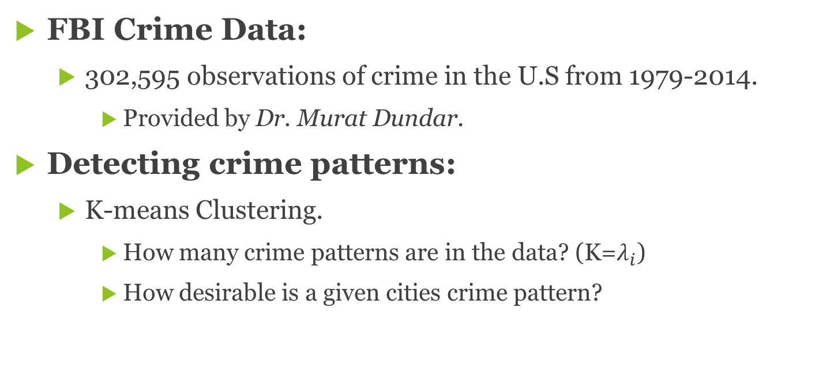
Project overview
FBI Crime Data:
302,595 observations of crime in the U.S from 1979-2014.
Provided by Dr. Murat Dundar.
Detecting crime patterns:
K-means Clustering.
How many crime patterns are in the data? (K=$λ_{i}$)
How desirable is a given cities crime pattern?

Slide 4
K=$λ_{i}$
K=𝜆_𝑖
Plot
Calculate
Assess

Slide 5
Prior Technique
Leveraging media data:
USA Today’s 10 best and worse cities:
Run K=5..30
Plot
Calculate Percent Expected
Find the best K

Slide 6
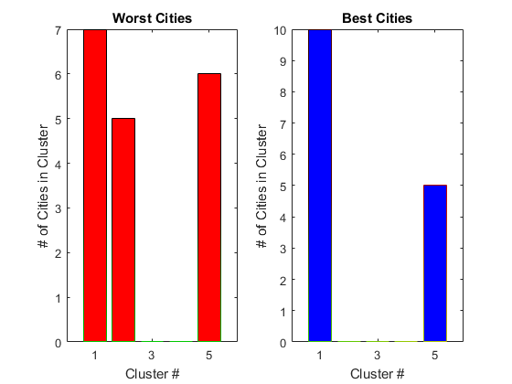
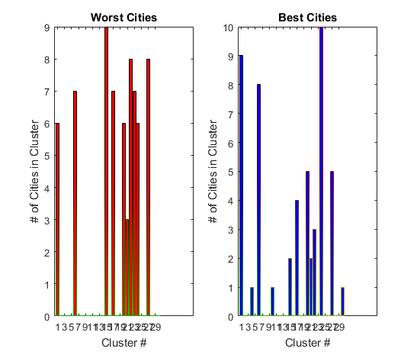
Prior Technique
K=5 | Centered Data | Population Included
Example of low Percent Expected: 33%
K=30 | Centered Data | Population Included
Example of high Percent Expected: 84.24%

Slide 7
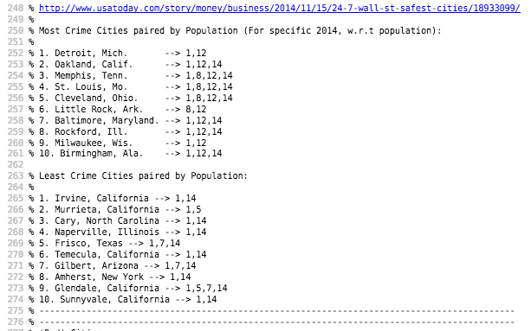
Prior Technique

Slide 8
Prior Technique
Apply PCA to visualize in lower dimension:
Drop from 11 dimensions to 2 dimensions.
Apply log(x+1) transformation on projected dimensions:
Centers the data.
Doesn’t drop zero observations.

Slide 9
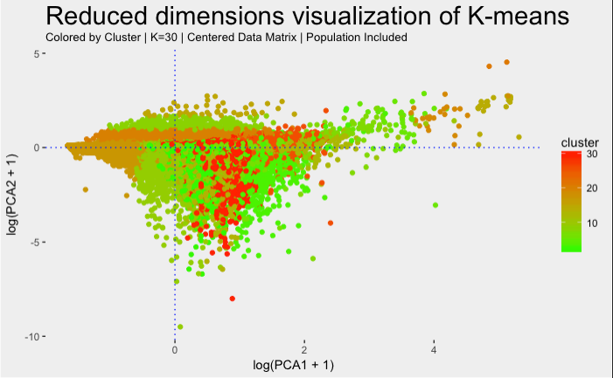
Prior Technique

Slide 10
Corrections
Skewed by population
New sources (recommended by advisor) that are not skewed:
Best 50 - http://time.com/money/collection/best-places-to-live/
Worst 50 - http://247wallst.com/special-report/2016/06/28/the-worst-cities-to-live-in/11/

Slide 11
New Approach
Apply K-means from 5..25
View the top 50 best/worst cities
Expect maximum differences in excel

Slide 12
Looking Forward
Get the K
Determine more favorable crime patterns
Visualize relationships over time w.r.t clusters
Make conclusions on city(s) with unusual patterns

Slide 13
Closing thoughts
Suggestions, questions, or thoughts regarding the project?
Feedback is both valued and appreciated.

