Slide 1
Blake Conrad
FBI Crime Predictive Analysis Via Unsupervised Learning
Advisor: Murat Dundar
21 April 2017

Slide 2
Purpose & Agenda
Project overview:
The dataset
Project goals
Project Milestones:
What is a good and bad city?
How many crime patterns are there?
How do we group similar cities?
How do certain groups behave as population changes
Case Studies
Project Outcomes
Concluding Thoughts

Slide 3
Project overview
FBI Crime Data:
Unique City/State/Year observations of a city’s crime
Population normalized per capita crime variables
Murder, manslaughter, total rape, total robbery, total assault, total burglary, total larceny, auto theft, number of officers killed, number of officers assaulted
Goal:
Determine what causes a city to become better or worse as population changes
Case study using the classifier

Slide 4
Project Milestones
What is a good and bad city?
Leveraged Non-population skewed media sources
http://time.com – best places to live based on crime
http://247wallstreet.com – worst places to live based on crime
Finding the best 50 and worst 50 gives support to determining the crime clusters

Slide 5

Project Milestones
How many crime patterns are there?
Run K-means several times
Compute purity of each run
Determine the highest purity score as our best K
From our best purity score matrix, we can determine the clusters associated with the best and worst cities from our sources

Slide 6
Project Milestones
How do we group similar cities?
Determine a subset city group of interest:
Large cities in 2014 (i.e., Population > 50,000)
Use Average Yearly Population Increase (AYPI) to determine:
Population Increasing Cities
Population Decreasing Cities

Slide 7
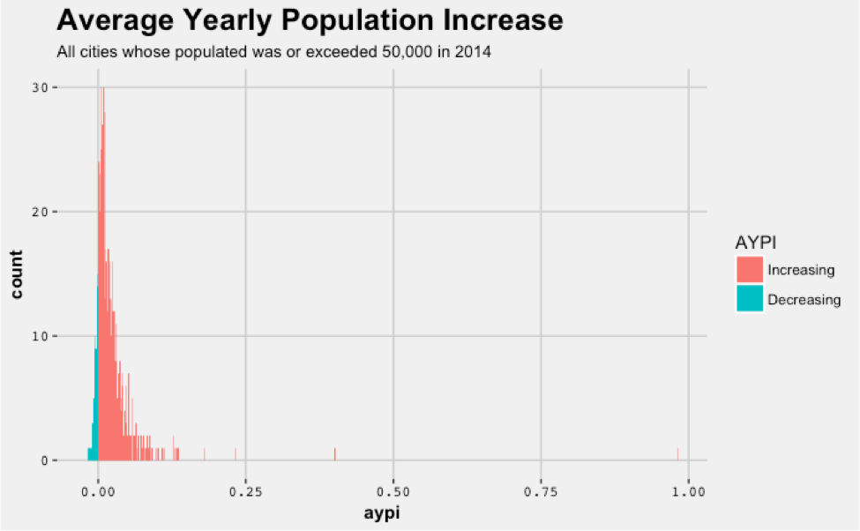
Plot to describe the AYPI of our subset of cities we are interested in

Slide 8
Project Milestones
How do certain groups behave as population changes?
Why does the algorithm assign clusters the way it does for increasing/decreasing cities?

Slide 9
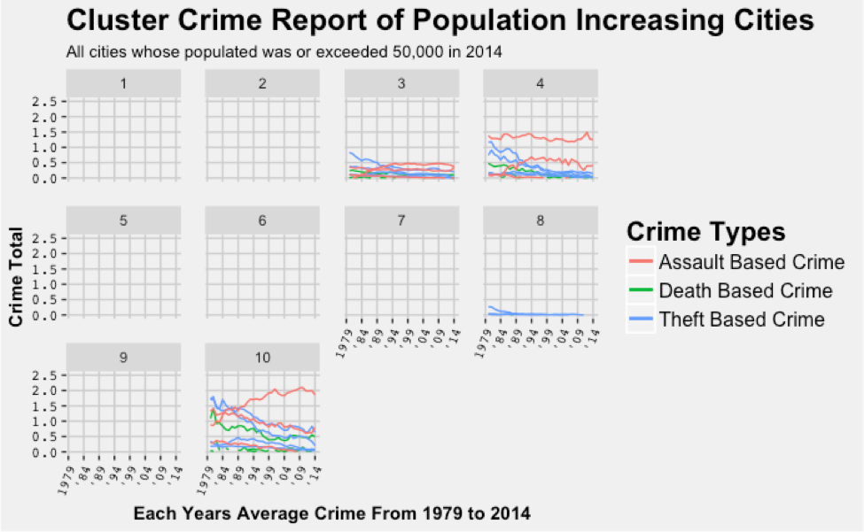
Plot to show how clusters reflected crime statistics for our increasing group

Slide 10
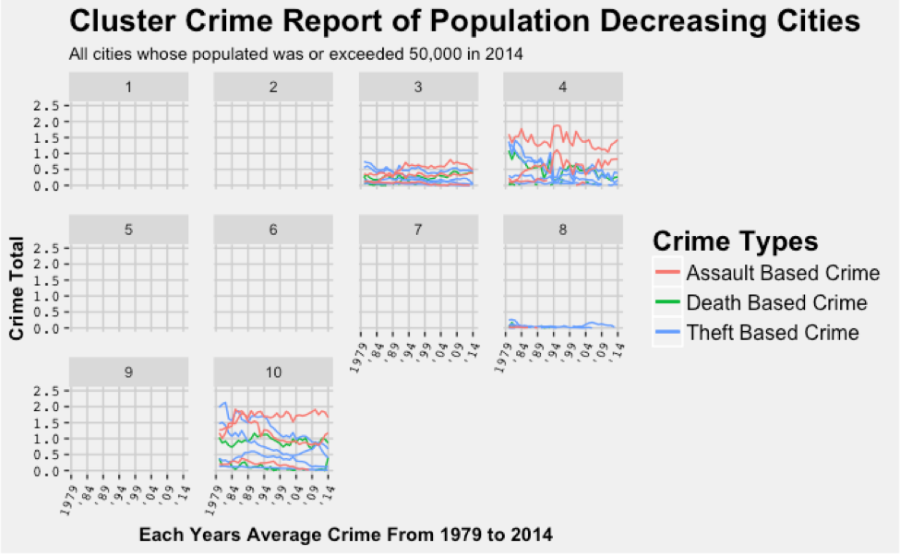
Plot to show how clusters reflected crime statistics for our decreasing group

Slide 11
Project Milestones
For both increasing and decreasing cities in worst clusters:
Dominant and growing or stagnant assault based crime
Dominant decreasing theft based crime
Death based crime is not number one?

Slide 12
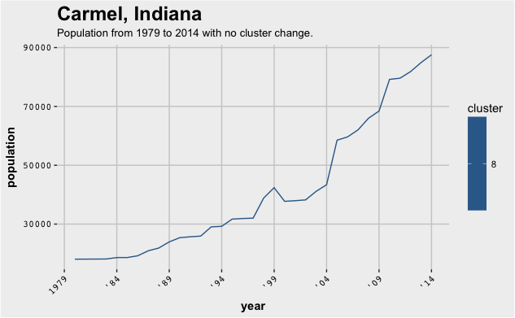
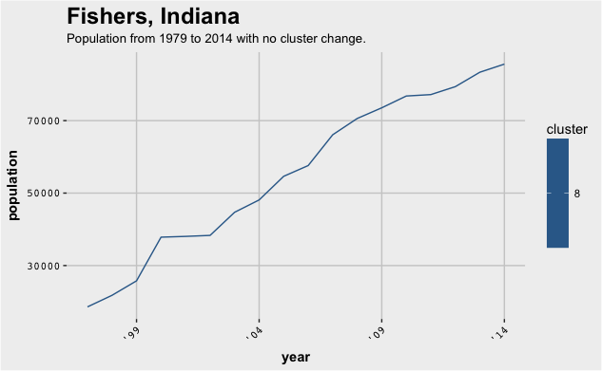
Case Study: Indiana
Look at all cities whose AYPI increased between 5% and 10%

Slide 13
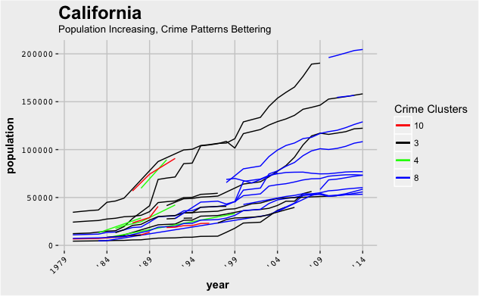
Case Study: California
Look at all cities whose AYPI increased between 5% and 10%

Slide 14
Project Outcomes
Achievements:
Developed a good classifier between good and bad cities
Was able to explain why the classifier acted for increasing/decreasing cities
Could be used to assess future crime and what to avoid for political personnel
Case study on Indiana showed positive crime change as population increased
Case study on California showed positive crime change as population increased

Slide 15
Project Outcomes
Challenges:
Time
Clear goal pivots
Lessons Learned:
Even simple problems can take much longer than expected
Gain as much domain expertise as possible on data and the problem before starting

Slide 16
Project Outcomes
Appreciation:
Faculty advisor
Data science projects
Scientific and statistical thinking and problem solving
Abstract problem solving

Slide 17
Closing thoughts
Suggestions, questions, or thoughts?
Feedback is both valued and appreciated.

