Slide 1
CSCI-49500 Research Findings
Blake Conrad
Advisor: Murat Dundar
19 February 2017

Slide 2
Purpose & Agenda
Purpose: Provide a concise overview of my research findings.
Agenda
Project overview:
The problem.
The data.
My approach:
Finding K.
Results:
Verifying K with Visualizations.

Slide 3
K=$λ_{i}$
K=𝜆_𝑖
Plot
Calculate
Assess

Slide 4
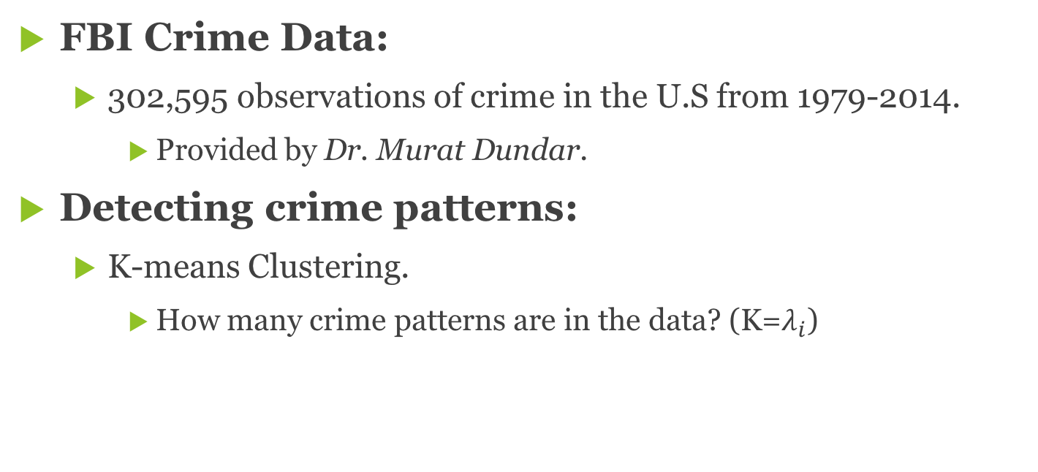
Project overview
FBI Crime Data:
302,595 observations of crime in the U.S from 1979-2014.
Provided by Dr. Murat Dundar.
Detecting crime patterns:
K-means Clustering.
How many crime patterns are in the data? (K=$λ_{i}$)

Slide 5
Finding K
Leveraging media data:
USA Today’s 10 best and worse cities:
Run K=5..30
Plot
Calculate Percent Expected
Find the best K

Slide 6
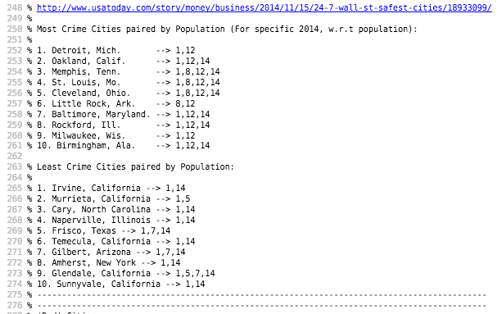
Finding K

Slide 7
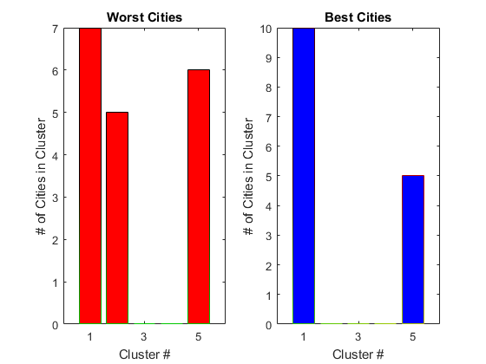
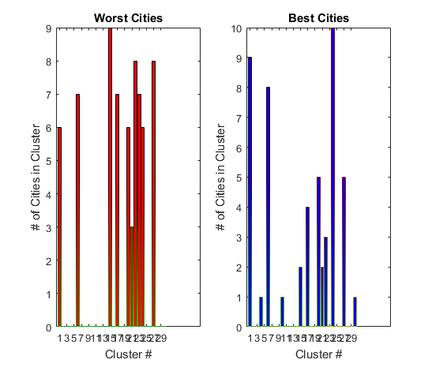
Finding K
K=5 | Centered Data | Population Included
Example of low Percent Expected: 33%
K=30 | Centered Data | Population Included
Example of high Percent Expected: 84.24%

Slide 8
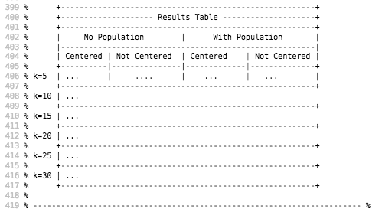
Finding K

Slide 9
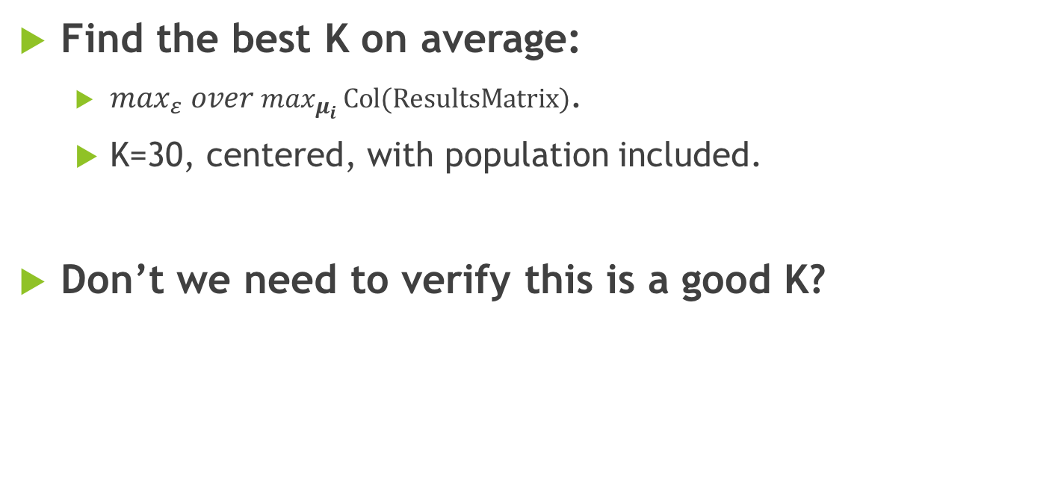
Finding K
Find the best K on average:
${\max_{ε} over max}_{μ_{i }}Col(ResultsMatrix)$.
K=30, centered, with population included.
Don’t we need to verify this is a good K?

Slide 10
Verifying K
Apply PCA to visualize in lower dimension:
Drop from 11 dimensions to 2 dimensions.
Apply log(x+1) transformation on projected dimensions:
Centers the data.
Doesn’t drop zero observations.

Slide 11
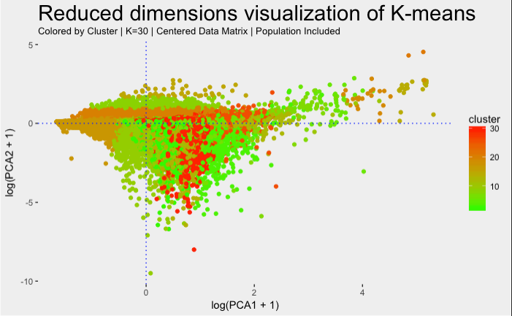
Verifying K

Slide 12
Closing thoughts
Suggestions, questions, or thoughts regarding the project?
Feedback is both valued and appreciated.

