Slide 1
Feature Selection

Slide 2
Why feature selection is needed?
Generally, the more the features, the better the performance
This is true as long as the newly added feature has some correlation with the class label (useful feature), but it is not correlated with another feature already being used (non-redundant).
Feature Selection methods are used for removing unnecessary or redundant features.
Some classification methods are immune to the adverse affect of unnecessary and redundant features (say, SVM)
On the other hand, some are poor, for example k-NN based method
Feature selection should generally be considered for any method that computes some sort of distance between instances.

Slide 3
Feature Selection Approaches
An exhaustive approach is to find the performance (say, error rate) of all subset of features and then choose the best one
Infeasible, because the cost is exponential to the number of features
So, some form of search algorithm needs to be used to greedily search over the space of feature subset.
Filter Methods
In this method a feature or a subset of features are evaluated with a class-sensitive discriminative score
Filter method can be used to find score of a single feature, but using multiple features together accounts for redundant features.
Wrapper Method
It uses a model to score feature subsets. Each new subset is used to train a model, and then the model is used on an unseen dataset. The performance of the model gives the score of that feature subset.
It is costly but usually better than the Filter based methods.
For both Filter and Wrapper method, a greedy search approach can be used.
Greedy forward selection or greedy backward elimination are used popularly.
For both of the above methods, once a feature is selected (or rejected) that decision is permanent

Slide 4
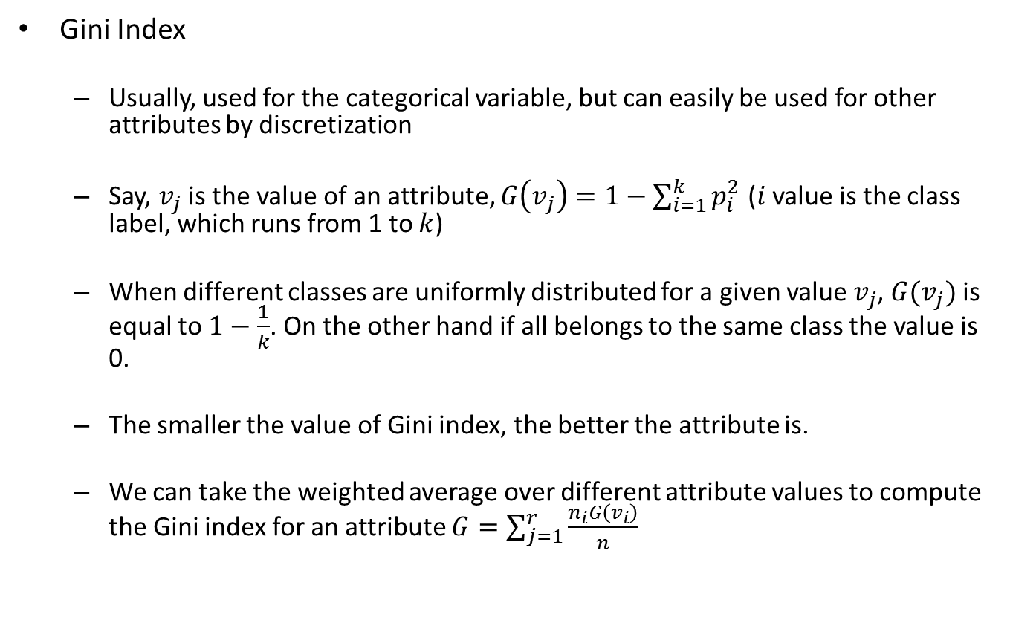
Feature score of single variable
Gini Index
Usually, used for the categorical variable, but can easily be used for other attributes by discretization
Say, $v_{j}$ is the value of an attribute, $G\left(v_{j}\right)=1−\sum_{i=1}^{k}{p_{i}^{2}}$ ($i$ value is the class label, which runs from 1 to $k$)
When different classes are uniformly distributed for a given value $v_{j}$, $G(v_{j})$ is equal to $1−\frac{1}{k}$. On the other hand if all belongs to the same class the value is 0.
The smaller the value of Gini index, the better the attribute is.
We can take the weighted average over different attribute values to compute the Gini index for an attribute $G=\sum_{j=1}^{r}{\frac{n_{i}G\left(v_{i}\right)}{n}}$

Slide 5
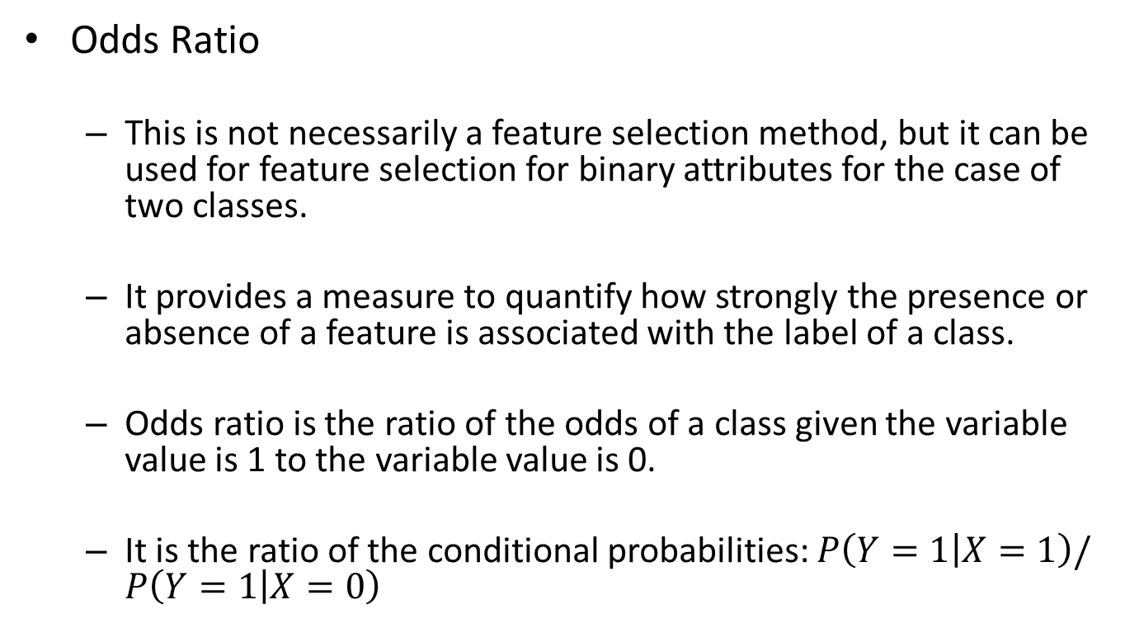
Feature Selection of Single Variable
Odds Ratio
This is not necessarily a feature selection method, but it can be used for feature selection for binary attributes for the case of two classes.
It provides a measure to quantify how strongly the presence or absence of a feature is associated with the label of a class.
Odds ratio is the ratio of the odds of a class given the variable value is 1 to the variable value is 0.
It is the ratio of the conditional probabilities: $P\left(Y=1 | X=1\right)/P\left(Y=1 | X=0\right)$

Slide 6
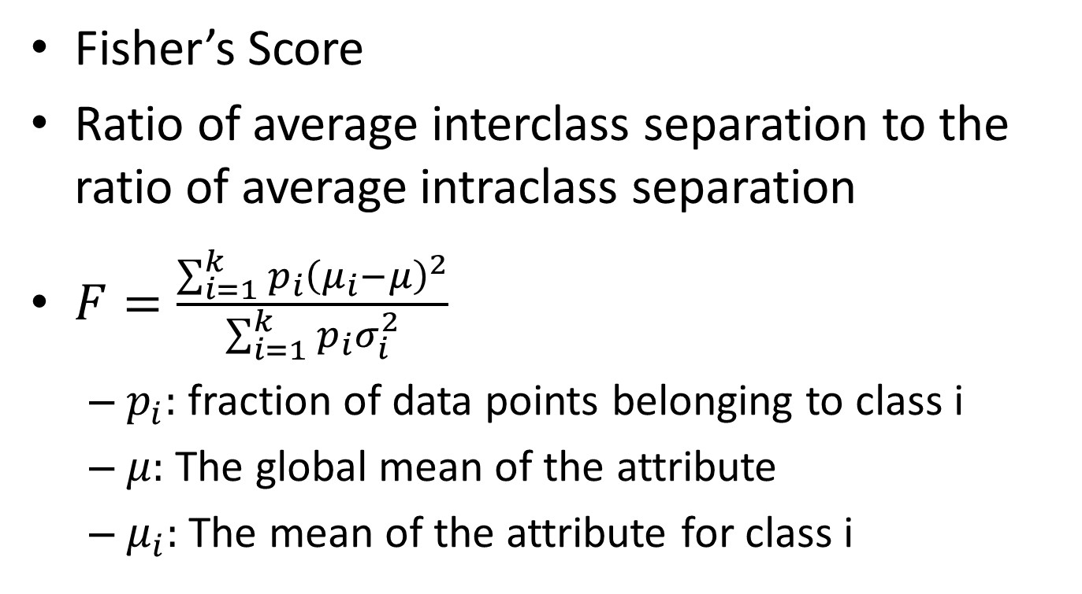
Feature Selection for Single Variable
Fisher’s Score
Ratio of average interclass separation to the ratio of average intraclass separation
$F=\frac{\sum_{i=1}^{k}{p_{i}{\left(μ_{i}−μ\right)}^{2}}}{\sum_{i=1}^{k}{p_{i}σ_{i}^{2}}}$
$p_{i}:$ fraction of data points belonging to class i
$μ:$ The global mean of the attribute
$μ_{i}:$ The mean of the attribute for class i

