Slide 1
Data Mining
Dimensionality Reduction using Principal Component Analysis

Slide 2
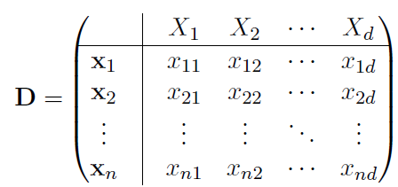
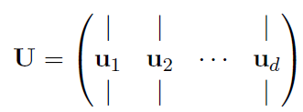

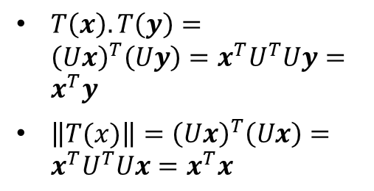
Dimensionality Reduction (Ch. 7)
Data Sample consist of $n$ points over $d$ attributes.
Each point $x_{i}$ is a vector in the $d$-dimensional vector space spanned by the $d$ standard vector, $e_{1}, e_{2},⋯, e_{d}$
Standard basis is an orthonormal basis, $e_{i}^{T}e_{j}=0$, and $\left\|e_{i}\right\|=1$
Given any other set of orthonormal vectors, $u_{1},⋯, u_{d}$, we can express a point $x$ as the linear combination: $x=a_{1}u_{1}+⋯+a_{d}u_{d}⇒x=Ua$, also from definition $U^{−1}=U^{T}$
The vector $a=(a_{1}, ⋯, a_{d})$ is the co-ordinate of $x$ in the new basis consisting of vectors $u_{1}, ⋯, u_{d}$, i.e, $a=U^{−1}x=U^{T}x$
This process is called orthogonal transformation, which preserve both norm and inner product
$T\left(x\right).T\left(y\right)={\left(Ux\right)}^{T}\left(Uy\right)=x^{T}U^{T}Uy=x^{T}y$
$\left\|T(x)\right\|={\left(Ux\right)}^{T}\left(Ux\right)=x^{T}U^{T}Ux=x^{T}x$

Slide 3
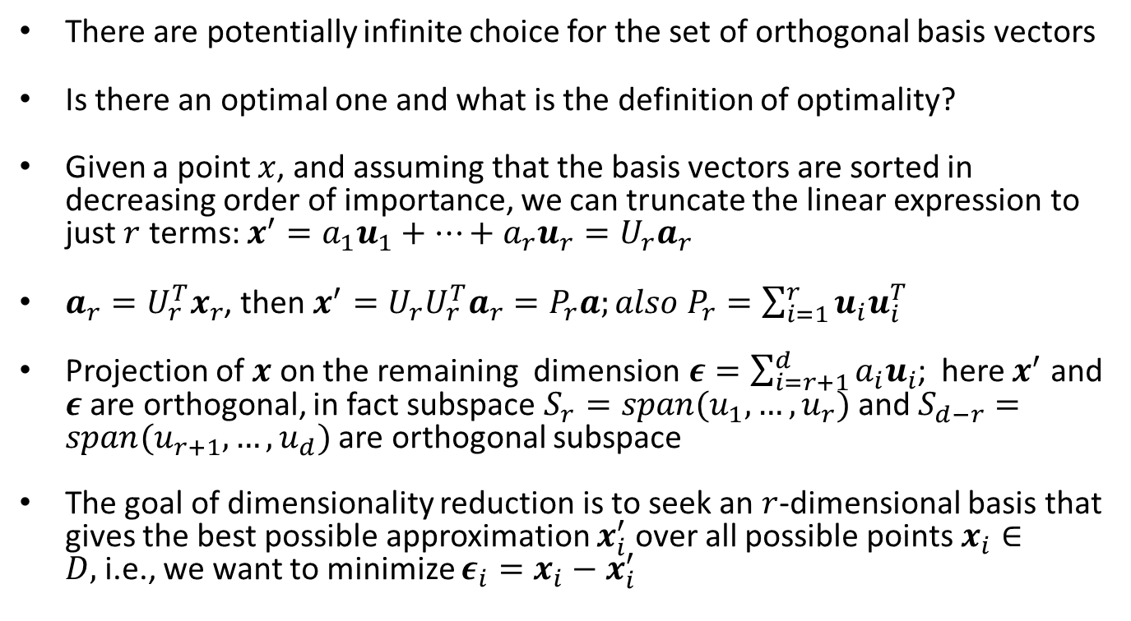
Introduction
There are potentially infinite choice for the set of orthogonal basis vectors
Is there an optimal one and what is the definition of optimality?
Given a point $x$, and assuming that the basis vectors are sorted in decreasing order of importance, we can truncate the linear expression to just $r$ terms: $x^{′}=a_{1}u_{1}+⋯+a_{r}u_{r}=U_{r}a_{r}$
$a_{r}=U_{r}^{T}x_{r}$, then $x^{′}=U_{r}U_{r}^{T}a_{r}=P_{r}a;also P_{r}=\sum_{i=1}^{r}{u_{i}u_{i}^{T}}$
Projection of $x$ on the remaining dimension$ε=\sum_{i=r+1}^{d}{a_{i}u_{i}}$; here $x^{′}$ and $ε$ are orthogonal, in fact subspace $S_{r}=span(u_{1}, …, u_{r})$ and $S_{d−r}=span(u_{r+1}, …, u_{d})$ are orthogonal subspace
The goal of dimensionality reduction is to seek an $r$-dimensional basis that gives the best possible approximation $x_{i}^{′}$ over all possible points $x_{i}∈D,$i.e., we want to minimize $ε_{i}=x_{i}−x_{i}^{′}$

Slide 4
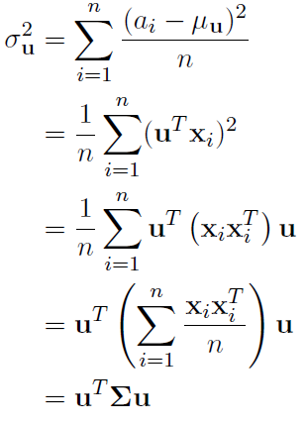
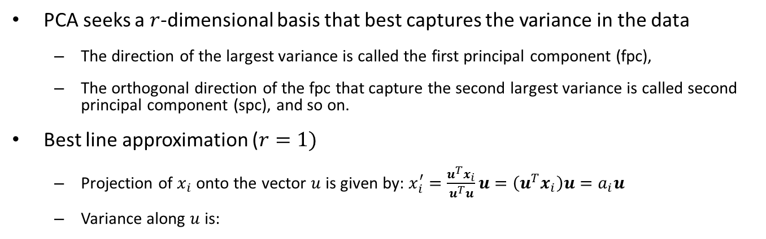
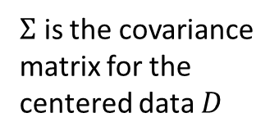
Principal Component Analysis (PCA)
PCA seeks a $r$-dimensional basis that best captures the variance in the data
The direction of the largest variance is called the first principal component (fpc),
The orthogonal direction of the fpc that capture the second largest variance is called second principal component (spc), and so on.
Best line approximation ($r=1)$
Projection of $x_{i}$ onto the vector $u$ is given by: $x_{i}^{′}=\frac{u^{T}x_{i}}{u^{T}u}u=\left(u^{T}x_{i}\right)u=a_{i}u$
Variance along $u$ is:
$Σ$ is the covariance matrix for the centered data $D$

Slide 5
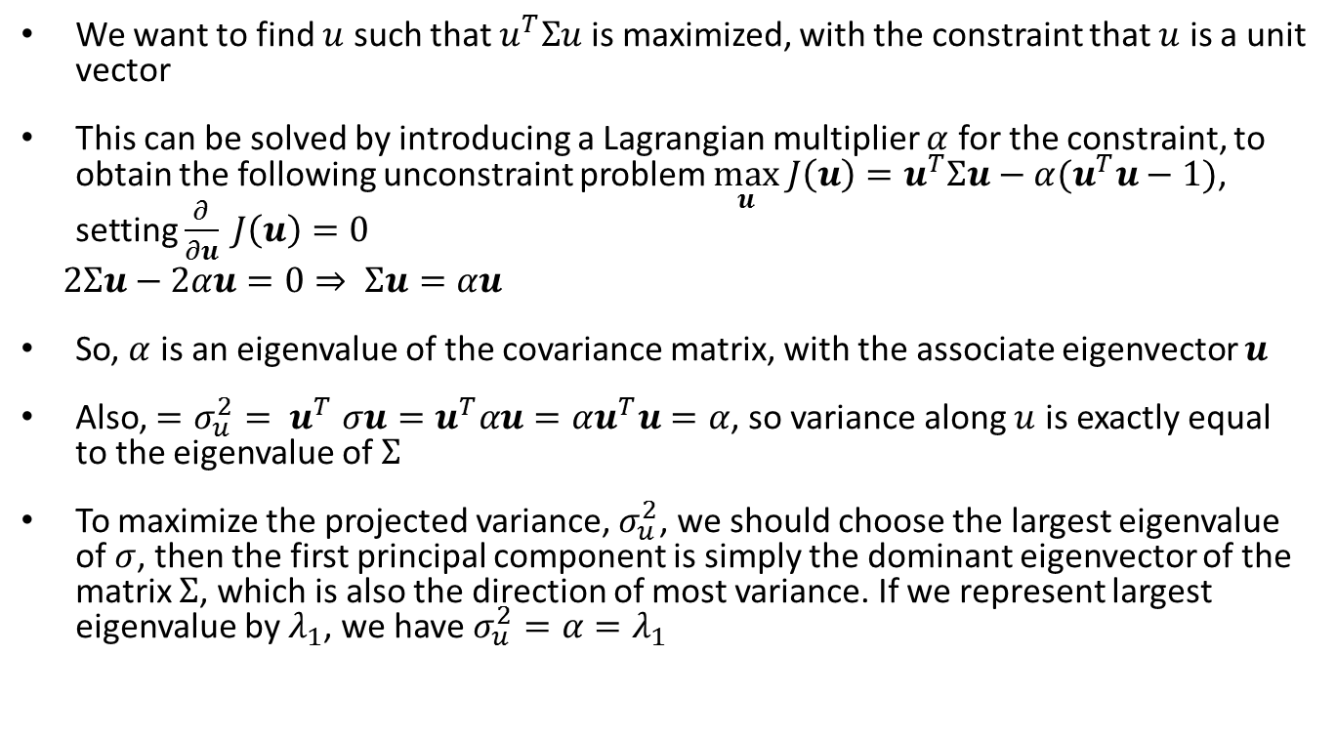
PCA (cont.)
We want to find $u$ such that $u^{T}Σu$ is maximized, with the constraint that $u$ is a unit vector
This can be solved by introducing a Lagrangian multiplier $α$ for the constraint, to obtain the following unconstraint problem $\max_{u} J\left(u\right)=u^{T}Σu−α(u^{T}u−1)$, setting $\frac{∂}{∂u} J\left(u\right)=0$
$2Σu−2αu=0⇒ Σu=αu$
So, $α$ is an eigenvalue of the covariance matrix, with the associate eigenvector $u$
Also, ${=σ_{u}^{2}= u}^{T}σu=u^{T}αu=αu^{T}u=α$, so variance along $u$ is exactly equal to the eigenvalue of $Σ$
To maximize the projected variance, $σ_{u}^{2}$, we should choose the largest eigenvalue of $σ$, then the first principal component is simply the dominant eigenvector of the matrix $Σ$, which is also the direction of most variance. If we represent largest eigenvalue by $λ_{1}$, we have $σ_{u}^{2}=α=λ_{1}$

Slide 6
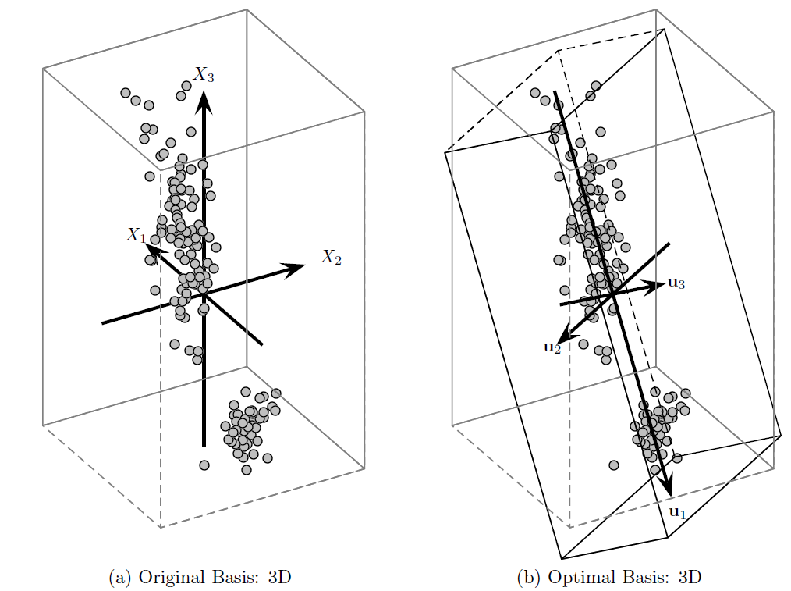
Iris on first three dimension

Slide 7
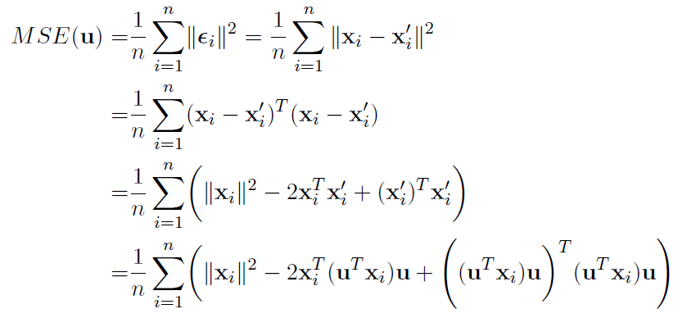
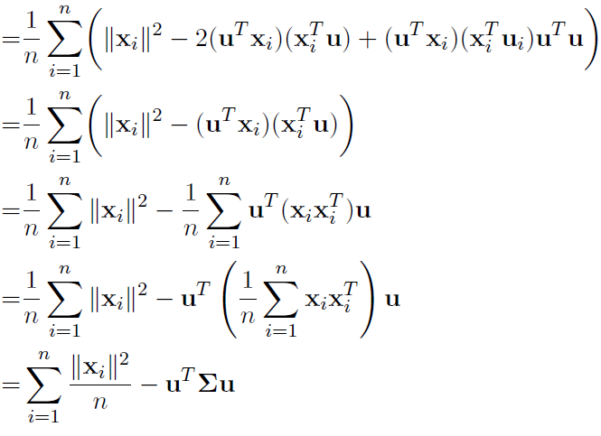
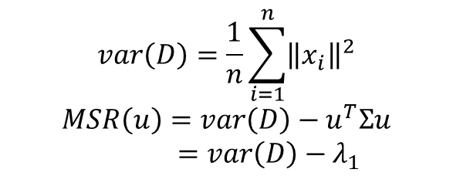
Alternate Analysis (using squared error)
The direction that maximizes the projected variance is also the direction that minimizes the average square error
$$var\left(D\right)=\frac{1}{n}\sum_{i=1}^{n}{{\left\|x_{i}\right\|}^{2}}$$
$$MSR\left(u\right)=var\left(D\right)−u^{T}Σu=var\left(D\right)−λ_{1}$$

Slide 8
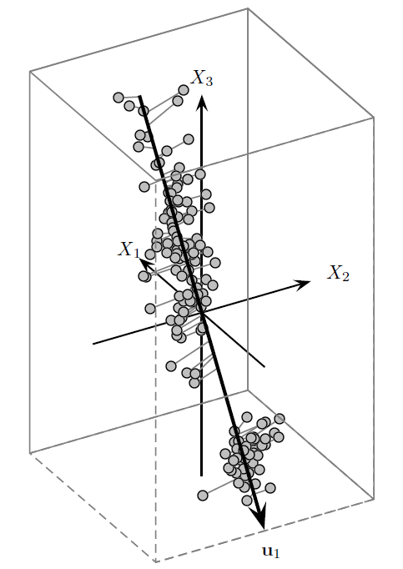
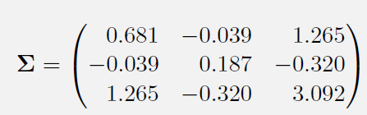
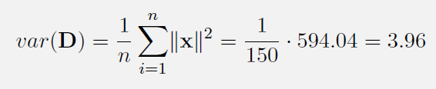

Example

Slide 9
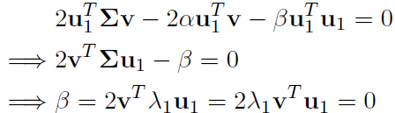

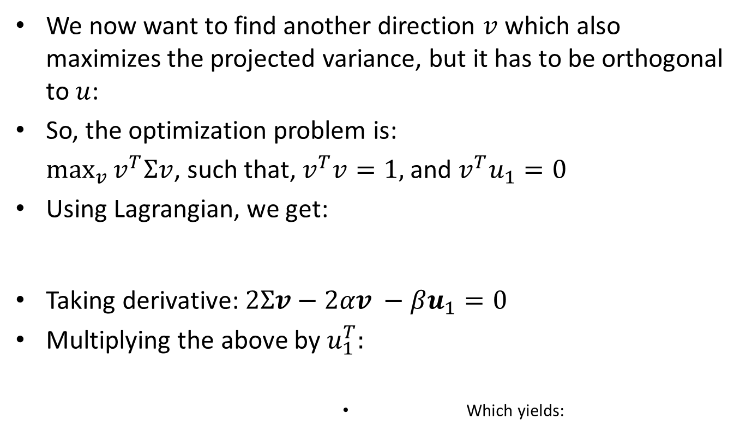
Best two dimensional approximation
We now want to find another direction $v$ which also maximizes the projected variance, but it has to be orthogonal to $u$:
So, the optimization problem is:
$\max_{v}{v^{T}Σv}$, such that, $v^{T}v=1,$and $v^{T}u_{1}=0$
Using Lagrangian, we get:
Taking derivative: $2Σv−2αv −βu_{1}=0$
Multiplying the above by $u_{1}^{T}:$
Which yields:

Slide 10
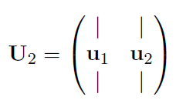

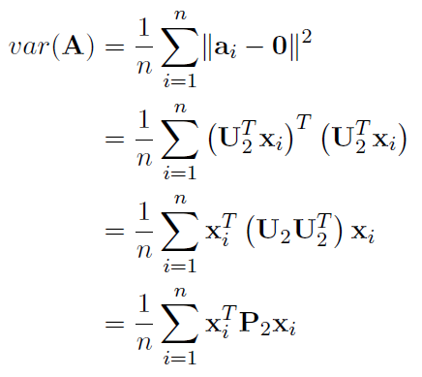

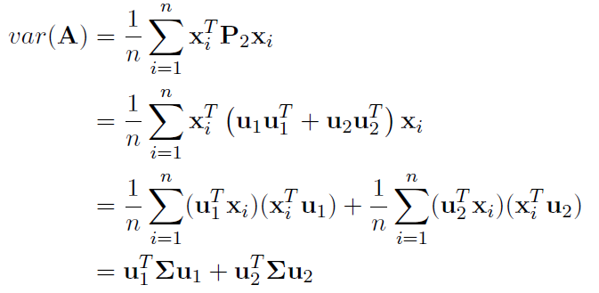
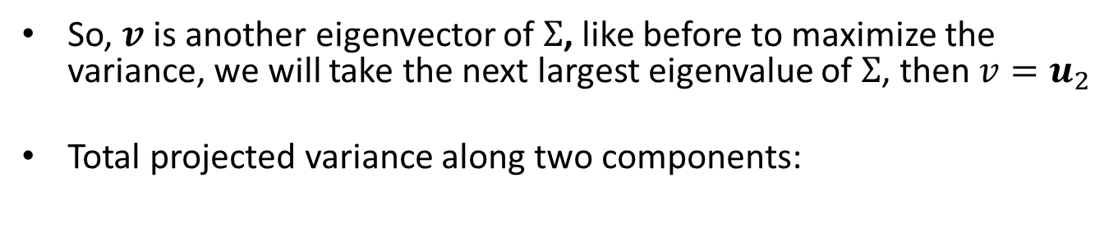
Best 2-D approximation
So, $v$is another eigenvector of $Σ$, like before to maximize the variance, we will take the next largest eigenvalue of $Σ$, then $v=u_{2}$
Total projected variance along two components:

Slide 11
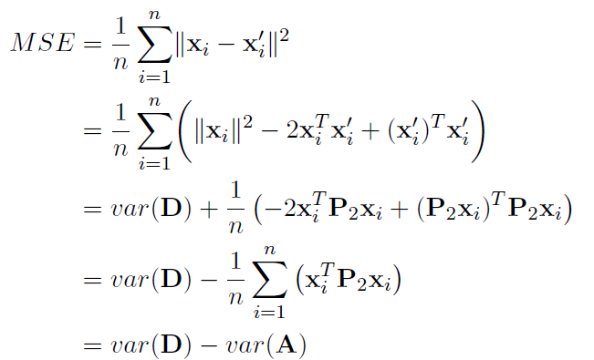
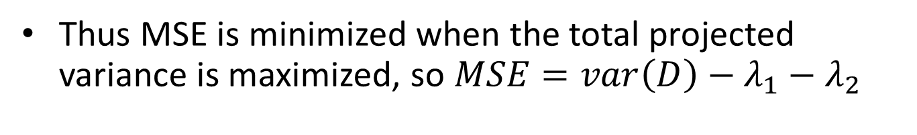
Mean Square Error
Thus MSE is minimized when the total projected variance is maximized, so $MSE=var\left(D\right)−λ_{1}−λ_{2}$

Slide 12
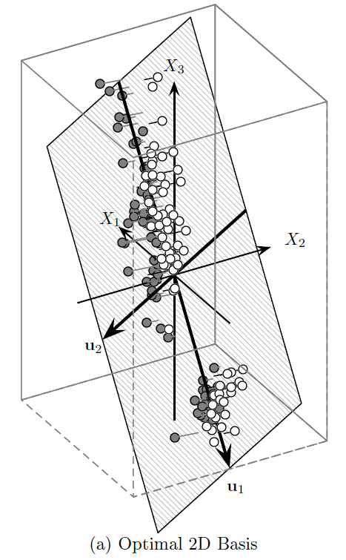
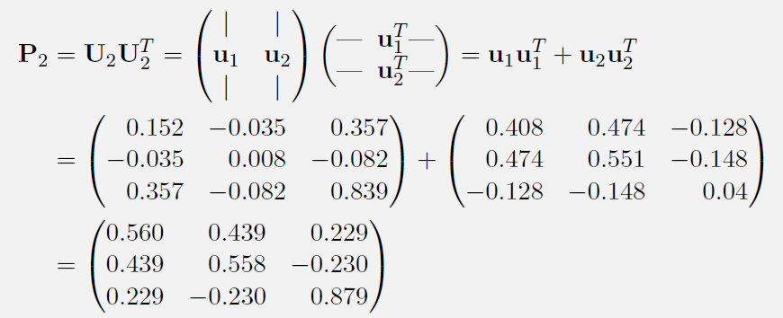
Example
98.5% of the variance is captured in the projected dimension

Slide 13
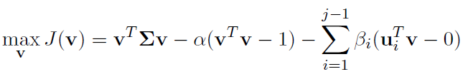
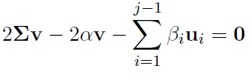
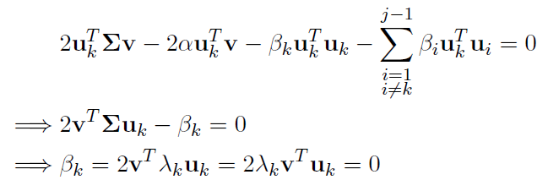

Best r-dimension Approximation
Assume that we already have $j−1$principal components, we are looking for $j$th component
Taking derivative we get:
Multiplying by $u_{k}^{T}$:
Finally, $Σv=αv$

Slide 14
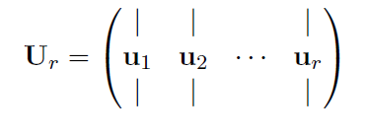

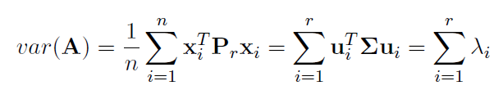
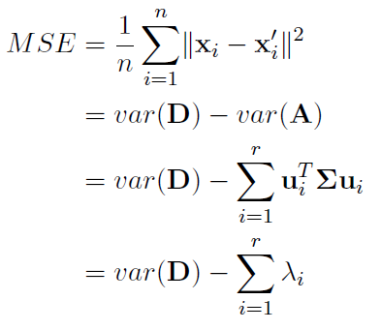
Total projected variance

Slide 15
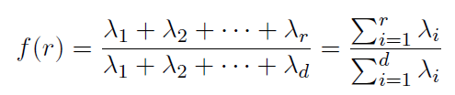
Choosing Diemsionality
Choose r to compute the fraction of the total variance captured by the first r principal components

Slide 16
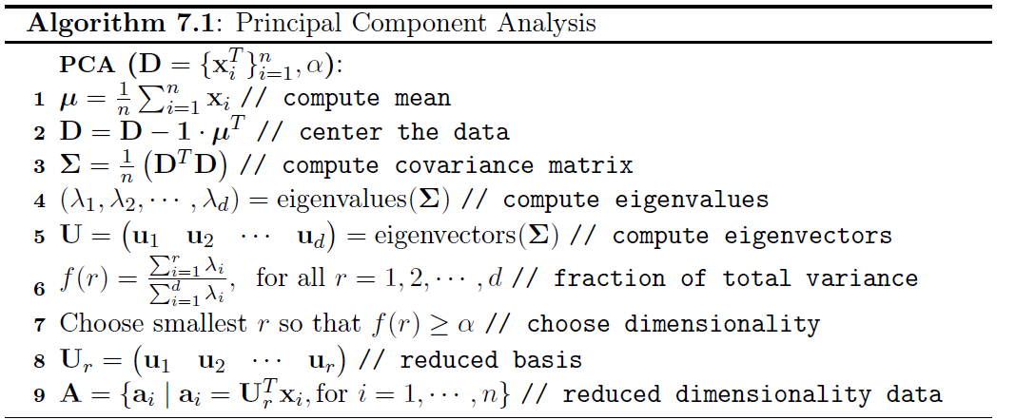
PCA Pseudo-code

Slide 17
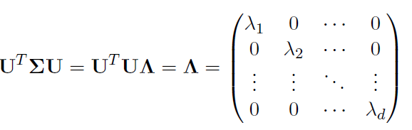
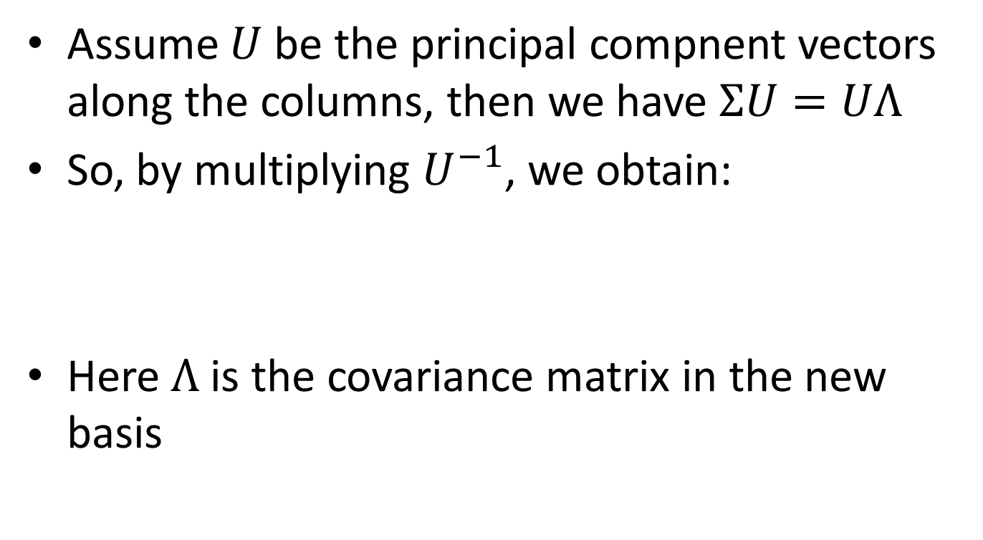
PCA geometry
Assume $U$ be the principal compnent vectors along the columns, then we have $ΣU=UΛ$
So, by multiplying $U^{−1}$, we obtain:
Here $Λ$ is the covariance matrix in the new basis

