Slide 1
Hierarchical Clustering
Chapter 14

Slide 2
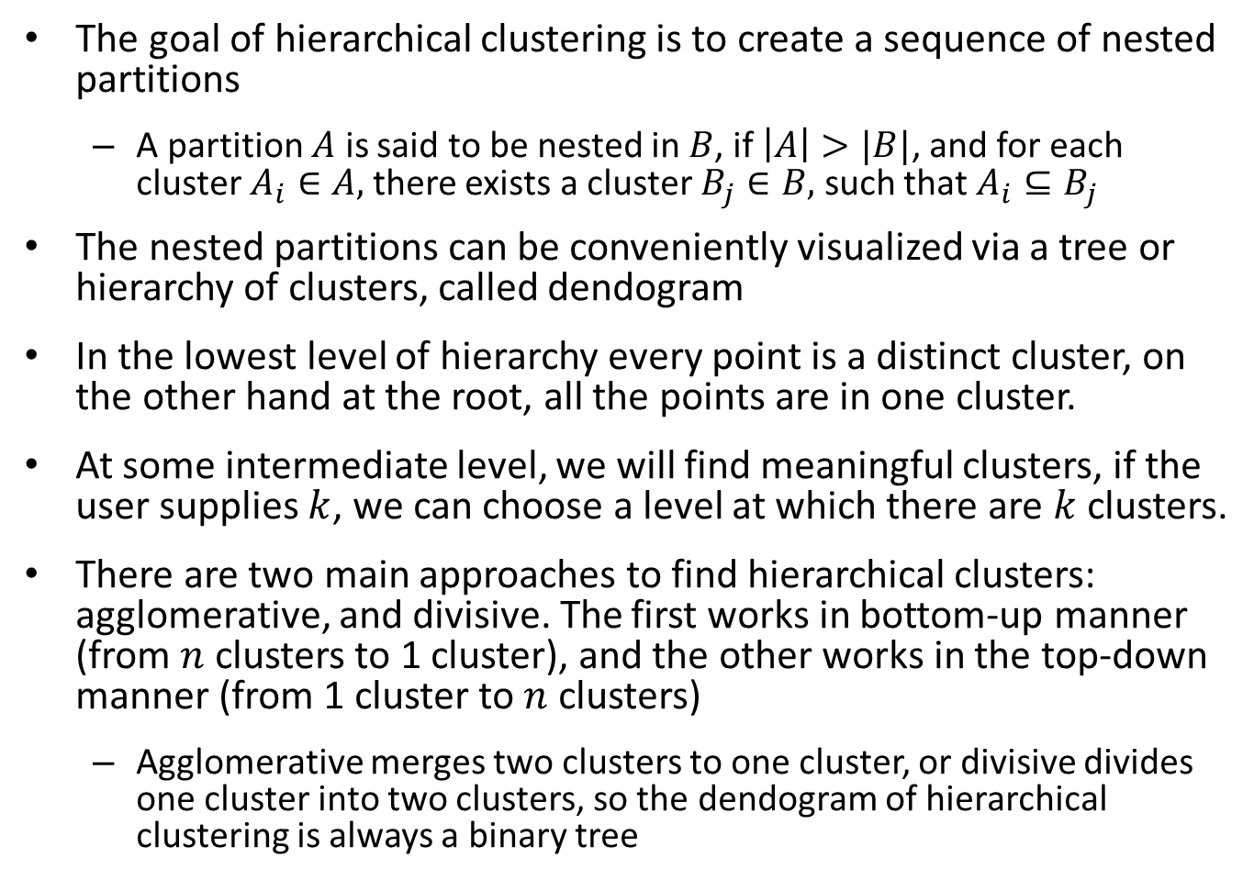
Overview
The goal of hierarchical clustering is to create a sequence of nested partitions
A partition $A$ is said to be nested in $B$, if $\left|A\right|>|B|$, and for each cluster $A_{i}∈A,$ there exists a cluster $B_{j}∈B,$ such that $A_{i}⊆B_{j}$
The nested partitions can be conveniently visualized via a tree or hierarchy of clusters, called dendogram
In the lowest level of hierarchy every point is a distinct cluster, on the other hand at the root, all the points are in one cluster.
At some intermediate level, we will find meaningful clusters, if the user supplies $k$, we can choose a level at which there are $k$ clusters.
There are two main approaches to find hierarchical clusters: agglomerative, and divisive. The first works in bottom-up manner (from $n$ clusters to 1 cluster), and the other works in the top-down manner (from 1 cluster to $n$ clusters)
Agglomerative merges two clusters to one cluster, or divisive divides one cluster into two clusters, so the dendogram of hierarchical clustering is always a binary tree

Slide 3
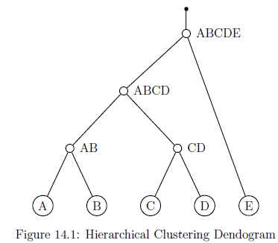
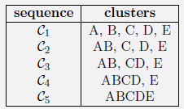
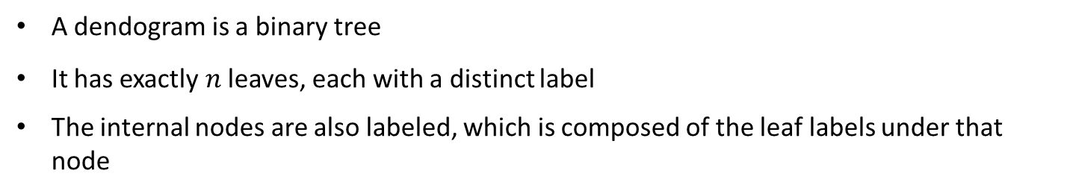
Example
Clustering at various levels
A dendogram is a binary tree
It has exactly $n$ leaves, each with a distinct label
The internal nodes are also labeled, which is composed of the leaf labels under that node

Slide 4
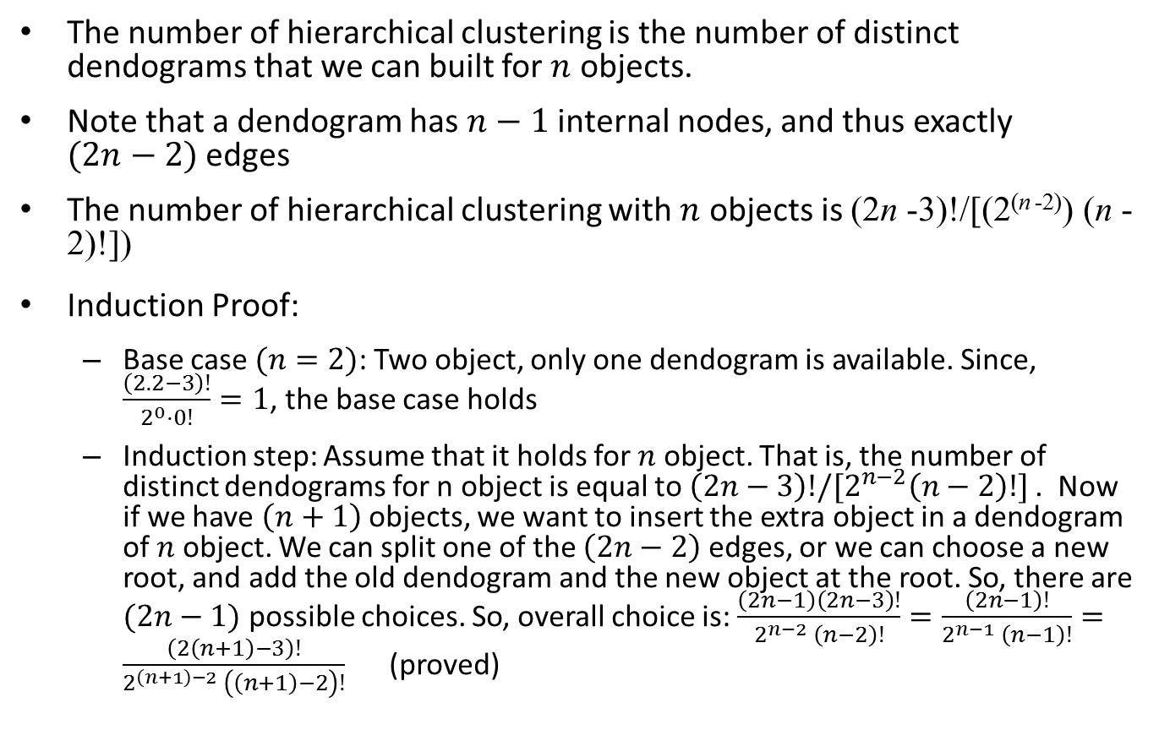
Number of hierarchical clustering
The number of hierarchical clustering is the number of distinct dendograms that we can built for $n$ objects.
Note that a dendogram has $n−1$ internal nodes, and thus exactly $(2n−2)$ edges
The number of hierarchical clustering with $n$ objects is (2n -3)!/[(2^{(n -2)}) (n -2)!])
Induction Proof:
Base case $(n=2)$: Two object, only one dendogram is available. Since, $\frac{\left(2.2−3\right)!}{2^{0}⋅0!}=1$, the base case holds
Induction step: Assume that it holds for $n$ object. That is, the number of distinct dendograms for n object is equal to $\left(2n−3\right)!/[2^{n−2}\left(n−2\right)!]$. Now if we have $\left(n+1\right)$ objects, we want to insert the extra object in a dendogram of $n$ object. We can split one of the $\left(2n−2\right)$ edges, or we can choose a new root, and add the old dendogram and the new object at the root. So, there are $(2n−1)$ possible choices. So, overall choice is: $\frac{\left(2n−1\right)\left(2n−3\right)!}{2^{n−2} \left(n−2\right)!}=\frac{\left(2n−1\right)!}{2^{n−1} \left(n−1\right)!}=\frac{\left(2\left(n+1\right)−3\right)!}{2^{\left(n+1\right)−2} \left(\left(n+1\right)−2\right)!}$ (proved)

Slide 5
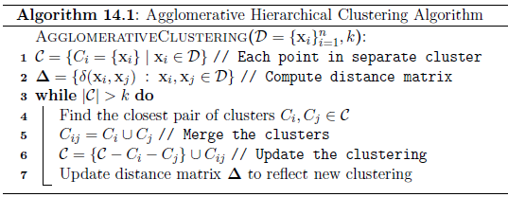
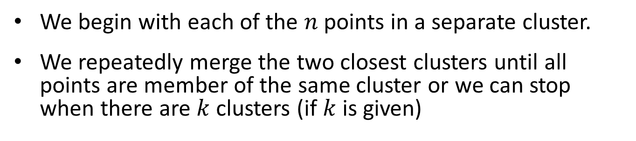
Agglomerative Hierarchical Clustering
We begin with each of the $n$ points in a separate cluster.
We repeatedly merge the two closest clusters until all points are member of the same cluster or we can stop when there are $k$ clusters (if $k$ is given)

Slide 6
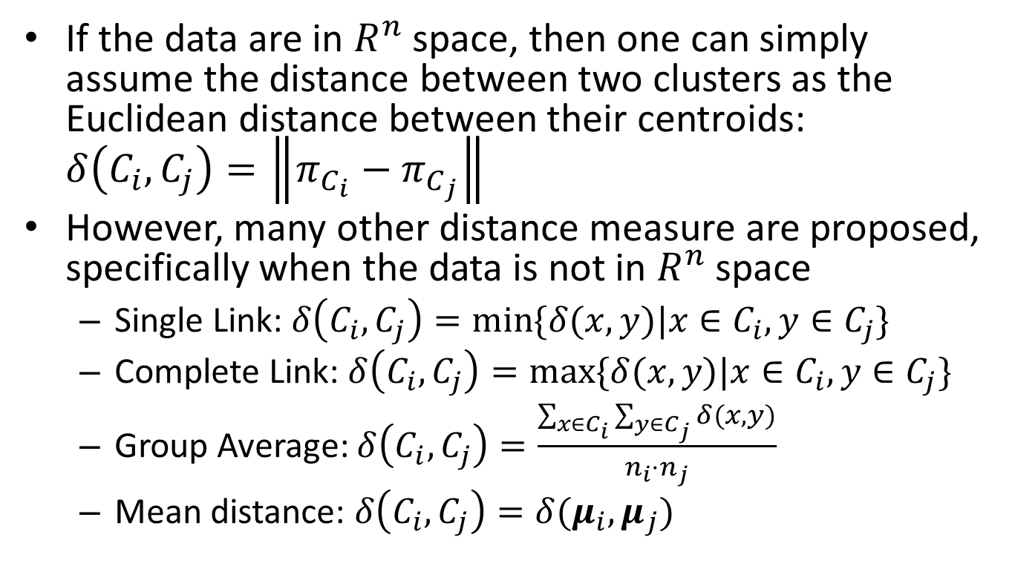
Measuring distance between two clusters
If the data are in $R^{n}$ space, then one can simply assume the distance between two clusters as the Euclidean distance between their centroids: $δ\left(C_{i},C_{j}\right)=\left\|π_{C_{i}}−π_{C_{j}}\right\|$
However, many other distance measure are proposed, specifically when the data is not in $R^{n}$ space
Single Link: $δ\left(C_{i}, C_{j}\right)=\min{\{δ(x, y)|x∈C_{i}, y∈C_{j}\}}$
Complete Link: $δ\left(C_{i}, C_{j}\right)=\max{\{δ(x, y)|x∈C_{i}, y∈C_{j}\}}$
Group Average: $δ\left(C_{i}, C_{j}\right)=\frac{\sum_{x∈C_{i}}{\sum_{y∈C_{j}}{δ(x, y)}}}{n_{i}⋅n_{j}}$
Mean distance: $δ\left(C_{i}, C_{j}\right)=δ(μ_{i}, μ_{j})$

Slide 7
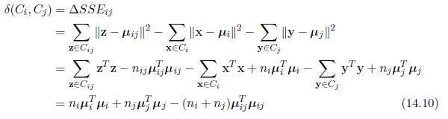
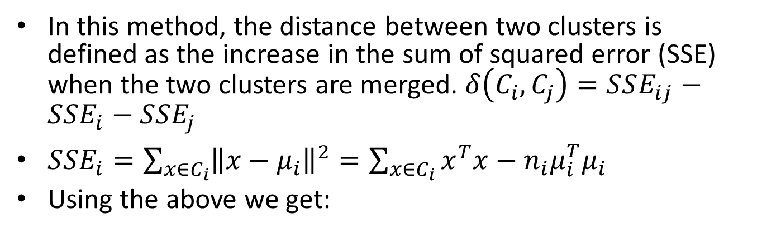
Ward’s Method
In this method, the distance between two clusters is defined as the increase in the sum of squared error (SSE) when the two clusters are merged. $δ\left(C_{i}, C_{j}\right)=SSE_{ij}−SSE_{i}−SSE_{j}$
$SSE_{i}=\sum_{x∈C_{i}}{{\left\|x−μ_{i}\right\|}^{2}=\sum_{x∈C_{i}}{x^{T}x−n_{i}μ_{i}^{T}μ_{i}}}$
Using the above we get:

Slide 8
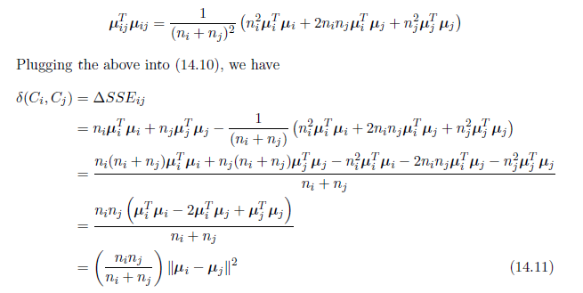
Ward’s method (cont.)
Now, $μ_{ij}=\frac{n_{i}μ_{i}+n_{j}μ_{j}}{n_{i}+n_{j}}$, using this:
Ward’s measure simply uses weighted version of the centroid distance, where the weight is the half of the harmonic mean of the cluster size.

Slide 9
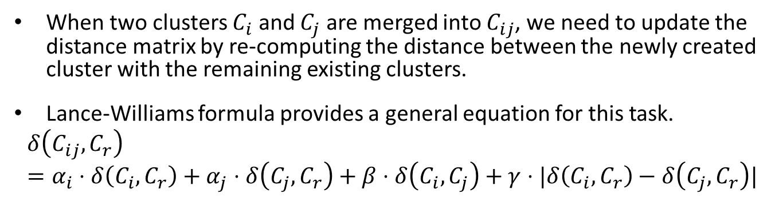
Updating distance matrix
When two clusters $C_{i}$ and $C_{j}$ are merged into $C_{ij}$, we need to update the distance matrix by re-computing the distance between the newly created cluster with the remaining existing clusters.
Lance-Williams formula provides a general equation for this task.
$$δ\left(C_{ij}, C_{r}\right)=α_{i}⋅δ\left(C_{i}, C_{r}\right)+α_{j}⋅δ\left(C_{j}, C_{r}\right)+β⋅δ\left(C_{i}, C_{j}\right)+γ⋅|δ\left(C_{i}, C_{r}\right)−δ\left(C_{j}, C_{r}\right)|$$

