Slide 1
Spectral and Graph Clustering
Chapter 16 (ZW)

Slide 2
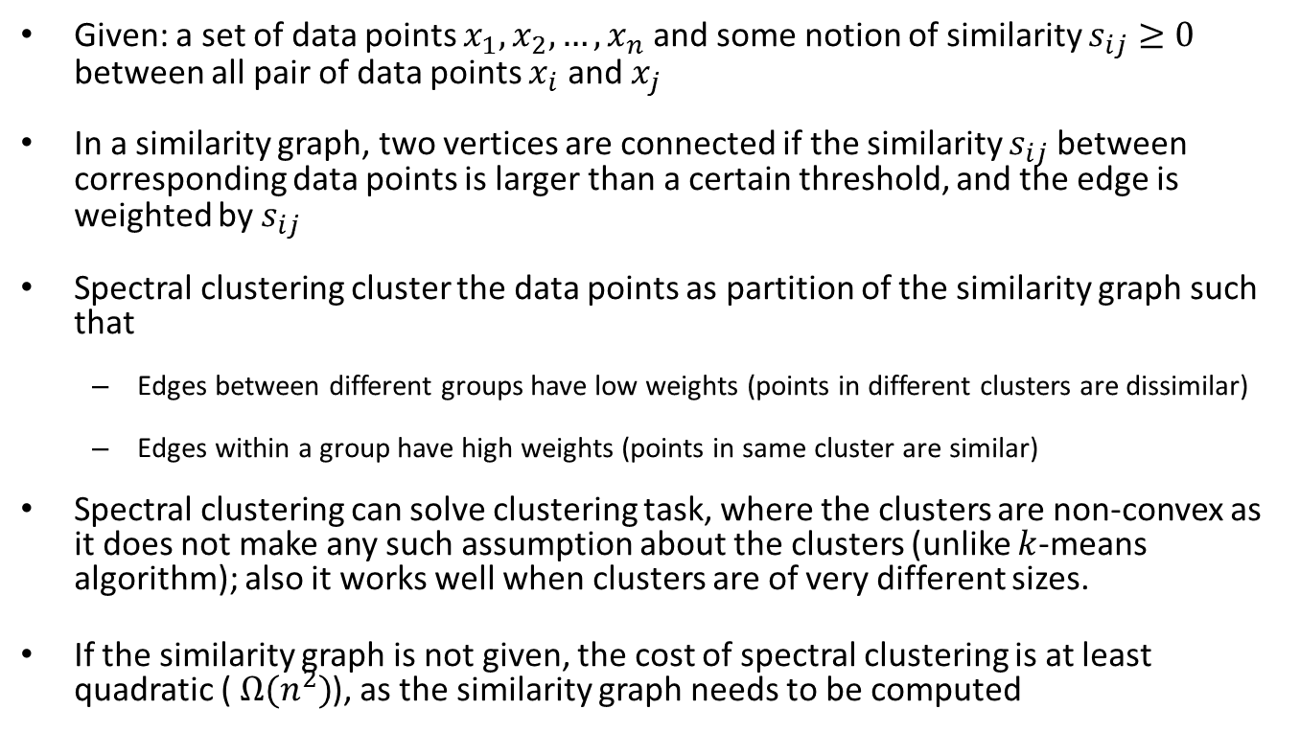
Similarity Graphs
Given: a set of data points $x_{1},x_{2},…, x_{n}$ and some notion of similarity $s_{ij}≥0$ between all pair of data points $x_{i}$ and $x_{j}$
In a similarity graph, two vertices are connected if the similarity $s_{ij}$ between corresponding data points is larger than a certain threshold, and the edge is weighted by $s_{ij}$
Spectral clustering cluster the data points as partition of the similarity graph such that
Edges between different groups have low weights (points in different clusters are dissimilar)
Edges within a group have high weights (points in same cluster are similar)
Spectral clustering can solve clustering task, where the clusters are non-convex as it does not make any such assumption about the clusters (unlike $k$-means algorithm); also it works well when clusters are of very different sizes.
If the similarity graph is not given, the cost of spectral clustering is at least quadratic ( $Ω(n^{2})$), as the similarity graph needs to be computed

Slide 3
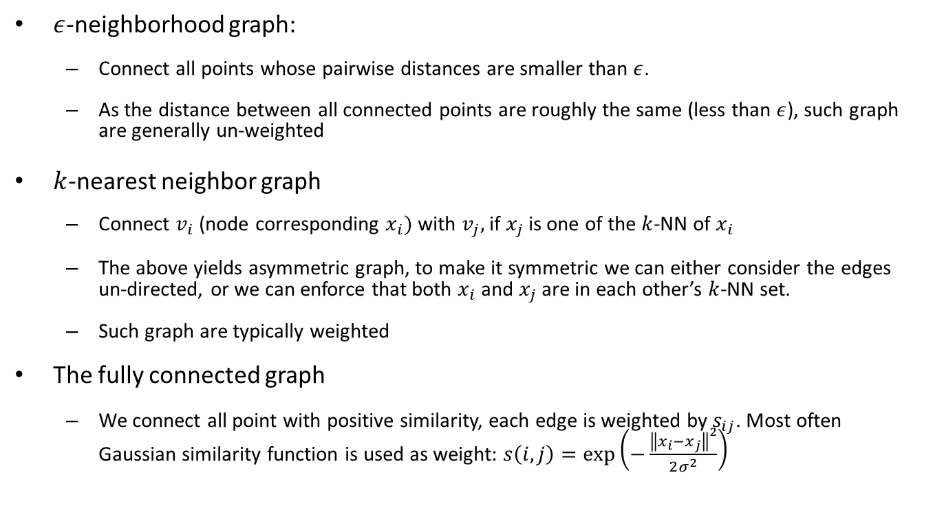
Constructing similarity graph
$ε$-neighborhood graph:
Connect all points whose pairwise distances are smaller than $ε$.
As the distance between all connected points are roughly the same (less than $ε$), such graph are generally un-weighted
$k$-nearest neighbor graph
Connect $v_{i}$ (node corresponding $x_{i})$ with $v_{j},$ if $x_{j}$ is one of the $k$-NN of $x_{i}$
The above yields asymmetric graph, to make it symmetric we can either consider the edges un-directed, or we can enforce that both $x_{i}$ and $x_{j}$ are in each other’s $k$-NN set.
Such graph are typically weighted
The fully connected graph
We connect all point with positive similarity, each edge is weighted by $s_{ij}$. Most often Gaussian similarity function is used as weight: $s\left(i, j\right)=\exp\left(−\frac{{\left\|x_{i}−x_{j}\right\|}^{2}}{2σ^{2}}\right)$

Slide 4
Similarity graph of IRIS dataset

Slide 5
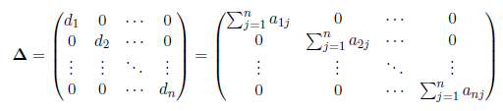
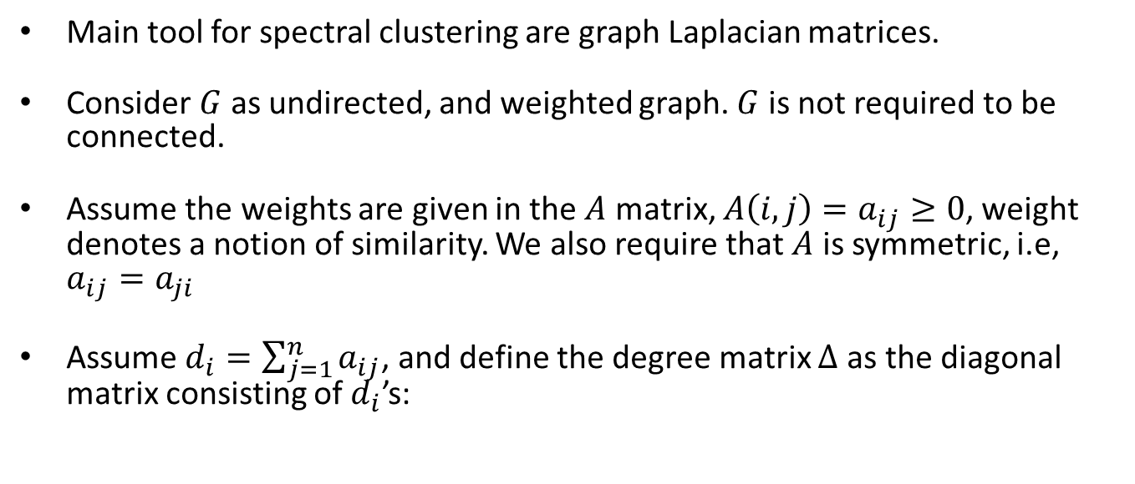
Background
Main tool for spectral clustering are graph Laplacian matrices.
Consider $G$ as undirected, and weighted graph. $G$ is not required to be connected.
Assume the weights are given in the $A$ matrix, $A\left(i, j\right)=a_{ij}≥0$, weight denotes a notion of similarity. We also require that $A$ is symmetric, i.e, $a_{ij}=a_{ji}$
Assume $d_{i}=\sum_{j=1}^{n}{a_{ij}}$, and define the degree matrix $Δ$ as the diagonal matrix consisting of $d_{i}$’s:

Slide 6
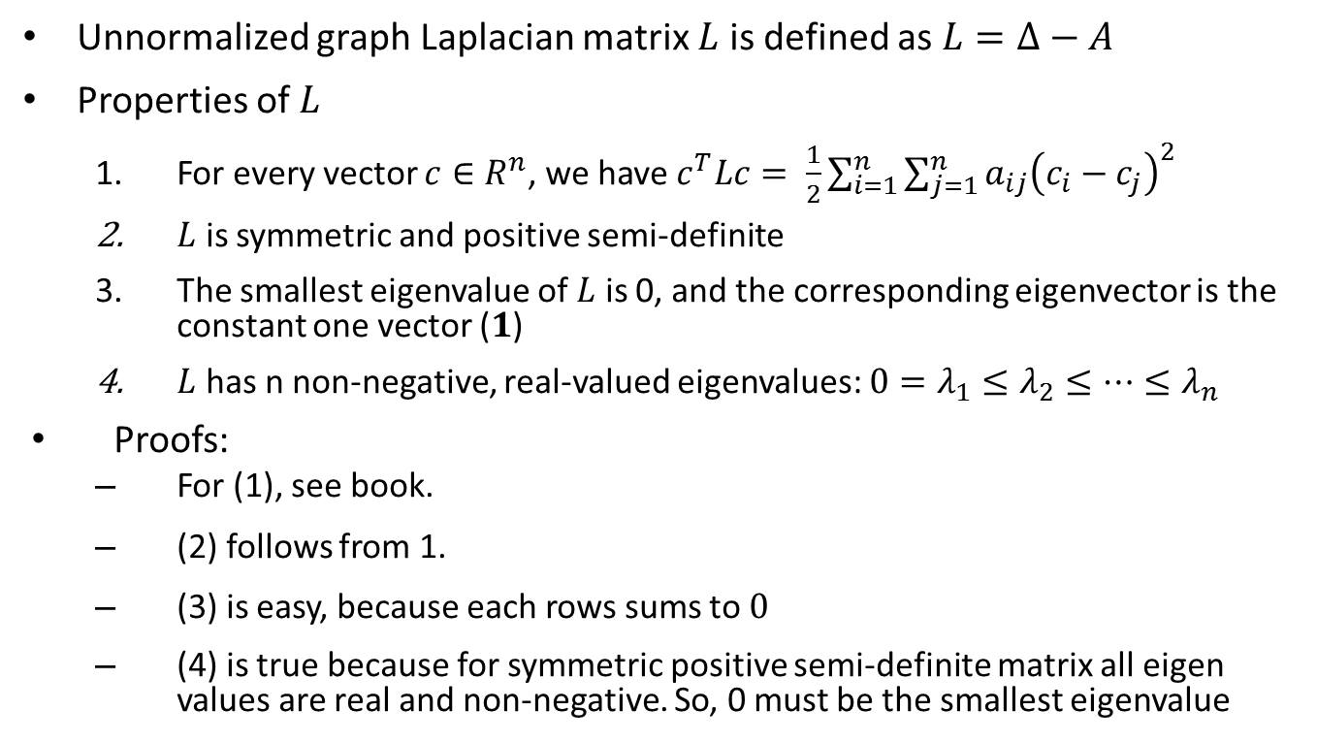
Unnormalized Graph Laplacian
Unnormalized graph Laplacian matrix $L$ is defined as $L=Δ−A$
Properties of $L$
For every vector $c∈R^{n}$, we have $c^{T}Lc= \frac{1}{2}\sum_{i=1}^{n}{\sum_{j=1}^{n}{a_{ij}{\left(c_{i}−c_{j}\right)}^{2}}}$
$L$ is symmetric and positive semi-definite
The smallest eigenvalue of $L$ is 0, and the corresponding eigenvector is the constant one vector ($1$)
$L$ has n non-negative, real-valued eigenvalues: $0=λ_{1}≤λ_{2}≤⋯≤λ_{n}$
Proofs:
For (1), see book.
(2) follows from 1.
(3) is easy, because each rows sums to $0$
(4) is true because for symmetric positive semi-definite matrix all eigen values are real and non-negative. So, 0 must be the smallest eigenvalue

Slide 8
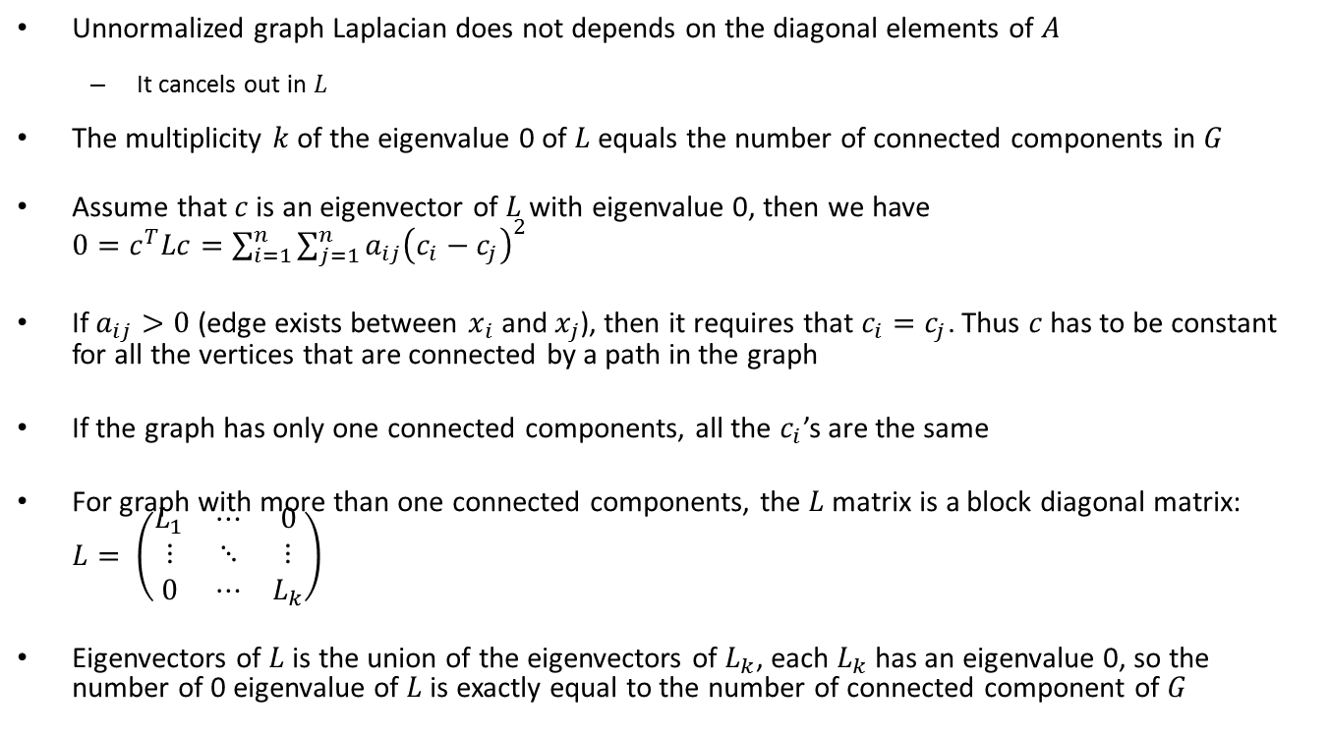

More properties of $L$
Unnormalized graph Laplacian does not depends on the diagonal elements of $A$
It cancels out in $L$
The multiplicity $k$ of the eigenvalue 0 of $L$ equals the number of connected components in $G$
Assume that $c$ is an eigenvector of $L$ with eigenvalue 0, then we have $0=c^{T}Lc=\sum_{i=1}^{n}{\sum_{j=1}^{n}{a_{ij}{\left(c_{i}−c_{j}\right)}^{2}}}$
If $a_{ij}>0$ (edge exists between $x_{i}$ and $x_{j}$), then it requires that $c_{i}=c_{j}$. Thus $c$ has to be constant for all the vertices that are connected by a path in the graph
If the graph has only one connected components, all the $c_{i}$’s are the same
For graph with more than one connected components, the $L$ matrix is a block diagonal matrix: $L= \left(\begin{matrix}L_{1} & ⋯ & 0 \\ ⋮ & ⋱ & ⋮ \\ 0 & ⋯ & L_{k}\end{matrix}\right)$
Eigenvectors of $L$ is the union of the eigenvectors of $L_{k}$, each $L_{k}$ has an eigenvalue 0, so the number of 0 eigenvalue of $L$ is exactly equal to the number of connected component of $G$

Slide 9
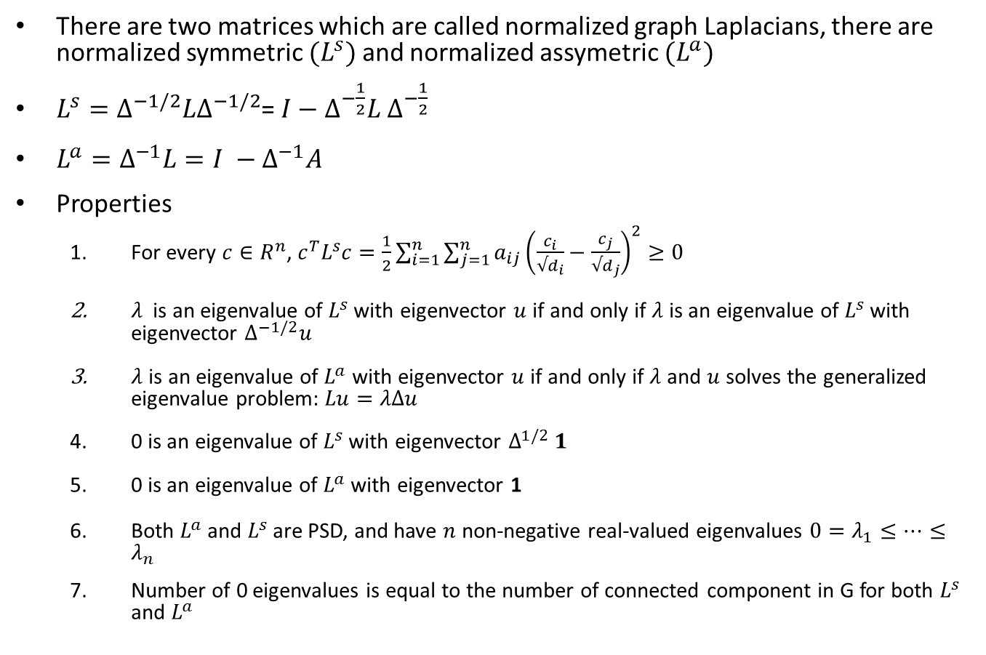
Normalized Graph Laplacian
There are two matrices which are called normalized graph Laplacians, there are normalized symmetric $(L^{s})$ and normalized assymetric $(L^{a})$
$L^{s}=Δ^{−1/2}LΔ^{−1/2}$= $I−Δ^{−\frac{1}{2}}L Δ^{−\frac{1}{2}}$
$L^{a}=Δ^{−1}L=I −Δ^{−1}A$
Properties
For every $c∈R^{n}$, $c^{T}L^{s}c=\frac{1}{2}\sum_{i=1}^{n}{\sum_{j=1}^{n}{a_{ij}{\left(\frac{c_{i}}{√d_{i}}−\frac{c_{j}}{√d_{j}}\right)}^{2}}≥0}$
$λ$is an eigenvalue of $L^{s}$ with eigenvector $u$ if and only if $λ$ is an eigenvalue of $L^{s}$ with eigenvector $Δ^{−1/2}u$
$λ$ is an eigenvalue of $L^{a}$ with eigenvector $u$ if and only if $λ$ and $u$ solves the generalized eigenvalue problem: $Lu=λΔu$
0 is an eigenvalue of $L^{s}$ with eigenvector $Δ^{1/2} 1$
0 is an eigenvalue of $L^{a}$ with eigenvector 1
Both $L^{a}$ and $L^{s}$ are PSD, and have $n$ non-negative real-valued eigenvalues $0=λ_{1}≤…≤λ_{n}$
Number of 0 eigenvalues is equal to the number of connected component in G for both $L^{s}$ and $L^{a}$

Slide 10
Normalized symmetric Laplacian

Slide 11
Normalized Asymmetric Laplacian

Slide 12
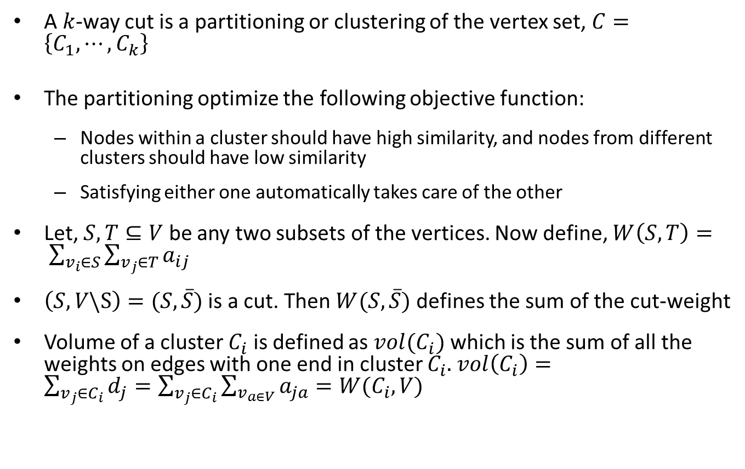
Clustering as graph Cut
A $k$-way cut is a partitioning or clustering of the vertex set, $C=\left\{C_{1}, ⋯, C_{k}\right\}$
The partitioning optimize the following objective function:
Nodes within a cluster should have high similarity, and nodes from different clusters should have low similarity
Satisfying either one automatically takes care of the other
Let, $S,T⊆V$ be any two subsets of the vertices. Now define, $W\left(S, T\right)= \sum_{v_{i}∈S}{\sum_{v_{j}∈T}{a_{ij}}}$
$\left(S, V\backslash S\right)=(S, \overline{S})$ is a cut. Then $W(S, \overline{S})$ defines the sum of the cut-weight
Volume of a cluster $C_{i}$ is defined as $vol(C_{i})$ which is the sum of all the weights on edges with one end in cluster $C_{i}.$ $vol\left(C_{i}\right)=\sum_{v_{j}∈C_{i}}{d_{j}=\sum_{v_{j}∈C_{i}}{\sum_{v_{a∈V}}{a_{ja}=W(C_{i},V)}}}$

Slide 13

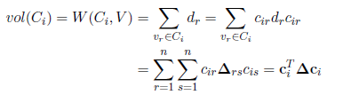
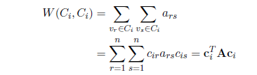
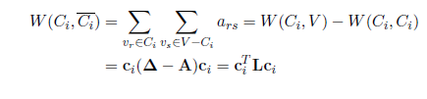
Cluster indicator vector and various cuts

Slide 14


Ratio Cut and normalized Cut
Ratio Cut formulation
Normalized Cut formulation

Slide 15

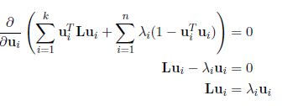
Ratio cut minimization
So, to minimize the ratio cut objective, we should choose the k smallest eigenvectors

Slide 16
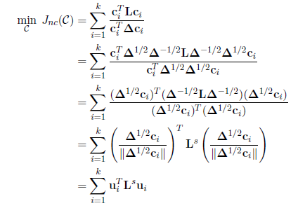
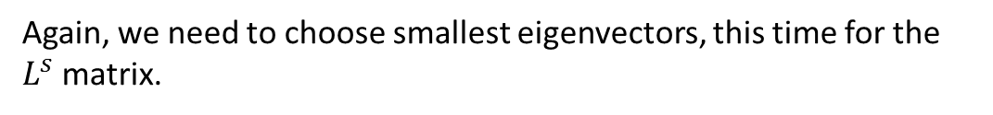
Normalized cut minimization (using symmetric Laplacian)
Again, we need to choose smallest eigenvectors, this time for the $L^{s}$ matrix.

Slide 17
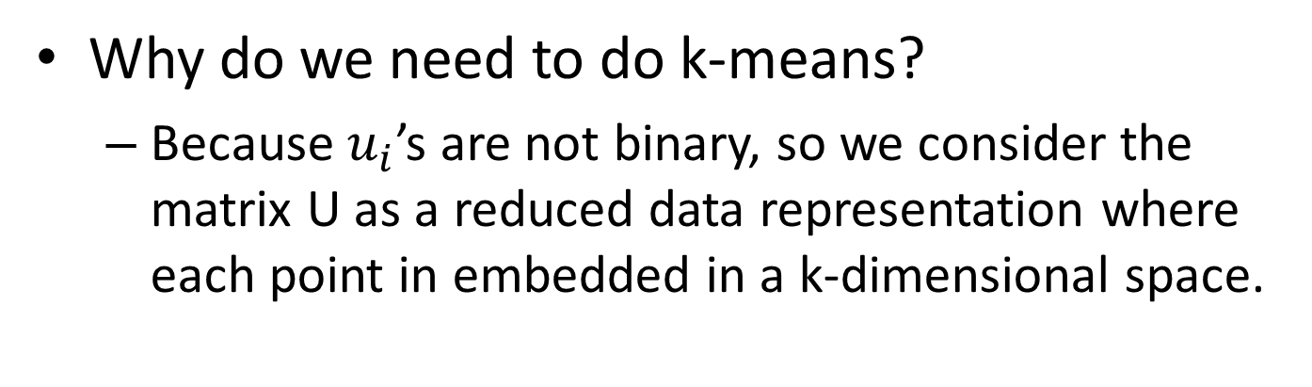
Spectral Clustering Pseudocode
Why do we need to do k-means?
Because $u_{i}$’s are not binary, so we consider the matrix U as a reduced data representation where each point in embedded in a k-dimensional space.

