Slide 1
Supervised Learning Theory

Slide 2
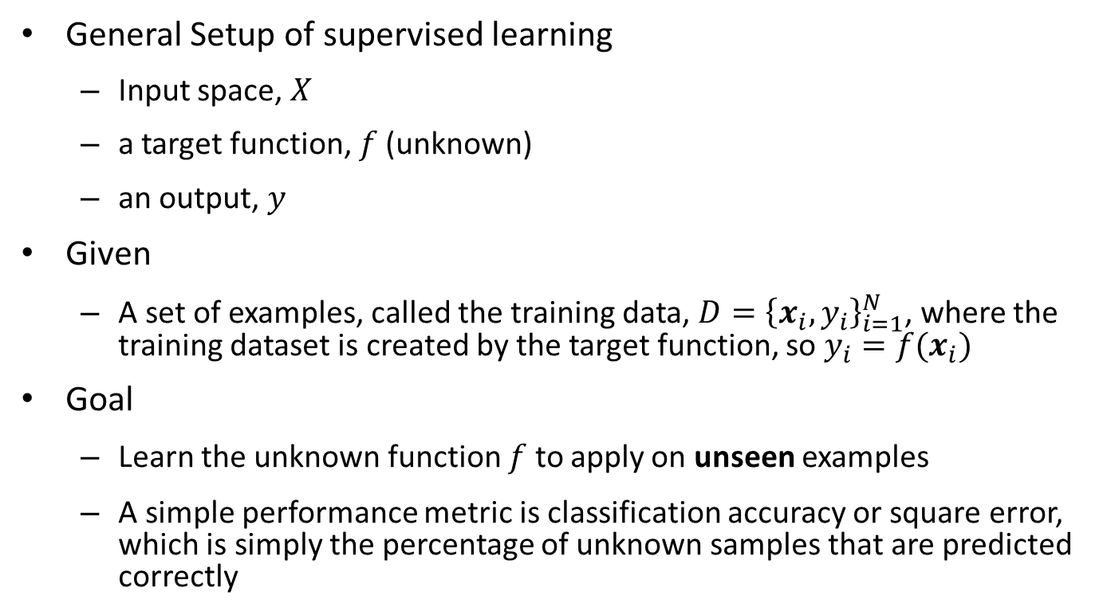
Introduction
General Setup of supervised learning
Input space, $X$
a target function, $f$(unknown)
an output, $y$
Given
A set of examples, called the training data, $D={\left\{x_{i}, y_{i}\right\}}_{i=1}^{N}$, where the training dataset is created by the target function, so $y_{i}=f(x_{i})$
Goal
Learn the unknown function $f$ to apply on unseen examples
A simple performance metric is classification accuracy or square error, which is simply the percentage of unknown samples that are predicted correctly

Slide 3
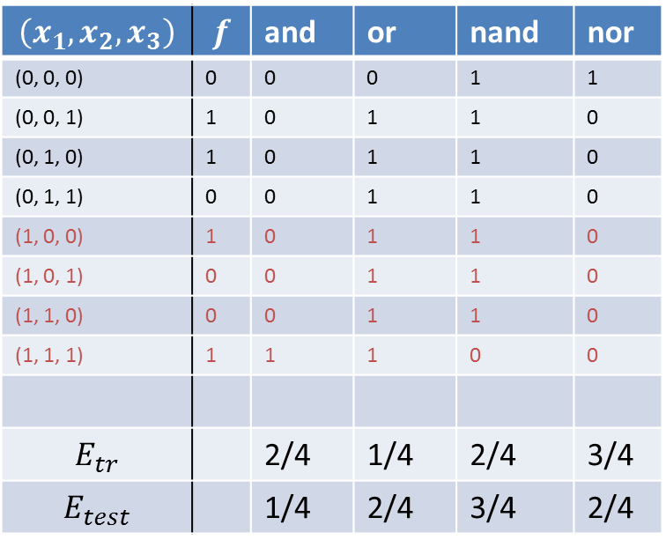
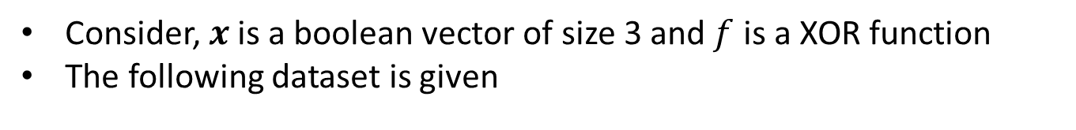
A simple example
Consider, $x$ is a boolean vector of size 3 and $f$ is a XOR function
The following dataset is given
$$\left(x_{1}, x_{2}, x_{3}\right)$$ | $$f$$ | and | or | nand | nor
(0, 0, 0) | 0 | 0 | 0 | 1 | 1
(0, 0, 1) | 1 | 0 | 1 | 1 | 0
(0, 1, 0) | 1 | 0 | 1 | 1 | 0
(0, 1, 1) | 0 | 0 | 1 | 1 | 0
(1, 0, 0) | 1 | 0 | 1 | 1 | 0
(1, 0, 1) | 0 | 0 | 1 | 1 | 0
(1, 1, 0) | 0 | 0 | 1 | 1 | 0
(1, 1, 1) | 1 | 1 | 1 | 0 | 0
$$E_{tr}$$ |  | 2/4 | 1/4 | 2/4 | 3/4
$$E_{test}$$ |  | 1/4 | 2/4 | 3/4 | 2/4
Training data
Test data
“Or” function has the smallest error in training, but “and” function has the smallest error in test

Slide 4
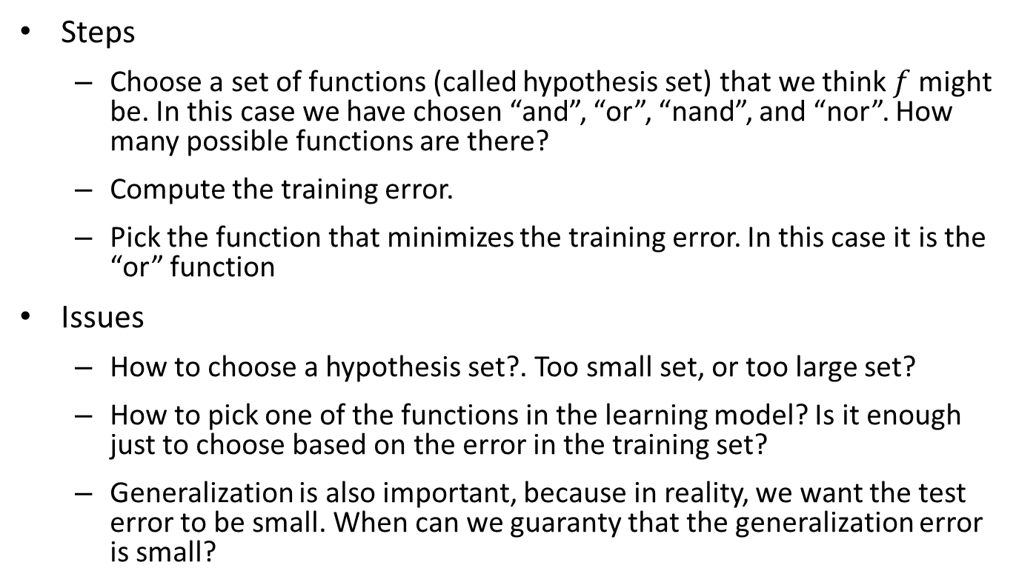
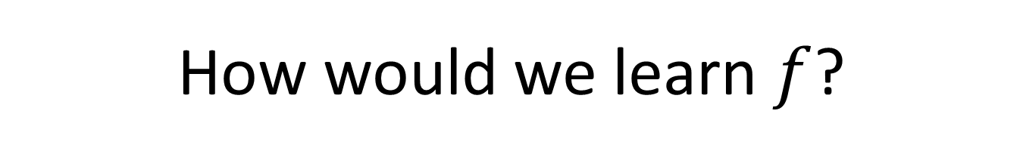
How would we learn $f$?
Steps
Choose a set of functions (called hypothesis set) that we think $f$ might be. In this case we have chosen “and”, “or”, “nand”, and “nor”. How many possible functions are there?
Compute the training error.
Pick the function that minimizes the training error. In this case it is the “or” function
Issues
How to choose a hypothesis set?. Too small set, or too large set?
How to pick one of the functions in the learning model? Is it enough just to choose based on the error in the training set?
Generalization is also important, because in reality, we want the test error to be small. When can we guaranty that the generalization error is small?

Slide 5
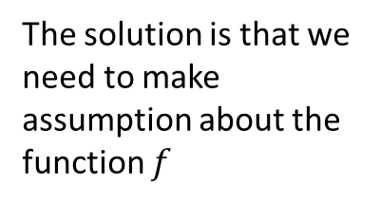
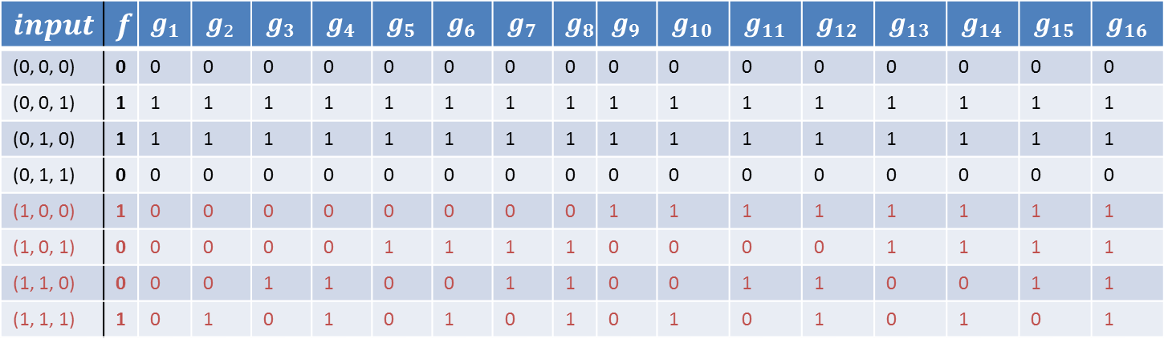
Expanding the hypothesis set
Let’s consider all the functions that yield a zero training error
We will choose one of the function randomly among all of those
$$input$$ | $$f$$ | $$g_{1}$$ | $$g_{2}$$ | $$g_{3}$$ | $$g_{4}$$ | $$g_{5}$$ | $$g_{6}$$ | $$g_{7}$$ | $$g_{8}$$ | $$g_{9}$$ | $$g_{10}$$ | $$g_{11}$$ | $$g_{12}$$ | $$g_{13}$$ | $$g_{14}$$ | $$g_{15}$$ | $$g_{16}$$
(0, 0, 0) | 0 | 0 | 0 | 0 | 0 | 0 | 0 | 0 | 0 | 0 | 0 | 0 | 0 | 0 | 0 | 0 | 0
(0, 0, 1) | 1 | 1 | 1 | 1 | 1 | 1 | 1 | 1 | 1 | 1 | 1 | 1 | 1 | 1 | 1 | 1 | 1
(0, 1, 0) | 1 | 1 | 1 | 1 | 1 | 1 | 1 | 1 | 1 | 1 | 1 | 1 | 1 | 1 | 1 | 1 | 1
(0, 1, 1) | 0 | 0 | 0 | 0 | 0 | 0 | 0 | 0 | 0 | 0 | 0 | 0 | 0 | 0 | 0 | 0 | 0
(1, 0, 0) | 1 | 0 | 0 | 0 | 0 | 0 | 0 | 0 | 0 | 1 | 1 | 1 | 1 | 1 | 1 | 1 | 1
(1, 0, 1) | 0 | 0 | 0 | 0 | 0 | 1 | 1 | 1 | 1 | 0 | 0 | 0 | 0 | 1 | 1 | 1 | 1
(1, 1, 0) | 0 | 0 | 0 | 1 | 1 | 0 | 0 | 1 | 1 | 0 | 0 | 1 | 1 | 0 | 0 | 1 | 1
(1, 1, 1) | 1 | 0 | 1 | 0 | 1 | 0 | 1 | 0 | 1 | 0 | 1 | 0 | 1 | 0 | 1 | 0 | 1
What happens to the training error now?
Say (1, 0, 0) is the input. What is the likelihood that we make it right?
Our chance of success is only half!
The problem now is that, our hypothesis set is too large
The solution is that we need to make assumption about the function $f$

Slide 6
Summarization of earlier slides
No Free Lunch Theorem:
In order to learn from data so that we can do well in unseen example, we need to make assumption about the data to connect data to unseen example
Such assumption will keep our hypothesis set small
The learning model will generalize, so that it does well in the unseen samples
For any learning model, There are two kinds of parameters
One that control the complexity of the model. We can call them hyper-parameters
For an abstract model with a given complexity, another set of parameters (tuning parameters) simply chose the numerical weights that defines the concrete learning model for the given dataset

Slide 7
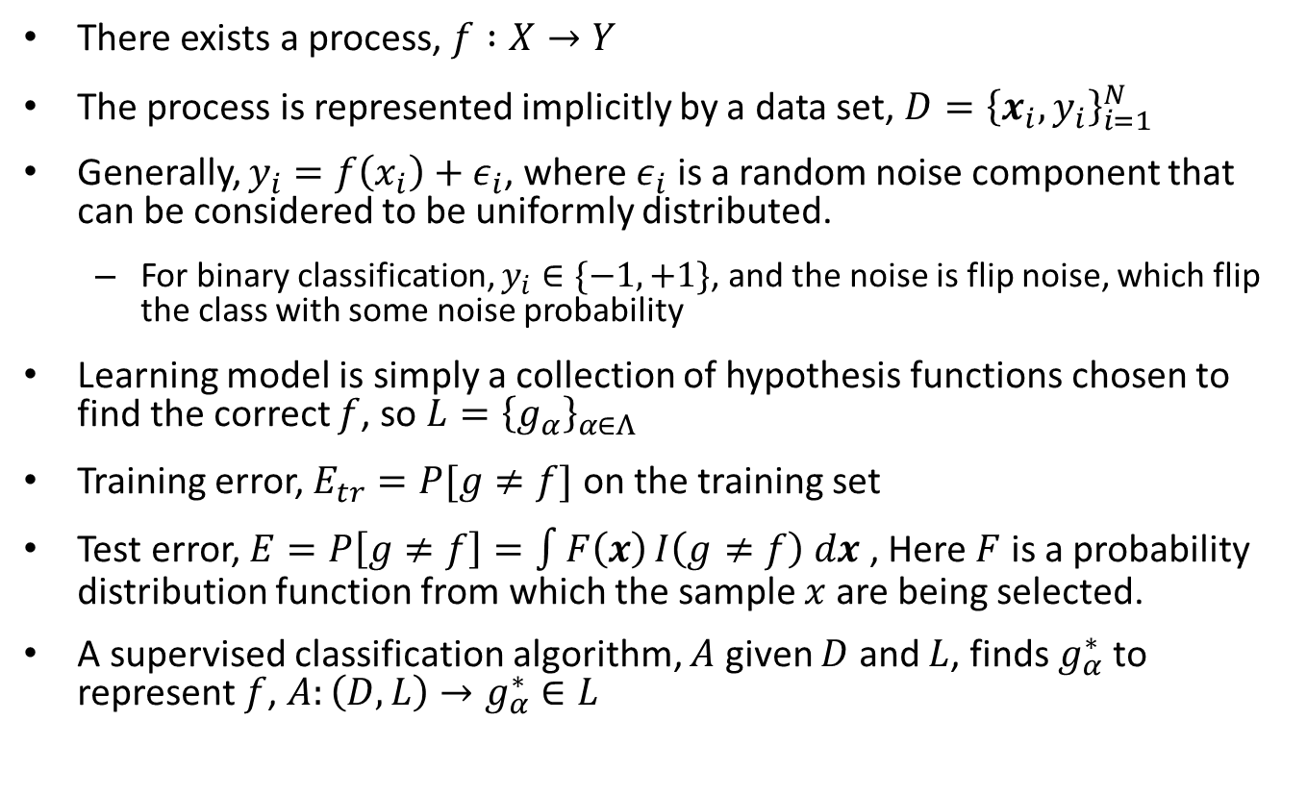
Supervised Classification
There exists a process, $f :X→Y$
The process is represented implicitly by a data set, $D={\left\{x_{i}, y_{i}\right\}}_{i=1}^{N}$
Generally, $y_{i}=f\left(x_{i}\right)+ε_{i}$, where $ε_{i}$ is a random noise component that can be considered to be uniformly distributed.
For binary classification, $y_{i}∈\{−1, +1\}$, and the noise is flip noise, which flip the class with some noise probability
Learning model is simply a collection of hypothesis functions chosen to find the correct $f$, so $L={\left\{g_{α}\right\}}_{α∈Λ}$
Training error, $E_{tr}=P[g≠f]$ on the training set
Test error, $E=P\left[g≠f\right]=\int{F\left(x\right)}I\left(g≠f\right) dx$ , Here $F$ is a probability distribution function from which the sample $x$ are being selected.
A supervised classification algorithm, $A$ given $D$ and $L$, finds $g_{α}^{∗}$ to represent $f$, $A:\left(D, L\right)→g_{α}^{∗}∈L$

Slide 8
Generalization and hypothesis set selection
A good learning model has two properties
It should be possible on any data set to guaranty a 0 training error. This is called universal approximation requirement
It has a computationally efficient learning algorithm that can select the tuning parameters in a reasonable amount of time
However, guarantying zero training error on any data is dangerous, however having zero training error is fine
Guarantying requires having a function that fit the dataset exactly, which means that you have included all possible functions in your hypothesis set.

Slide 9
Bias-Variance tradeoff
Training error = Bias Error + Variance Error + noise
Bias describes the systematic mismatch between our learning model and the process that generates the data
Too simple model have high bias (under-fitting)
By considering more complex model bias can be decreased
Variance defines the sensitivity of a learning model to the particular choice of data set
Complex models are more sensitive to the choice of datasets, thus complex models have higher variance
Bias-Variance tradeoff is the phenomenon of trading one for other as we move from simpler to complex learning model and vice-versa.
To find the optimal point, we “regularize” our learning model

Slide 10
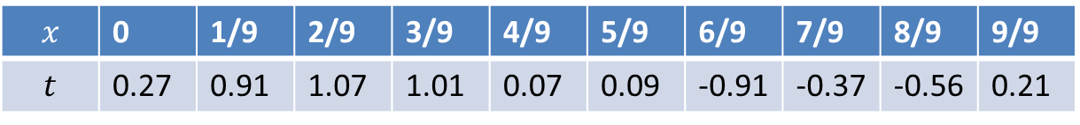
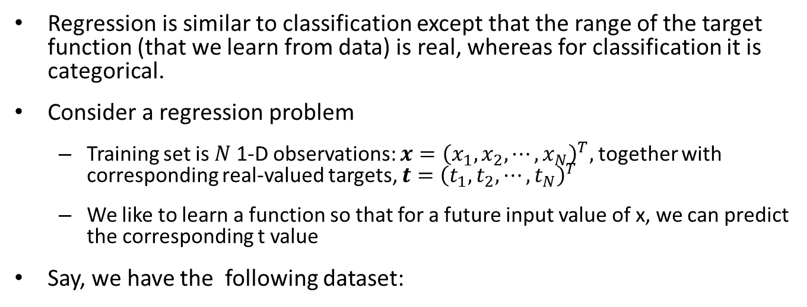
Overfitting from Regression Setting
Regression is similar to classification except that the range of the target function (that we learn from data) is real, whereas for classification it is categorical.
Consider a regression problem
Training set is $N$ 1-D observations: $x={\left(x_{1},x_{2},⋯, x_{N}\right)}^{T},$ together with corresponding real-valued targets, $t={\left(t_{1},t_{2},⋯, t_{N}\right)}^{T}$
We like to learn a function so that for a future input value of x, we can predict the corresponding t value
Say, we have the following dataset:
$$x$$ | 0 | 1/9 | 2/9 | 3/9 | 4/9 | 5/9 | 6/9 | 7/9 | 8/9 | 9/9
$$t$$ | 0.27 | 0.91 | 1.07 | 1.01 | 0.07 | 0.09 | -0.91 | -0.37 | -0.56 | 0.21

Slide 11
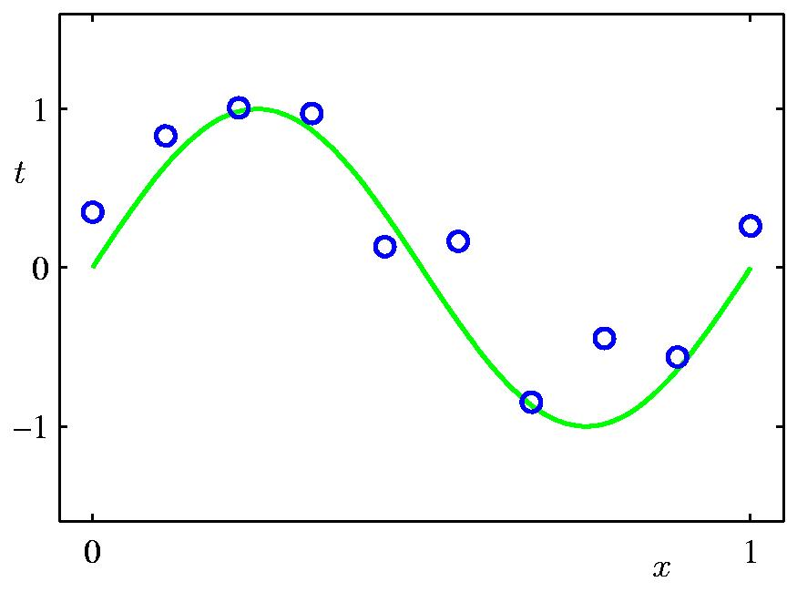
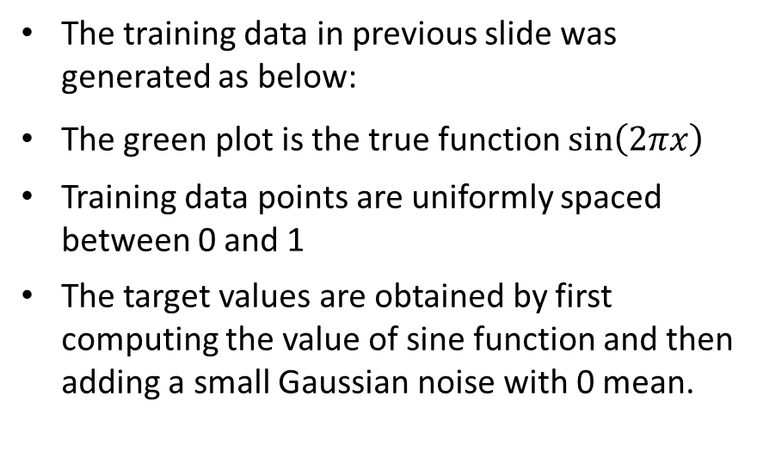
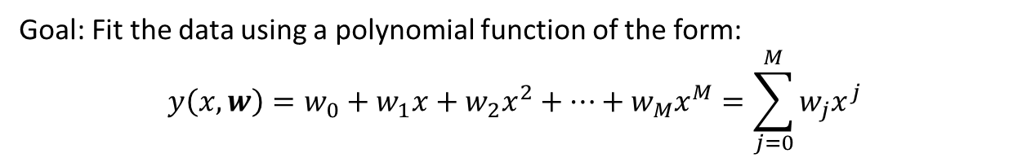
Regression using polynomial curve
The training data in previous slide was generated as below:
The green plot is the true function $\sin\left(2πx\right)$
Training data points are uniformly spaced between 0 and 1
The target values are obtained by first computing the value of sine function and then adding a small Gaussian noise with 0 mean.
Goal: Fit the data using a polynomial function of the form:
$$y\left(x, w\right)=w_{0}+w_{1}x+w_{2}x^{2}+⋯+w_{M}x^{M}=\sum_{j=0}^{M}{w_{j}x^{j}}$$
Model is linear with respect to the parameter w, so this is a linear model. In other words, our hypothesis set contains all linear functions. There is only one hyper-parameter (M), which defines model complexity. w is the tuning parameter.

Slide 12
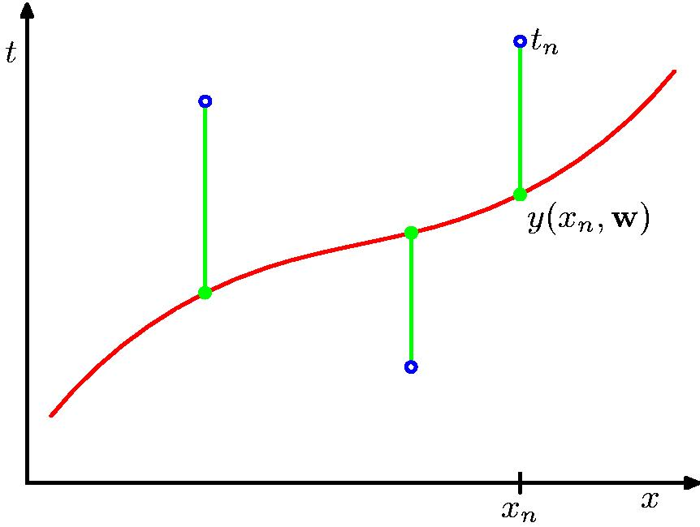
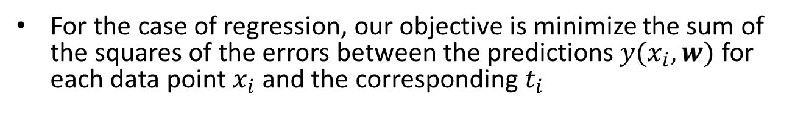
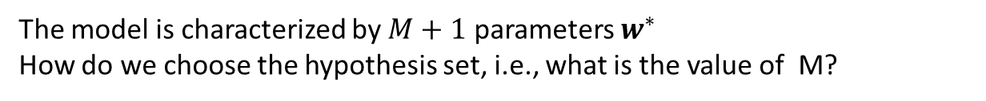
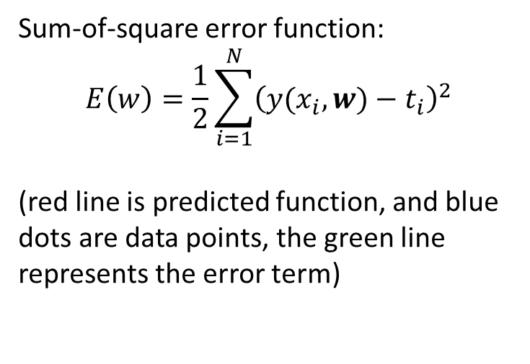
Regression using polynomial curve
For the case of regression, our objective is minimize the sum of the squares of the errors between the predictions $y(x_{i}, w)$ for each data point $x_{i}$ and the corresponding $t_{i}$
Sum-of-square error function:
$$E\left(w\right)=\frac{1}{2}\sum_{i=1}^{N}{{\left(y(x_{i},w)−t_{i}\right)}^{2}}$$
(red line is predicted function, and blue dots are data points, the green line represents the error term)
The model is characterized by $M+1$ parameters $w^{∗}$
How do we choose the hypothesis set, i.e., what is the value of M?

Slide 13
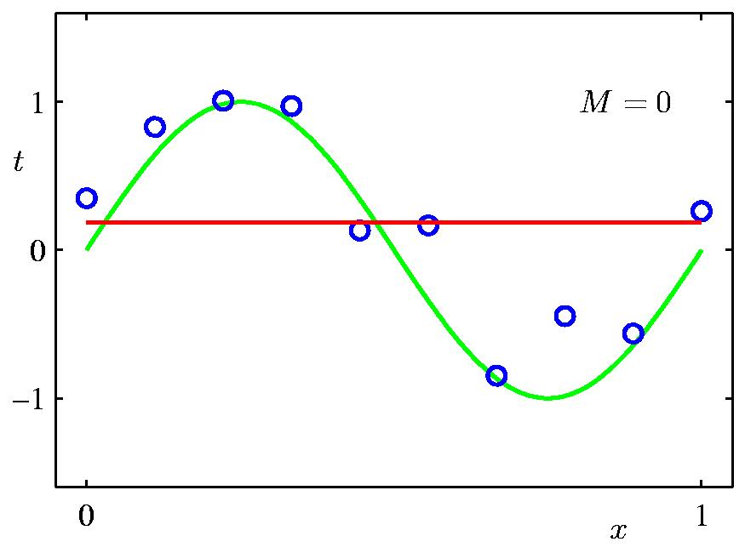
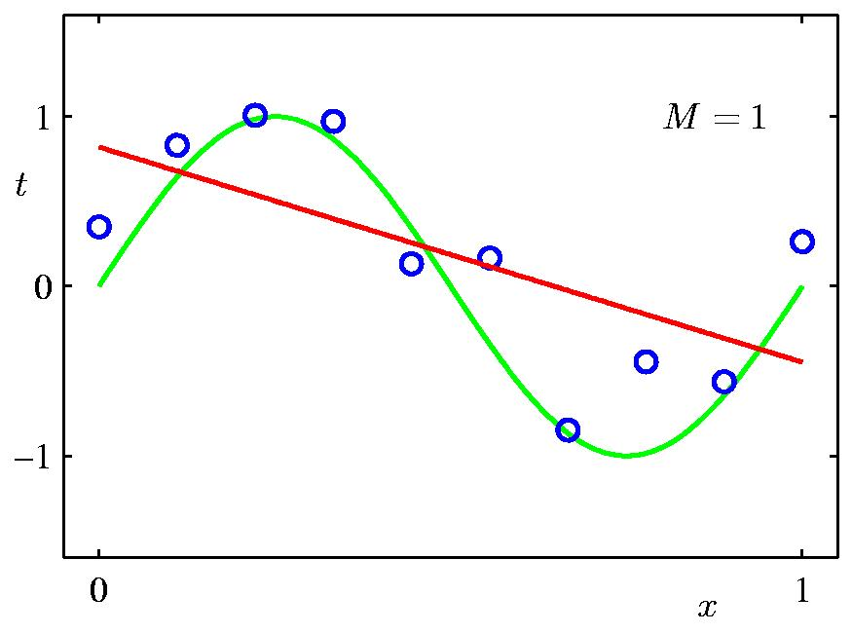
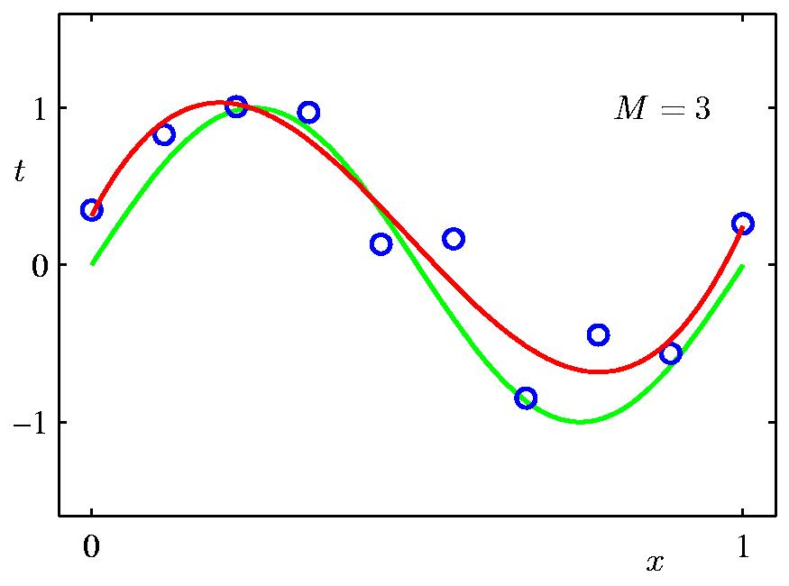
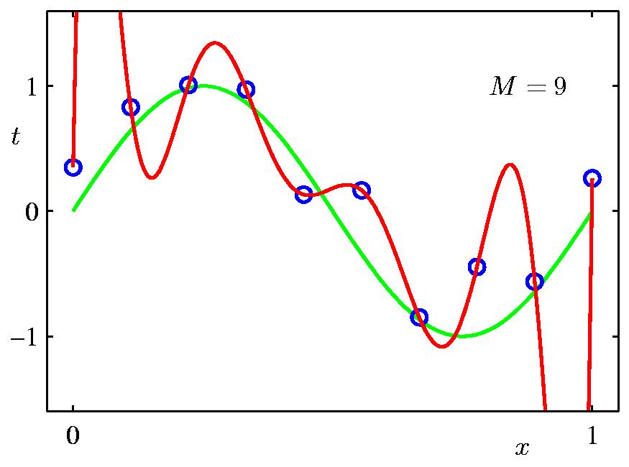
Some fits to the data
Green line is the original sine curve, blue dots are training data, and red line is the predicted polynomial function for different degree (M) of polynomials

Slide 14
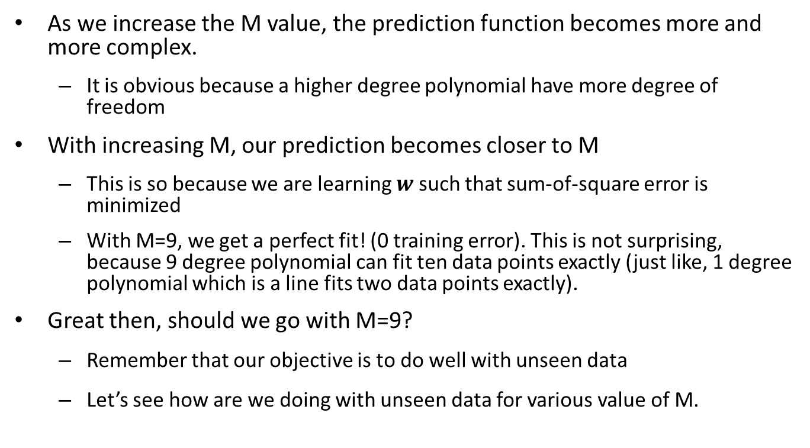
Observations
As we increase the M value, the prediction function becomes more and more complex.
It is obvious because a higher degree polynomial have more degree of freedom
With increasing M, our prediction becomes closer to M
This is so because we are learning $w$ such that sum-of-square error is minimized
With M=9, we get a perfect fit! (0 training error). This is not surprising, because 9 degree polynomial can fit ten data points exactly (just like, 1 degree polynomial which is a line fits two data points exactly).
Great then, should we go with M=9?
Remember that our objective is to do well with unseen data
Let’s see how are we doing with unseen data for various value of M.

Slide 15
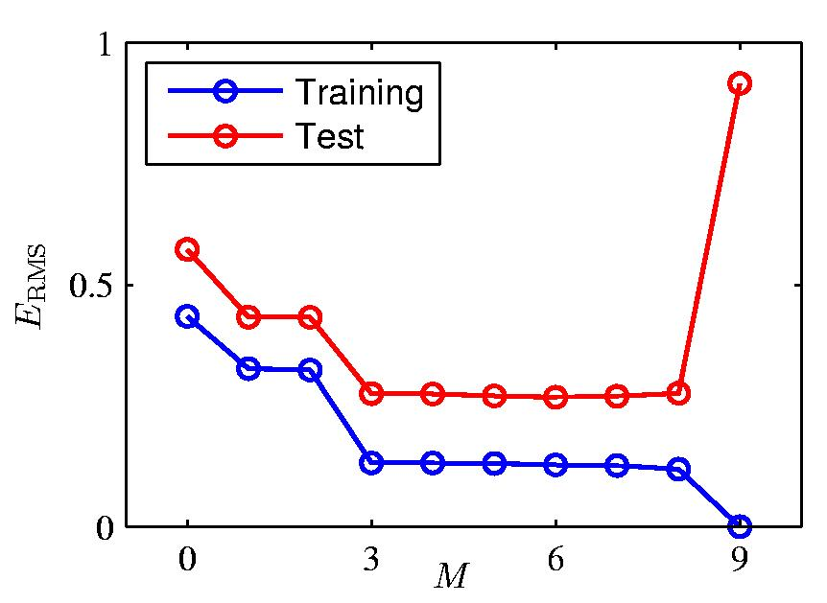
Overfitting
Let’s build a test set containing 100 new data points generated using the same procedure that was used to generate the training data.
For M=9, the training error is zero (see right figure above). 10 equations, and 10 unknowns; can be solved exactly
But, the test error is very large, why?

Slide 16
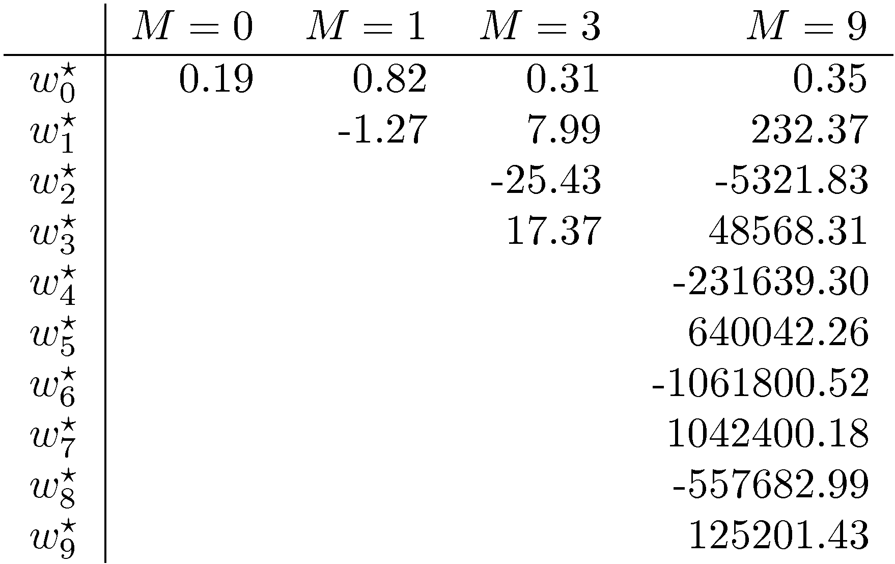
Overfitting (cont.)
As M increases, the magnitude of coefficients gets larger (which makes the wiggly function)
For M=9, the coefficient have become finely tuned to the data
Between data points, the function exhibits large oscillation (why?)
Flexible polynomial with large M value is tuned to the random noise on the target value. This is called overfitting, which we do not want. So, user need to choose the right M using his domain knowledge, in this case a 3 degree polynomial may be sufficient.

