Slide 1
Data Mining (CS 481)
Lecture 1

Slide 2
Course Information
Instructor
Mohammad Al Hasan (Office: SL 277, phone 4-3862), email: alhasan@iupui.edu)
Office Hour: Tuesday 2:30 pm – 3:30 pm
TA
Vachik Dave (email: vsdave@iupui.edu )
Office Hour: TBA
Location: Will be posted on piazza forum
Course web forum
https://piazza.com/iupui/spring2017/cs481/home
To enroll in this course, you must register in this forum
Canvas will be used for assignment submission and grading only. All communication with the instructors/TAs must be made through this forum or by personal email. Message sent through Canvas will not be read.

Slide 3
Textbooks
(ZW) Data Mining and Analysis: Foundations and Algorithms
By Zaki, and Wagner.
Cambridge University Press, 2014
Avilable for free online: http://www.dataminingbook.info/uploads/book.pdf
(TSK) Introduction to Data Mining, by Pang-Ning Tan, Michael Steinbach, and Vipin Kumar
Optional
3 free chapters are available from the book web page (http://www-users.cs.umn.edu/~kumar/dmbook/index.php)
This book has more coverage, you can use it as a reference book

Slide 4
Course Grading
There are total 100 points: at least 5 homeworks (35 points), first midterm exam (15 points), second mid-term exam (15 points), final exam (25 points), in-class and piazza participation (10 points). To pass this course, you need to pass each of the above components.
Final letter grade will be determined based on the following table*.
Grade Category Grade Score Score Required Class Rank
Exceptional A+ > 93 Top 10%
Outstanding A [86, 93) Top 20%
Very Good A- [80, 86) Top 30%
Good B+ [75, 80) Median%
Satisfactory B [70, 75) Lower 40%
Reasonable (Pass) B- [65, 70) Lower 25%
Marginal (Pass) C+, C, C- [50, 65) Lower 10%
Fail F [0, 50)
* Actual grade will be determined using the above table as reference by balancing the score required
and relative class rank factors.

Slide 5
Homeworks
There will be 3 to 4 homeworks
Homeworks are individual works. Students are not allowed to collaborate for solving homework questions.
Homeworks will be on writing Matlab/R/python programs to implement some of the data mining algorithms.
TA will post instruction to set up the necessary software in your laptop, so that you can start your homework on time
Questions on homeworks and their solution should be exclusively posted on piazza web site. TA and instructors will help you generously by answering your questions. However, no questions will be answered within 24 hours of the due date, so you need to start early.

Slide 6
Data Mining Introduction
Data Mining is a field that develops algorithms and tools for analyzing data for knowledge discovery.
The tools should be efficient, and scalable to handle large real-life datasets
The tools should generate actionable knowledge
Data Mining borrows some of the data management concepts from database, and algorithms, and analysis tools from statistics, machine learning, AI, and information retrieval

Slide 7
Data Mining Tasks
Predictive Tasks
Predict the value of a field, from the values of other fields in a record
Examples are classification, regression, and building generative models
Descriptive and Exploratory tasks
Derive patterns (correlations, trends, clusters, anomalies) that summarizes the underlying relationship in data
Find anomalous records

Slide 8
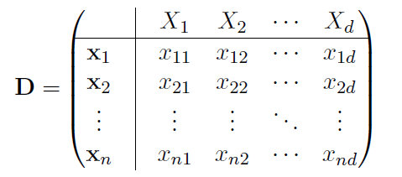
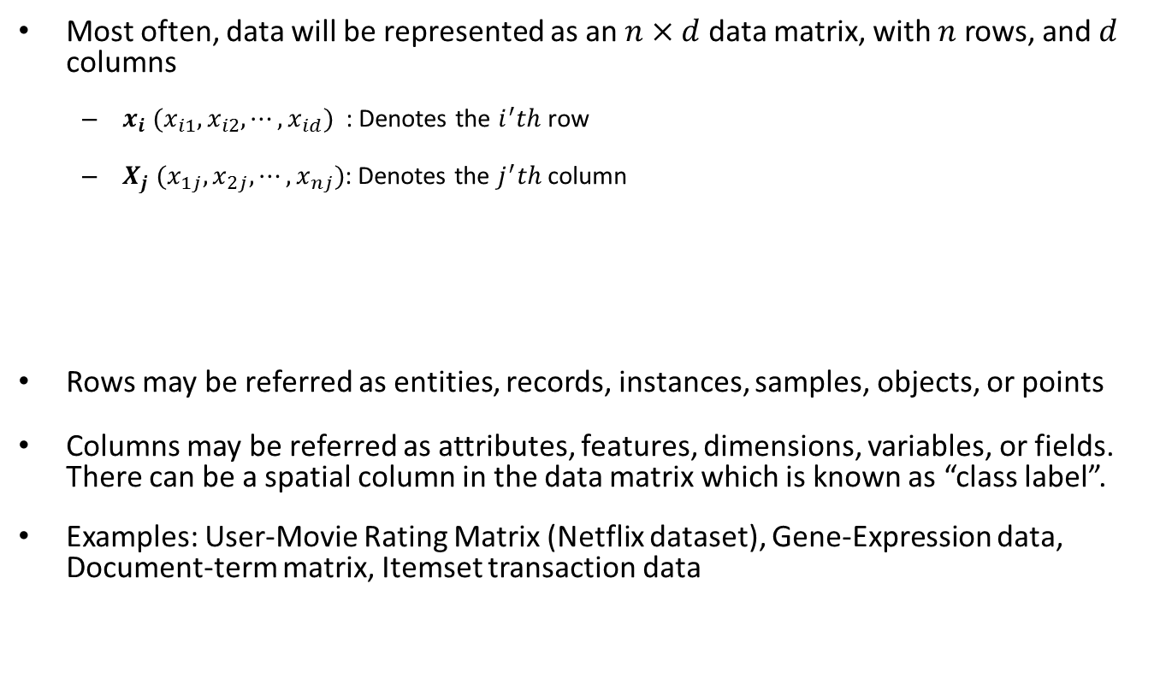
Data
Most often, data will be represented as an $n×d$ data matrix, with $n$ rows, and $d$ columns
$x_{i}$ ${(x}_{i1}, x_{i2}, ⋯, x_{id})$ : Denotes the $i^{′}th$ row
$X_{j}$ $(x_{1j}, x_{2j}, ⋯, x_{nj})$: Denotes the $j^{′}th$ column
Rows may be referred as entities, records, instances, samples, objects, or points
Columns may be referred as attributes, features, dimensions, variables, or fields. There can be a spatial column in the data matrix which is known as “class label”.
Examples: User-Movie Rating Matrix (Netflix dataset), Gene-Expression data, Document-term matrix, Itemset transaction data

Slide 9
Example
Document/Term matrix with a class label
Document | Terms | Class
1 | Dollar, inflation, tax, government, loan, country, market | Finance
2 | Drug, vaccine, flu, cancer, patient, death, health | Medicine
3 | Super bowl, touchdown, wicket, cricket, football, gymnast | Sports
4 | Tax, president, white house, election, issues, domestic, national security | Politics
… | …. | …
… | … | …
… | … | …

Slide 10
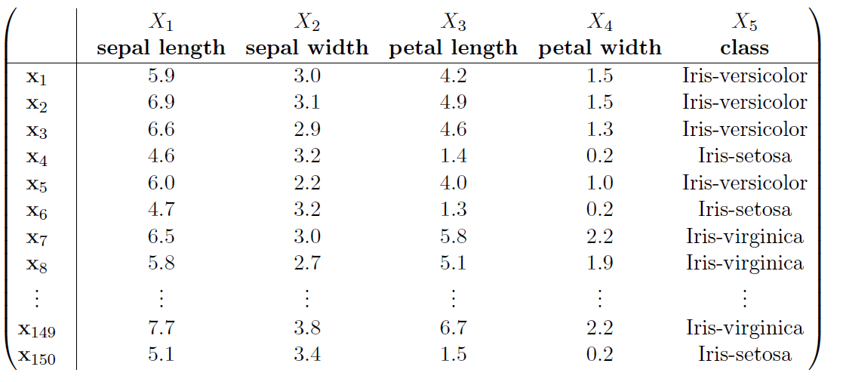
More Examples (Iris dataset)
Extract from Iris Dataset (available from UCI Machine Learning Repository, http://archive.ics.uci.edu/ml/)

Slide 11
Non-Matrix Data
Dataset can be in the form of sequences, graphs, text, time-series, image, video, and so on.
However, many of the above data can be represented as a matrix (or a collection of matrix), so matrix data is the most important
Sometimes matrix data can be represented as a graph by connecting similar instances; in such a graph, the nodes are instances, and the edges represent the relationship between a pair of instances.
Also, some matrix data can be represented as a bi-partite graph, in which one partition contains the rows, and the other partition contains the columns, non-zero entries of the matrix are the edges of the graph which connects the corresponding rows and columns
Such a matrix is called dyadic matrix

Slide 12
Attributes
Categorical Attributes
It has a set-valued domain. For example Sex, and Education. domain(sex) = {M, F}; domain (education) = {HS, BS, MS, PhD}
Nominal
Values are unordered: domain (iris-class) = {iris-setosa, iris-versicolor, iris-virginica}
Only equality comparison is allowed
Ordinal
The attributes are ordered, both equality and inequality comparison are allowed

Slide 13
Attributes (cont.)
Numeric
It has real-valued or integer valued domain. domain (age) = N (set of natural numbers); domain (petal length) = R⁺ ( set of real)
Interval-scaled: Only difference makes sense, such as the “temperature” attribute
Ratio-scaled: Both differences, and ratios between values make sense. Such as, attribute “income”.
If all attributes are numeric, then we can consider each row as a point in the space of real numbers (R^{d})

Slide 14
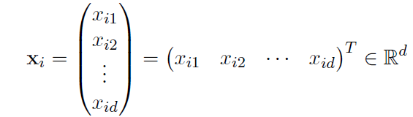
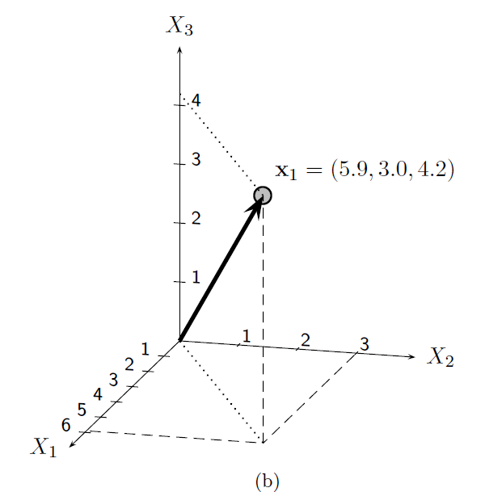
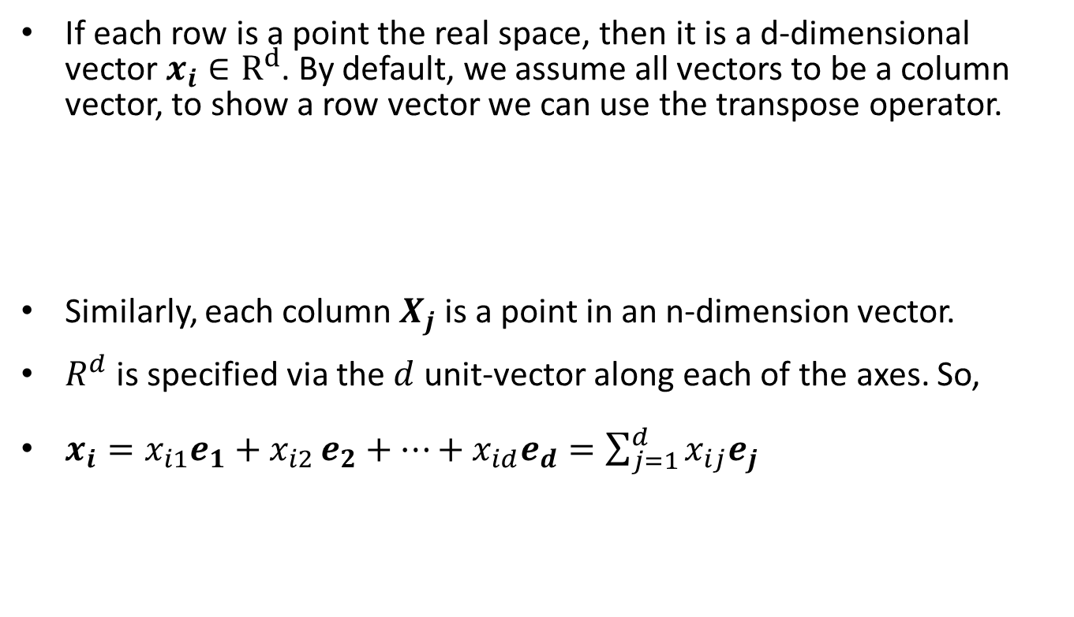
Data: Algebraic View
If each row is a point the real space, then it is a d-dimensional vector $x_{i}∈R^{d}$. By default, we assume all vectors to be a column vector, to show a row vector we can use the transpose operator.
Similarly, each column $X_{j}$ is a point in an n-dimension vector.
$R^{d}$ is specified via the $d$ unit-vector along each of the axes. So,
$x_{i}=x_{i1}e_{1}+x_{i2 }e_{2}+…+x_{id}e_{d}=\sum_{j=1}^{d}{x_{ij}e_{j}}$

Slide 15
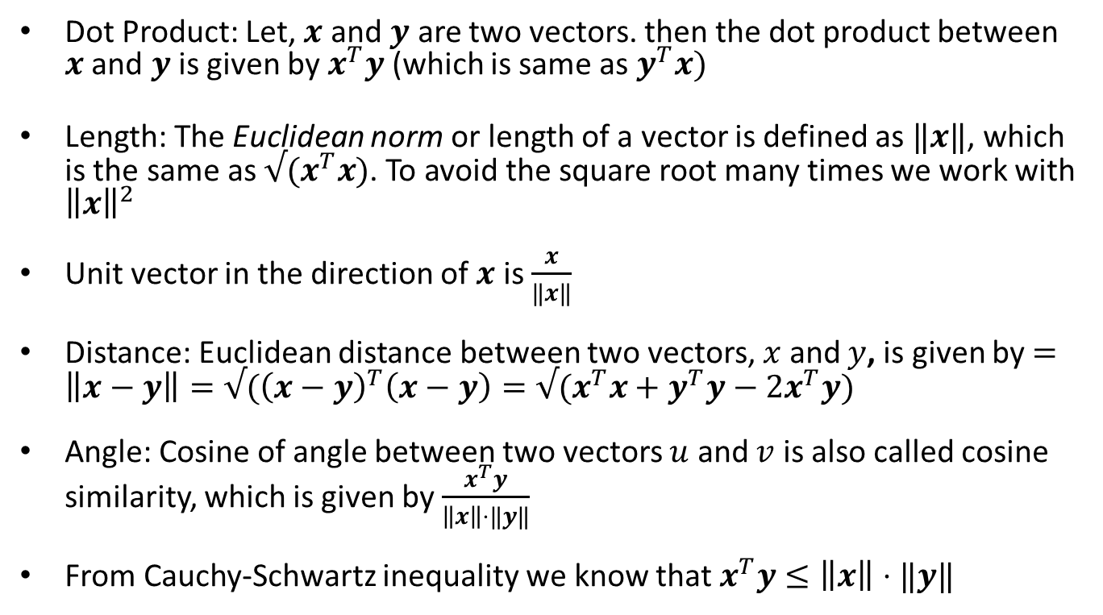
Distance and Angle
Dot Product: Let, $x$ and $y$ are two vectors. then the dot product between $x$ and $y$ is given by $x^{T}y$ (which is same as $y^{T}x)$
Length: The Euclidean norm or length of a vector is defined as $‖x‖$, which is the same as $√(x^{T}x)$. To avoid the square root many times we work with ${\left\|x\right\|}^{2}$
Unit vector in the direction of $x$ is $\frac{x}{‖x‖}$
Distance: Euclidean distance between two vectors, $x$ and $y$, is given by $=\left\|x−y\right\|=√({\left(x−y\right)}^{T}\left(x−y\right)=√(x^{T}x+y^{T}y−2x^{T}y)$
Angle: Cosine of angle between two vectors $u$ and $v$ is also called cosine similarity, which is given by $\frac{x^{T}y}{\left\|x\right\|⋅‖y‖}$
From Cauchy-Schwartz inequality we know that $x^{T}y≤\left\|x\right\|⋅‖y‖$

Slide 16
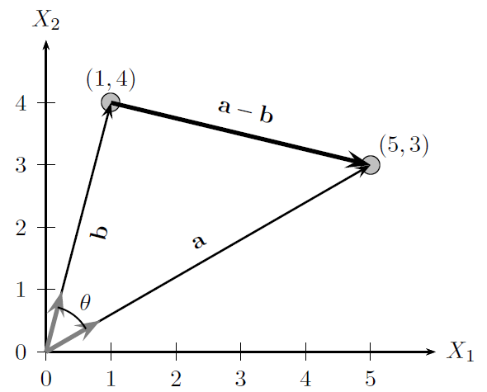

Examples
$a=\left({1 \atop 4}\right), b=\left({5 \atop 3}\right), \left\|a\right\|=√17$, $\left\|b\right\|=√34$
$a−b=\left({−4 \atop 1}\right)$, ${\left(a−b\right)}^{T}\left(a−b\right)=17,$ Distance$\left(a,b\right)=√17$
$cosine\left(a,b\right)=\frac{a^{T}b}{\left\|a\right\|⋅‖b‖}=\frac{17}{\sqrt{17}⋅\sqrt{34}}=\frac{1}{\sqrt{2}}$, so the angle between the vectors is 45 degree

Slide 17
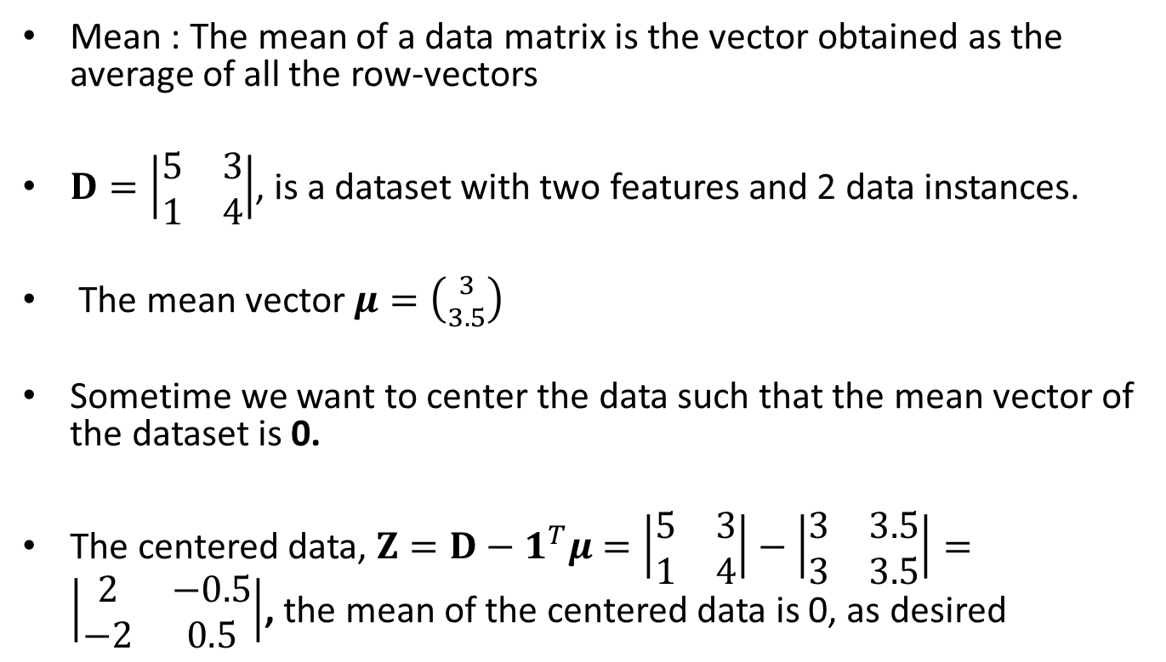
Mean and Total Variance
Mean : The mean of a data matrix is the vector obtained as the average of all the row-vectors
$D=\left|\begin{matrix}5 & 3 \\ 1 & 4\end{matrix}\right|$, is a dataset with two features and 2 data instances.
The mean vector $μ=\left({3 \atop 3.5}\right)$
Sometime we want to center the data such that the mean vector of the dataset is 0.
The centered data, $Z=D−1^{T}μ=\left|\begin{matrix}5 & 3 \\ 1 & 4\end{matrix}\right|−\left|\begin{matrix}3 & 3.5 \\ 3 & 3.5\end{matrix}\right|=\left|\begin{matrix}2 & −0.5 \\ −2 & 0.5\end{matrix}\right|$, the mean of the centered data is 0, as desired

Slide 18

Variance
Variance of a data matrix of size $\left(d×n\right)$ can be computed as below:
Variance $(D)$ =$\frac{1}{n}\sum_{i=1}^{n}{{\left\|x_{i}−μ\right\|}^{2}}$
if the data is centered Variance $(D)$ =$\frac{1}{n}\sum_{i=1}^{n}{{\left\|x_{i}\right\|}^{2}}$
For uncentered data $Var\left(D\right)=\frac{1}{n}\sum_{i=1}^{n}{{\left(x_{i}−μ\right)}^{T}(x_{i}−μ)}$
$$=\frac{1}{n}\sum_{i=1}^{n}{{\left\|x_{i}\right\|}^{2}+μ^{T}μ}−2{\frac{1}{n}μ}^{T}(\sum_{i=0}^{n}{x_{i}) }$$
$$=\frac{1}{n}\sum_{i=1}^{n}{{\left\|x_{i}\right\|}^{2}+μ^{T}μ}−\frac{2μ^{T}}{n}⋅nμ$$
$$=\frac{1}{n}\sum_{i=1}^{n}{{\left\|x_{i}\right\|}^{2}+μ^{T}μ}−2μ^{T}μ$$
$$=\frac{1}{n}\sum_{i=1}^{n}{{\left\|x_{i}\right\|}^{2}−μ^{T}μ}$$

Slide 19
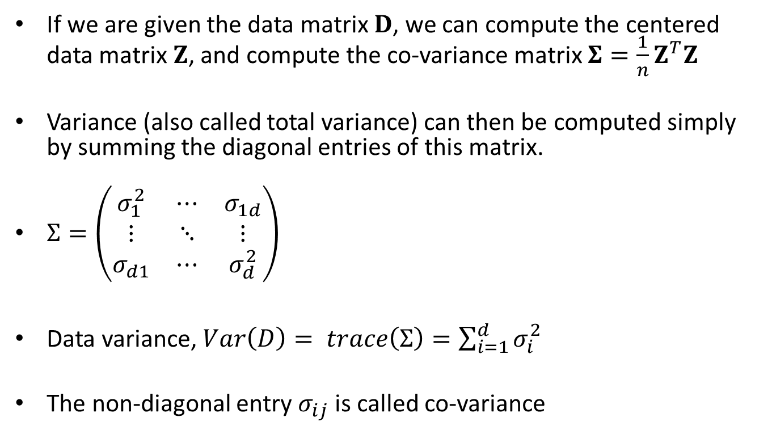
Different ways to compute data variances
If we are given the data matrix $D$, we can compute the centered data matrix $Z$, and compute the co-variance matrix $Σ=\frac{1}{n}Z^{T}Z$
Variance (also called total variance) can then be computed simply by summing the diagonal entries of this matrix.
$Σ=\left(\begin{matrix}σ_{1}^{2} & ⋯ & σ_{1d} \\ ⋮ & ⋱ & ⋮ \\ σ_{d1} & ⋯ & σ_{d}^{2}\end{matrix}\right)$
Data variance, $Var\left(D\right)= trace\left(Σ\right)=\sum_{i=1}^{d}{σ_{i}^{2}}$
The non-diagonal entry $σ_{ij}$ is called co-variance

Slide 20
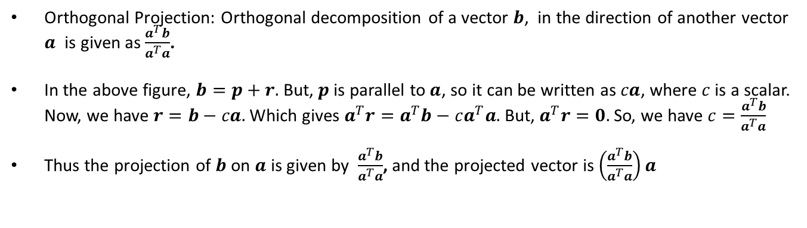
Projection
Orthogonal Projection: Orthogonal decomposition of a vector $b$, in the direction of another vector $a$ is given as $\frac{a^{T}b}{a^{T}a}$.
In the above figure, $b=p+r.$ But, $p$ is parallel to $a$, so it can be written as $ca$, where $c$ is a scalar. Now, we have $r=b−ca.$Which gives $a^{T}r=a^{T}b−ca^{T}a.$ But, $a^{T}r=0.$So, we have $c=\frac{a^{T}b}{a^{T}a}$
Thus the projection of $b$ on $a$ is given by $\frac{a^{T}b}{a^{T}a}$, and the projected vector is $\left(\frac{a^{T}b}{a^{T}a}\right)a$

Slide 21
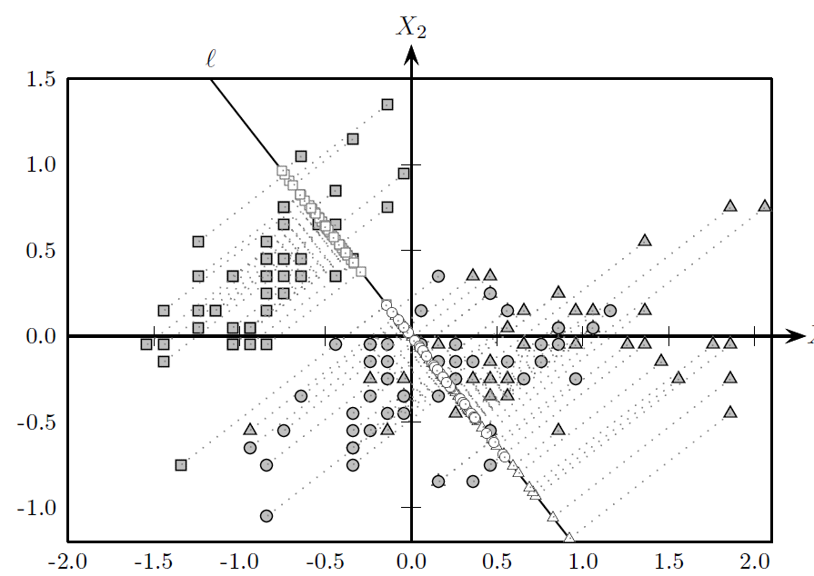
Projection Example
Projecting the centered data (first two dimension of iris data) on a line that maximizes the separation. The process of finding this line is known as Linear Discriminant Analysis

Slide 22
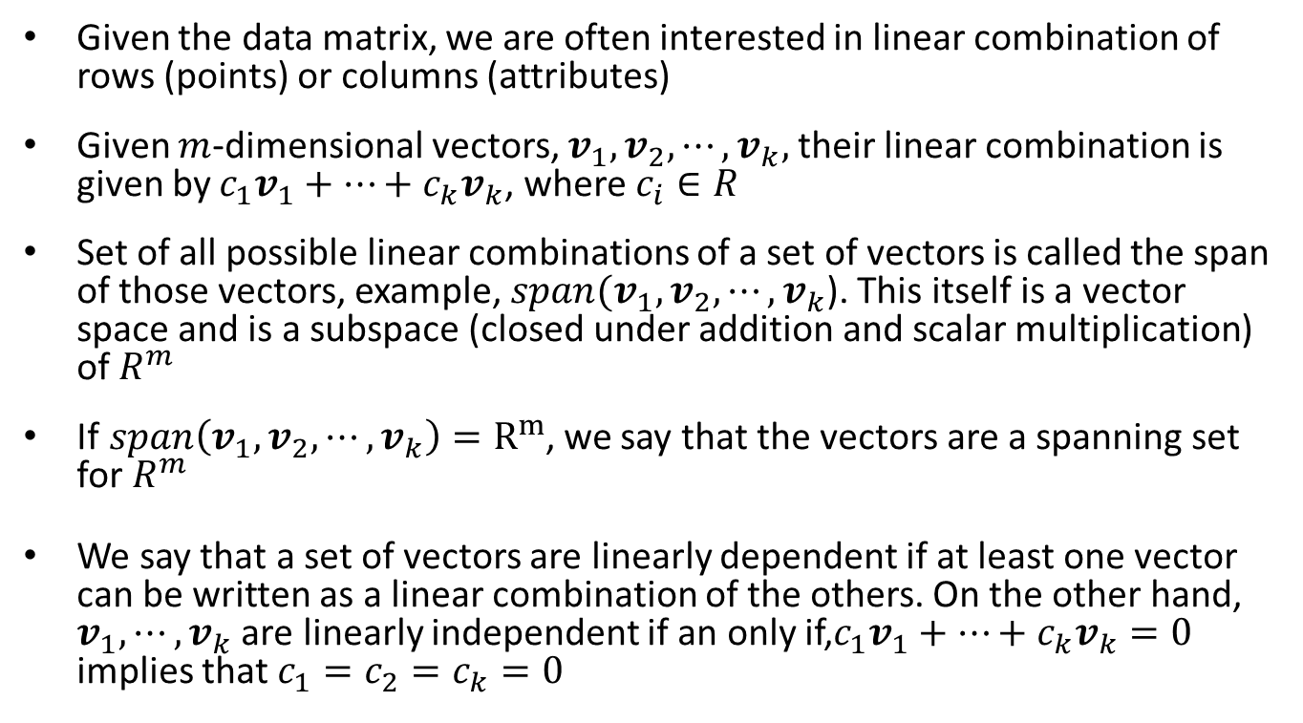
Linear Independence
Given the data matrix, we are often interested in linear combination of rows (points) or columns (attributes)
Given $m$-dimensional vectors, $v_{1}, v_{2},⋯, v_{k},$their linear combination is given by $c_{1}v_{1}+⋯+c_{k}v_{k}$, where $c_{i}∈R$
Set of all possible linear combinations of a set of vectors is called the span of those vectors, example, $span(v_{1}, v_{2},⋯, v_{k}$). This itself is a vector space and is a subspace (closed under addition and scalar multiplication) of $R^{m}$
If$span\left(v_{1}, v_{2},⋯, v_{k}\right)=R^{m}$, we say that the vectors are a spanning set for $R^{m}$
We say that a set of vectors are linearly dependent if at least one vector can be written as a linear combination of the others. On the other hand, $v_{1},⋯, v_{k}$ are linearly independent if an only if,$c_{1}v_{1}+⋯+c_{k}v_{k}=0$ implies that $c_{1}=c_{2}=c_{k}=0$

Slide 23
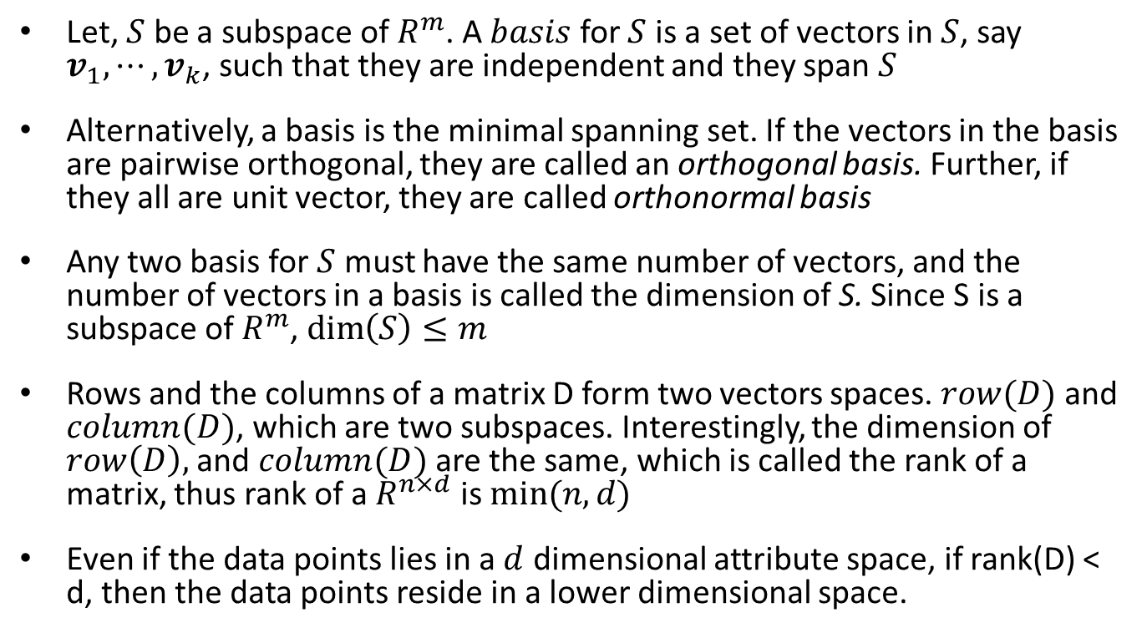
Dimensionality of a Matrix
Let, $S$ be a subspace of $R^{m}$. A $basis$ for $S$ is a set of vectors in $S$, say $v_{1},⋯, v_{k}$, such that they are independent and they span $S$
Alternatively, a basis is the minimal spanning set. If the vectors in the basis are pairwise orthogonal, they are called an orthogonal basis. Further, if they all are unit vector, they are called orthonormal basis
Any two basis for $S$ must have the same number of vectors, and the number of vectors in a basis is called the dimension of S. Since S is a subspace of $R^{m}$, $\dim\left(S\right)≤m$
Rows and the columns of a matrix D form two vectors spaces. $row(D)$ and $column(D)$, which are two subspaces. Interestingly, the dimension of $row\left(D\right),$ and $column(D)$ are the same, which is called the rank of a matrix, thus rank of a $R^{n×d}$ is $min⁡(n, d)$
Even if the data points lies in a $d$ dimensional attribute space, if rank(D) < d, then the data points reside in a lower dimensional space.

Slide 24
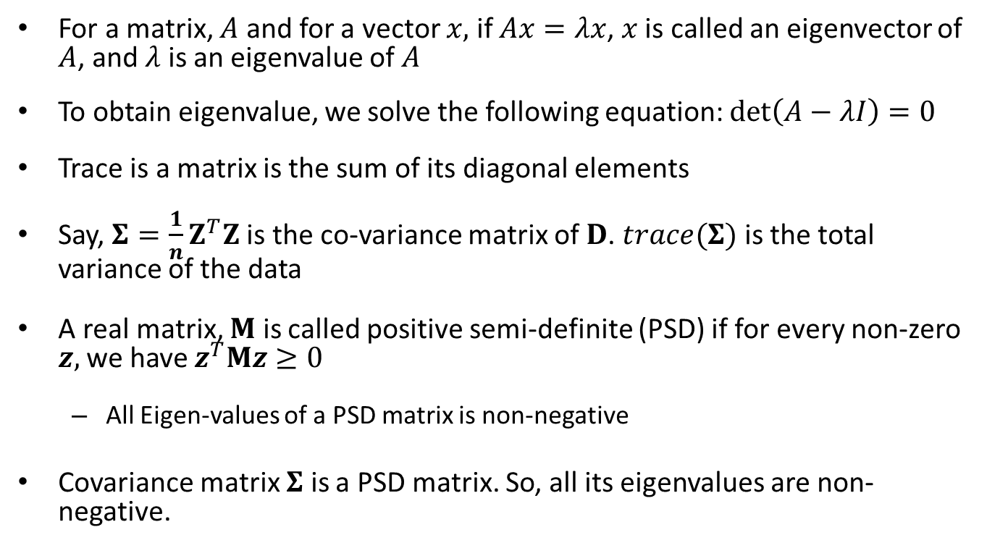
Eigenvalue, Eigenvector, trace
For a matrix, $A$ and for a vector $x,$ if $Ax=λx$, $x$ is called an eigenvector of $A$, and $λ$ is an eigenvalue of $A$
To obtain eigenvalue, we solve the following equation: $\det\left(A−λI\right)=0$
Trace is a matrix is the sum of its diagonal elements
Say, ${Σ=\frac{1}{n}Z}^{T}Z$ is the co-variance matrix of $D$. $trace(Σ)$ is the total variance of the data
A real matrix, $M$ is called positive semi-definite (PSD) if for every non-zero $z,$we have $z^{T}Mz≥0$
All Eigen-values of a PSD matrix is non-negative
Covariance matrix $Σ$ is a PSD matrix. So, all its eigenvalues are non-negative.

Slide 25
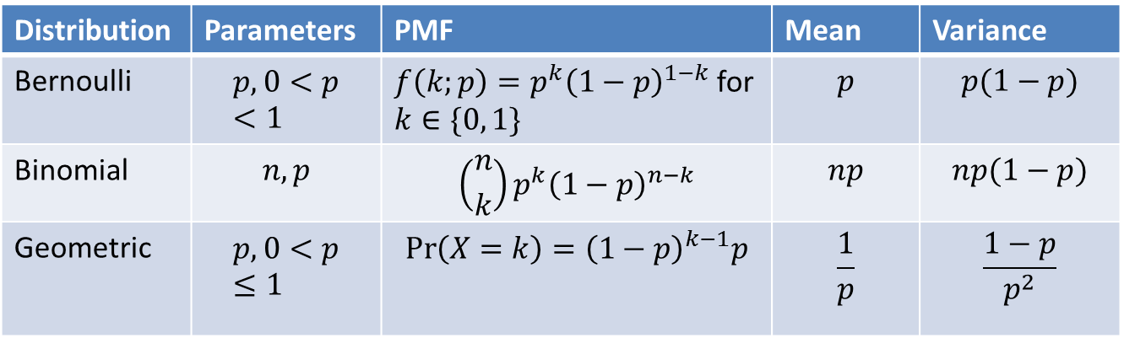
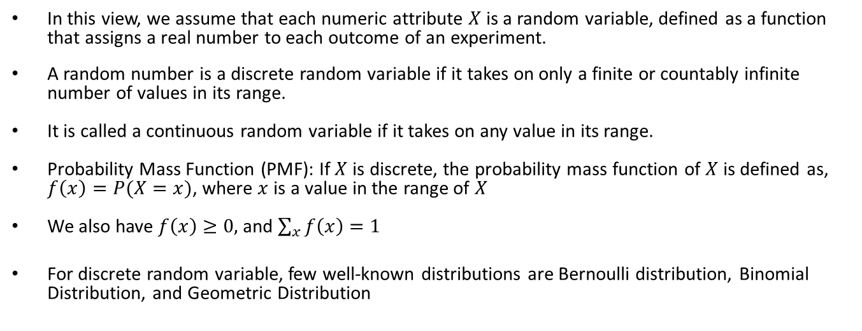
Probabilistic view
In this view, we assume that each numeric attribute $X$ is a random variable, defined as a function that assigns a real number to each outcome of an experiment.
A random number is a discrete random variable if it takes on only a finite or countably infinite number of values in its range.
It is called a continuous random variable if it takes on any value in its range.
Probability Mass Function (PMF): If $X$ is discrete, the probability mass function of $X$ is defined as, $f\left(x\right)=P(X=x)$, where $x$ is a value in the range of $X$
We also have $f\left(x\right)≥0,$ and $\sum_{x}{f\left(x\right)=1}$
For discrete random variable, few well-known distributions are Bernoulli distribution, Binomial Distribution, and Geometric Distribution
Distribution | Parameters | PMF | Mean | Variance
Bernoulli | $$p, 0<p<1$$ | $f\left(k;p\right)=p^{k}{\left(1−p\right)}^{1−k}$ for $k∈\{0, 1\}$ | $$p$$ | $$p(1−p)$$
Binomial | $$n, p$$ | $$\left({n \atop k}\right)p^{k}{\left(1−p\right)}^{n−k}$$ | $$np$$ | $$np(1−p)$$
Geometric | $$p, 0<p≤1$$ | $$\operatorname{Pr}\left(X=k\right)={\left(1−p\right)}^{k−1}p$$ | $$\frac{1}{p}$$ | $$\frac{1−p}{p^{2}}$$

Slide 26
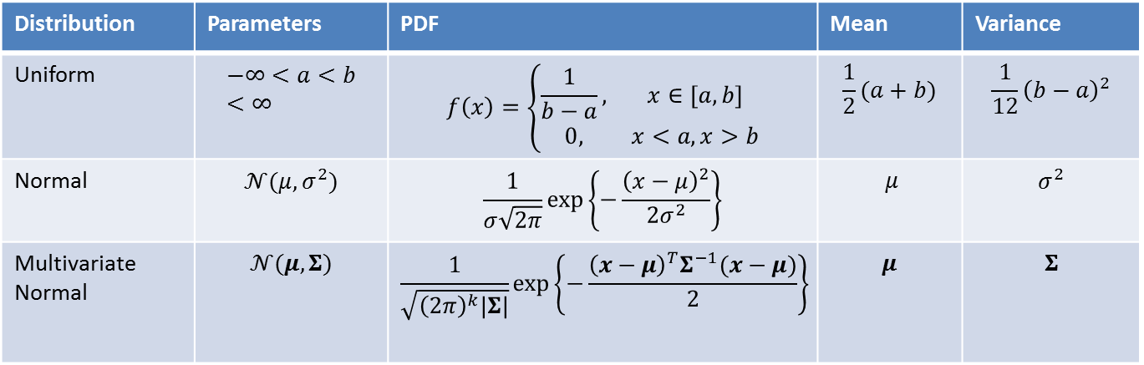
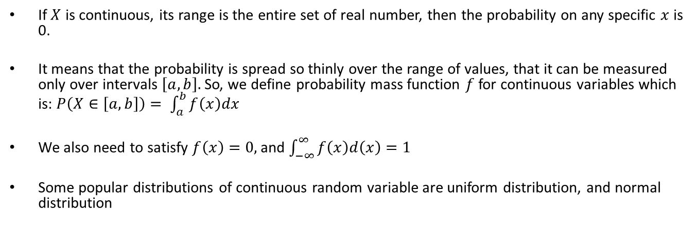
Probability Density Function (PDF)
If $X$ is continuous, its range is the entire set of real number, then the probability on any specific $x$ is 0.
It means that the probability is spread so thinly over the range of values, that it can be measured only over intervals $\left[a, b\right].$ So, we define probability mass function $f$for continuous variables which is: $P\left(X∈\left[a, b\right]\right)= \int_{a}^{b}{f\left(x\right)dx}$
We also need to satisfy $f\left(x\right)=0,$and $\int_{−∞}^{∞}{f\left(x\right)d\left(x\right)=1}$
Some popular distributions of continuous random variable are uniform distribution, and normal distribution
Distribution | Parameters | PDF | Mean | Variance
Uniform | $$−∞<a<b<∞$$ | $$f\left(x\right)=\left\{\begin{matrix}\frac{1}{b−a}, & x∈[a, b] \\ 0, & x<a, x>b\end{matrix}\right.$$ | $$\frac{1}{2}(a+b)$$ | $$\frac{1}{12}{\left(b−a\right)}^{2}$$
Normal | $$𝒩(μ, σ^{2})$$ | $$\frac{1}{σ\sqrt{2π}}\exp\left\{−\frac{{\left(x−μ\right)}^{2}}{2σ^{2}}\right\}$$ | $μ$ | $$σ^{2}$$
Multivariate Normal | $$𝒩(μ, Σ)$$ | $$\frac{1}{\sqrt{{\left(2π\right)}^{k}|Σ|}}\exp\left\{−\frac{{\left(x−μ\right)}^{T}Σ^{−1}(x−μ)}{2}\right\}$$ | $$μ$$ | $$Σ$$

Slide 27
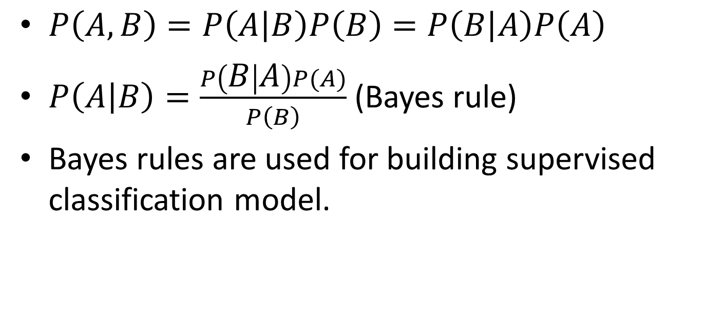
Baye’s Theorem
$P\left(A, B\right)=P\left(A | B\right)P\left(B\right)=P\left(B | A\right)P\left(A\right)$
$P\left(A | B\right)=\frac{P\left(B | A\right)P(A)}{P\left(B\right)}$ (Bayes rule)
Bayes rules are used for building supervised classification model.

