Slide 1
Density based Clustering
Chapter 15

Slide 2
Introduction
The clustering methods, like k-Means, or EM are suitable for finding ellipsoid-shaped clusters, or at best convex clusters
For non-convex clusters these methods have trouble finding the true clusters, as for non-convex situation two points from different clusters may be closer than two points in the same cluster
The density-based clusters that we consider in this chapter are able to mine such non-convex clusters
Note that hierarchical clustering with single-link cluster merging criterion can also find non-convex clusters, but they are sensitive to noises, so does not really works in many real-life scenarios

Slide 3
Example Dataset
The dataset has 9 clusters

Slide 4
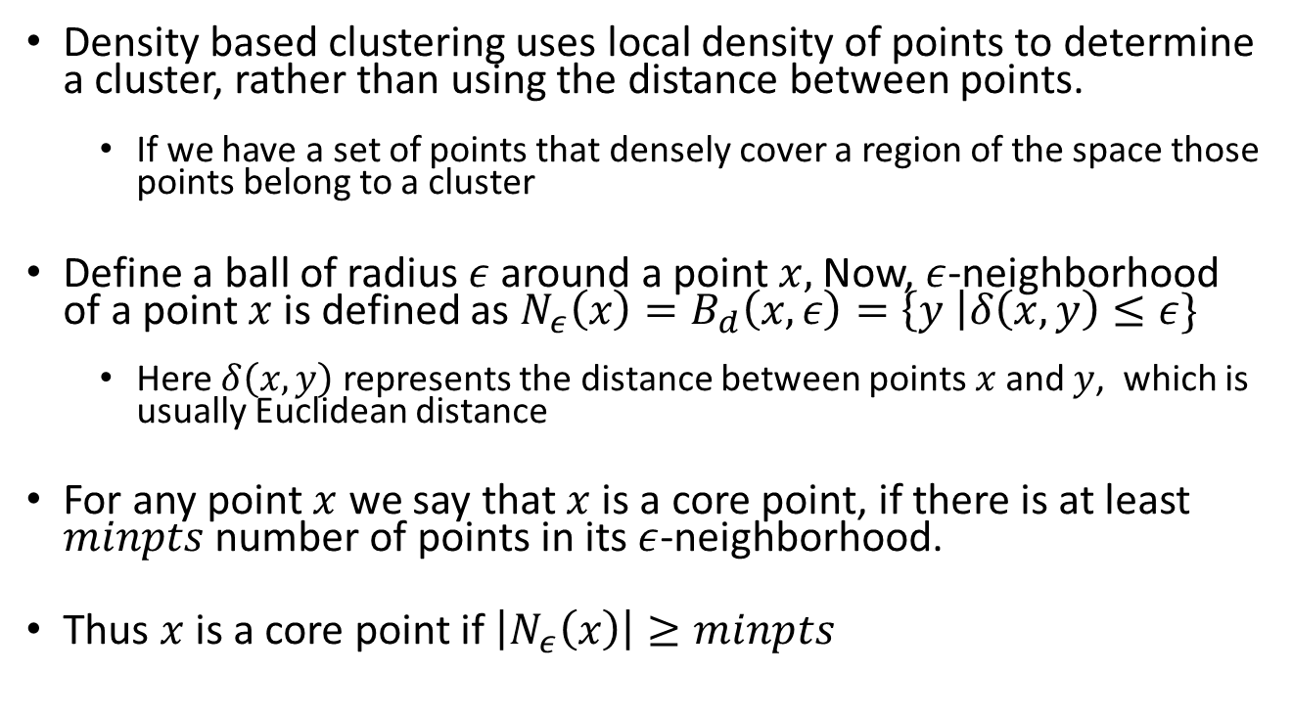
DBSCAN Algorithm
Density based clustering uses local density of points to determine a cluster, rather than using the distance between points.
If we have a set of points that densely cover a region of the space those points belong to a cluster
Define a ball of radius $ε$ around a point $x,$Now, $ε$-neighborhood of a point $x$ is defined as $N_{ε}\left(x\right)=B_{d}\left(x, ε\right)=\left\{y \right|δ\left(x, y\right)≤ε\}$
Here $δ\left(x,y\right)$ represents the distance between points $x$ and $y$, which is usually Euclidean distance
For any point $x$ we say that $x$ is a core point, if there is at least $minpts$ number of points in its $ε$-neighborhood.
Thus $x$ is a core point if $\left|N_{ε}\left(x\right)\right|≥minpts$

Slide 5
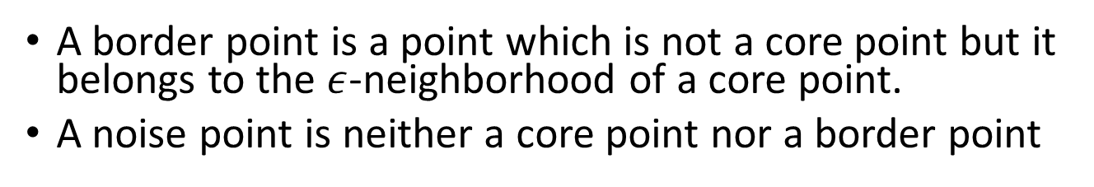
DBSCAN (cont.)
A border point is a point which is not a core point but it belongs to the $ε$-neighborhood of a core point.
A noise point is neither a core point nor a border point
x is a core point, y is a border point, and z is a noise point (minpts=6 is assumed)

Slide 6
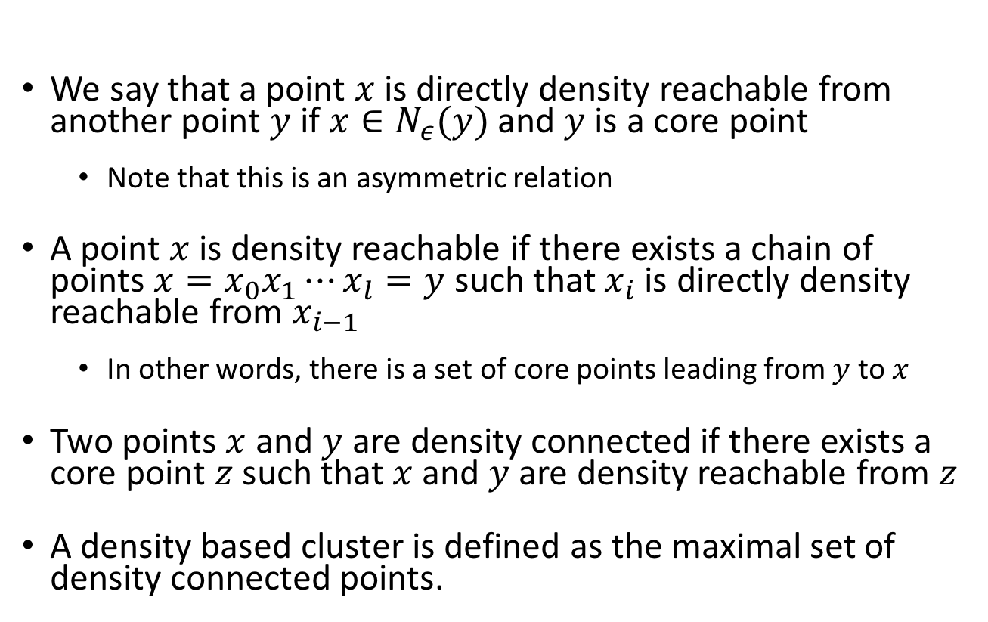
Density reachability
We say that a point $x$is directly density reachable from another point $y$ if $x∈N_{ε}(y)$ and $y$ is a core point
Note that this is an asymmetric relation
A point $x$ is density reachable if there exists a chain of points $x=x_{0}x_{1}⋯x_{l}=y$ such that $x_{i}$ is directly density reachable from $x_{i−1}$
In other words, there is a set of core points leading from $y$ to $x$
Two points $x$ and $y$ are density connected if there exists a core point $z$ such that $x$ and $y$ are density reachable from $z$
A density based cluster is defined as the maximal set of density connected points.

Slide 7
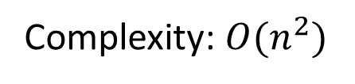
DBSCAN Algorithm
Complexity: $O(n^{2})$

Slide 8
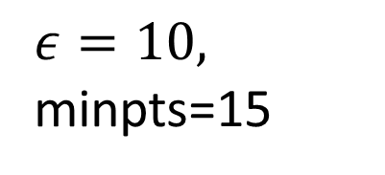
Example
$ε=10,$ minpts=15
Cluster quality depends on the choice of parameters
Does not work well if the clusters have non-uniform density

Slide 9
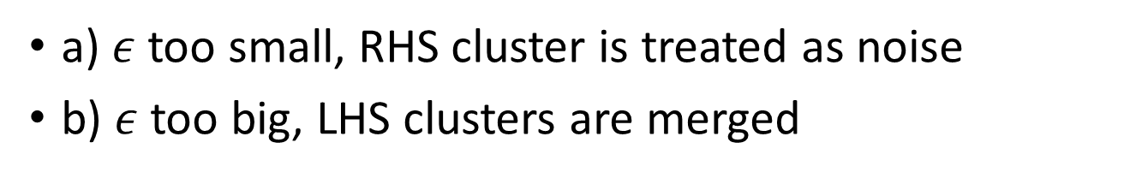
DBSCAN parameter isssues
a) $ε$ too small, RHS cluster is treated as noise
b) $ε$ too big, LHS clusters are merged

