Slide 1
Clustering Validation
Chapter 17

Slide 2
Introduction
Clustering is an unsupervised task, so generally:
We don’t know what is the right number of clusters
We don’t even know whether the data matrix has any clustering tendency
Even if data has clustering tendency, we do not know what kind of similarity assumption we should assume for the clustering task
However, if we know any of the above, we should use that in our clustering task
There are three tasks
Clustering tendency assessment (test whether data has clusters)
Clustering evaluation (test goodness of clustering)
Clustering stability (test parameter sensitivity of clustering)

Slide 3
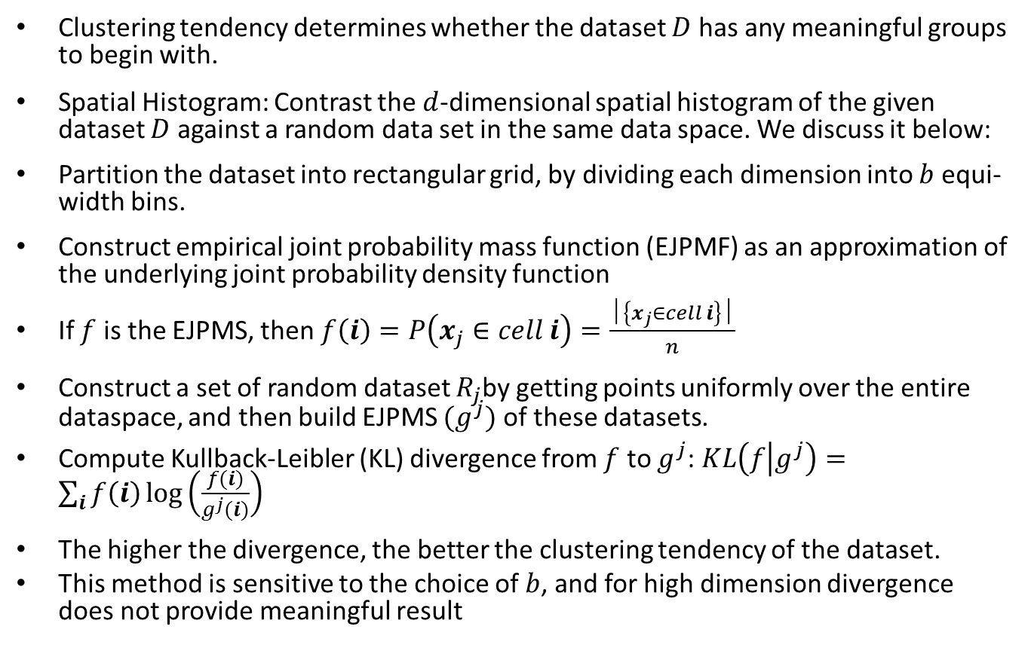
Clustering Tendency
Clustering tendency determines whether the dataset $D$ has any meaningful groups to begin with.
Spatial Histogram: Contrast the $d$-dimensional spatial histogram of the given dataset $D$ against a random data set in the same data space. We discuss it below:
Partition the dataset into rectangular grid, by dividing each dimension into $b$ equi-width bins.
Construct empirical joint probability mass function (EJPMF) as an approximation of the underlying joint probability density function
If $f$ is the EJPMS, then $f\left(i\right)=P\left(x_{j}∈cell i\right)=\frac{│\left\{x_{j}∈cell i\right\}│}{n}$
Construct a set of random dataset $R_{j}$by getting points uniformly over the entire dataspace, and then build EJPMS ${(g}^{j})$ of these datasets.
Compute Kullback-Leibler (KL) divergence from $f$ to $g^{j}$: $KL\left(f | g^{j}\right)=\sum_{i}{f\left(i\right)\log\left(\frac{f(i)}{g^{j}(i)}\right)}$
The higher the divergence, the better the clustering tendency of the dataset.
This method is sensitive to the choice of $b$, and for high dimension divergence does not provide meaningful result

Slide 4
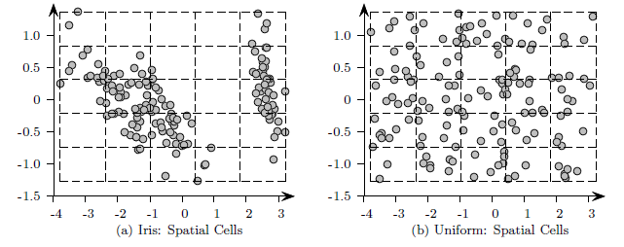
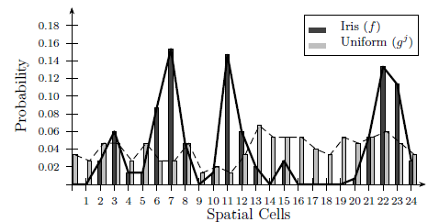
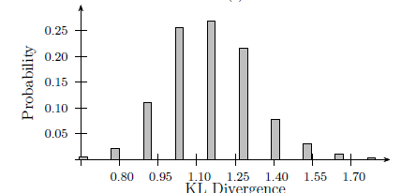
Example

Slide 5
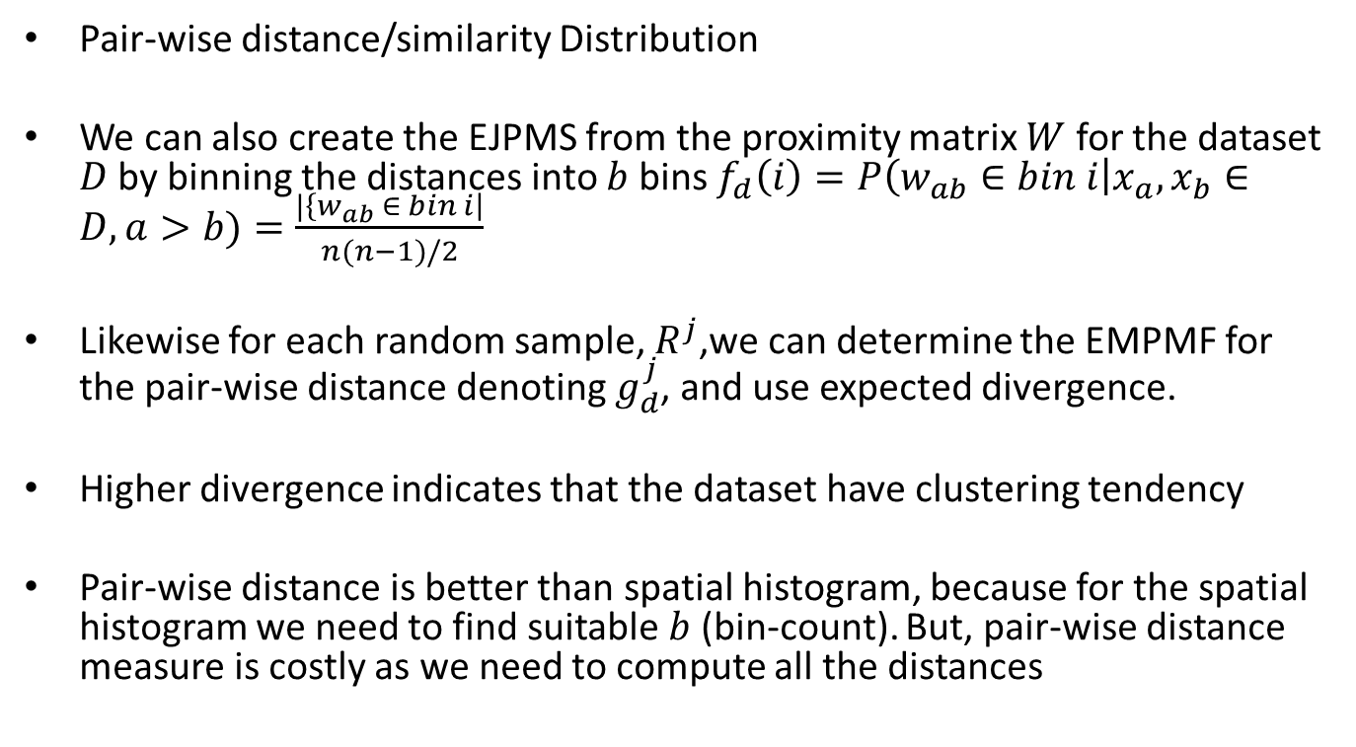
Clustering tendency
Pair-wise distance/similarity Distribution
We can also create the EJPMS from the proximity matrix $W$ for the dataset $D$ by binning the distances into $b$ bins $f_{d}\left(i\right)=P\left(w_{ab}∈bin i\right|x_{a},x_{b}∈D, a>b)=\frac{|\left\{w_{ab} ∈ bin i\right|}{n(n−1)/2}$
Likewise for each random sample, $R^{j}$,we can determine the EMPMF for the pair-wise distance denoting $g_{d}^{j}$, and use expected divergence.
Higher divergence indicates that the dataset have clustering tendency
Pair-wise distance is better than spatial histogram, because for the spatial histogram we need to find suitable $b$ (bin-count). But, pair-wise distance measure is costly as we need to compute all the distances

Slide 6
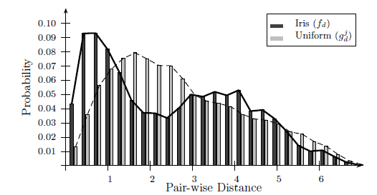
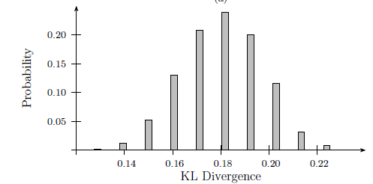
Example

Slide 7
Clustering evaluation
Evaluate the goodness of clustering
External: Uses criteria that is not inherent to the dataset
Internal: Uses criteria that is derived from data itself
Relative: Directly compare different clustering, using different parameter settings for the same algorithm.

Slide 8
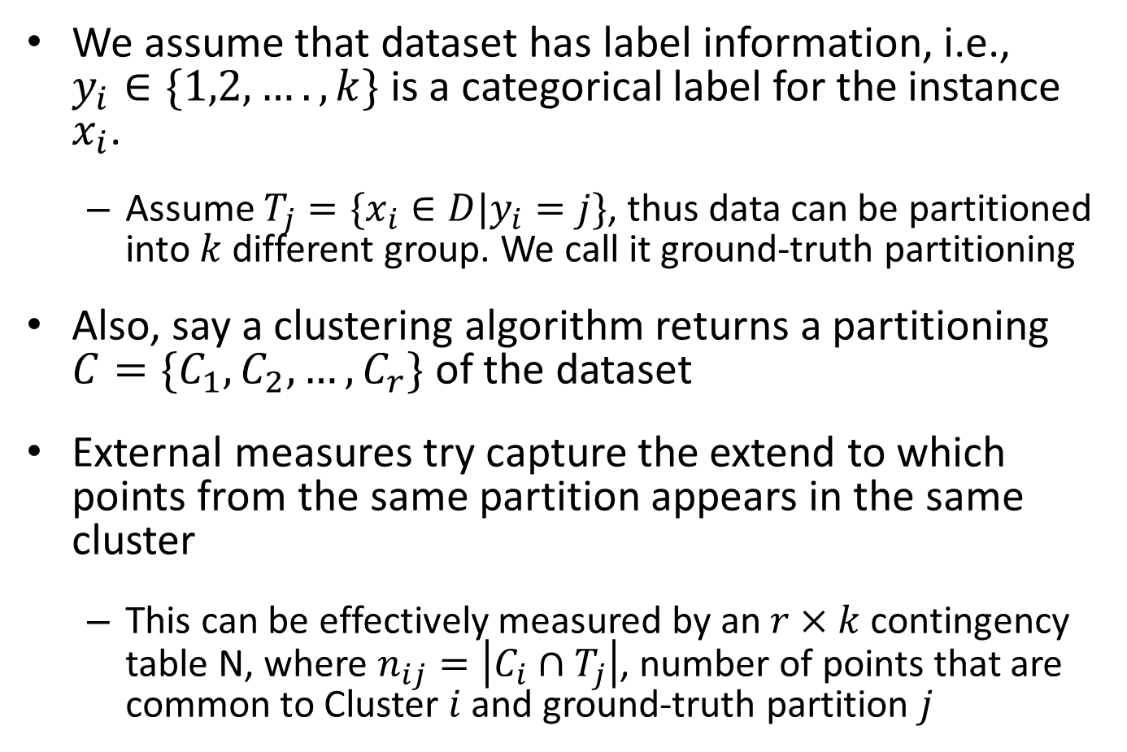
External Clustering Evaluation
We assume that dataset has label information, i.e., $y_{i}∈\{1,2,…., k\}$ is a categorical label for the instance $x_{i}$.
Assume $T_{j}=\{x_{i}∈D|y_{i}=j\}$, thus data can be partitioned into $k$ different group. We call it ground-truth partitioning
Also, say a clustering algorithm returns a partitioning $C=\{C_{1},C_{2},…, C_{r}\}$ of the dataset
External measures try capture the extend to which points from the same partition appears in the same cluster
This can be effectively measured by an $r×k$ contingency table N, where $n_{ij}=\left|C_{i}∩T_{j}\right|$, number of points that are common to Cluster $i$ and ground-truth partition $j$

Slide 9
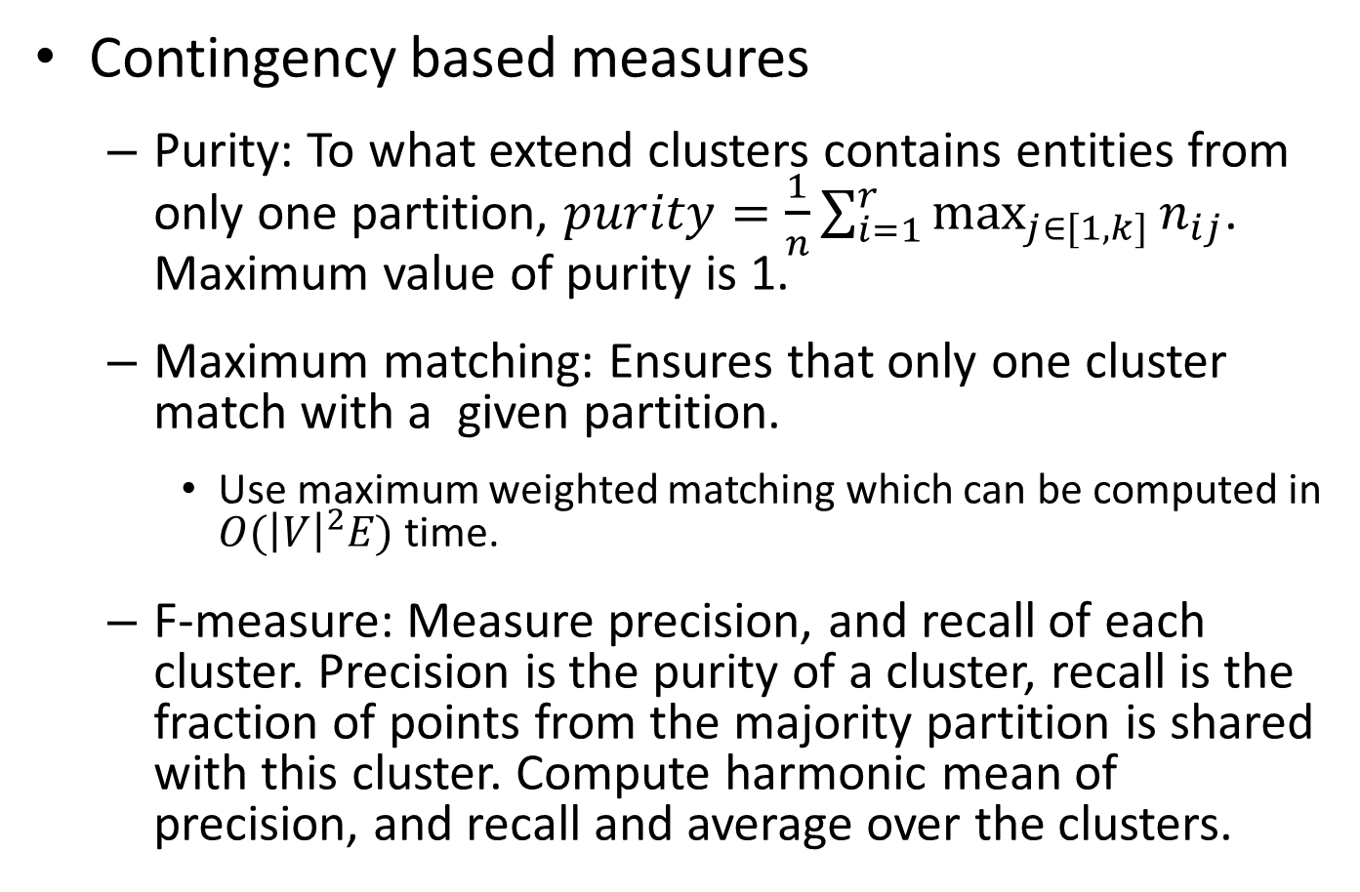
Clustering Evaluation
Contingency based measures
Purity: To what extend clusters contains entities from only one partition, $purity=\frac{1}{n}\sum_{i=1}^{r}{\max_{j∈[1,k]}{n_{ij}}}$. Maximum value of purity is 1.
Maximum matching: Ensures that only one cluster match with a given partition.
Use maximum weighted matching which can be computed in $O({\left|V\right|}^{2}E)$ time.
F-measure: Measure precision, and recall of each cluster. Precision is the purity of a cluster, recall is the fraction of points from the majority partition is shared with this cluster. Compute harmonic mean of precision, and recall and average over the clusters.

Slide 10
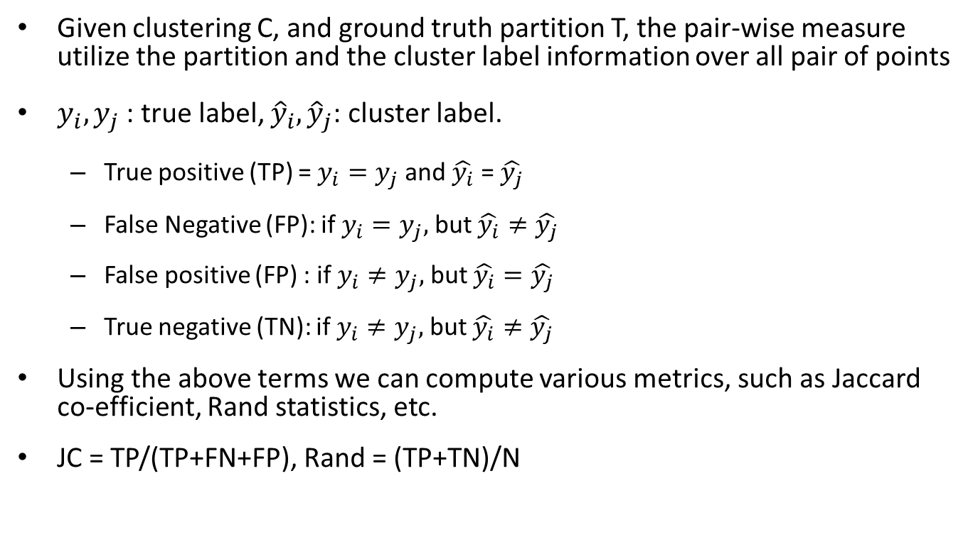
Pair-wise measures
Given clustering C, and ground truth partition T, the pair-wise measure utilize the partition and the cluster label information over all pair of points
$y_{i}, y_{j}$ : true label, ${\hat{y}}_{i},{\hat{y}}_{j}$: cluster label.
True positive (TP) = $y_{i}=y_{j}$ and $\hat{y_{i}}$ = $\hat{y_{j}}$
False Negative (FP): if $y_{i}=y_{j},$ but $\hat{y_{i}}≠\hat{y_{j}}$
False positive (FP) : if $y_{i}≠y_{j},$ but $\hat{y_{i}}=\hat{y_{j}}$
True negative (TN): if $y_{i}≠y_{j},$ but $\hat{y_{i}}≠\hat{y_{j}}$
Using the above terms we can compute various metrics, such as Jaccard co-efficient, Rand statistics, etc.
JC = TP/(TP+FN+FP), Rand = (TP+TN)/N

Slide 11
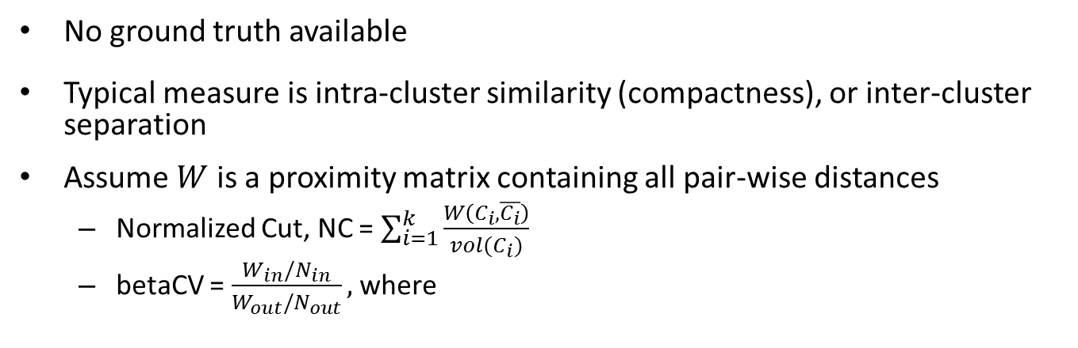
Internal measures
No ground truth available
Typical measure is intra-cluster similarity (compactness), or inter-cluster separation
Assume $W$ is a proximity matrix containing all pair-wise distances
Normalized Cut, NC = $\sum_{i=1}^{k}{\frac{W\left(C_{i}, \overline{C_{i}}\right)}{vol(C_{i})}}$
betaCV = $\frac{W_{in}/N_{in}}{W_{out}/N_{out}},$where

