Slide 1
Data Mining
Linear Discriminant Analysis

Slide 2
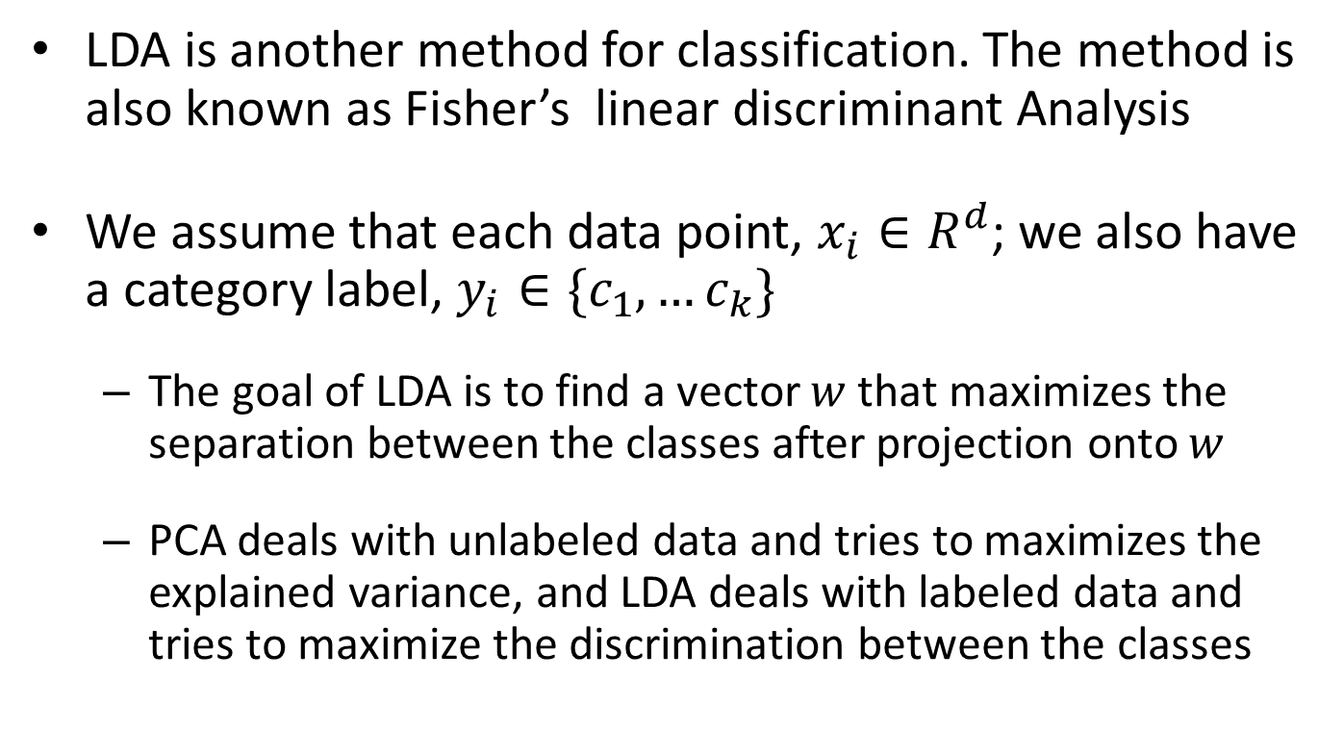
Linear Discriminant Analysis (chapter 20)
LDA is another method for classification. The method is also known as Fisher’s linear discriminant Analysis
We assume that each data point, $x_{i}∈R^{d}$; we also have a category label, $y_{i}∈\{c_{1}, …c_{k}\}$
The goal of LDA is to find a vector $w$ that maximizes the separation between the classes after projection onto $w$
PCA deals with unlabeled data and tries to maximizes the explained variance, and LDA deals with labeled data and tries to maximize the discrimination between the classes

Slide 3
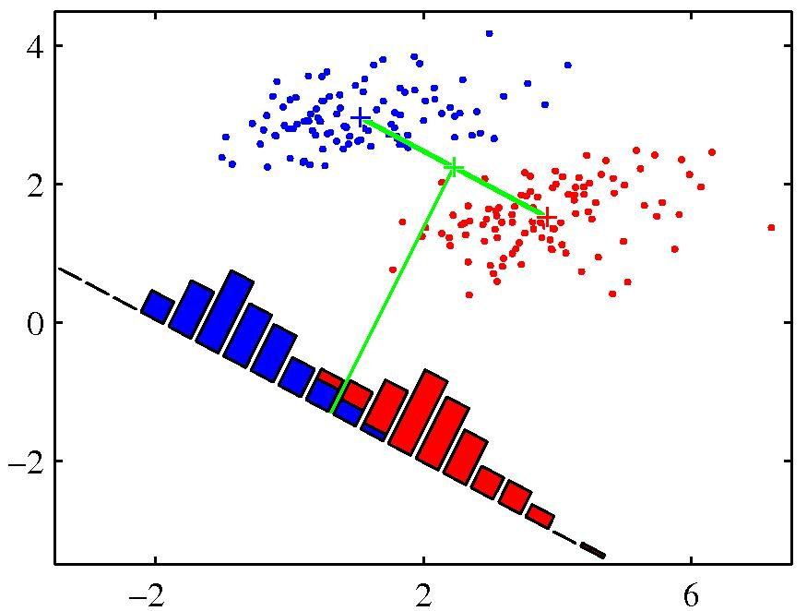
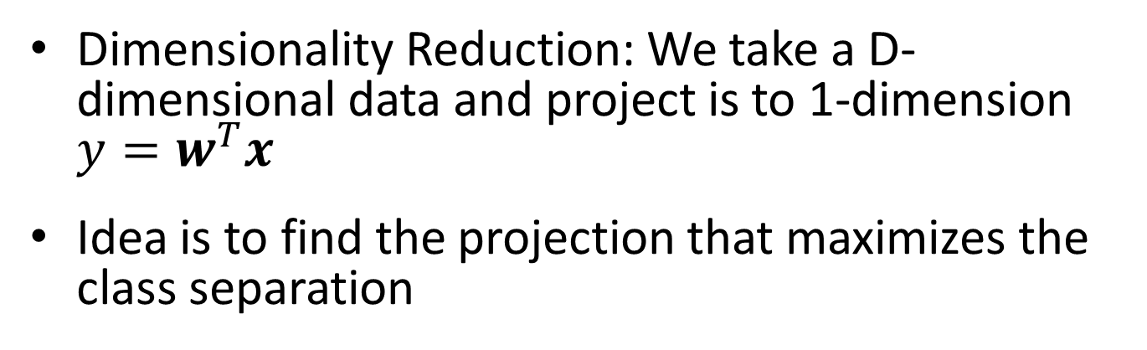
Fishers Linear Discriminant
Dimensionality Reduction: We take a D-dimensional data and project is to 1-dimension $y=w^{T}x$
Idea is to find the projection that maximizes the class separation
The simplest measure of separation is the separation of projected class mean

Slide 4
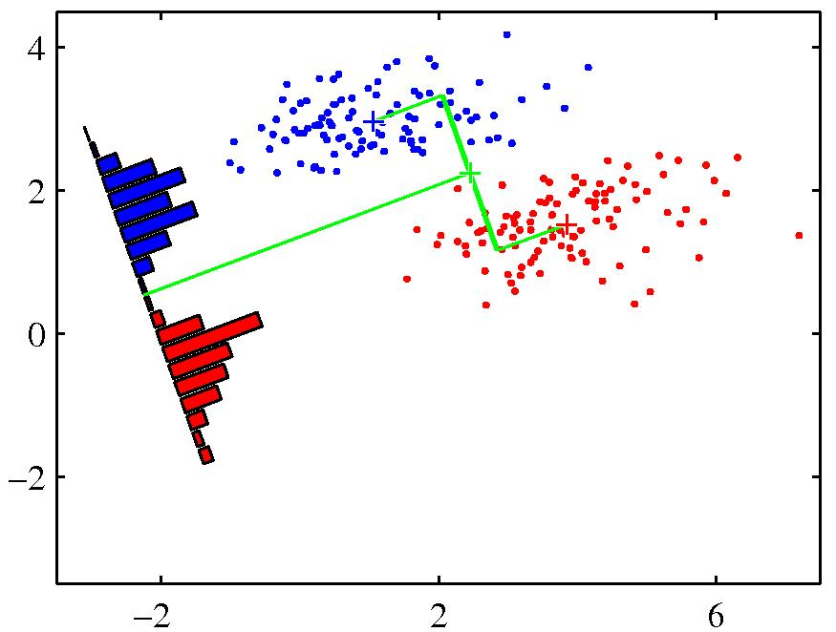
Better Projection
Better Projection

Slide 5
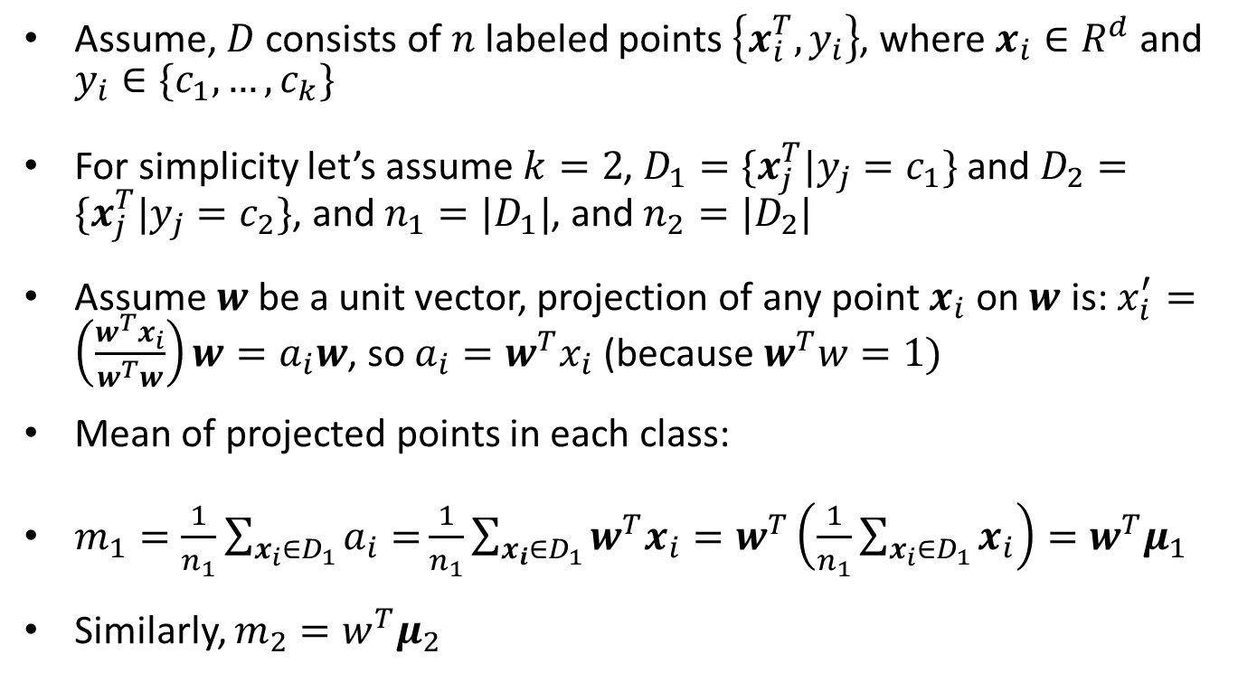
LDA (cont.)
Assume, $D$ consists of $n$ labeled points $\left\{x_{i}^{T},y_{i}\right\}$, where $x_{i}∈R^{d}$ and $y_{i}∈\{c_{1},…, c_{k}\}$
For simplicity let’s assume $k=2$, $D_{1}=\{x_{j}^{T}|y_{j}=c_{1}\}$ and $D_{2}=\{x_{j}^{T}|y_{j}=c_{2}\}$, and $n_{1}=|D_{1}|$, and $n_{2}=|D_{2}|$
Assume $w$be a unit vector, projection of any point $x_{i}$ on $w$ is: $x_{i}^{′}=\left(\frac{w^{T}x_{i}}{w^{T}w}\right)w=a_{i}w$, so $a_{i}=w^{T}x_{i}$ (because $w^{T}w=1)$
Mean of projected points in each class:
$m_{1}=\frac{1}{n_{1}}\sum_{x_{i}∈D_{1}}{a_{i}=}\frac{1}{n_{1}}\sum_{x_{i}∈D_{1}}{w^{T}x_{i}=w^{T}\left(\frac{1}{n_{1}}\sum_{x_{i}∈D_{1}}{x_{i}}\right)=w^{T}μ_{1}}$
Similarly, $m_{2}=w^{T}μ_{2}$

Slide 6
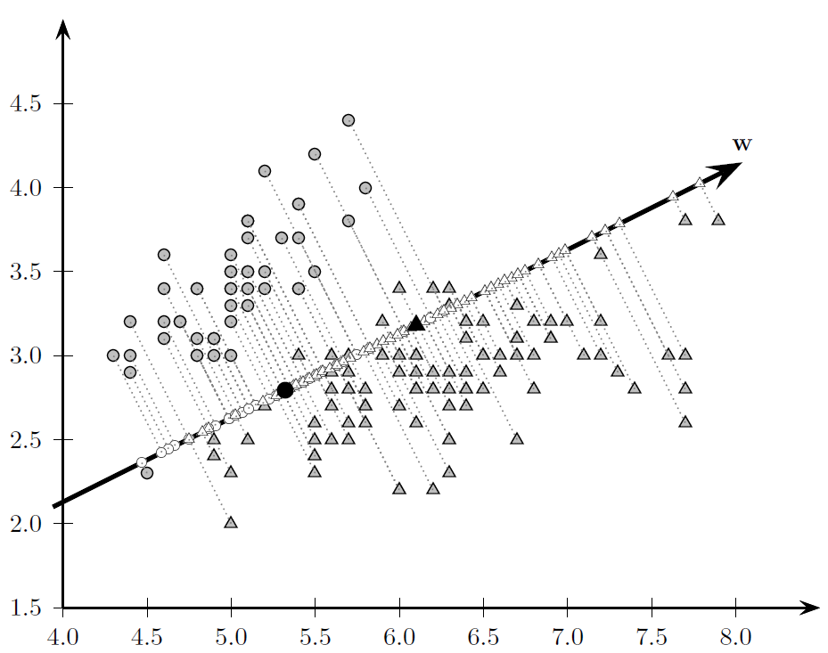
Example, projection along w

Slide 7
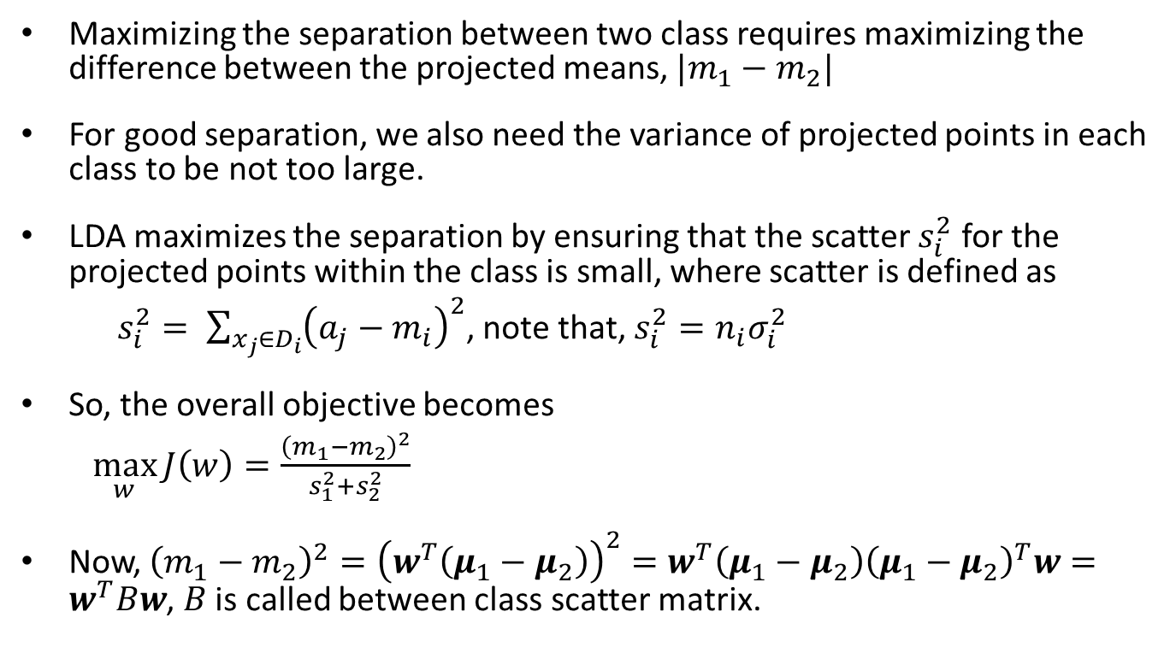
LDA (cont.)
Maximizing the separation between two class requires maximizing the difference between the projected means, $|m_{1}−m_{2}|$
For good separation, we also need the variance of projected points in each class to be not too large.
LDA maximizes the separation by ensuring that the scatter $s_{i}^{2}$ for the projected points within the class is small, where scatter is defined as
$s_{i}^{2}= \sum_{x_{j}∈D_{i}}{{\left(a_{j}−m_{i}\right)}^{2}}$, note that, $s_{i}^{2}=n_{i}σ_{i}^{2}$
So, the overall objective becomes
$\max_{w}{J\left(w\right)=\frac{{\left(m_{1}−m_{2}\right)}^{2}}{s_{1}^{2}+s_{2}^{2}}}$
Now, ${\left(m_{1}−m_{2}\right)}^{2}={\left(w^{T}\left(μ_{1}−μ_{2}\right)\right)}^{2}=w^{T}\left(μ_{1}−μ_{2}\right){\left(μ_{1}−μ_{2}\right)}^{T}w=w^{T}Bw$, $B$ is called between class scatter matrix.

Slide 8
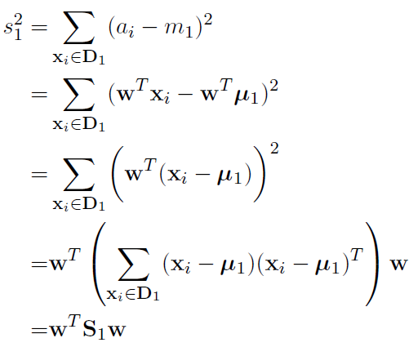

LDA (cont.)
As for the projected scatter for class $c_{1}$, we can compute it as follows:
Similarly, $s_{2}^{2}=w^{T}S_{2}w,$
So, $s_{1}^{2}+s_{2}^{2}=w^{T}\left(S_{1}+S_{2}\right)w=w^{T}Sw$, $S$ is called within class scatter matrix. S is a symmetric positive semi-definite matrix of size $d×d$

Slide 9
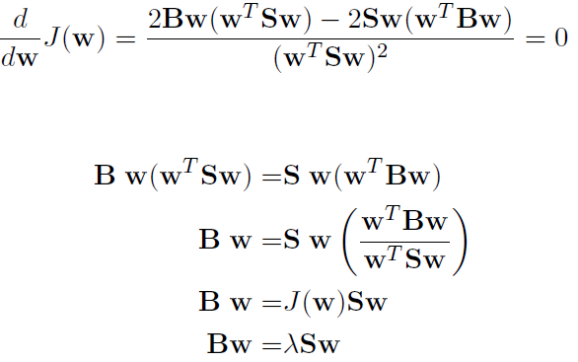
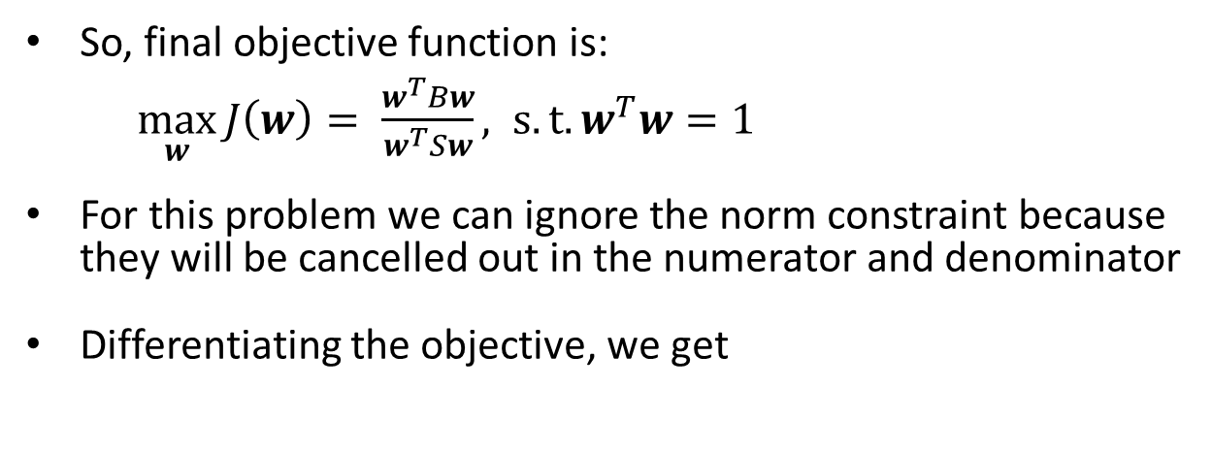
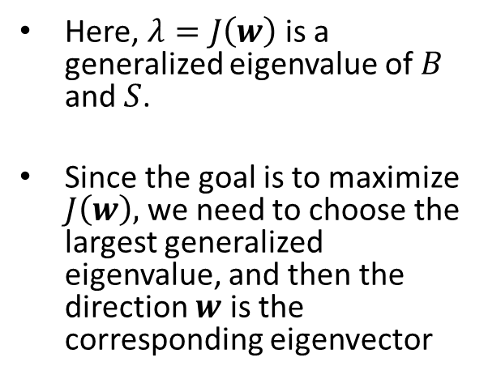
LDA (cont.)
So, final objective function is:
$\max_{w}{J\left(w\right)= \frac{w^{T}Bw}{w^{T}Sw}, s.t. w^{T}w=1}$
For this problem we can ignore the norm constraint because they will be cancelled out in the numerator and denominator
Differentiating the objective, we get
Here, $λ=J\left(w\right)$ is a generalized eigenvalue of $B$ and $S$.
Since the goal is to maximize $J\left(w\right),$we need to choose the largest generalized eigenvalue, and then the direction $w$ is the corresponding eigenvector

Slide 10
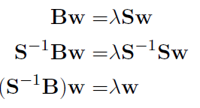
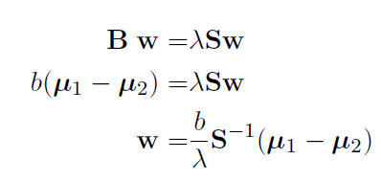

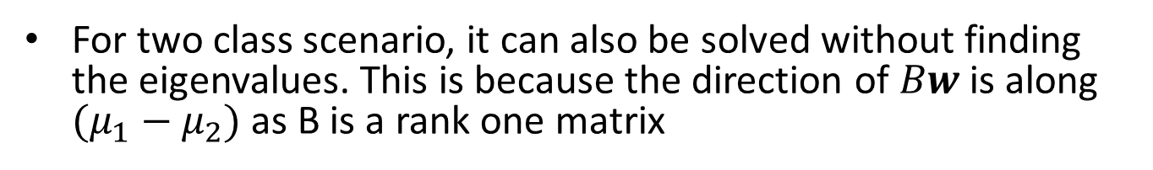
LDA (cont.)
If $S^{−1}$ exists, we can convert it to a regular eigenvalue problem.
For two class scenario, it can also be solved without finding the eigenvalues. This is because the direction of $Bw$ is along $(μ_{1}−μ_{2})$ as B is a rank one matrix

Slide 11
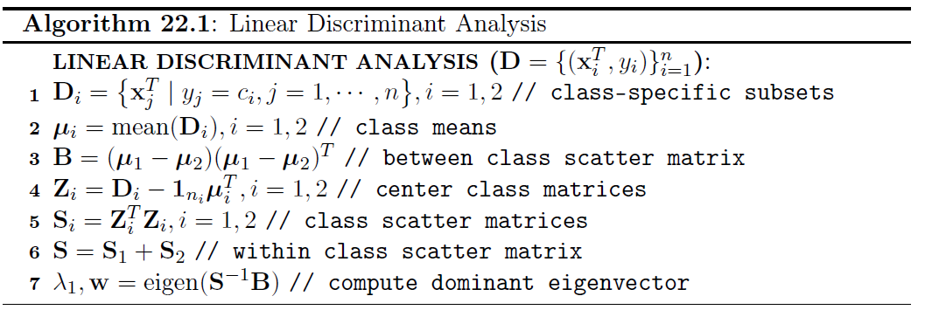
Pseudo-code

Slide 12
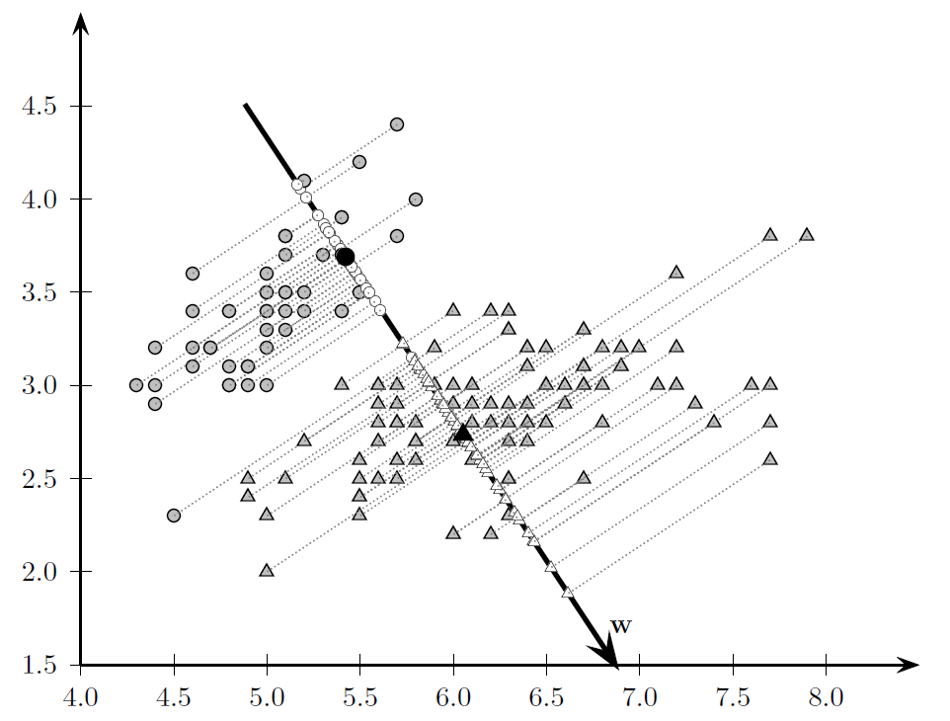
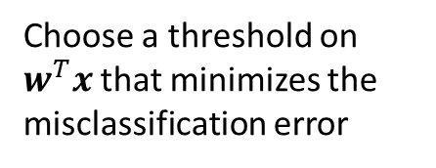
Example
Choose a threshold on $w^{T}x$ that minimizes the misclassification error

