Slide 1
Probabilistic Classification
Chapter 21 (ZW)

Slide 2
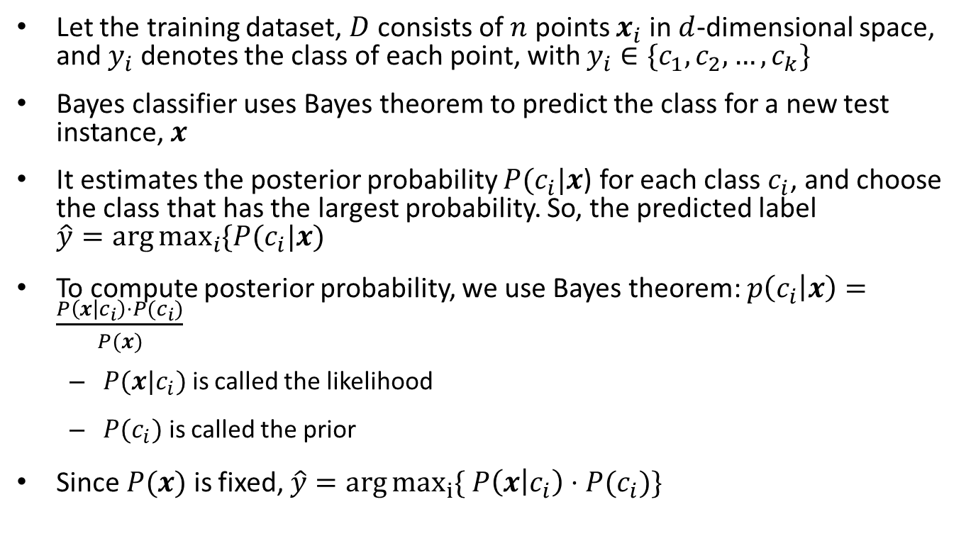
Bayes Classifier
Let the training dataset, $D$ consists of $n$ points $x_{i}$in $d$-dimensional space, and $y_{i}$ denotes the class of each point, with $y_{i}∈\{c_{1},c_{2},…, c_{k}\}$
Bayes classifier uses Bayes theorem to predict the class for a new test instance, $x$
It estimates the posterior probability $P(c_{i}|x$) for each class $c_{i}$, and choose the class that has the largest probability. So, the predicted label $\hat{y}=\arg{\max_{i}{\{P(c_{i}|x)}}$
To compute posterior probability, we use Bayes theorem: $p\left(c_{i} | x\right)=\frac{P\left(x | c_{i}\right)⋅P(c_{i})}{P(x)}$
$P(x|c_{i})$ is called the likelihood
$P(c_{i})$ is called the prior
Since $P(x)$ is fixed, $\hat{y}=\arg{\max_{i}{\{ P\left(x | c_{i}\right)⋅P(c_{i})\}}}$

Slide 3

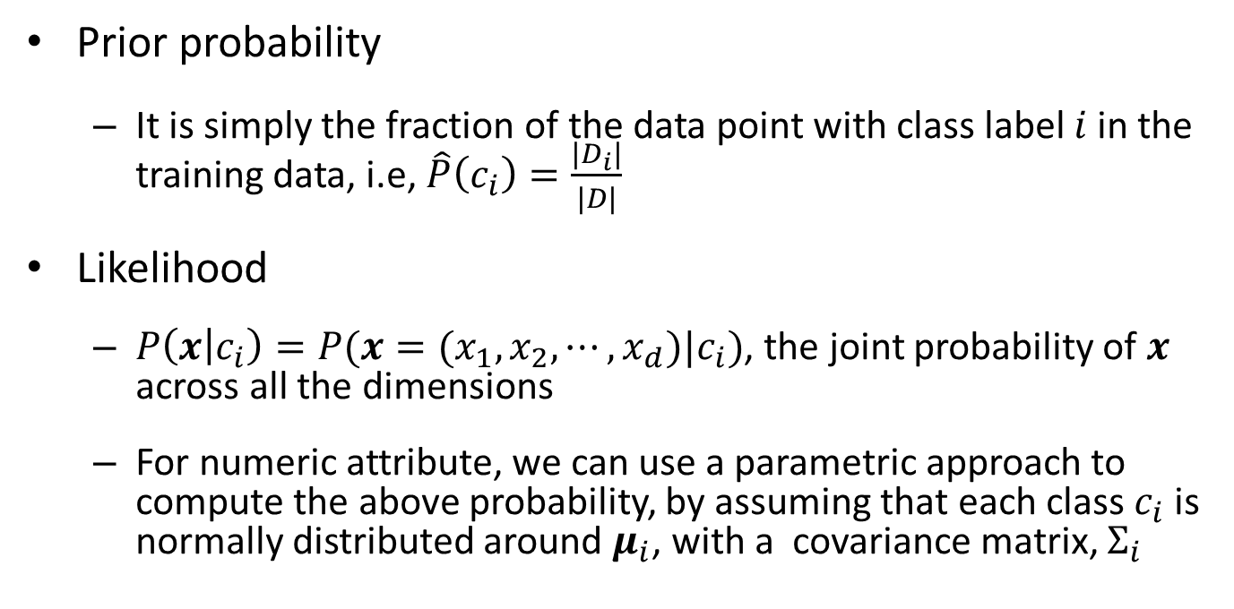
Prior Probability and Likelihood
Prior probability
It is simply the fraction of the data point with class label $i$ in the training data, i.e, $\hat{P}\left(c_{i}\right)=\frac{|D_{i}|}{|D|}$
Likelihood
$P\left(x | c_{i}\right)=P(x=(x_{1}, x_{2},⋯, x_{d})|c_{i})$, the joint probability of $x$ across all the dimensions
For numeric attribute, we can use a parametric approach to compute the above probability, by assuming that each class $c_{i}$ is normally distributed around $μ_{i}$, with a covariance matrix, $Σ_{i}$

Slide 4



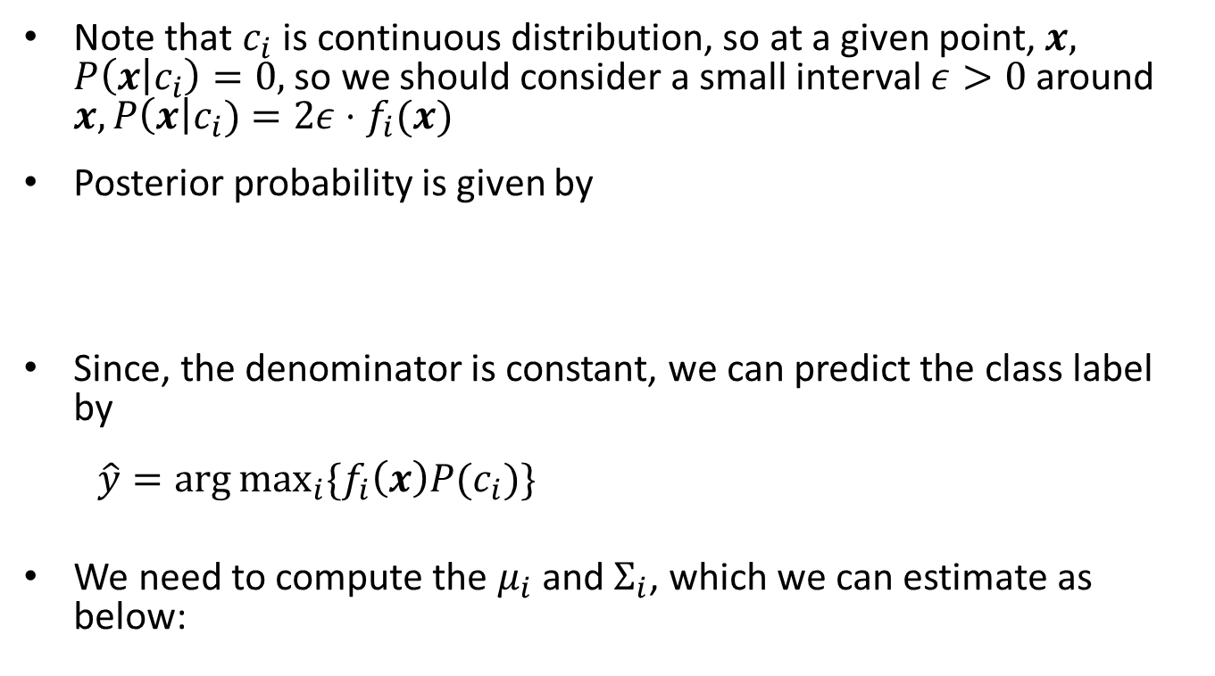
Likelihood (cont.)
Note that $c_{i}$ is continuous distribution, so at a given point, $x,$ $P\left(x | c_{i}\right)=0,$so we should consider a small interval $ε>0$ around $x, P\left(x\right|c_{i})=2ε⋅f_{i}(x)$
Posterior probability is given by
Since, the denominator is constant, we can predict the class label by
$\hat{y}=\arg{\max_{i}{\{f_{i}\left(x\right)P(c_{i})\}}}$
We need to compute the $μ_{i}$ and $Σ_{i}$, which we can estimate as below:

Slide 5
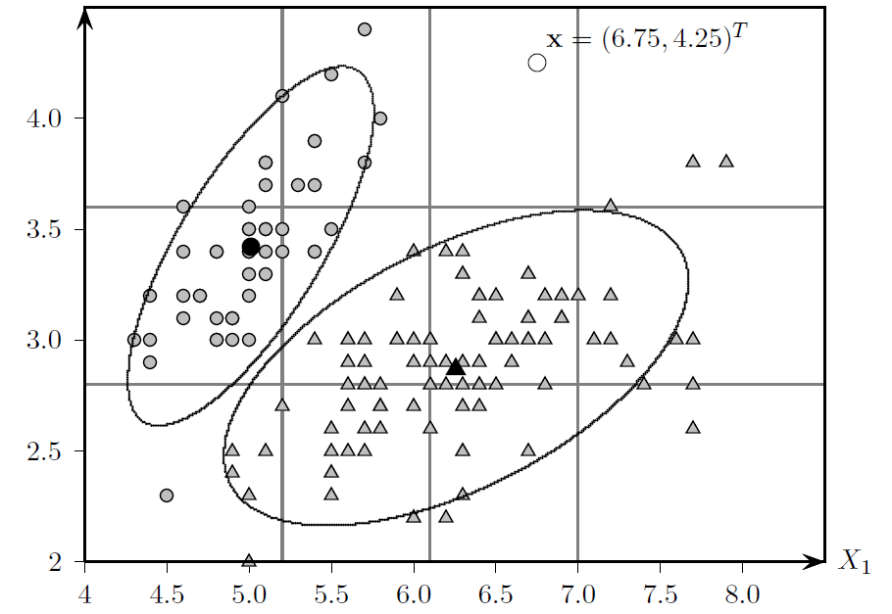
Example
IRIS Data: sepal length vs sepal width

Slide 6
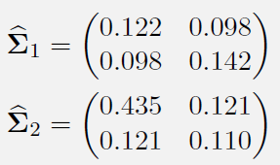
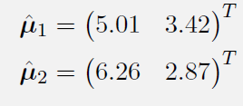
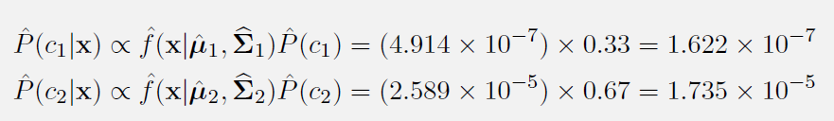
Example (cont.)
Let, x = (6.75, 4.25) be a test point
So, x will be predicted as class 2

Slide 7
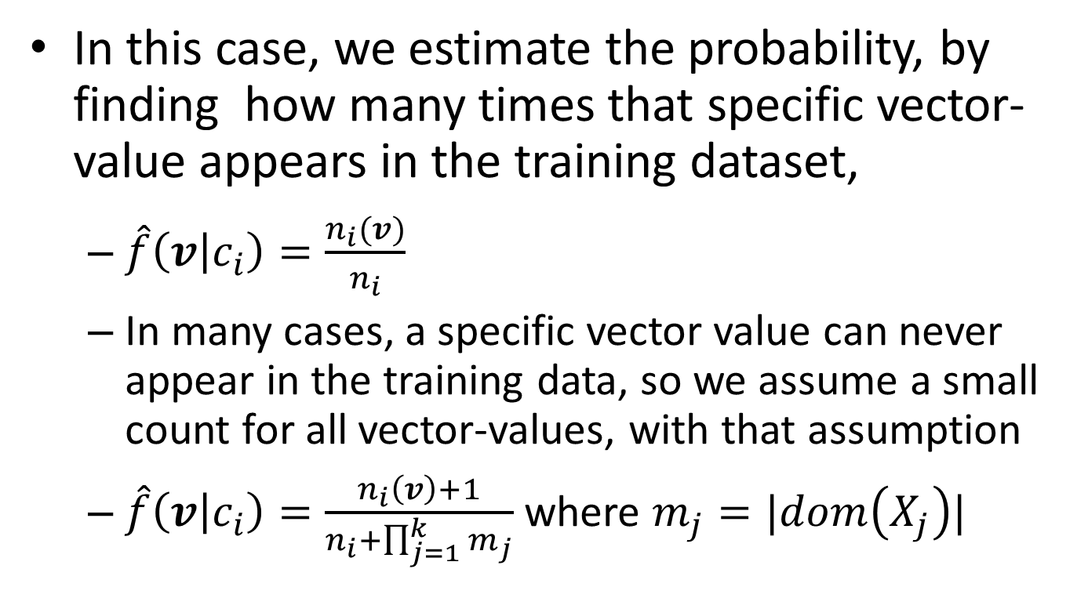
Categorical Attribute
In this case, we estimate the probability, by finding how many times that specific vector-value appears in the training dataset,
$\hat{f}\left(v | c_{i}\right)=\frac{n_{i}(v)}{n_{i}}$
In many cases, a specific vector value can never appear in the training data, so we assume a small count for all vector-values, with that assumption
$\hat{f}\left(v | c_{i}\right)=\frac{n_{i}\left(v\right)+1}{n_{i}+\prod_{j=1}^{k}{m_{j}}}$ where $m_{j}=|dom\left(X_{j}\right)|$

Slide 8

Challenges
Lack of enough example to reliably estimate the joint probability density or mass function
Also, it becomes costly with the dimension, note that $Σ$ has $O(d^{2})$ entries

Slide 9

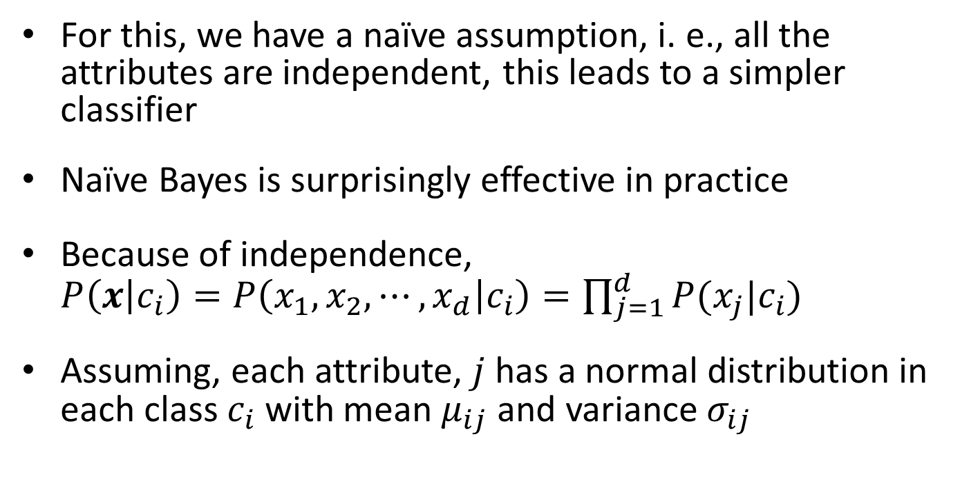
Naïve Bayes Classifier
For this, we have a naïve assumption, i. e., all the attributes are independent, this leads to a simpler classifier
Naïve Bayes is surprisingly effective in practice
Because of independence, $P\left(x | c_{i}\right)=P\left(x_{1},x_{2},⋯, x_{d} | c_{i}\right)=\prod_{j=1}^{d}{P(x_{j}|c_{i})}$
Assuming, each attribute, $j$ has a normal distribution in each class $c_{i}$ with mean $μ_{ij}$ and variance $σ_{ij}$

Slide 10
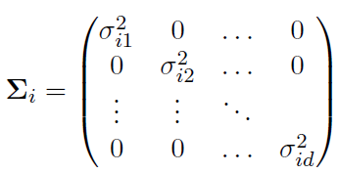
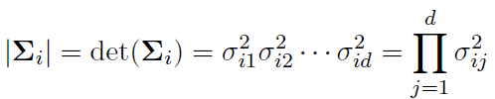
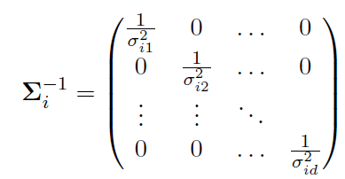

Naïve Bayes classifier
For naïve Bayes, we are assuming that all the co-variances are 0
This has the following consequences:

Slide 11
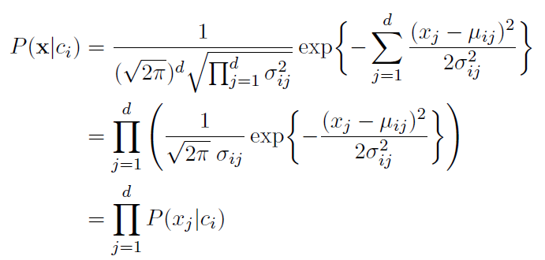

Naïve Bayes (cont.)
Plugging into Bayes Classifier formula:
Independent assumption leads to univariate modeling
We find mean and covariance of each attribute independently, for numerical attribute
For categorical attribute, we find joint probability by simple multiplication of $P\left(v_{j} | c_{i}\right),$ which is equal to $\frac{n_{i}\left(v_{j}\right)+1}{n_{i}+m_{j}}$, where $m_{j}=|dom\left(X_{j}\right)|$

Slide 12
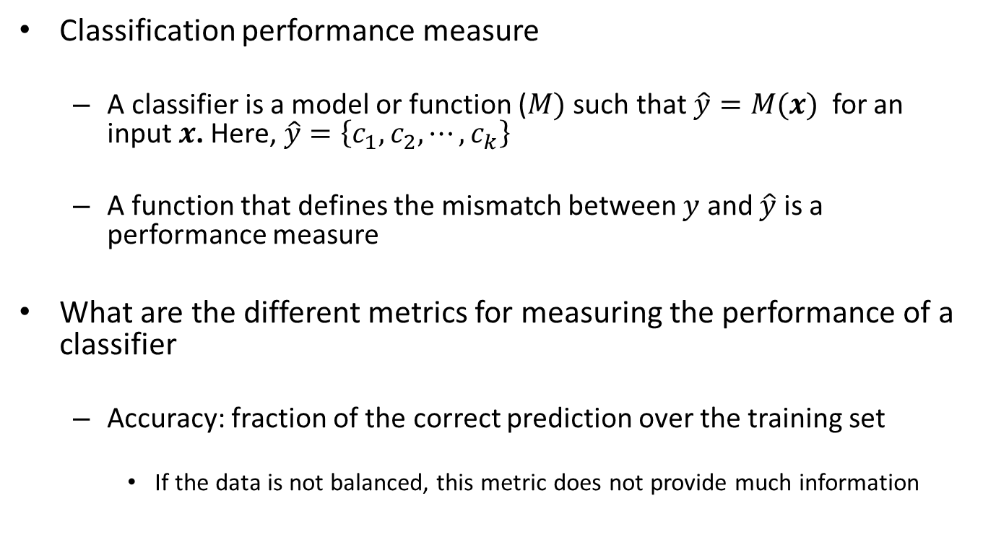
Classification assessment (Chapter 22)
Classification performance measure
A classifier is a model or function ($M)$ such that $\hat{y}=M(x)$for an input $x$. Here, $\hat{y}=\left\{c_{1},c_{2},⋯, c_{k}\right\}$
A function that defines the mismatch between $y$ and $\hat{y}$ is a performance measure
What are the different metrics for measuring the performance of a classifier
Accuracy: fraction of the correct prediction over the training set
If the data is not balanced, this metric does not provide much information

Slide 13
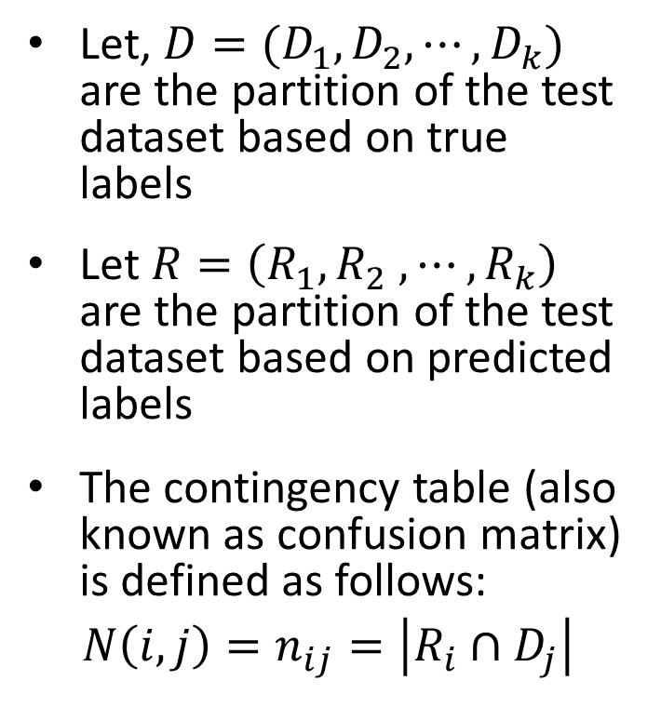
Contingency Table based measures
Let, $D=(D_{1},D_{2},⋯, D_{k})$ are the partition of the test dataset based on true labels
Let $R=\left(R_{1},R_{2} ,⋯, R_{k}\right)$ are the partition of the test dataset based on predicted labels
The contingency table (also known as confusion matrix) is defined as follows:
$N\left(i, j\right)=n_{ij}=\left|R_{i}∩D_{j}\right|$
+
-
TP | FP
FN | TN
+
predicted
Labels
-
Actual Label
2-class contingency table

Slide 14
Measures using contingency table
Precision
Recall
F-Measure
ROC/AUC

