Slide 1
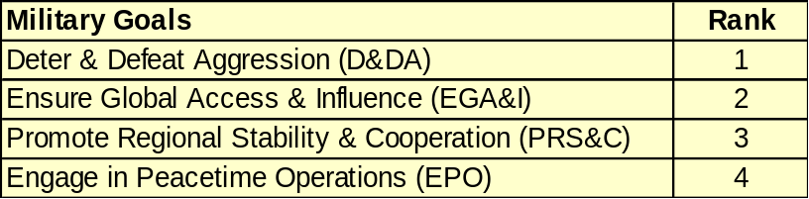
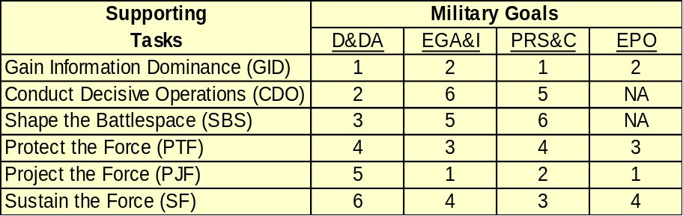
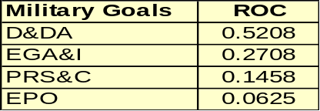
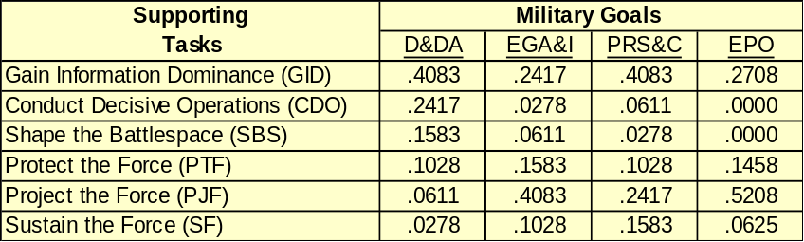
Composite ROC Weighting Technique
Example Hierarchy
Sustain the Force
Ranking
Gain Information
Dominance
Protect the Force
Engage in Peacetime
Operations
Project the Force
Promote Regional
Stability & Cooperation
Ensure Global Access
& Influence
Sustain the Force
Deter & Defeat
Aggression
Project the Force
Protect the Force
Shape the Battlespace
Conduct Decisive
Operations
Gain Information
Dominance
Goals
Tasks
Compute ROC Weights from Ranks
Matrix Multiplication
Formula & Example
D&DA EGA&I PRS&C EPO
GID .4083 .2417 .4083 .2708 .3546 GID
CDO .2417 .0278 .0611 .0000 .5208 D&DA .1423 CDO
SBS .1583 .0611 .0278 .0000 * .2708 EGA&I = .1030 SBS
PTF .1028 .1583 .1028 .1458 .1458 PRS&C .1205 PTF
PJF .0611 .4083 .2417 .5208 .0625 EPO .2102 PJF
SF .0278 .1028 .1583 .0625 .0693 SF
_{n}
w_{i}(ROC) = (1/n) Σ (1/j), i = 1, . . . ,n
^{j=i}
v(D&DA) = 1/4(1/1 + 1/2 + 1/3 + 1/4) = .5208

