Slide 1
Network Attacks and
Intrusion Detection
CSCI 43200 - Security in Computing
Copyright © 2005, 2015 by Scott Orr and the Trustees of Indiana University

Slide 2
References
Computer Security: Principles and Practice, 3rd Ed.
  Chapter 8

Slide 3
Section Overview
Anatomy of an Attack
Intruders
Network Attacks
Host/Network Intrusion Detection
Honeypots

Slide 4
Why are Networks Vulnerable?
Reliance on shared resources
System Complexity
Unknown perimeter
Many points of attack
Attacker anonymity
Multiple paths to hosts

Slide 5
Anatomy of an Attack
Footprinting
Scanning
Enumeration
Gaining Access
Denial of Service
Escalating Privilege
Pilfering
Covering Tracks
Creating Back Doors
Source: Hacking Exposed: Network Security: Secrets and Solutions,
by S. McClure, J. Scambray, and G. Kurtz

Slide 6
Intruder Classes
Masquerader – Targets user accounts
Misfeasor – Legitimate user who misuses access privileges (or access to restricted resources)
Clandestine User – Attempts to gain administrative access to systems

Slide 7
“Hackers”
Media popular term
Motivations
  Thrill of the chase
  Looking for net-cred
Targets of Opportunity
Skill level varies
Benign vs. Malevolent

Slide 8
Cyber Criminals
Organized
  Corporate
  Government
  Cyber-Gangs
Targets are specific
Hit and run tactics
Motivations
  Fraud/Financial (ID theft, eCommerce, Espionage)
  Personal/Ideological (Harassment, Threats)
  Terrorism/Warfare (intelligence Gathering, Disruption)

Slide 9
Insiders
Employees who already have access
Motivations
  Revenge
  Entitlement
  Whistleblowers
Very difficult to detect/prevent

Slide 10
Insider Attack Traits
Create accounts for themselves/others
Use accounts/applications not associated with their position
Email former/potential employers
Secretive IM chats
Visit sites catering to disgruntled employees
Large downloads and file copying
Off hour network access

Slide 11
Impersonation Attacks
Social Engineering
Cracked Passwords
Stolen Passwords
  Sniffed
  Phishing
Berkeley R-Commands

Slide 12
Packet Sniffing
Promiscuous mode
  See every packet as it crossed the network
  Transparent
Capture account passwords
Read email
Analyze network traffic

Slide 13
Network Hubs vs. Switches
Hub
Switch
Everyone can see traffic
Virtual circuit (bridge )
between pair

Slide 14
Switch Attacks
MAC Flooding – switch will act like hub
ARP Spoofing
Who is 10.0.0.1?
I am (1:2:3:7:8:9)
10.0.0.1
10.0.0.2
10.0.0.3
10.0.0.4

Slide 15


Token-based Login Race Attack
Login:
scott
Password:
2
4
3
5
6
Guesses last
number and
enters it before
Scott can finish.
Login:
scott
Password:
2
9
4
3
5
6

Slide 16
Replay Attacks
Buy New CD
Buy New CD

Slide 17
Resource Sharing
May not need account to access files
Microsoft Shares
  Guest Shares
  Accounts
NFS Exports
Samba

Slide 18
Service Exploits
Banner Grabbing/Vulnerability Scanners
Stack/Buffer Overflow
Code/SQL Injections
Backdoors
File Transfer Programs
  Anonymous FTP
  TFTP
FTP Bounces

Slide 19

FTP Bounces
PORT
address, port
Upload
Commands
File
RETR file
Attacker
Anonymous FTP Server
with upload area
Target Host
Trusted Hosts increase threat!!!

Slide 20
Trust Spoofing
DNS/ARP Cache Poisoning
Pharming
Trust-based access to other machines
  Berkeley R Commands
  SSH Public Key w/ no passphrases
  Remote File systems (NFS/SMB)
  Web Site Phishing
DNSSEC

Slide 21
Man in the Middle Attack
Buy New CD

Slide 22
Source Routing Attacks
DoS Trusted Host
Address set to
Trusted Host
(IP Spoofing)
Trusted Host
Source routed
connection request
R
R
R
R
Attacker
R
R
R
R
Source routed
response
Trusted Host

Slide 23
Session Hijacking
User Host
Destination Host
Attacker
Attacker watches live sessions to record sequence numbers
Attacker DoS’s User Host and IP spoofs packets to Destination using User Host’s sequence numbers
Destination continues session as if nothing happened

Slide 24
TCP Sequence Guessing
Attacker DoS’s Trusted Host
Attacker attempts to connect to target many times and records sequence numbers
Attacker calculates sequence numbers which will be assigned for next connection.
Trusted Host
Target
Router
Attacker spoofs address of trusted host and uses calculated sequence numbers (router passes trusted internal address
Target runs command from spoofed trusted host
Attacker

Slide 25

Session Encryption
Application
Server
Internet

Slide 26
Intrusion Detection
Host-Based (HIDS)
  Monitors system/user behavior for suspicious activities
Network-Based (NIDS)
  Monitors network traffic for suspicions activity
IDS Components
  Sensors
  Analyzers
  User Interface

Slide 27
Host-Based IDS
Monitoring system activity
Internal and External events
Approaches
  Anomaly Detection
    Threshold Detection (Event-based)
    Profile-Based (variations from normal use)
  Signature Detection
    Rule-based Anomaly Detection
    Rule-based Penetration Detection
Distributed HIDS

Slide 28

Network Intrusion Detection
Internal
Network
Internet
Dual-Homed
Proxy
Screening
Router
Screening
Router
Analysis
Station
Sensors

Slide 29
Network IDS Methods
Signature-based
  Known Network/Service Attacks
  Unexpected Services
  Spoofing
  Content (e.g. Web Data)
  Policy Violations
Behavioral based
  Port Scans
  Denial of Service
  Worms

Slide 30
IDS Weaknesses
Very young technology
Scalability
False Positives
False Negatives

Slide 31
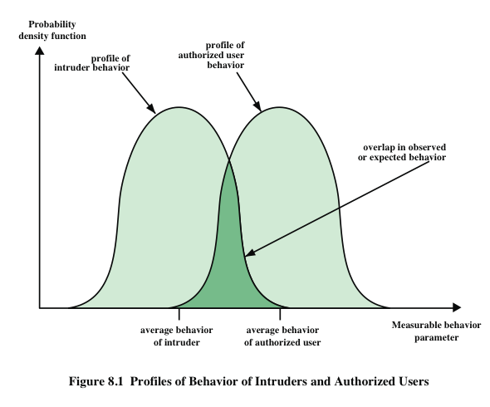
False Positives/Negatives

Slide 32
Honeypots
Sacrificial host used to lure attackers
Simulates a vulnerable system
Used to study attacker techniques
  Firewall/IDS traffic logs
  System logs
  File Integrity Checker logs
  Keystroke capturing
Early Case – “Berferd”
Honeynets

