Slide 1
Email Privacy and
Spam Filtering
CSCI 43200 - Security in Computing
Copyright © 2005, 2015 by Scott Orr and the Trustees of Indiana University

Slide 2
Section Overview
Email architecture
GPG
SPAM Countermeasures
CS Spam Filtering

Slide 3
References
Computer Security: Principles and Practice, 2nd Ed.
  Chapter 22 (Sections 22.1 and 22.2)

Slide 4


Email Server Architecture
MTA
MTA
MDA
(sendmail)
(postfix)
(procmail)
smtp
imap(s)
pop(s)
smtp(s)
MUA
AA
(Outlook)
(imapd)
(popd)

Slide 5
SMTP Protocol
[smo@sysadmin ~]$ telnet tempest.cs.iupui.edu 25
Trying 134.68.140.202...
Connected to tempest.cs.iupui.edu (134.68.140.202).
Escape character is '^]'.
220 tempest.cs.iupui.edu ESMTP Postfix
helo sysadmin
250 tempest.cs.iupui.edu
mail from: <smorr@indiana.edu>
250 2.1.0 Ok
rcpt to: <sorr@cs.iupui.edu>
250 2.1.5 Ok
data
354 End data with <CR><LF>.<CR><LF>
Subject: Hello
Hi Scott
.
250 2.0.0 Ok: queued as B06375050618
quit
221 2.0.0 Bye
Connection closed by foreign host.

Slide 6
Email Headers
Return-Path: smo@ix.netcom.com
Received: from dfw-ix4.ix.netcom.com by klingon (SMI-8.6/SMI-SVR4)
id TAA24482; Sun, 2 Nov 1997 19:19:38 -0500
Received: (from smap@localhost)
by dfw-ix4.ix.netcom.com (8.8.4/8.8.4)
id SAA19695 for <sorr@cs.iupui.edu>; Sun, 2 Nov 1997 18:18:14 -0600 (CST)
Received: from ind-in13-20.ix.netcom.com(207.220.129.116) by dfw-ix4.ix.netcom.com via smap (V1.3) id rma019634; Sun Nov 2 18:18:01 1997
Message-ID: <345D17E0.DA801FDC@ix.netcom.com>
Date: Sun, 02 Nov 1997 19:16:33 -0500
From: Scott Orr <smo@ix.netcom.com>
Organization: Purdue U. CS Dept. - IUPUI
X-Mailer: Mozilla 4.03 [en] (Win95; I)
MIME-Version: 1.0
To: sorr@cs.iupui.edu
Subject: Hello from NetCom
Content-Type: text/plain; charset=us-ascii
Content-Transfer-Encoding: 7bit
Content-Length: 43
Hi Scott,
You work too hard!!! :-)
~smo

Slide 7
Secure Email Requirements
Message Confidentiality
Message Integrity
Sender Authenticity
Nonrepudiation
Great use of Public Key Cryptography

Slide 8
Public-Key Encryption
Recipient’s
Public Key
Recipient’s
Private Key
-------
-------
-------
-------
-------
-------
Encryption
++++++
++++++
++++++
++++++
++++++
++++++
Decryption
-------
-------
-------
-------
-------
-------
Plaintext
Ciphertext
Plaintext

Slide 9
Digital Signatures
Sender’s
Private Key
Sender’s
Public Key
-------
-------
-------
-------
-------
-------
Hash
Encryption
------
------
------
------
++++++
++++++
Hash
Decryption
-------
-------
-------
-------
-------
-------
Plaintext
Signed
Message
Plaintext

Slide 10
GPG Key Management
Key Generation
  gpg –-gen-key
  Key type (e.g. RSA)
  Key size
  Validity period
Key sharing (export)
  gpg -–export -–armor name@domain > file.asc

Slide 11


Slide 12
Email Spam
Mass transmissions of electronic junk mail
  USENET News
  Electronic Mail
Often use legitimate systems as remailers
Section 227, Title 47 of the US. Code
  It Shall be unlawful for any person within the United States:
  (C) to use any telephone facsimile machine, computer, or other device to send an unsolicited advertisement to a telephone facsimile machine;...
Coalition Against Unsolicited Commercial Email

Slide 13
Opening Spam-dora’s Box
April 12, 1994 – Lawyers Laurence Canter and Martha Siegel sent message about upcoming Green Card lottery to some 6000+ Usenet News Groups in less than 90 minutes
Arizona ISP Internet Direct received so many email complaints, their email server(s) crashed more than 15 times.
C&S account gets cancelled and threaten to sue (although never do)
C&S publish How to Make a Fortune on the Information Superhighway (1995)

Slide 14
20 years later…
SPAM (Unsolicited Commercial Email) 68.3% of all email (3rd Qtr. 2013)
Phishing Attacks still less than 1% of all email
Many use Botnets to send
Top Spam-Sending Countries
  China (22.2%)
  United States (18.4%)
  South Korea (14.7%)
  Taiwan (5.7%)
Source: Commtouch Software Online Labs

Slide 15
Costs of Spam
Spammers
  Great ROI!!!
  Malware writer partnerships
  Phishing
Recipent
  Time
  Bandwidth
  Storage space

Slide 16
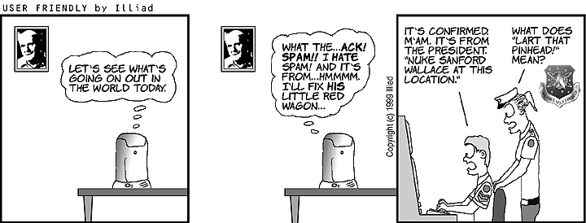
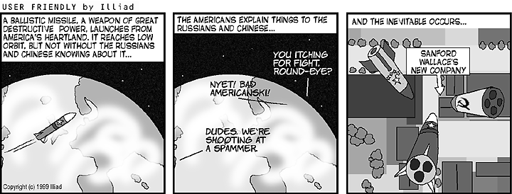
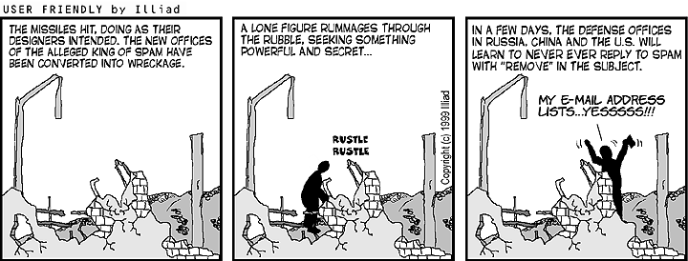
Illiad’s Solution to Spam…
Source: www.userfriendly.org

Slide 17
SPAM Legislation
CAN-SPAM Act of 2003
  Label Messages as “unsolicited Commercial”
  Prohibit False subject lines/header info
  Include OPT-OUT instructions Preempt state laws
Computer Owner’s Bill of Rights
  FTC maintained subscribed do-not-email list
  FTC can impose civil penalties on offenders
Wireless Telephone SPAM Protection Act
  Prohibit sending Unsolicited AdVerts to wireless devices

Slide 18
Preventive Measures to SPAM
Personal Methods
  Don’t post email address on web pages
  Send Unsubscribe email to Spammers?
  Configure filters within email programs
  Third party SPAM prevention lists
System Administrator Methods
  Direct contact with Spammers
  Configure filters on Mail Servers (RBL)
  Block offending address blocks

Slide 19
SPAM Filtering Techniques
Black lists
White lists
Content (keyword blocking)
Invalid addresses/header values
Heuristics
Bayesian Filtering

Slide 20
Tagged Message Delivery Agent
Whitelist based system
Lists are per account
Ensures email senders are “trusted”
  If new sender, send a challenge/response message back to sender
  Hold original message in a queue
  If sender responds to challenge, deliver original email and add to whitelist.

Slide 21
Greylisting
Each message identified by a triplet
  Envelope recipient
  Envelope sender
  IP address of delivering host
Delivery based on following rules:
  If IP address or recipient on whitelist – send msg to recipient
  If not seen triplet before – send tempfail msg and record triplet
  If time limit on triplet not expired – send tmpfail msg
  If time limit on triplet expired – send msg to recipient and update last seen time.
  Remove triplet from database after not seen for set period of time

Slide 22
Sender Policy Framework (SPF)
Receiving host verifies sender is legitimate mail server for originating domain
Add TXT (SPF) records to Domain DNS
  Domain specific
  Each host with MX record (also A, PTR, IP addr, external hosts)
  cs.iupui.edu. IN TXT "v=spf1 mx a:storm.cs.iupui.edu"
Issues
  Breaks email forwarding
  Spammers can still send messages if they have an account on domain
  Most major ISPs do not support SPF (yet)

Slide 23
DomainKeys Identified Mail (DKIM)
Verifies sending domain and message integrity
  Sender digitally signs message
  Receiver gets sender public key from sender’s DNS server to verify signature
Issues
  User is not authenticated
  No central Certificate Authority
  DNS Security?

Slide 24

CS Email Architecture
smtp
postfix
Maia-Mailguard (Amavisd)
clamav
spamassasin
Greylist?
Procmail
Quarantine
(MySQL)
Mail spool

Slide 25
Clam Antivirus
Open Source
If signature match…
  Added header fields:
    Delivered-To: virus-quarantine
    X-Quarantine-Id: <zzWB7-YxAXsI>
    X-Amavis-Alert: INFECTED, message contains virus: <virus signature ID>
  Moved to quarantine area
  Email sent to virusalert@cs.iupui.edu
Hourly checks for signature updates
Phishing signatures included ☺

Slide 26
Spamassassin
Open Source (Part of Apache project)
Weighted Heuristic tests
  Full Message
  Header
  Body
  URI
Third party plugins

Slide 27
SA: Full Message Tests
Message found in hashed Spam databases
Entries contributed by Spam recipients
Uses statistical and randomized signatures
Distributed Checksum Clearinghouse (DCC)
Vipul’s Razor

Slide 28
SA: Message Header Tests
Header Anomalies (length, sender, etc.)
Subject Obfuscation
Realtime Blackhole Lists (RBL)
  Open Relays/Proxy (SORBS)
  Address/Domain Abuse lists
Sender Policy Framework (SPF)
DomainKeys

Slide 29
SA: Message Body Tests
Common Spam content checks
HTML obfuscation*
Locale specific checks
URLs in RBLs
Bayesian Filters
  Calculates probability message is Spam
  (- score) < 50% / (+ score) > 50%
  Must be trained using Spam and “Ham”
*The Spammers' Compendium

Slide 30
SA: URI Message Tests
Focuses on embedded URLs
Keywords in URLs
Address obfuscation
TLD checks
CGIs and Authentications

Slide 31
Spam Thresholds
Spam check [header] tagging (-999)
  Spam Status
  Score & breakdown by test
  Spam-level histogram
Spam detected (6.3)
Quarantine Level (-)

Slide 32
Header Tagging Example
X-Spam-Status: No, hits=6.069 tagged_above=3 required=6.3
tests=[DNS_FROM_RFC_ABUSE=0.374,
DNS_FROM_RFC_POST=1.376, HTML_50_60=0.095,
HTML_FONT_BIG=0.232, HTML_IMAGE_ONLY_24=1.003,
HTML_MESSAGE=0.001, MIME_HTML_ONLY=1.158,
MSGID_FROM_MTA_HEADER=0,
RCVD_IN_BL_SPAMCOP_NET=1.832,
SPF_HELO_PASS=-0.001, SPF_PASS=-0.001]
X-Spam-Level: ******

