Slide 1
Wireless Security
CS432 - Security in Computing
Copyright © 2005, 2014 by Scott Orr and the Trustees of Indiana University

Slide 2
References
Computer Security: Principles and Practice, 2nd Ed.
  Chapter 24

Slide 3
Section Overview
Wireless networks
Basic Security Settings
WEP
WPA2

Slide 4
Wireless Networking
Bandwidth (shared)
  802.11b – 11Mbps
  802.11g – 54Mbps
  802.11n – 600Mbps
Modes
  Ad Hoc (Hosts talk directly to each other)
  Infrastructure (uses Access Points)
Identified by Set Server ID (SSID) names

Slide 5


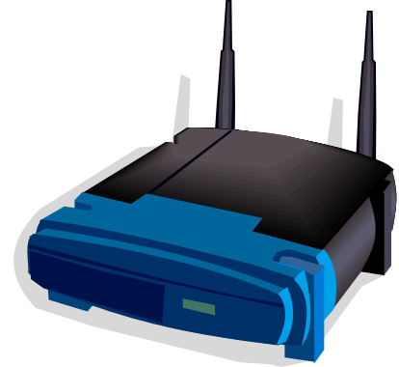

Infrastructure Model
Internet

Slide 6
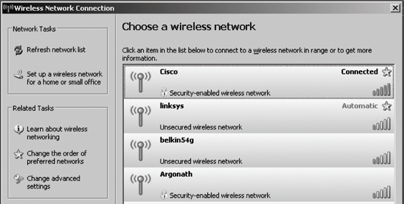
SSID Broadcasts
SSID: Cisco
SSID: belkin54g
SSID: linksys

Slide 7
SSID Beacons
MAC header
Timestamp
Beacon interval
Capability Info
SSID
Supported Data Rates
Radio Parameters
Power Slave Flags

Slide 8
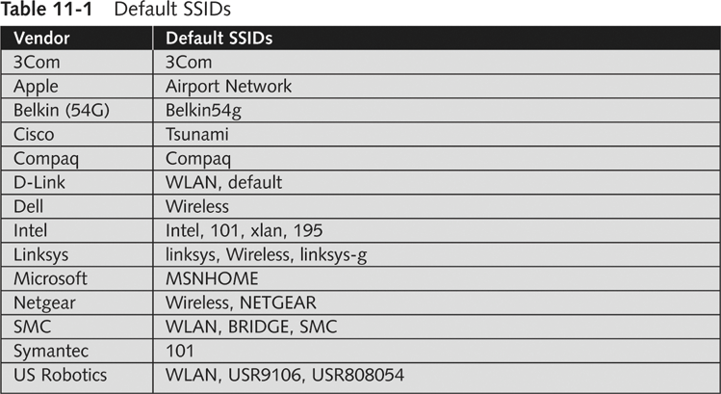
Default SSIDs

Slide 9
Wireless Network Access Control
Only allow known systems to connect
Every wireless NIC has a unique address
  Known as the MAC address
  Assigned by vendor
  BSSID: MAC address of Access Point
Access Control List
MAC Spoofing?

Slide 10
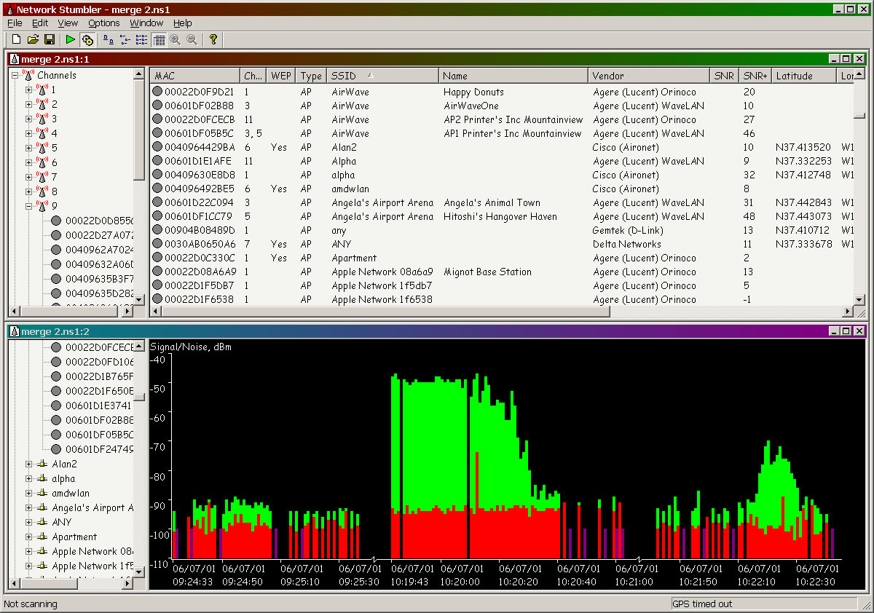
Wardriving
Disable SSID Broadcasts?

Slide 11
What now?
Limit Wireless Network Range
Use Secure Protocols
  SSL
  SSH
  Virtual Private Networks (VPNs)
Encryption
  WEP (Wired Equivalent Protocol) – Weak!!!
  Wi-Fi Protected Access (WPA/WPA2)

Slide 12
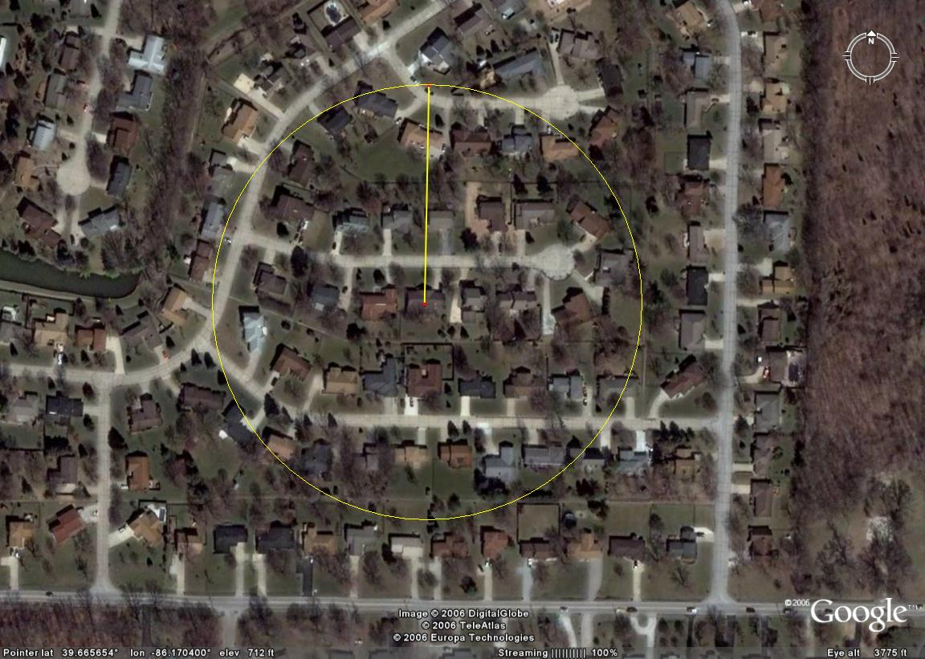
High Power Mode
450ft = 40 houses, 4 streets

Slide 13
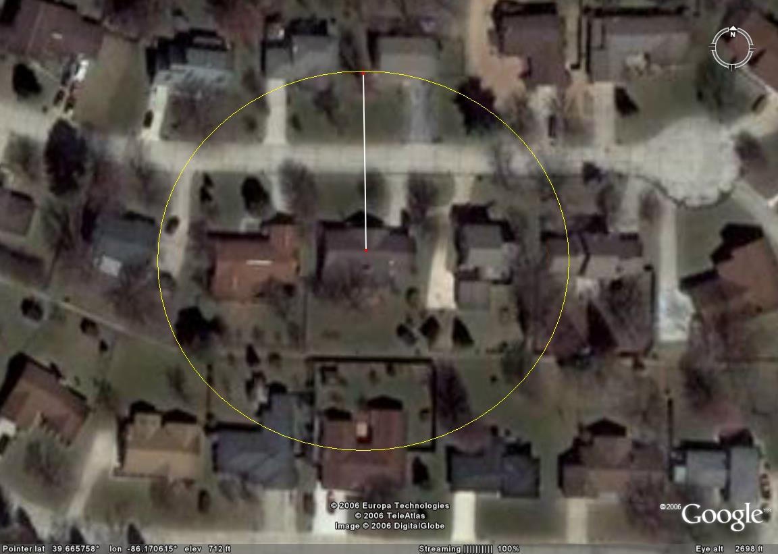
Low Power Mode
150ft = 6 Houses, 1 street

Slide 14
Man in the Middle Attack
SSID: linksys

Slide 15
DNS Spoofing
DNS/ARP Cache Poisoning
Pharming
Trust-based access to other machines
  Web Site Phishing
  Remote File systems (NFS/SMB)
Secure AP passwords!!!

Slide 16
Wireless Equivalent Privacy
Uses RC4 Algorithm
Shared 40 or 104 bit key
  Authentication
  Encryption
  APs maintain list of keys
Introduced in 802.11b
Implementation very flawed!

Slide 17
RC4 – Key Seq.
for i = 0 to 255 do
S[i] = i
end
j = 0
for i = 0 to 255 do
j = j + S[i] + K[i mod len(K)] mod 256
swap(S, i, j)
end
i = j = 0

Slide 18
RC4 - PRGA
i = i + 1 mod 256
j = j + S[i] mod 256
swap(S, i, j)
Return S[ S[i] + S[j] mod 256 ]

Slide 19
WEP Authentication
Request to Connect
Challenge Plaintext
RC4 ( )
⊕ Plaintext
Access Granted
WEP
Key
WEP
Key

Slide 20
WEP Frame
Message
CRC
⊕
Keystream = RC4 (IV, )
IV
ID
Ciphertext

Slide 21
WEP IV Attacks
Initial connection sniffing
Injection attacks with known plaintext
IV Reuse
  Look for IV collisions
  Some APs reset IV to 0 each time system is (re)initialized
  IV Dictionary Attacks

Slide 22
IV Reuse Occurrences
1% after 582 encrypted frames
10% after 1,881 encrypted frames
50% after 4,823 encrypted frames
99% after 12,430 encrypted frames
Jesse R. Walker
IEEE P802.11 Wireless LANS: Unsafe at any key size

Slide 23
Replay Attacks
ARP Request
ARP
Request

Slide 24
RC4 Attacks
FMS, KoreK, PTW
RC4 Matrix Initialization Weakness
If a key is weak, keystream will contain some portions of key more than other combinations
Statistical Analysis to find

Slide 25
Chopchop Attack
Doesn’t exploit RC4
Interactively decrypt last m bytes of an encrypted packet
Sends m x 128 packets
Involves modifications to the encrypted ICV (CRC32) values 1 byte at a time
AP will generate errors for incorrect ICV

Slide 26
Wi-Fi Protected Access (WPA2)
Certificate
Username/Password
Credentials
TLS
PEAP
Authentication Protocols
EAP
802.1x
Encryption Algorithms
RC4
RC4
AES
Encryption Standards
WEP
WPA-TKIP
802.11i
Source: Effective Wireless Security – Technology and Policy
By Dan Ziminski and Bill Davidge

Slide 27

Temporal Key Integrity Protocol
TA
TSC
Base Key
Message
CRC
⊕
Keystream = RC4 (IV,PK)
Ciphertext

Slide 28
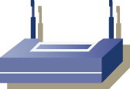
802.1x EAP-TLS Authentication
Client digital cert
From XYZ CA
Access Point
Authenticator
Station
Supplicant
RADIUS Server
Authorizer
Server Digital cert
From XYZ CA
Source: Effective Wireless Security – Technology and Policy
By Dan Ziminski and Bill Davidge

Slide 29


802.1x PEAP authentication
Digital cert
From XYZ CA
Station
Supplicant
Access Point
Authenticator
RADIUS Server
Authorizer
Username sorr
Password: encrypted
Success/Fail
Directory Server
Source: Effective Wireless Security – Technology and Policy
By Dan Ziminski and Bill Davidge

