Slide 1
Classical Cryptography I
CSCI 43200 - Security in Computing
Copyright © 2005, 2016 by Scott Orr and the Trustees of Indiana University

Slide 2
Section Overview
Cryptography Types
Shifts and Keyword Substitution Ciphers
Polyalphabetic Substitution Ciphers
Perfect Ciphers and Random Number Generation

Slide 3
References
Security in Computing, 3rd Ed.
  Chapter 2 (pgs. 35-66)
Online Resources
  The Codebook CD, Simon Singh

Slide 4
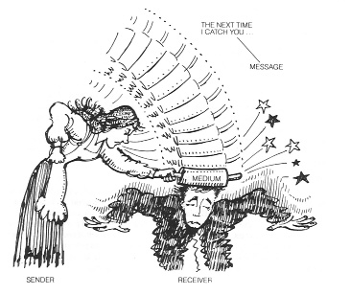
Message Components
Source: Gilbert Held
Understanding Data Communications, 1st Ed.

Slide 5




Possible Intruder Goals
Alice
Bob
Eve (aka Mallory)
  Intercept it
  Modify it
  Fabricate an authentic looking message
  Block it (deny access to)

Slide 6
Basic Encryption Process
-------
-------
-------
-------
-------
-------
Encryption
++++++
++++++
++++++
++++++
++++++
++++++
Decryption
-------
-------
-------
-------
-------
-------
Plaintext
Ciphertext
Plaintext

Slide 7
Symmetric Key Encryption
Shared
Key
-------
-------
-------
-------
-------
-------
Encryption
++++++
++++++
++++++
++++++
++++++
++++++
Decryption
-------
-------
-------
-------
-------
-------
Plaintext
Ciphertext
Plaintext

Slide 8
Substitution Ciphers
Substitution
Monoalphabetic
Shift
Source: Richard Spillman
Pacific Lutheran University

Slide 9
Caesar Cipher - Simple Shift
This is a cipher algorithm that transforms each Plaintext character into a Ciphertext character shifted a fixed distance down the alphabet
  The key is the distance of the shift
  For example, a key of 3 would replace each Plaintext “a” with “d”, each “b” with “e”, etc.
Easy for children to use as a secret code, but obvious pattern is its major weakness

Slide 10
Caesar Cipher Example
If the key is 5 then the Plaintext alphabet becomes the Ciphertext alphabet shown below:
t h i s
a b c d e f g h i j k l m n o p q r s t u v w x y z
f g h i j k l m n o p q r s t u v w x y z a b c d e
y
m
n
x
Source: Richard Spillman
Pacific Lutheran University

Slide 11
DECRYPTING CAESAR CIPHERS
Break between words. Blank translated
to self reveals small words
Double letter. No QQ pairs in English!
Repeated letters translating to same thing
wuhdwb lpsrvvleoh
Source: Lance J. Hoffman

Slide 12
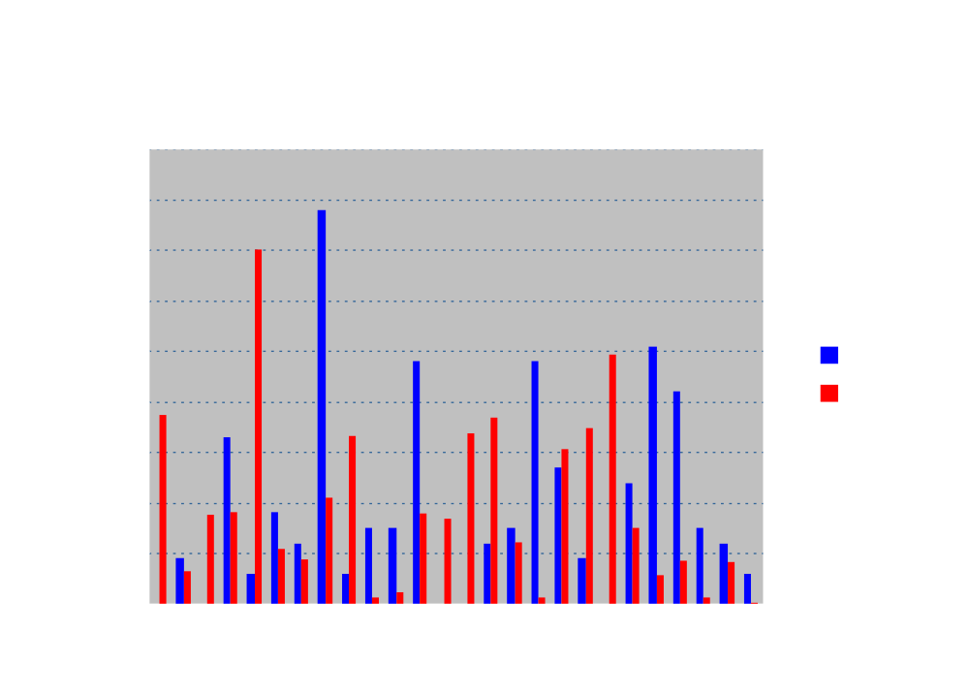
Frequency Distribution
Source: Hoffman & Pfleeger

Slide 13
Substitution Ciphers
Substitution
Monoalphabetic
Shift
Keyword
Source: Richard Spillman
Pacific Lutheran University

Slide 14
Keyword Substitutions
Choose a “key word” such as count
Write out the alphabet; then write the keyword directly below the first few letters of the alphabet
Complete the second row by writing (in order) the unused letters
Letter:
a b c d e f g h i j k l m n o p q r s t u v w x y z
c o u n t a b d e f g h i j k l m p q r s v w x y z
Code:

Slide 15
Starting Position
The keyword does not have to start at the beginning of the plaintext alphabet
  it could start at any letter
  for example, “count” could start at “k”
a b c d e f g h i j k l m n o p q r s t u v w x y z
m p q r s v w x y z c o u n t a b d e f g h i j k l
Note: the alphabet wraps around
Source: Spillman

Slide 16
Key Word Example
If the keyword is “visit” (note, the second “i” is visit is dropped below) starting at “a” and the plaintext is “next”, the application is:
n e x t
a b c d e f g h i j k l m n o p q r s t u v w x y z
v i s t a b c d e f g h j k l m n o p q r u w x y z
k
a
x
q
Source: Spillman

Slide 17
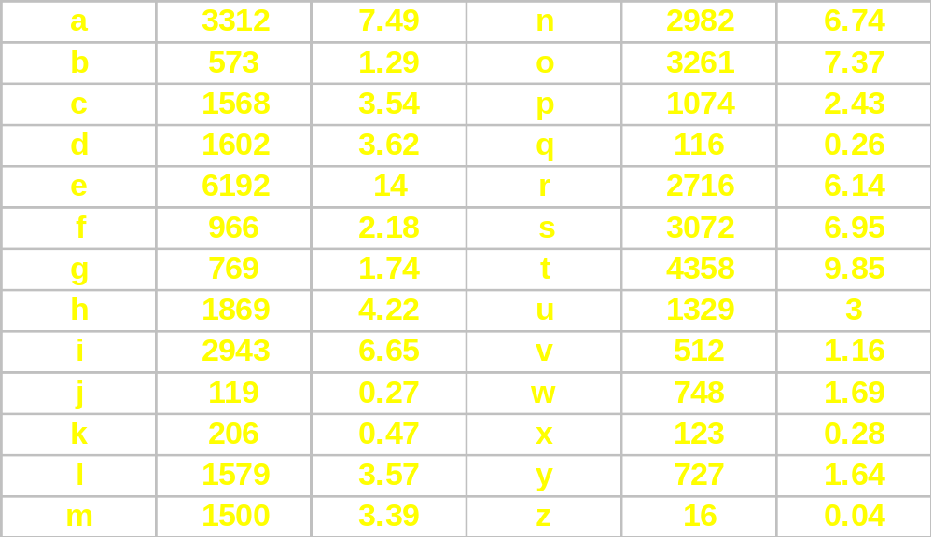
Frequency Table
Letter Frequency Pct. Letter Frequency Pct.
n = 44232

Slide 18
Frequency Groupings
High | E T A O N I R S H
Medium | D L U C M
Low | P F Y W G B V
Rare | J K Q X Z
There is usually a 2% drop between the high and medium
Frequency letter groups
Source: Richard Spillman

Slide 19
English Characteristics
Three vowels: “a”, “i”, “o” tend to avoid each other
Vowels make up 40% of messages
High-frequency letters make up 70% of message
80% of letters before “n” are vowels
“h” frequently proceeds “e” but rarely follows
Source: Richard Spillman

Slide 20
Digrams and Trigrams
Top 10 Digrams
TH IN
HE ER
RE ON
ES AN
AT TI
Top 10 Trigrams
THE ING
THA AND
HAT ION
ENT YOU
THI FOR
These are just as prevalent as individual characters
and can be subjected to the same kind of relative
frequency analysis ~ some like qp just don’t exist.
Source: Making, Breaking Codes
By Paul Garrett

Slide 21
Substitution Ciphers
Substitution
Monoalphabetic
Polyalphabetic
Shift
Keyword
Other
Source: Richard Spillman
Pacific Lutheran University

Slide 22
The Alphabet & Modular Arithmetic
A B C D E F G H I J K L M
0 1 2 3 4 5 6 7 8 9 10 11 12
N O P Q R S T U V W X Y Z
13 14 15 16 17 18 19 20 21 22 23 24 25
Arithmetic operation mod 26 = [0,25]

Slide 23
Polyalphabetic Substitutions
Monoalphabetic ciphers produce the same distributions as plaintext. To flatten the ciphertext distribution, try combining two ciphers so that letters of high and low frequency will map to the same cipher letter.
  ABCDEFGHIJKLMNOPQRSTUVWXYZ
  ADGJMPSVYBEHKNQTWZCFILORUX
    3a mod 26 above for odd positions
  ABCDEFGHIJKLMNOPQRSTUVWXYZ
  NSXCHMRWBQLQVAFKPUZEJOTYDI
    (5a + 13) mod 26 above for even positions
  TREAT YIMPO SSIBL E encrypts to
  FUMNF DYVTF CZYSH H

Slide 24
Vigenère Cipher
This is an example of a polyalphabetic cipher where the substitution pattern varies
  that is, a plaintext “e” may be replaced by a ciphertext “p” one time and a ciphertext “w” another
  the Vigenère cipher does this using a Vigenère table

Slide 25
Vigenère Table
a b c d e f g h i j k l m n o p q r s t u v w x y z
a a b c d e f g h i j k l m n o p q r s t u v w x y z
b b c d e f g h i j k l m n o p q r s t u v w x y z a
n c d e f g h i j k l m n o p q r s t u v w x y z a b
d d e f g h i j k l m n o p q r s t u v w x y z a b c
e e f g h i j k l m n o p q r s t u v w x y z a b c d
f f g h i j k l m n o p q r s t u v w x y z a b c d e
g g h i j k l m n o p q r s t u v w x y z a b c d e f
h h i j k l m n o p q r s t u v w x y z a b c d e f g
i i j k l m n o p q r s t u v w x y z a b c d e f g h
j j k l m n o p q r s t u v w x y z a b c d e f g h i
k k l m n o p q r s t u v w x y z a b c d e f g h i j
l l m n o p q r s t u v w x y z a b c d e f g h i j k
m m n o p q r s t u v w x y z a b c d e f g h i j k l
n n o p q r s t u v w x y z a b c d e f g h i j k l m
o o p q r s t u v w x y z a b c d e f g h i j k l m n
p p q r s t u v w x y z a b c d e f g h i j k l m n o
q q r s t u v w x y z a b c d e f g h i j k l m n o p
r r s t u v w x y z a b c d e f g h i j k l m n o p q
s s t u v w x y z a b c d e f g h i j k l m n o p q r
t t u v w x y z a b c d e f g h i j k l m n o p q r s
u u v w x y z a b c d e f g h i j k l m n o p q r s t
v v w x y z a b c d e f g h i j k l m n o p q r s t u
w w x y z a b c d e f g h i j k l m n o p q r s t u v
a x y z a b c d e f g h i j k l m n o p q r s t u v w
y y z a b c d e f g h i j k l m n o p q r s t u v w x
z z a b c d e f g h i j k l m n o p q r s t u v w x y
The table lists the key
characters on
top and the
plaintext
characters on
the side

Slide 26
Vigenère Cipher Steps
A keyword is selected and it is repeatedly written above the plaintext
  EXAMPLE: using the keyword “hold”
  Each column forms a keyword/plaintext letter pair which is used in the Vigenère table to determine the ciphertext letter
h o l d h o l d h o l d h o l d
t h i s t h e p l a i n t e x t

Slide 27
Vigenère Example
a b c d e f g h i . . .
a a b c d e f g h i
b b c d e f g h i j . . .
n c d e f g h i j k . . .
d d e f g h i j k l . . .
e e f g h i j k l m . . .
f f g h i j k l m n . . .
g g h i j k l m n o . . .
h h i j k l m n o p . . .
i i j k l m n o p q . . .
j j k l m n o p q r . . .
k k l m n o p q r s . . .
l l m n o p q r s t . . .
m m n o p q r s t u . . .
n n o p q r s t u v . . .
o o p q r s t u v w . . .
p p q r s t u v w x . . .
q q r s t u v w x y . . .
r r s t u v w x y z . . .
s s t u v w x y z a . . .
t t u v w x y z a b . . .
u u v w x y z a b c . . .
Using the keyword “hold”
h o l d h o l d h o l d h o l d
t h i s t h e p l a i n t e x t
a
w
So, “t” becomes “a” but
at the end “t” becomes “w”

Slide 28
Cryptanalysis of Polyalphabetics
While difficult, these are not immune
Basic strategy is to determine the number of alphabets used to encrypt, and then…
  break message into its monoalphabetic components and
  solve each of these as before

Slide 29
KASISKI METHOD for repeated patterns
Relies on frequency of letter patterns such as
-th, -ing, in-, un-, re-, of, and, to
If message enciphered with n alphabets in cyclic
rotation and a word appears k times in plaintext,
it should be enciphered approximately k/n times
from same alphabet

Slide 30
KASISKI METHOD
Example using Dickens' work
dicke nsdic kensd icken sdick ensdi ckens dicke
itwas thebe stoft imesi twast hewor stoft imesi
nsdic kensd icken sdick ensdi ckens dicke nsdic
twast heage ofwis domit wastn eageo ffool ishne
kensd icken sdick ensdi ckens dicke nsdic kensd
ssitw asthe epoch ofbel iefit wasth eepoc hofin
IT WAS THE is encrypted using keyword nsdicken three times
above, once in the first line, twice in the third line
These all appear as identical 8-character ciphertext
patterns. Distance between repeated patterns is a multiple
of keyword length. Any repeated pattern over 3 characters
is probably not accidental.

Slide 31
Kasiski Method cont’d
Although many 2-letter combinations are coincidental, the probability of 4-letter coincidences is only 0.0000021
Once a repeated phrase has been found, compute the distance to the next occurrence and determine the factors for that distance.
Repeat as necessary and determine most likely factors
Starting Distance from Factors
Position Previous
20 ----------- -------------
83 63 (83-20) 3, 7, 9, 21, 63
104 21 (104-83) 3, 7, 21
3 or 7

Slide 32
Steps in the Kasiski Method
Identify repeated patterns of 3 or more characters
For each pattern, note the position at which each
instance of the pattern begins
Note the difference between starting points of
successive instances
Compute factors of each difference; key length is
likely to be one of the factors that appears often
Then try to divide message into pieces enciphered
with same alphabet

Slide 33
Index of Coincidence
Once a key length is selected (3 or 7), divide the encrypted message into that
number of sub-messages.
Compare frequency distributions to English to determine whether a particular set was used to encrypt.
M₁ = {c1,c4,c7,… } M₂ = {c2,c5,c8,… } M₃ = {c3,c6,c9,… }

Slide 34
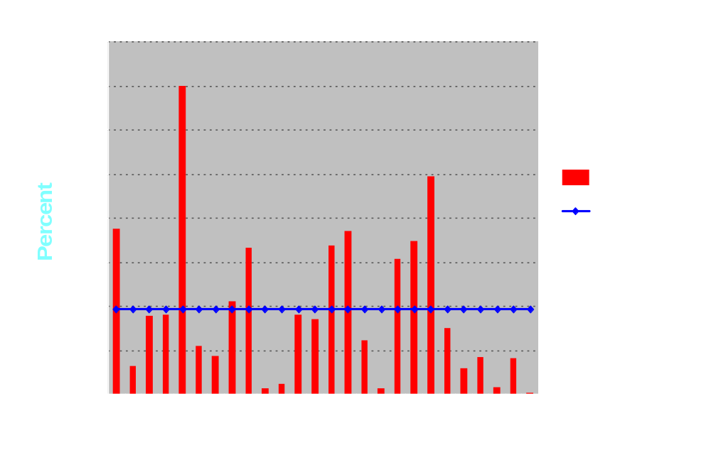
Roughness of Distribution of English Text

Slide 35
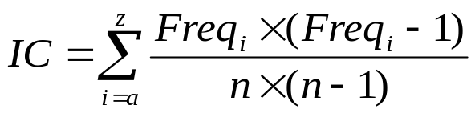
Index of Coincidence
If we have lots of ciphertext AND underlying plaintext has a fairly standard distribution of letters, THEN can use IC:
NUMBER OF
INDEX OF
ALPHABETS
COINCIDENCE
1
0.068
2
0.052
3
0.047
4
0.044
5
0.044
10
0.041
large
0.038

Slide 36
Decrypting Polyalphabetics
Use Kasiski method to predict likely
number of enciphering alphabets. If
it does not work, then encryption is
probably not simply a polyalphabetic
substitution.
Separate ciphertext into appropriate
subsets and independently compute IC
for each subset (should be near 0.068)
Use frequency analysis on each subset
Low frequency analysis (“j”, “k”, “q”, “x”, “z”)

Slide 37
The Perfect Substitution Cipher
Use many alphabets to produce a perfectly flat distribution with no recognizable pattern for the choice of any alphabet at any given point.
Suppose the Vigenère Tableau were extended infinitely with a random key
Would defy the Kasiski Method. Any repeat encryptions would be purely coincidental
IC = 0.038 suggesting a totally random encryption.

Slide 38
Autokey Ciphers
Extension of the Vigenère Cipler
Start with a keyword as before
Instead of repeating the keyword, start using the plaintext message after first occurrence of the keyword (running key).
Variation: using the cipher text as the running key.

Slide 39
Autokey Example
Key is “dickens”
dicke nsitw asthe besto ftime sitwa sthew orsto
itwas thebe stoft imesi twast hewor stoft imesi
lbykw gzmua slhmx jqwlw ypiex zmpkr kmvjp wewlw

Slide 40
Substitution Ciphers
Substitution
Monoalphabetic
Polyalphabetic
One-time Pad
Shift
Keyword
Other
Source: Richard Spillman
Pacific Lutheran University

Slide 41
One-time Pads
Called the perfect cipher because it uses an arbitrarily long encryption key
Sender and receiver are provided a book of keys and encryption tableaus. If each key has length = 20, then a 300 letter message would require 15 keys pasted adjacently. After encryption and subsequent decryption, both sender and receiver destroy the keys.
No key is ever used twice.

Slide 42
Problems with One-time Pads
Requires absolute synchronization between sender and receiver
Need exists for an unlimited number of keys
Publishing, distributing and securing keys is a major problem - an administrative burden

Slide 43
Long Sequences from Books
Use the phone book (middle two digits of a telephone number make a good RN)
  RN mod 26 defines the Vigenère key column
Use a novel for a nonrepeating key
  Problem is that both key and plaintext have the same frequency distribution
  also {a,e,i,n,o,t} make up 50% of all letter occurrences in English. Probability that they map to same subset is 0.25
  leads to a reduced Vigenère Tableau and some effective guessing

Slide 44
Use Of Random Numbers
Approximates one-time pads
  computer generated random numbers must be scaled to the interval [0, 25]
Requires complete synchronization between sender and receiver
RN Generators are not truly random, and given enough ciphertext, they can be broken

Slide 45
Random Number Generators
Many encryption algorithms rely on random numbers
RNGs produce long period sequences but the cycle eventually repeats
The linear congruential RNG is the most common type - requires a seed value
NEW_RANDNO := (A*OLD_RANDNO + B) mod N
A, B and N are constants;
seed number and B must be prime relative to N

Slide 46
The Vernam Cipher
Named after its developer, Gilbert Vernam who worked for AT&T
Vernam used a punched paper tape containing a long series of non-algorithmic random numbers to produce the ciphertext
Keys destroyed after a single use to make them immune to analysis

Slide 47
Vernam Model
Long Random Number Sequence
Original
Plaintext
Plaintext
Ciphertext
⊕
⊕
Encryption
Decryption
⊕ denotes an XOR or other combining function

Slide 48
Vernam Example
plaintext
numeric equivalent
+ random number
= sum
≡ mod 26
ciphertext
V E R N A M C I P H E R
21 4 17 13 0 12 2 8 15 7 4 17
76 48 16 82 44 3 58 11 60 5 48 88
97 52 33 95 44 15 60 19 75 12 52 105
19 0 7 17 18 15 8 19 23 12 0 1
T A H R S P I T X M A B

Slide 49
CRYPTANALYSIS TOOLS
Encrypted messages
Known encryption algorithms
Intercepted plaintext
Cribs - Data known or suspected to be
in enciphered messages
Math and statistical techniques
Properties of languages
Computers
Ingenuity and luck
Source: Lance Hoffman
George Washington University

