Slide 1
Introduction to Security
CSCI 43200 – Security in Computing
Copyright © 2005, 2017 by Scott Orr and the Trustees of Indiana University

Slide 2
Section Overview
Why Security?
Terms and Concepts
Security Threats
Security Countermeasures

Slide 3
References
Computer Security: Principles and practice 3rd Ed.
  Chapter 1

Slide 4
Why Worry about Security?
Y2K Bug – 1/1/2000
DDoS Attack of Yahoo, CNN – 2/2000
Microsoft break-in – 10/2000
SPAM and Phishing
Viruses, Worms, and Botnets
Physical Disasters (Natural and Man-made)
Cyber Warfare
Ransomeware
Insider Threats (e.g. Edward Snowden)
Identity Theft and Privacy
Heartbleed, Poodle, and Shellshocked – 2014
IoT!

Slide 5
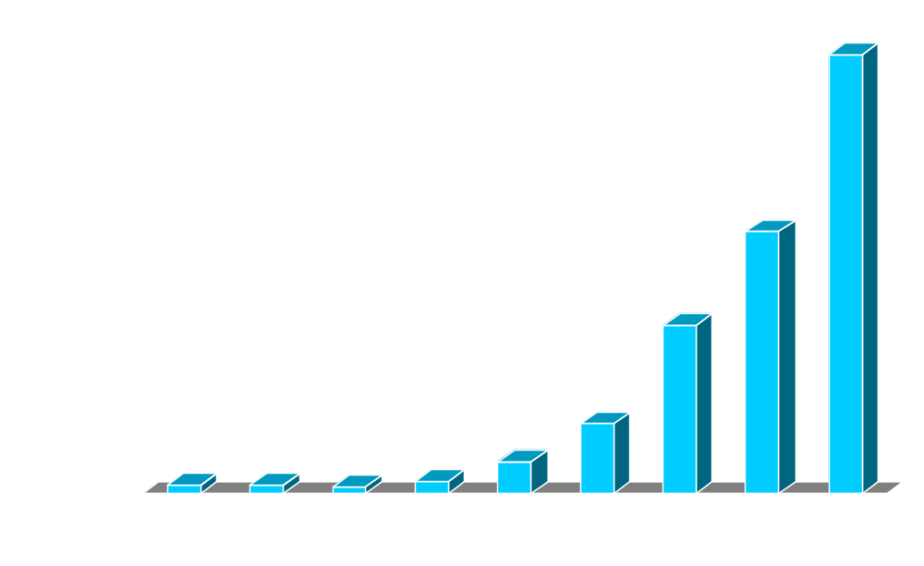
Reported Incidents
Source: CERT

Slide 6
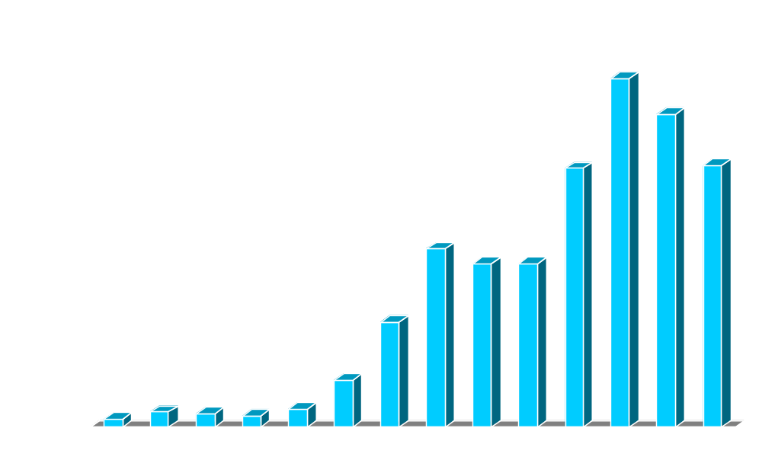
Reported Vulnerabilities
Source: CERT

Slide 7
Security Lingo
Risk
Vulnerability
  Corrupted
  Leaky
  Unavailable
Threat
Attack and Adversary (Threat Agent)
  Active vs. Passive
  Inside vs Outside
Countermeasures and Security Policy

Slide 8




What are we protecting?
Hardware
Software
Data
Networks
Computer System Assets

Slide 9
Threats to these Assets
Unauthorized Disclosure
  Exposure, Interception, Inference (Traffic Analysis), Intrusion
Deception
  Masquerade, Falsification, Repudiation
Disruption
  Incapacitation, Corruption, Obstruction
Usurpation
  Misappropriate, Misuse

Slide 10
Other Assets
Storage Media
Access to resources
Key People
Reputation

Slide 11
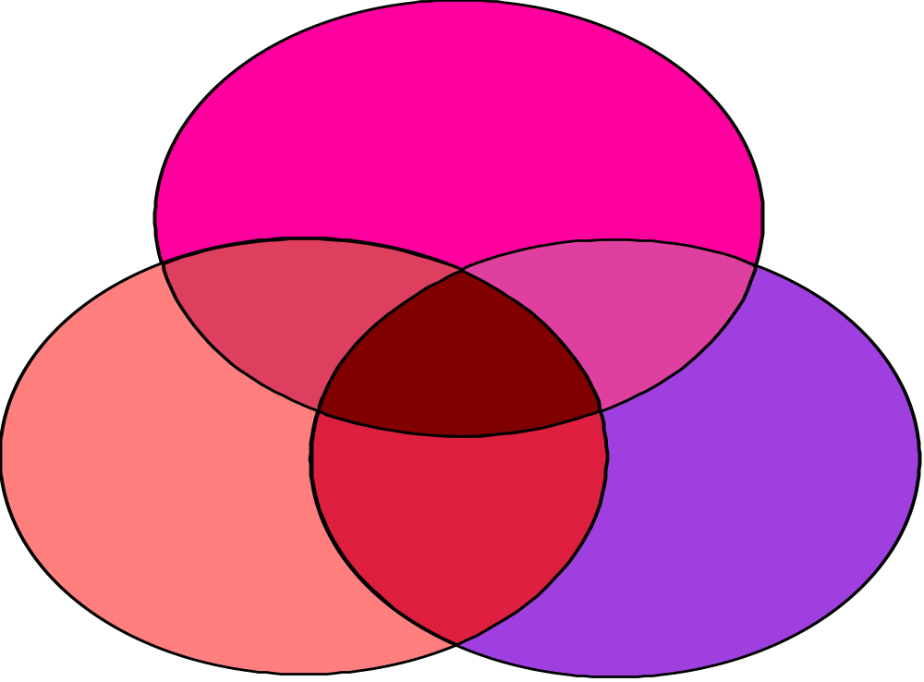
Goals of Security
Confidentiality
Integrity
Availability
Accountability?

Slide 12
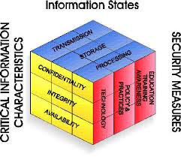
McCumber Cube
Source: https://buildsecurityin.us-cert.gov/sites/default/files/McCumber.pdf

Slide 13
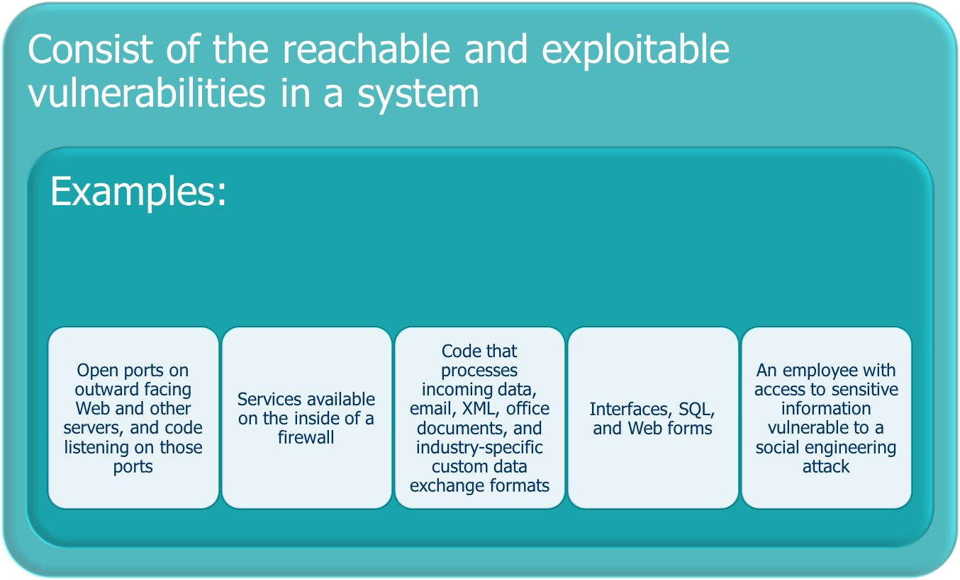
Attack Surfaces
Source: Computer Security: Principles and Practice, 3rd Ed.
Notes:
An attack surface consists of the reachable and exploitable vulnerabilities in a system
[MANA11, HOWA03]. Examples of attack surfaces are the following:
• Open ports on outward facing Web and other servers, and code listening on
those ports
• Services available on the inside of a firewall
• Code that processes incoming data, email, XML, office documents, and industry-specific
custom data exchange formats
• Interfaces, SQL, and Web forms
• An employee with access to sensitive information vulnerable to a social engineering
attack

Slide 14
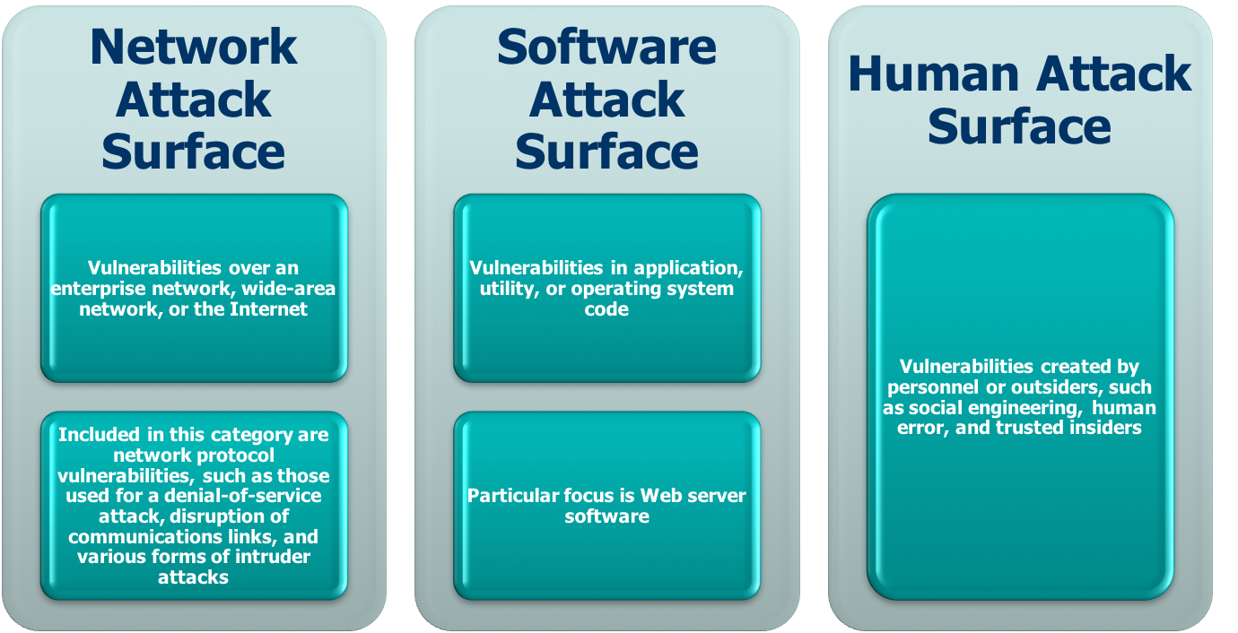
Attack Surface Categories
Source: Computer Security: Principles and Practice, 3rd Ed.
Notes:
Attack surfaces can be categorized in the following way:
• Network attack surface: This category refers to vulnerabilities over an enterprise
network, wide-area network, or the Internet. Included in this category
are network protocol vulnerabilities, such as those used for a denial-of-service
attack, disruption of communications links, and various forms of intruder attacks.
• Software attack surface: This refers to vulnerabilities in application, utility,
or operating system code. A particular focus in this category is Web server
software.
• Human attack surface: This category refers to vulnerabilities created by personnel
or outsiders, such as social engineering, human error, and trusted insiders.
An attack surface analysis is a useful technique for assessing the scale and
severity of threats to a system. A systematic analysis of points of vulnerability
makes developers and security analysts aware of where security mechanisms are
required. Once an attack surface is defined, designers may be able to find ways to
make the surface smaller, thus making the task of the adversary more difficult. The
attack surface also provides guidance on setting priorities for testing, strengthening
security measures, or modifying the service or application.

Slide 15
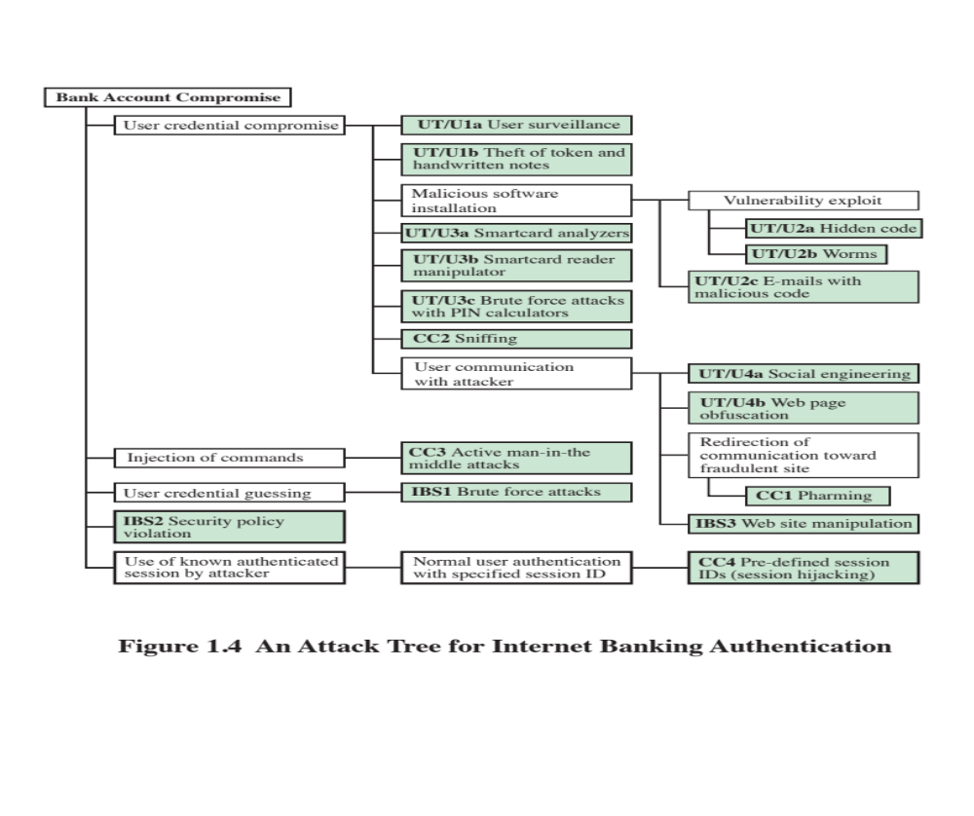
Attack Trees
Source: Computer Security: Principles and Practice, 3rd Ed.
Notes:
An attack tree is a branching, hierarchical data structure that represents a set of
potential techniques for exploiting security vulnerabilities [MAUW05, MOOR01,
SCHN99]. The security incident that is the goal of the attack is represented as the
root node of the tree, and the ways that an attacker could reach that goal are iteratively
and incrementally represented as branches and subnodes of the tree. Each
subnode defines a subgoal, and each subgoal may have its own set of further subgoals,
etc. The final nodes on the paths outward from the root, i.e., the leaf nodes,
represent different ways to initiate an attack. Each node other than a leaf is either
an AND-node or an OR-node. To achieve the goal represented by an AND-node,
the subgoals represented by all of that node’s subnodes must be achieved; and for
an OR-node, at least one of the subgoals must be achieved. Branches can be labeled
with values representing difficulty, cost, or other attack attributes, so that alternative
attacks can be compared.
The motivation for the use of attack trees is to effectively exploit the information
available on attack patterns. Organizations such as CERT publish security
advisories that have enabled the development of a body of knowledge about both
general attack strategies and specific attack patterns. Security analysts can use the
attack tree to document security attacks in a structured form that reveals key vulnerabilities.
The attack tree can guide both the design of systems and applications,
and the choice and strength of countermeasures.
Figure 1.4, from [DIMI07], is an example of an attack tree analysis for an
Internet banking authentication application. The root of the tree is the objective of
the attacker, which is to compromise a user’s account. The shaded boxes on the tree
are the leaf nodes, which represent events that comprise the attacks. The white boxes
are categories which consist of one or more specific attack events (leaf nodes).
Figure 1.4 provides a thorough view of the different types of attacks on an
Internet banking authentication application. Using this tree as a starting point, security
analysts can assess the risk of each attack and, using the design principles outlined
in the preceding section, design a comprehensive security facility. [DIMO07]
provides a good account of the results of this design effort.

Slide 16
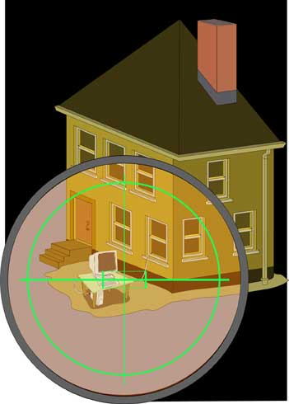
Why me?!?!?!
You are the Target
  Blackmail
  Revenge
  Espionage
Target of Opportunity
  Thrill Seeker & Net Cred
  Scams & ID Theft
  Botnet recruitment
  Ideological (“Hacktivists”)
“MOM”
  Means, Opportunity, Motive

Slide 17
Threat Pyramid
Governments
100’s
Aggressive
1K’s
Moderate
10K’s
Script
Kids
1M’s
Source: Tom Perrine, SDSC
Security as Infrastructure

Slide 18
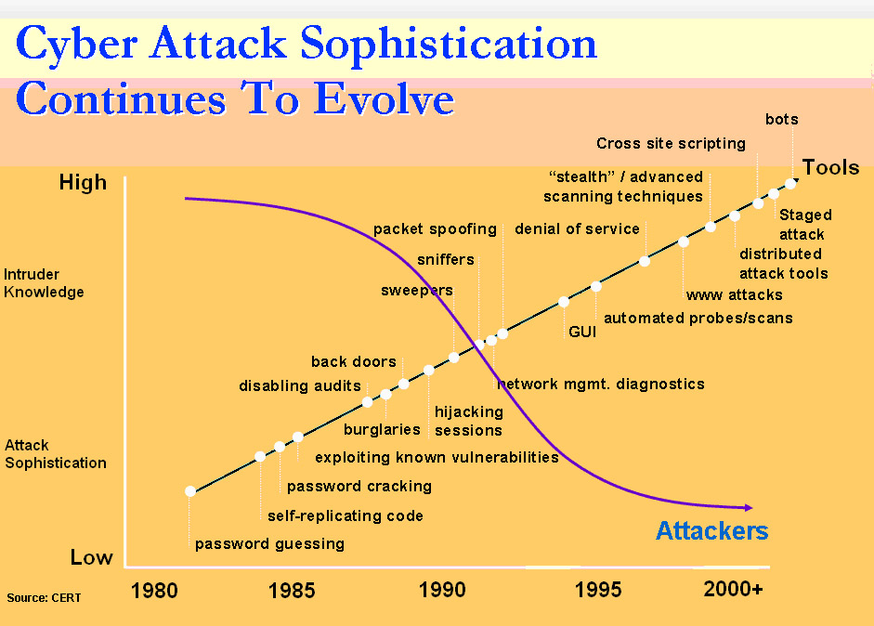
Source: CERT (Phishing Exposed)

Slide 19
The good, the bad, & the ugly
White
Hats
Gray
Hats
Black
Hats

Slide 20
Approaches to Defense
Prevent – Block attack entirely
Deter – Make attack harder
Deflect – Make target less interesting
Detect – Know attack is occurring (or occurred)
Respond – Mitigate active attack/damage
Recover – Fix aftermath

Slide 21
Cryptography Features
Non-repudiation
Integrity
Confidentiality
Authorization
Authentication

Slide 22
Other Countermeasures
Software
  Code within applications
  Operating System
  Stand Alone Security Applications
  Code Standards and Testing
Hardware
Physical
Policies

Slide 23
Applying Countermeasures
Awareness of Problem
Likelihood of Use
  “Principle of Effectiveness”
Overlapping measures (Layering)
Periodic Review
  “Principle of Weakest Link”

Slide 24
How much security?
Security
Ease of Use
Beware of Security through Obscurity
“Principle of Easiest Penetration”

Slide 25
Role of Security
“Security is like adding brakes to cars. The underlying purpose of brakes is not to stop you: it’s to enable you to go fast! Brakes help avoid accidents caused by mechanical failures in other cars, rude drivers, and road hazards.
Better security is an enabler for greater freedom and confidence in the Cyber world.”
Source: Gene Spafford
Purdue University

