Slide 1
Identification and Authentication
CS43200 - Security in Computing
Copyright © 2005, 2017 by Scott Orr and the Trustees of Indiana University

Slide 2
Section Overview
Identity
Password Authentication
Password System Vulnerabilities
Two Factor Authentication

Slide 3
References
Computer Security: Principles and Practice, 3rd Ed.
  Chapter 3
Online Resources
  Password Security: A Case History by Robert T. Morris and Ken Thompson
  Foiling the Cracker by Daniel V. Klein

Slide 4
Common OS Security Features
Audit
Access Control
Authentication

Slide 5
Identity and Authentication
Why usernames?
  Grant access to system
  Control access to resources
  Accountability
Passwords
  Prove you are who you say you are
  Often weakest link in system security

Slide 6
Low-Tech Vulnerabilities
Shared Passwords
  Email
  Spoken
Written down near computer
Social Engineering
Shoulder Surfing
Dumpster Diving or “Trashing”
  Account slips
  Manuals/Documentation

Slide 7
Early Authentication
Password file
alice:boxcar
bob:secret
chris:qwerty
debbie:aaaaa
linda:adnil
scott:secret
tom:tom1
Login:
scott
Password:
secret
Welcome…
Security was not a concern!

Slide 8

Password Encryption
Password file
Login:
scott
Password:
secret
alice:kDiBZ7
bob: Fq%sd6
chris:3ybIY/
debbie:1vaZlR
linda:kAQWNz
scott: Fq%sd6
tom:wXmvVq
Welcome…
One-way
Hash
Fq%sd6
What if two users have the same password?

Slide 9
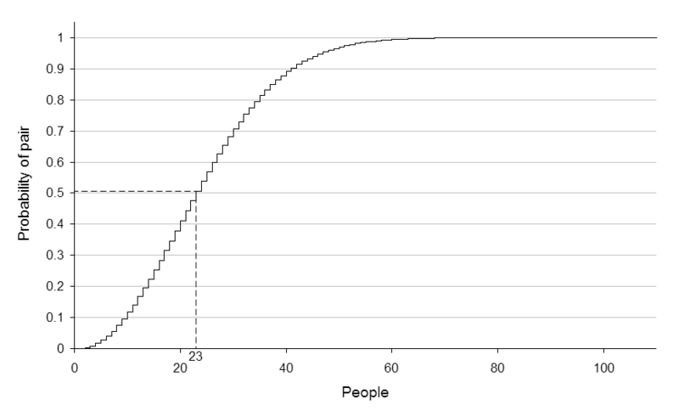
Birthday Paradox

Slide 10
Salting the Password
Password file
Login:
scott
alice: jrhS/T2I
bob: 9qW1ky!e
chris:d5UTV1w5
debbie:b9lvn17j
linda:9sNBXr/Z
scott: pAFq%sd6
tom:q.ZFrpuN
Password:
secret
Welcome…
Salt?
One-way
Hash
pA
pAFq%sd6
Encrypted passwords randomized but still readable.

Slide 11
UNIX Password Encryption
Password
balloons
Salt
Vs
DES
One-way
Hash
0x00000000
Randomize
25 times
VsjqYhTwQiJPw
Asciify
Newer systems use SHA-512 now
Valid: A-Za-z0-9./

Slide 12
Lan Manager Password Encryption
Password
14charpassword
14CHARP
P
ASSWORD
P
DES
One-way
Hash
DES
One-way
Hash
0xAAD3B435B51404EE
0xE79E56A8E5C6F8FE
0xAAD3B435B51404EE

Slide 13
Windows Password Encryption
16-bit character
Unicode
MD4
One-way Hash
Password
SAM
6-14 character passwords
Stored in registry and files
Backwards compatible with LAN Manager (2nd entry)

Slide 14
Weak Passwords
No passwords used
Smoking Joes
Information about user
Dictionary Attacks
  Modification of user ID or name
  Modification of dictionary(s) word(s)
  Keyboard patterns
  Any systematic, algorithmic generator

Slide 15
Dictionary Attacks
Dictionary
/etc/passwd
a
aback
…
secrecy
secret
secrete
…
zurich
zygote
alice:######
bob: 9qW1ky!e
scott: pAFq%sd6
tom:######
Salt?
One-way
Hash
pA
pAFq%sd6
Match!!!
Quick but only catches weaker passwords

Slide 16
Klein’s Tests (1990)
Type of words in dictionary | % of Broken passwords
/usr/dict/words | 30.6%
Common names | 16.5%
User/account name | 11.2%
Male/Female names | 9.1%
Phrases and patterns | 7.5%
System names | 4.1%
24.2% of all passwords tested were broken.
Source: Dan Klein, Foiling the Cracker

Slide 17
Selecting Strong Passwords
At least 14 characters in length
Mix of case, numbers and special characters
Something you can remember
Techniques
  Texting shortcuts & letter/number replacements
  Acronyms from phrases
  Passphrases

Slide 18
Pass Phrase Examples
  smo11012006
    Poor
  ardl79BEf76357
    14 spaces
    Hard to remember
    Good
  MydogSkiplovestoplayfetcheveryday
    33 spaces
    Easier to remember
    Better
  Myd0gSkipluvs2playfetchev3ryday
    31 spaces
    Easier to remember
    Limit Duplicate letters –substitute with numbers, punctuation, or special characters
    Best

Slide 19
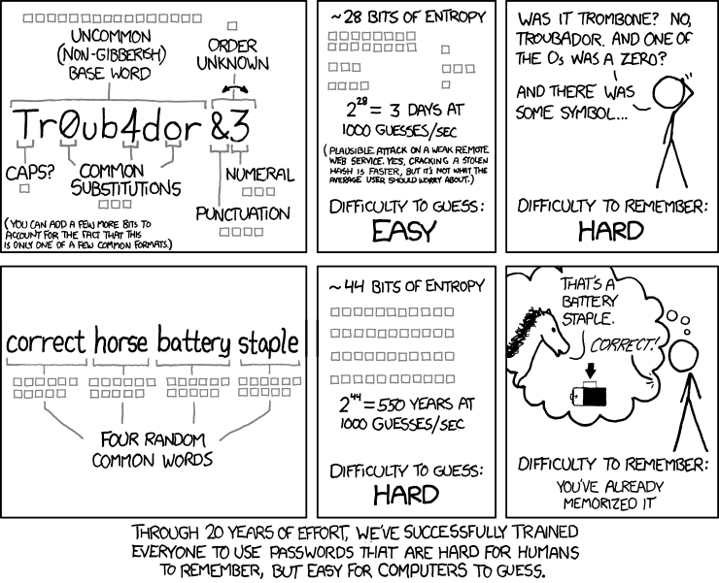
Password Strength
Bits of Entropy:
Number of option to try
E = ∑ log₂(R) * L
  R: Range of Available Characters
  L: Password Length
2E possible password
Source: https://xkcd.com/936/

Slide 20
Brute Force Attacks
/etc/passwd
a
aa
…
secres
secret
secreu
…
zzzzzzzy
zzzzzzzz
alice:######
bob: 9qW1ky!e
scott: pAFq%sd6
tom:######
Salt?
One-way
Hash
pA
pAFq%sd6
Match!!!
Effective but very slow!
(Hybrids - will try rule-based dictionary attacks first)

Slide 21
Rainbow Tables
Brute force attacks are time consuming
Alternative – Calculate all hashes ahead of time (Time/Memory tradeoff)
Look hash up in table to find password
Space saved by grouping into chains
Salting can defeat system

Slide 22
Creating Tables
Index
Hash
Reduce
Index
I
H
I
H
o o o
I
H
I
H
I
H
I
H
o o o
I
H
I
H
I
H
I
H
o o o
I
H
I
H

Slide 23
Rainbow Cracking
Obtain password hash to crack
Does it match any hash at end of chains?
  Yes: Stop (password is in this chain)
  No: Reduce password and rehash
  Repeat until match
Keep track of number of checks
Iterate through chain to get password

Slide 24
Minimizing Password Threats
User Education!!!
Shadow Passwords
More secure password changing programs
System-wide weak-password checks
Password Aging
  Maximum time between changes
  Minimum time between changes

Slide 25
UNIX /etc/shadow
Example: sorr:$1$KHvoRlZt$n3z6SWZa09tMU5EC4FTr9/:12784:3:90:7::13149:
Username
Encrypted password
Day last changed
Minimum # days between changes
Maximum # days between changes
Notify # days before account expires
Account Inactivation
  Expire # days after max change (Linux)
  Expire after # days of inactivity (Solaris)
Expiration day
Flags (unused)

Slide 26
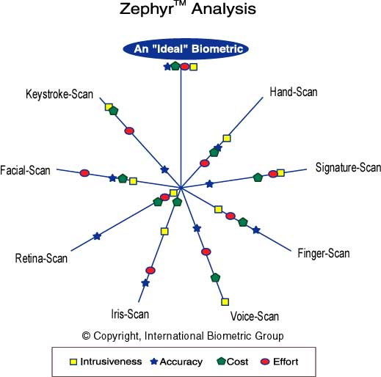
Biometrics
Source: www.biometricgroup.com

Slide 27
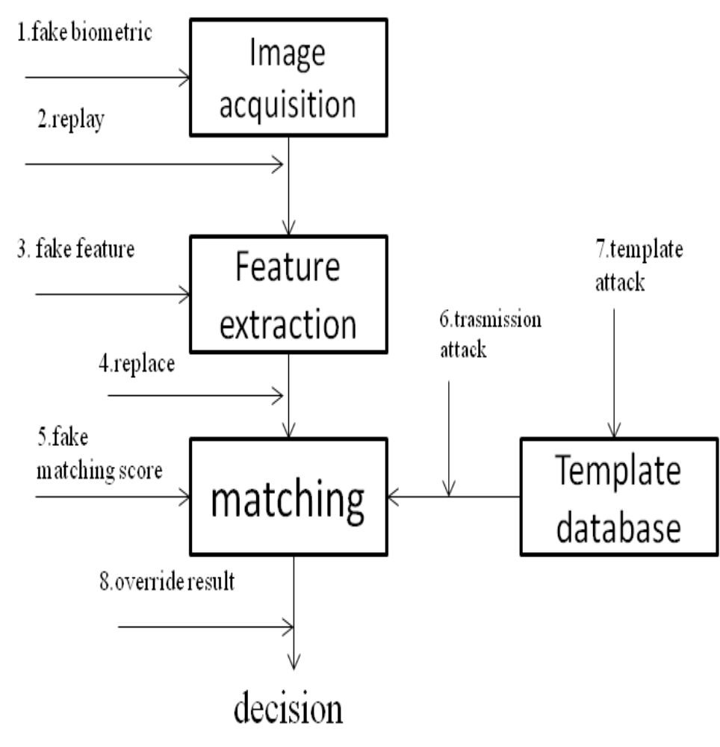
Security Concerns of Biometrics
U Uludag, U. and A. Jain (2004). Attacks on biometric systems: a case study in fingerprints.

Slide 28


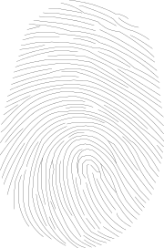
Two Factor Authentication
Something
You have
Something
You know
Something
You are

Slide 29
Challenge/Response OTP
Login:
scott
OTP
Calculator
otp 87 mj1492
Response:
DOG FOX ONE TOO
Welcome…
Seq #:
87
Seed:
mj1492
Pass Phrase:
Open me!
DOG FOX ONE TOO

Slide 30
Synchronized OTP
Login:
scott
SecureID Code:
234836
Welcome…
Changes every minute
Beware of Race Condition Attacks

Slide 31
Misc. Access Control
Failed attempt lockouts
Password reuse restrictions
User can only log in if certain conditions are met:
  Time of Day
  Day of Week
  Location or Terminal
Unique for each user

