Slide 1
Lecture 23
Random Numbers

Slide 2
Random Variate Generator
General Strategy:
Generate a random number between [0,1] i.e. uniform distribution within the range [0,1]
Use an inverse transformation of CDF function to convert the uniform random variate into a specific RV within that CDF

Slide 3
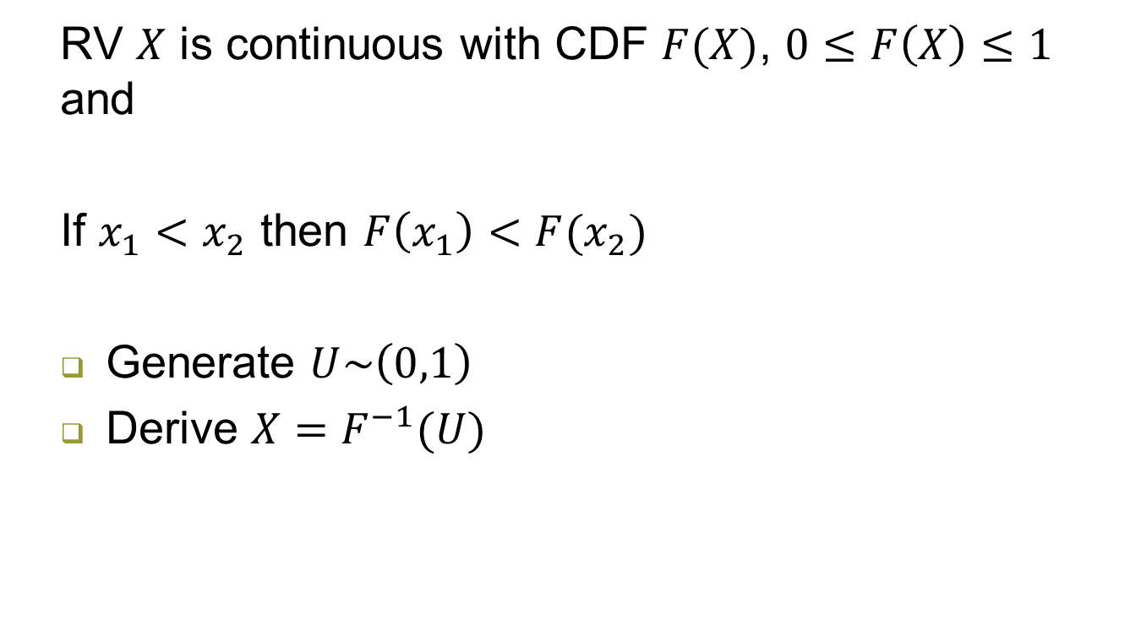
Inverse Transformation
RV $X$ is continuous with CDF $F(X)$, $0≤F\left(X\right)≤1$ and
If $x_{1}<x_{2}$ then $F\left(x_{1}\right)<F(x_{2})$
Generate $U\sim \left(0,1\right)$
Derive $X=F^{−1}(U)$

Slide 4

Inverse Transformation – Exponential
$$F\left(X\right)=1−e^{−λx}, if x≥0$$
Lets Generate $X$

Slide 5

Inverse Transformation – Normal
$$F\left(X\right)=\frac{1}{2}[1+\operatorname{erf}\left(\frac{x−μ}{σ\sqrt{2}}\right)]$$
Where $\operatorname{erf}\left(z\right)= \frac{2}{√π}\int_{0}^{z}{e^{−t^{2}}dt}$ is error function
What are your thoughts?

Slide 6
Pseudo Random
In arithmetic generators, there is no such thing as a random number – there are only methods to produce random numbers (Neumann, 1951)
If we know one number in the random number sequence, then we can completely determine the next random numbers

Slide 7
Good Random Number Generators
Uniformity: the numbers should be distributed uniformly on [0,1] and no correlation with each other
Computational and storage efficiency: the generator should be fast to use and does not require large storage
Reproducibility: the random number steams should be reduced to 1. debug and validate computer codes; 2. obtain more precise comparison among various alternatives

Slide 8
Good Random Number Generators
Facilities for multiple streams: it should have the capability to produce multiple/separate streams of random variables easily (e.g. one stream for arrivals and another for services)
Portability: a generator should be portable to be run on different computer languages and OS

Slide 9
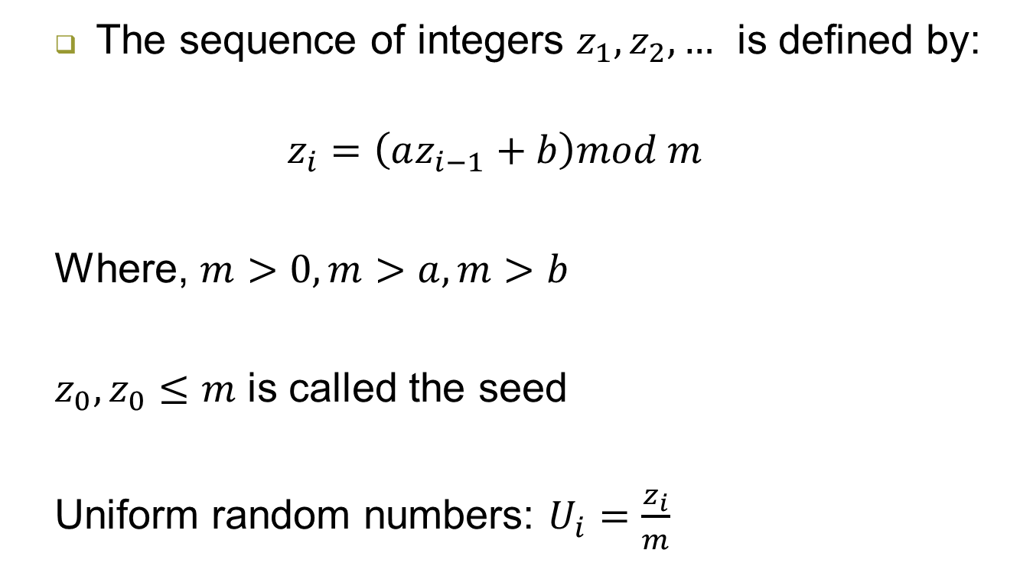
Linear Congruential Generator (LCG)
The sequence of integers $z_{1},z_{2},…$ is defined by:
$$z_{i}=\left(az_{i−1}+b\right)mod m$$
Where, $m>0, m>a, m>b$
$z_{0}, z_{0}≤m$ is called the seed
Uniform random numbers: $U_{i}=\frac{z_{i}}{m}$

Slide 10

Example
$$m=7, a=3, b=4, z_{0}=5$$
Generate 5 random numbers
$$z_{i}=\left(3z_{i−1}+4\right)mod 7$$

Slide 11
LCG - Properties
Full period of LCG: all numbers < m appear in the same sequence. In the previous example, is LCG a full period?
Hull-Dobell Theorem
The LCG has full period if and only if the following conditions hold:
The only positive integer that divides both m and c is 1.
If q is a prime number that divides m, the q divides a-1
a-1 is divisible by 4 if m is divisible by 4

Slide 12
Composite Generators

