Slide 1
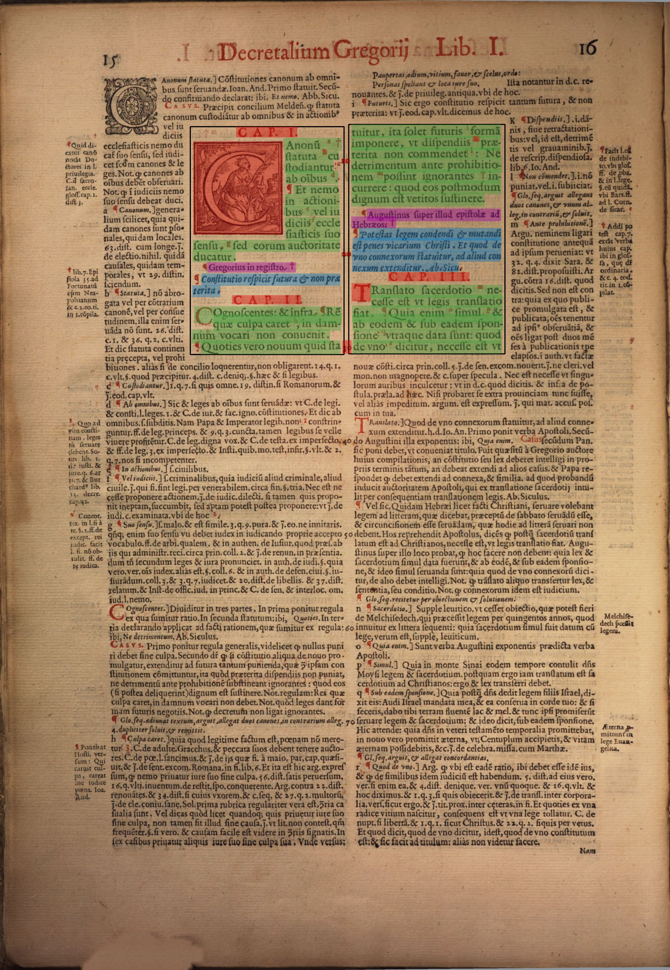
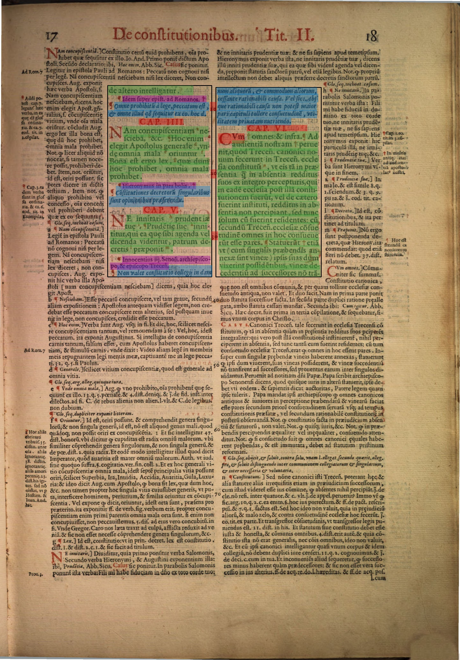
TASK I · 1 / 5
The two-page task: 131 / 131 correct
Rome, 1582 · Decretals · MDZ bsb10144443 · scans 40 and 41
A complete, reproducible submission
Fetch images + hOCR
Find the two central blocks
Assign the four requested roles
Export overlays + evaluation
PERSONALLY CHECKED AGAINST BOTH PAGES
OpenCV + NumPy · no training required
text
summarium
inscriptio
other
CONRAD COMPAGNA / PETRIUS
01
Notes:
Task I | 60 seconds | Slide 1 of 5
My starting point is the assignment itself: these two pages of the Roman Decretals. The submitted minimal program retrieves both images and both hOCR files directly from MDZ, finds the central text blocks, assigns the four requested roles, and produces these colour overlays together with the evaluation. It scores 131 out of 131 against the reference, and I personally inspected both page overlays. The colours separate legal text, summaria, inscriptiones and other material. The surrounding gloss remains outside the selected blocks. The implementation needs only OpenCV and NumPy. I have included this small program because the committee should be able to run and inspect the actual task solution immediately.
Evidence: task1_min/task1.py; task1_min/reference.csv; task1_min/labels_00040.jpg; task1_min/labels_00041.jpg

Slide 2
TASK I · 2 / 5
A small rule system is sufficient for this edition
The visual distinctions stated in the brief become explicit measurements.
Reference → program
Red ink
other
text
summ.
inscr.
other
outside
Slanted type
summarium
text
60
0
0
0
0
summ.
0
16
0
0
0
Large black type
text
0
0
7
0
0
inscr.
other
0
0
0
6
0
Remaining small type
inscriptio
outside
0
0
0
0
42
Also labelled: gutter numbers + initial
131 checked labels · all diagonal
Adaptive thresholding · split gutter-crossing OCR lines · grow each block to its chapter head
CONRAD COMPAGNA / PETRIUS
02
Notes:
Task I | 60 seconds | Slide 2 of 5
There are three measurements: red ink, slant, and letter height relative to the page's usual type. Large black lines establish the central blocks. The program extends each block upwards and downwards to include its chapter heads, and rejects lines extending into the gloss. Red material becomes other; slanted type becomes summarium; large type becomes text; the remaining small type becomes inscriptio. It uses the library's word and line geometry, splitting the five OCR lines that cross the gutter. The matrix contains sixty text labels, sixteen summaria, seven inscriptiones, six other labels, and forty-two outside controls. All are correct. The completed program also labels six gutter numbers and the woodcut initial, and rejects two junk OCR fragments. This solves the specified pages with a compact, inspectable implementation.
Evidence: task1_min/task1.py; task1_min/reference.csv; minimal confusion matrix verified in source

Slide 3
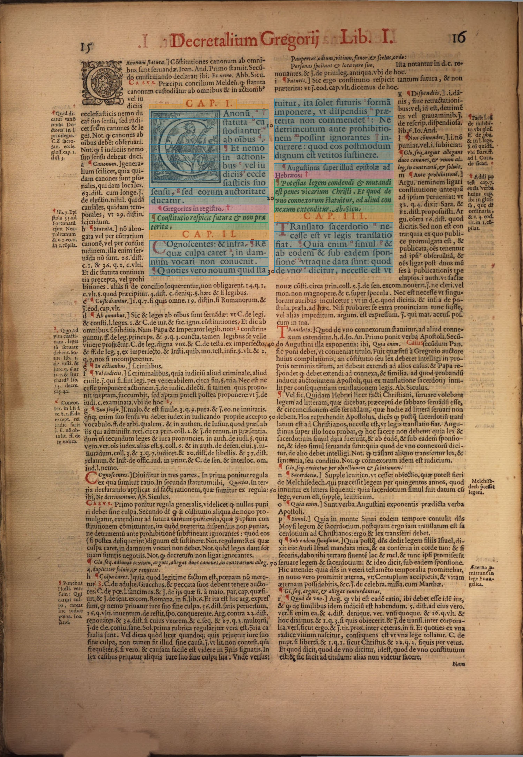
TASK I · 3 / 5
Across editions, use learned page and line models
D-FINE finds regions. PERO reads inside them. The neural tagger assigns roles.
D-FINE
PERO
Neural v3
region detection
lines + recognition
region + line roles
120 pages
120 pages
Region dataset
100 training + 20 evaluation
Role dataset
100 training + 20 evaluation
Line image + OCR characters + position + page context
CONRAD COMPAGNA / PETRIUS
03
Notes:
Task I | 60 seconds | Slide 3 of 5
The cross-edition solution is a neural pipeline. Fixed rules depend on the relationship between text size, gloss size, spacing and position in one edition. Those relationships change between printers and typefaces. I therefore trained D-FINE to find the regions, constrained PERO to find and recognise lines within those regions, and trained a neural model to select the central blocks and assign line roles. The line model combines colour image strips, OCR characters, coordinates and the other lines on the page. The two training collections each contain one hundred training pages and twenty evaluation pages. This image shows the combined pipeline on an original interview page. The package contains its model weights, inference code and a viewer for inspecting the results.
Evidence: out/dfine_region_training_v1/data_manifest.json; out/central_block_annotations_v1/manifest.json; line_nn_v3/model.py; out/line_nn_v3/task_predictions/bsb10144443/00040.json

Slide 4
TASK I · 4 / 5
The trained systems have measurable results
The two evaluations answer different questions: finding regions and assigning roles.
REGIONS · D-FINE
ROLE LABELS · NEURAL v3
0.862
Text
99.4%
Summarium
99.0%
region F1 at IoU ≥ 0.50
Inscriptio
89.7%
20 evaluation pages from 20 other books
206 matched · 32 extra · 34 missed regions
Other
90.0%
0.945 macro-F1 · 20 evaluation pages
14 label errors among 5,065 supplied lines
Training priorities: small source labels, chapter apparatus and precise region boundaries.
CONRAD COMPAGNA / PETRIUS
04
Notes:
Task I | 60 seconds | Slide 4 of 5
These results identify what each stage accomplishes and what to improve next. The region detector reaches an F1 score of 0.862 at fifty percent overlap on twenty pages from twenty books outside its training books. That represents 206 matched regions, thirty-two extra detections and thirty-four missed regions. The neural role model reaches macro-F1 of 0.945 on its twenty evaluation pages. Its text and summarium F1 scores are approximately ninety-nine percent; inscriptio and other are approximately ninety percent. There are fourteen label errors among 5,065 supplied lines. The practical next steps are clear: improve small source labels, chapter apparatus and region boundaries, then extend the labelled examples to Gothic and mixed-script material.
Evidence: D-FINE epoch14/step1400 in out/dfine_region_training_v1/full/epoch_metrics.jsonl; line_nn_v3/work/result_train_full.json; line_nn_v3/work/train_full.log

Slide 5
TASK I · 5 / 5
Six days: a complete experimental environment
LLM agents made this breadth of implementation and testing possible.
100
26k+
200+
3
volumes inventoried
source lines
source files
neural versions
Acquire → annotate → train → evaluate → inspect → revise
Claude + Codex: implementation, debugging and experiments
ChatGPT: training annotations
My work: research direction, decisions and personal checking
CONRAD COMPAGNA / PETRIUS
05
Notes:
Task I | 60 seconds | Slide 5 of 5
I used LLM agents extensively, and that is central to how this work was done. In six days I developed an acquisition layer for a hundred volumes, more than twenty-six thousand source lines across more than two hundred files, a review viewer, labelled training collections, a trained region detector and three generations of neural classifiers. Multiple candidate systems were tested and rejected. Claude and Codex implemented code, ran experiments and investigated failures under my direction. ChatGPT generated the training annotations, which I reviewed. I set the questions, judged the results and personally check the submission. This is a modern research workflow: it gives one researcher the implementation capacity and experimental breadth that previously demanded a much larger effort.
Evidence: FINDINGS.md section12; out/webgpt_ocr_fullpage100_20261006/timeline_evidence.json; project source inventory; NOTE.md tools statement

Slide 6
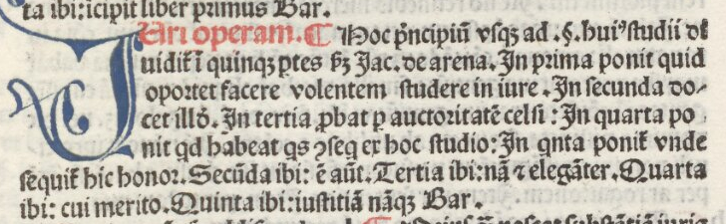
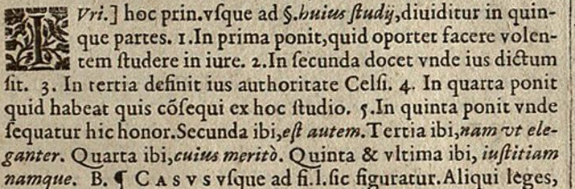
TASK III · 1 / 5
The same divisio; a different attribution
D. 1.1.1pr · the supplied witnesses, Venice 1490 and Lyon 1627
1490
1627
Jac. de arena … Bar.
B.
Jacobus de Arena + Bartolus
Bartolus
The historical event to detect: Jacobus de Arena disappears from the attribution.
CONRAD COMPAGNA / PETRIUS
06
Notes:
Task III | 60 seconds | Slide 1 of 5
The supplied example makes the historical objective concrete. These are crops of the complete divisio in the left column of each image. In 1490 the text names Jacobus de Arena and ends with Bartolus. In 1627 it retains only Bartolus. We need a system that retrieves these two units, recognises them as versions of the same paratext, and records the loss of an attribution. The abbreviation Bar and the abbreviation B should resolve to the same person. Jac de arena must remain a separate attribution that can disappear. This is why a single fuzzy text similarity score is insufficient. The workflow must distinguish variation in written form from changes in the information communicated by the paratext.
Evidence: PetrIUS Interview Tasks for the Postdoc 4 Position.docx, Task III; D. 1.1.1. 1490.jpg; D. 1.1.1. 1627.jpg

Slide 7
TASK III · 2 / 5
Retrieve the legal locus, then recover its paratext
An edition-independent anchor connects different page layouts.
1 Anchor
2 Retrieve
3 Attach
4 Assemble
D. 1.1.1pr
Book / title / fragment / incipit
OCR character n-grams
RapidFuzz: fuzzy text matching
Layout + lemma + sequence
Find the neighbouring divisio
Join lines into a whole unit
Keep image coordinates
Unit key
edition × legal locus × paratext type × occurrence
CONRAD COMPAGNA / PETRIUS
07
Notes:
Task III | 60 seconds | Slide 2 of 5
I begin with an edition-independent legal identifier, here D.1.1.1pr. I retrieve the corresponding passage using the OCR, book and title headings, incipits, and RapidFuzz for character-level fuzzy matching. This gives a local search area even when spelling and abbreviations differ. Within that area, the page model identifies the text streams. A unit classifier uses the lemma, position and neighbouring material to attach the divisio to the fragment. It assembles a complete unit across lines and, where needed, across page breaks. Each result receives a stable key combining edition, legal locus, paratext type and occurrence. The record retains the original image coordinates and raw OCR, so every later comparison can be checked against the actual witness.
Evidence: Proposed workflow for Task III; RapidFuzz official documentation: https://rapidfuzz.github.io/RapidFuzz/Usage/fuzz.html ; existing implementation components: region_dataset/, line_nn_v3/, annotation_viewer/

Slide 8
TASK III · 3 / 5
Compare wording and historical content separately
Normalize for matching; preserve the evidence needed to detect change.
Diplomatic layer
Raw OCR → checked reading → image link
Matching layer
Content layer
Abbreviation alternatives · long-s / u-v
CollateX alignment · candidate similarity
Names · legal citations · negation
Conditions · exceptions · attribution
Bar. ↔ B. → Bartolus
Jac. de arena → Jacobus de Arena
Cluster aligned variants; keep every deletion of a name or qualification visible.
CONRAD COMPAGNA / PETRIUS
08
Notes:
Task III | 60 seconds | Slide 3 of 5
I keep a diplomatic layer and derive two representations from it. The matching layer handles spelling variation, long s, u and v, and alternative abbreviation expansions. Character n-grams retrieve candidates; CollateX then exposes correspondences in a multiple-witness alignment. The content layer records named authorities, citations, negation, conditions and exceptions. A controlled authority list resolves Bar and B to Bartolus, while retaining the printed forms and locations. Candidate units are grouped through aligned similarity and shared legal locus, then checked for conflicting content fields before they become a variant group. Crucially, normalisation never deletes an author or a qualification. A name disappearing is therefore an event to inspect, rather than noise that a high similarity score silently removes.
Evidence: Proposed Task III workflow; CollateX official documentation: https://collatex.net/doc/ ; source example from the interview task document and supplied images

Slide 9
TASK III · 4 / 5
Make the change an explicit, inspectable record
One aligned unit; two resolved authority sets; one deletion event.
1490
1627
Jacobus de Arena
×
ATTRIBUTION REMOVED
Printed: Jac. de arena
Bartolus
Bartolus
Printed: Bar.
Printed: B.
Event: D.1.1.1pr / divisio / Jacobus de Arena / present in 1490 → absent in 1627
CONRAD COMPAGNA / PETRIUS
09
Notes:
Task III | 60 seconds | Slide 4 of 5
This is the structured result I want. The 1490 authority set contains Jacobus de Arena and Bartolus; the 1627 set contains Bartolus. Alignment links the shared division of the passage, so the remaining difference becomes an attribution-removal event with an edition, a locus and a paratext type. The record stores both excerpts, the exact source spans and the reason for the flag. The same mechanism can flag a lost exception, a changed negation or an added legal reference. It does not equate every textual difference with a doctrinal difference. Historians assign the interpretation in the review interface. The computer's contribution is systematic detection and comparison of these events across thousands of corresponding units.
Evidence: Proposed output schema; the named-author difference is specified in Task III and visible in both source images

Slide 10
TASK III · 5 / 5
Return evidence to historians—and patterns to research
Proposed comparison desk: link each event to both witnesses.
D. 1.1.1pr / divisio / attribution removed
Main risk
OCR loss masquerades
as historical deletion.
1490: Jacobus de Arena; Bartolus
1627: Bartolus
Inspect the complete source unit;
re-recognise or transcribe
the disputed span.
CONFIRM
CORRECT
EXPORT EVIDENCE
Research payoff: where, when and in which editorial families did attribution disappear?
CONRAD COMPAGNA / PETRIUS
10
Notes:
Task III | 60 seconds | Slide 5 of 5
Historians see the two images, aligned diplomatic text, the resolved names and the proposed event side by side. They can confirm, correct and export a citable evidence record. The main risk is precise: a name missed by OCR can masquerade as a historical deletion. A missing-name flag therefore triggers inspection of the complete source unit, with targeted re-recognition or transcription of the disputed span. The unit boundary is checked too, because an attribution may sit on another line. Once events are confirmed, the analysis asks where, when and in which editorial families attribution disappears. That produces a corpus-wide history of editorial selection, while allowing every aggregate pattern to be traced back to its printed evidence.
Evidence: Task III requirements; proposed comparison interface, building on annotation_viewer/; no implemented variant-detection result is claimed

Slide 11
TASK IV · 1 / 5
A 360-page pilot across six editions
1 December 2026 → 31 May 2027 · matched legal loci + contrasting page structures
Work
Edition
Purpose
Pages
Digest
Venice 1490
Gothic + gloss
60
Digest
Lyon 1569
Roman + gloss
60
Digest
Venice 1606
Roman + Greek notes
60
Digest
Lyon 1627
Roman + dense apparatus
60
Decretals
Venice 1494
Gothic + gloss
60
Decretals
Rome 1582
Roman + gloss
60
40 Digest loci × 4 editions
20 Decretals loci × 2 editions
240 train / 60 development / 60 test
Freeze test pages before iteration.
CONRAD COMPAGNA / PETRIUS
11
Notes:
Task IV | 60 seconds | Slide 1 of 5
I would start with three hundred and sixty complete pages: sixty from each of these six editions. The four Digest witnesses give a sequence from Gothic print in 1490 through Roman editions to 1627, including a witness with Greek notes. The two Decretals editions connect the task's successful Roman example to an earlier Gothic edition. I would select forty matched Digest loci across four witnesses and twenty Decretals loci across two, giving two hundred paratext witness units for direct comparison. The remaining page coverage supplies difficult layouts and continuation cases. The split is two hundred and forty training pages, sixty development pages and sixty sealed test pages. Adjacent pages of one sampled passage stay together in the same split.
Evidence: Pilot proposed here; edition metadata in corpus/benchmark_inventory.json: bsb00051759, bsb11396145, bsb10520013, heidelberg_justinian1627bd1, bsb00082927, bsb10144443

Slide 12
TASK IV · 2 / 5
Historians define the units and the distinctions
Annotation concentrates expertise on decisions with historical consequences.
Page structure
Unit identity
Text and meaning
Regions · line order · continuation
Main text / gloss / additions / paratext
Legal locus · lemma · paratext type
Where the unit begins and ends
Names · citations · abbreviation readings
Attribution · conditions · exceptions
Draft → correct → discuss disagreements → update the guide
December: 12-page calibration workshop
Weekly: focused review clinic + annotated examples
Evaluation: double-review 60 focal units, then adjudicate
CONRAD COMPAGNA / PETRIUS
12
Notes:
Task IV | 60 seconds | Slide 2 of 5
I need three kinds of historian input. First, page structure: the text streams, their reading order and where they continue. Second, unit identity: the legal locus, the paratext type and the exact boundaries of the unit. Third, text and meaning: difficult abbreviation readings, names, citations and whether a difference changes an attribution, condition or exception. We begin with a twelve-page calibration workshop covering all six editions. I prefill annotations with the existing models; historians correct them in the viewer and discuss disagreements in a short weekly clinic. Their decisions become examples in a living annotation guide. Sixty focal paratext units receive two independent readings and an adjudication, creating a focused reference for the historical event detection.
Evidence: Proposed collaboration protocol; existing annotation tools in annotation_viewer/ and region_dataset/

Slide 13
TASK IV · 3 / 5
Six months, with a usable result at each stage
The existing software becomes the starting point for the pilot.
DEC
JAN
FEB
MAR
APR
MAY
Corpus + rights + guide
Regions + line roles
OCR + Gothic / Greek
Locus + unit linking
Variants + historian review
Sealed evaluation + release
End January: checked pilot data
End March: linked paratexts
End May: tested variant workflow
+ first attribution-change study
CONRAD COMPAGNA / PETRIUS
13
Notes:
Task IV | 60 seconds | Slide 3 of 5
December fixes the corpus, source terms and annotation guide. January produces a checked pilot dataset and a first retrained region and role pipeline. OCR work begins alongside it, concentrating on the Gothic and Greek examples and the fields needed for historical comparison. February and March develop legal-locus alignment and complete paratext assembly, including continuations. By the end of March, a historian can move from a locus to its corresponding units in the pilot editions. April adds variant grouping and attribution-change detection, reviewed in the comparison desk. May runs the sealed evaluation, packages the reproducible release and produces the first matched-locus study. Each stage ends in an inspectable artifact, so progress is measured by usable data and demonstrated operations.
Evidence: Proposed schedule for Task IV, start date specified in task document

Slide 14
TASK IV · 4 / 5
Success means recovering the historical evidence
Evaluate on complete pages and matched units, then measure the cost of correction.
Regions + roles
Find full units, preserve streams
Region F1 ≥ .90; role macro-F1 ≥ .95
OCR + anchors
Recover the fields comparisons depend on
Names / citations exact recovery ≥ 95%
Linking + variants
Attach and group the correct paratexts
Locus linking F1 ≥ .95; grouping F1 ≥ .90
Substantive events
Detect attribution and qualification changes
Precision ≥ 95%; recall ≥ 90%
Historian effort
Reduce the work needed per usable unit
Median correction time at least halved
Pilot targets · report by edition, typeface and class · score all 60 sealed test pages
CONRAD COMPAGNA / PETRIUS
14
Notes:
Task IV | 60 seconds | Slide 4 of 5
I would measure success at the points where errors affect the research. The pilot targets are region F1 of at least point nine and role macro-F1 of at least point nine five. For OCR, the key test is recovery of the names and citations used in comparisons, with ninety-five percent exact recovery as the target. Legal-locus linking and variant grouping receive their own reference sets. Attribution and qualification events are judged for both precision and recall: we need to know which changes were invented and which were missed. Results are broken down by edition, typeface and class. Finally, I compare timed manual work with assisted correction of comparable units, targeting a reduction of at least half in median correction time.
Evidence: Proposed pilot acceptance targets, not current model results; sealed evaluation comprises 60 complete pages and focal comparison units

Slide 15
TASK IV · 5 / 5
Publish a reusable corpus and an answerable question
The first study: when and where did named interpretation become anonymous?
GitHub
Hugging Face / archival release
Versioned code · run scripts · tests
Annotation guide · evaluation protocol
Model weights · permitted annotations
Dataset / model cards · versioned identifiers
Keep rights at the item level
Library identifiers + IIIF links + retrieval scripts
Redistribute images only under their recorded terms.
Matched loci × editions × attribution events
A corpus-wide pattern, with every conclusion linked back to its witnesses.
CONRAD COMPAGNA / PETRIUS
15
Notes:
Task IV | 60 seconds | Slide 5 of 5
The release separates code, models, annotations and library images. GitHub carries the implementation, launch scripts, annotation guide and evaluation protocol. A versioned model and dataset release carries weights and the annotations we can distribute. Every item retains its library identifier, source address and terms. Retrieval scripts reproduce image acquisition; image redistribution follows the recorded terms of each holding institution. The first historical output is a matched-locus study of attribution: which names survive, disappear or move between paratextual layers across the pilot editions. Scaling that design reveals patterns that individual reading cannot assemble systematically. The deliverable is therefore both a reusable research instrument and a concrete investigation, with each computational result linked back to the witnesses.
Evidence: Task IV publication requirement; source rights metadata in corpus/benchmark_inventory.json; proposed historical study

Slide 16
APPENDIX · RUNNING THE TASK
The committee can reproduce the result locally
See the package README for the supplied Windows launchers.
Minimal task
python -m pip install opencv-python numpy
python task1.py
MDZ interfaces
IIIF image API: api.digitale-sammlungen.de/iiif/image/v2/bsb10144443_00040
hOCR: api.digitale-sammlungen.de/ocr/bsb10144443/40
Image: use 00041. OCR: use /41 for the second task page.
CONRAD COMPAGNA / PETRIUS
16
Notes:
Task IV | 0 seconds | Appendix
Backup slide for reproducibility questions. Use the submission README and supplied launchers. The minimal task uses only OpenCV and NumPy; Python standard-library modules provide the HTTP, parsing and CSV operations. The learned pipeline is supplied separately with its trained model assets.
Evidence: task1_min/task1.py; final submission README

Slide 17
APPENDIX · NEURAL MODEL EVALUATION
Neural v3: the complete confusion matrix
20 evaluation pages · reference in rows, prediction in columns
Text
Summarium
Inscriptio
Other
Outside
Text
811
0
0
1
0
Summarium
0
143
0
0
0
Inscriptio
4
1
26
0
0
Other
4
2
1
36
0
Outside
1
0
0
0
4035
Correct: 5,051 / 5,065 · Four-role macro-F1: 0.9450
CONRAD COMPAGNA / PETRIUS
17
Notes:
Task IV | 0 seconds | Appendix
Exact confusion matrix from the selected v3 training result. The supplied 384 region candidates are classified correctly. The role score is computed on supplied D-FINE/PERO lines, including outside lines. Four-role macro-F1 excludes outside from the average.
Evidence: line_nn_v3/work/result_train_full.json; train_full.log

Slide 18
APPENDIX · MODEL AND DATA SPECIFICATION
The shipped models and evaluation sets
Distinct stages have distinct datasets and outputs.
D-FINE Large · epoch 14 / step 1400
100 training pages from 20 books; 20 evaluation pages from 20 other books.
One text-region class; 1,280-pixel input; score threshold 0.50.
PERO ParseNet_296000 + OCR_350000
Line detection and recognition run inside the D-FINE regions.
Language-model decoding is switched off.
Neural v3 · full.pt
100 training + 20 evaluation pages from ten Roman-glossed books.
Colour image + raw characters + coordinates + transformer page context.
CONRAD COMPAGNA / PETRIUS
18
Notes:
Task IV | 0 seconds | Appendix
D-FINE checkpoint: out/dfine_region_training_v1/full/best_instances.safetensors. Neural v3 checkpoint: line_nn_v3/models/full.pt. D-FINE training used the twenty-page evaluation set to select the checkpoint; v3 training used its own twenty-page evaluation set to select region and line weights. The printed task result uses the separate minimal rule program.
Evidence: out/dfine_region_training_v1/data_manifest.json; line_nn_v3/model.py; line_nn_v3/work/train_full.log; out/dfine_pero_interview_v1/provenance.json

