Slide 1

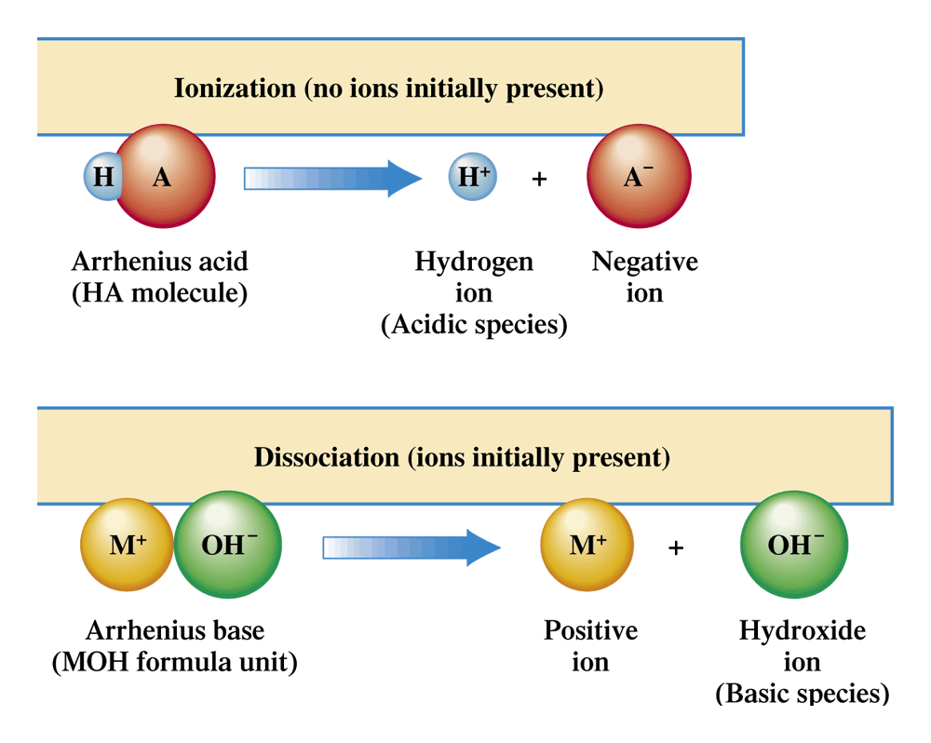
Figure 10.1 The difference between the aqueous solution processes of ionization (Arrhenius acids) and dissociation (Arrhenius bases).

Slide 2
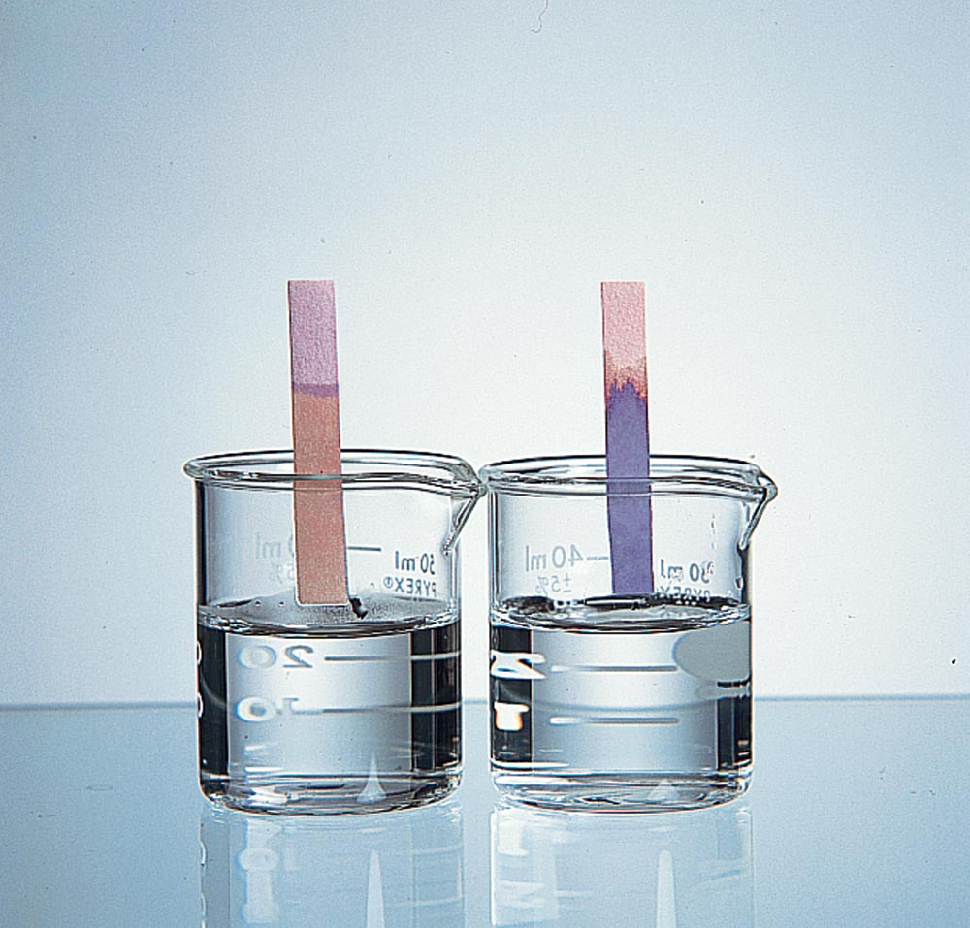
Figure 10.2 Litmus is a vegetable dye obtained from certain lichens found principally in the Netherlands. Paper treated with this dye turns from blue to red in acids (left) and from red to blue in bases (right).

Slide 3
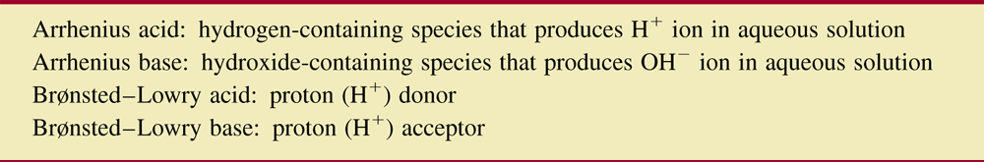
Table 10.1 Summary of Acid-Base Definitions.

Slide 4
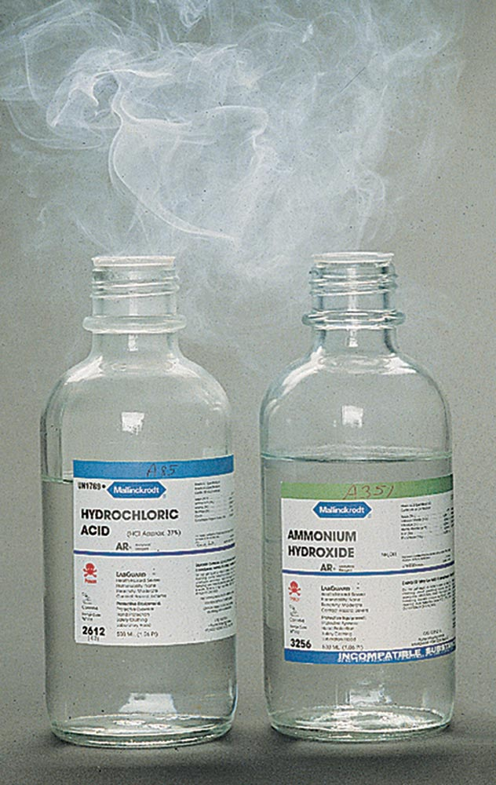
Figure 10.3
A white cloud of finely divided solid NH4Cl is produced by the acid-base reaction that results when the colorless gases HCl and NH3 mix. (The gases involved escape from the concentrated solutions of HCl and NH3.)
Source: Ken O’Donoghue

Slide 5
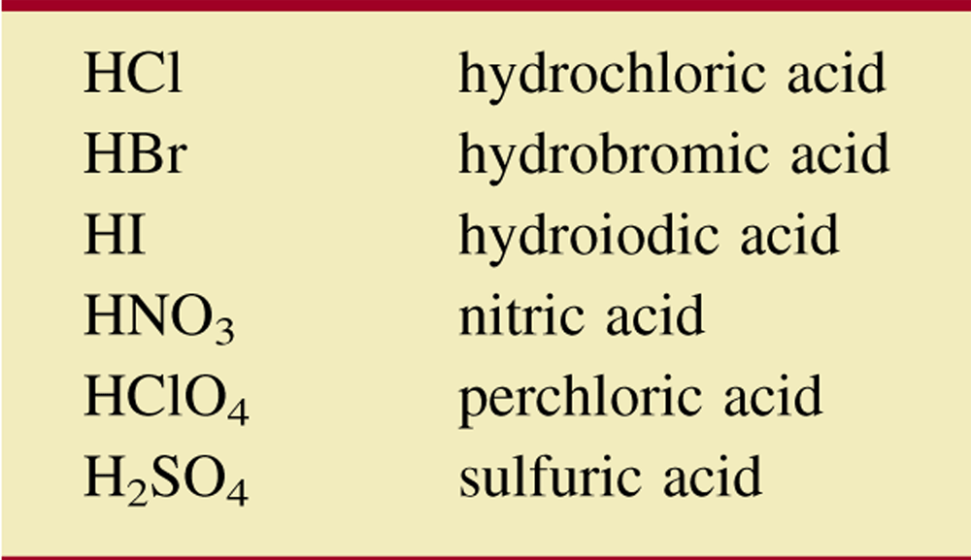
Table 10.2 Commonly Encountered Strong Acids.

Slide 6
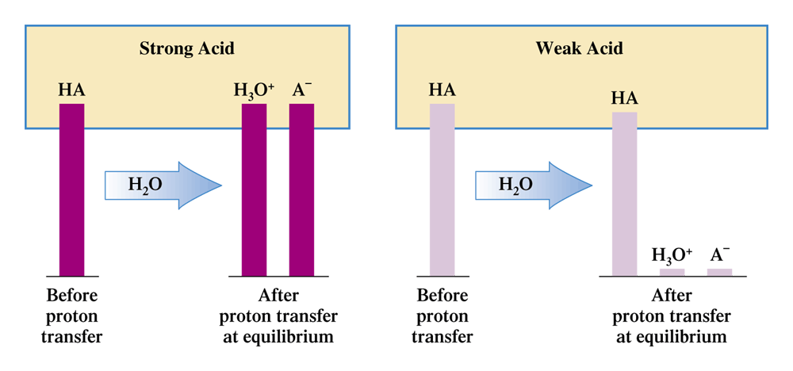
Figure 10.5 A comparison of the number of H3O1 ions (the acidic species) present in strong acid and weak acid solutions of the same concentration.

Slide 7
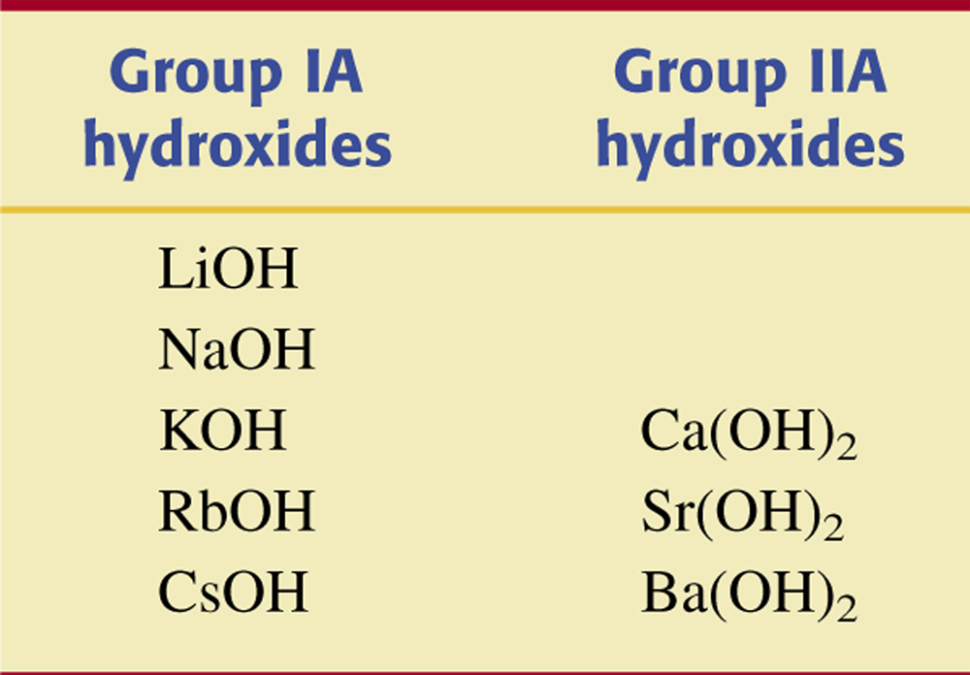
Table 10.3 Commonly Encountered Strong Hydroxide Bases.

Slide 8
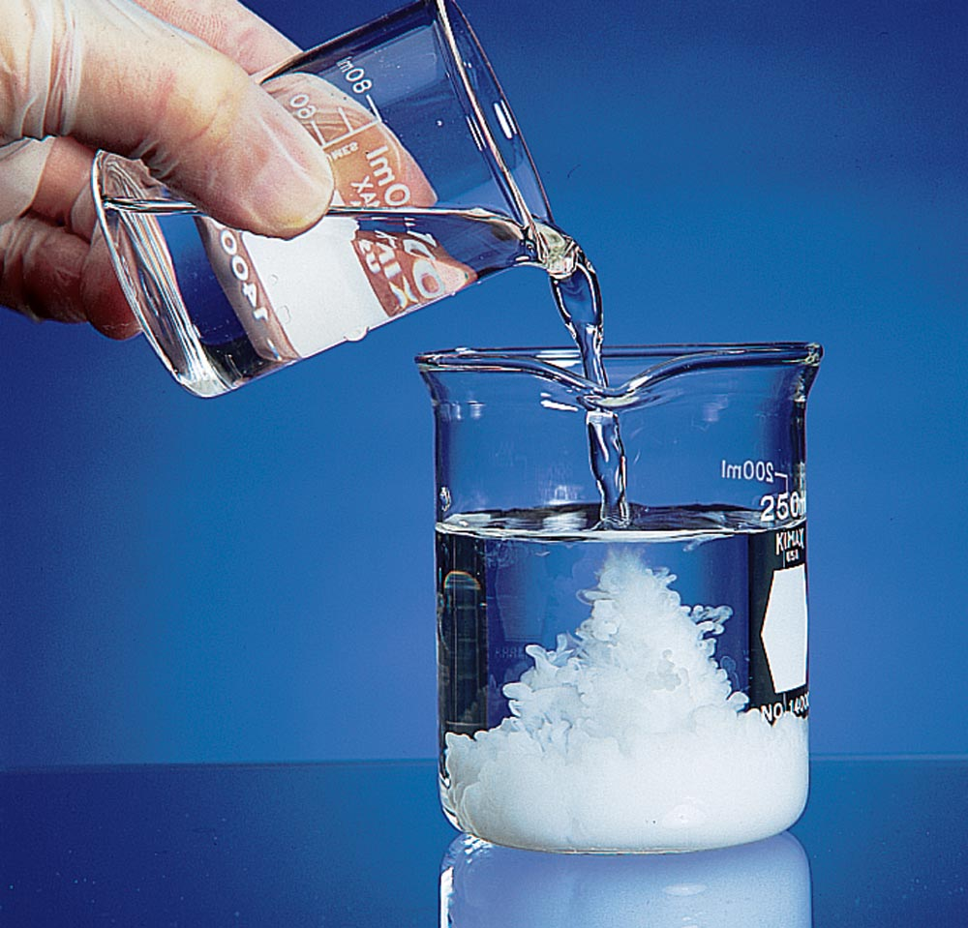
Figure 10.6 The acid-base reaction between sulfuric acid (H2SO4) and barium hydroxide (Ba(OH)2) produces the insoluble salt BaSO4.

Slide 9
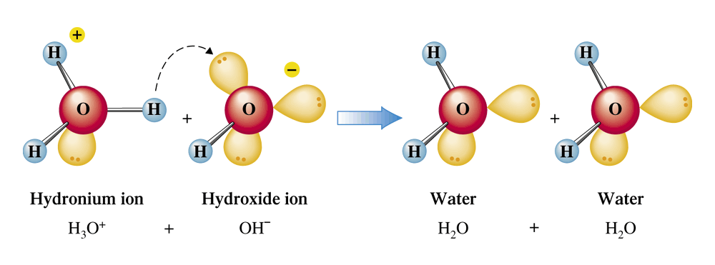
Figure 10.7 Formation of water by the transfer of protons from H₃O⁺ ions to OH⁻ ions.

Slide 10
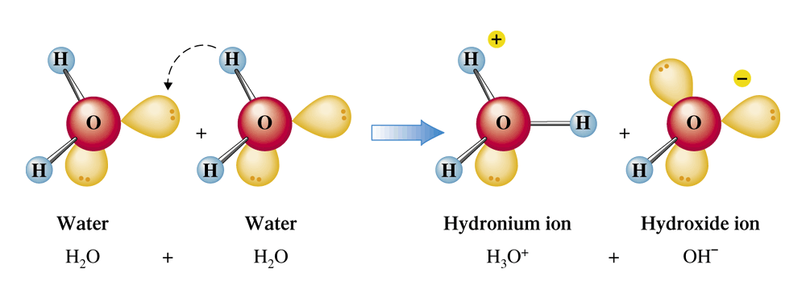
Figure 10.8 Self-ionization of water through proton transfer between water molecules.

Slide 11
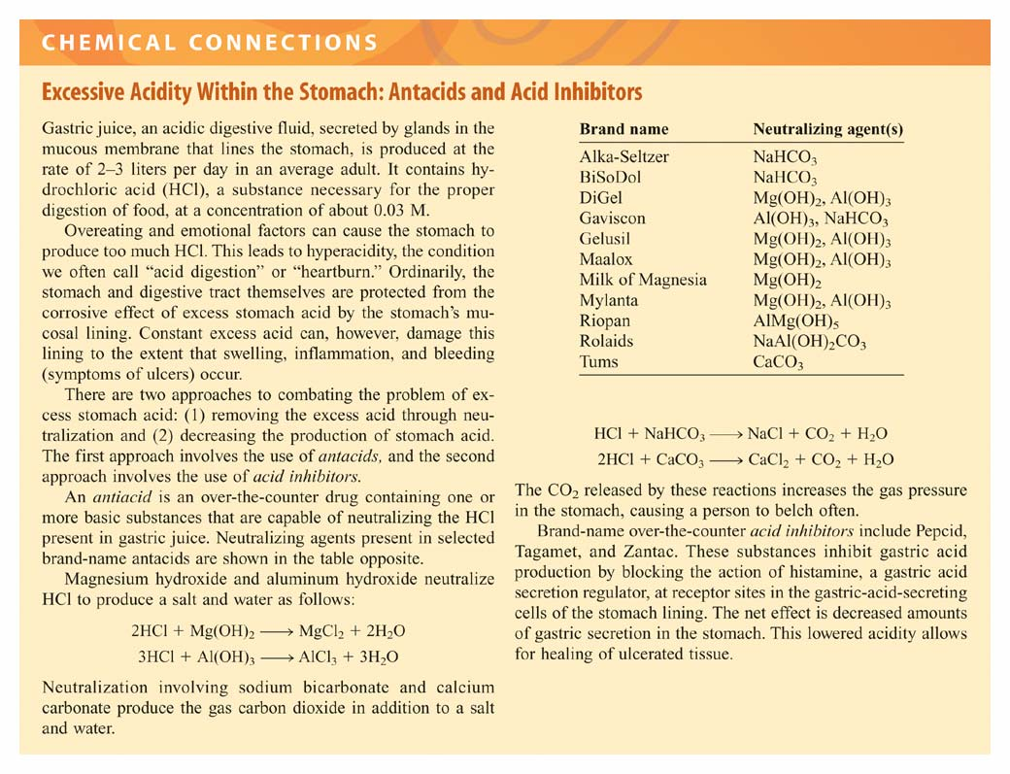

Slide 12
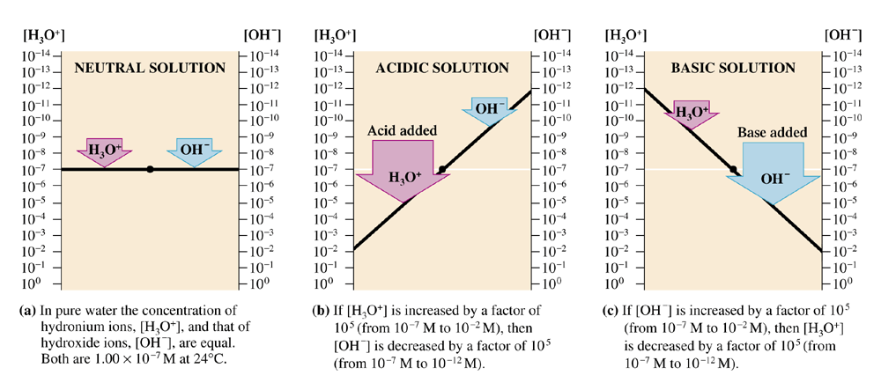
Figure 10.9 The relationship between (H₃O⁺) and (OH⁻) in aqueous solution is an inverse proportion; when (H₃O⁺) is increased, (OH⁻) decreases, and vice versa.

Slide 13
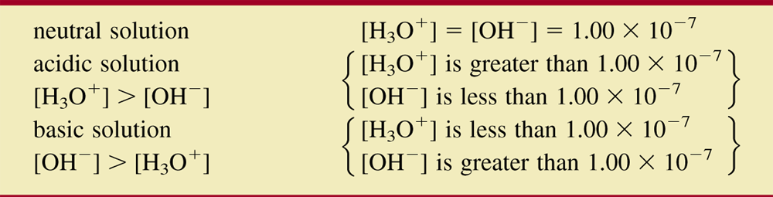
Table 10.5 Relationship Between [H₃O⁺] and [OH⁻] in Neutral, Acidic, and Basic Solutions.

Slide 14
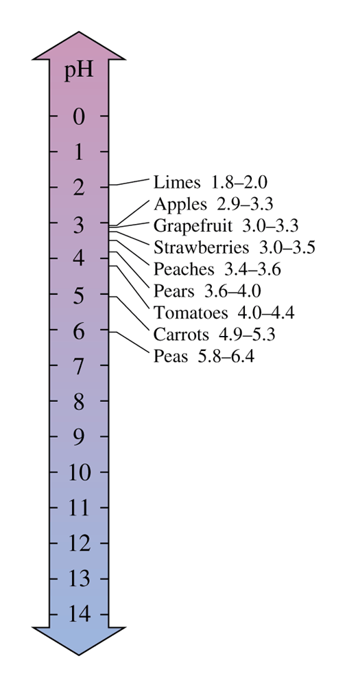
Figure 10.10
Most fruits and vegetables are acidic. Tart or sour taste is an indication that such is the case. Nonintegral pH values for selected foods are as shown here.

Slide 15
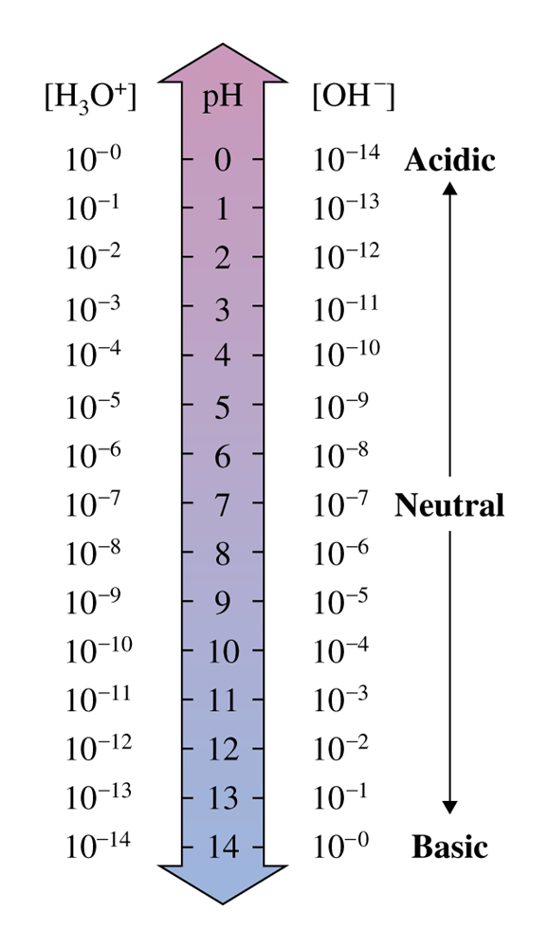
Figure 10.11
Relationships among pH values, (H₃O⁺), and (OH⁻) at 24º C.

Slide 16
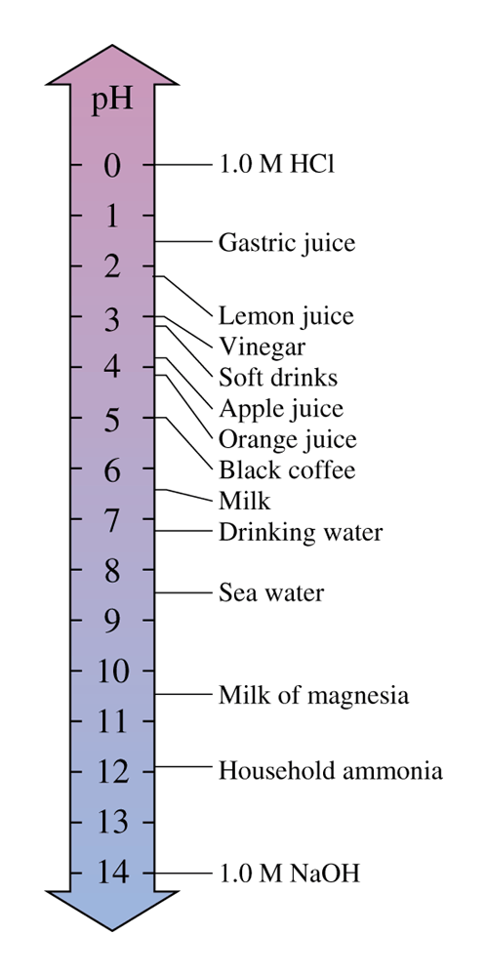
Figure 9.12
The pH values of selected common liquids. The lower the numerical value of the pH, the more acidic the substance.

Slide 17
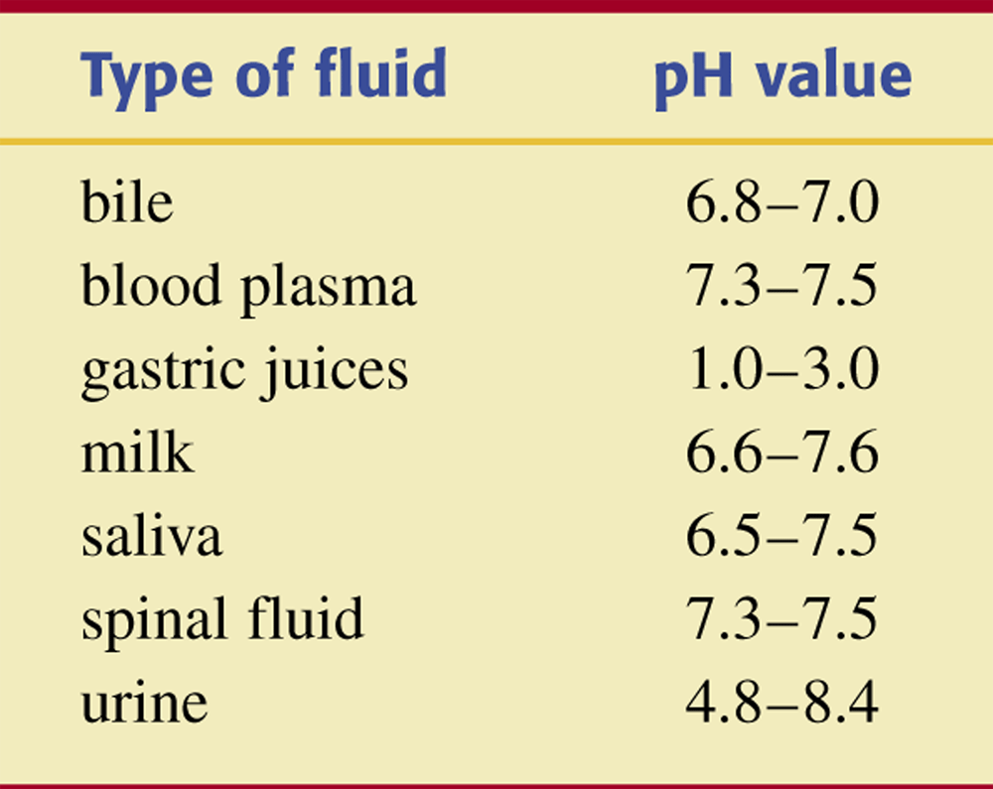
Table 10.6 The Normal pH Range of Selected
Body Fluids.

Slide 18
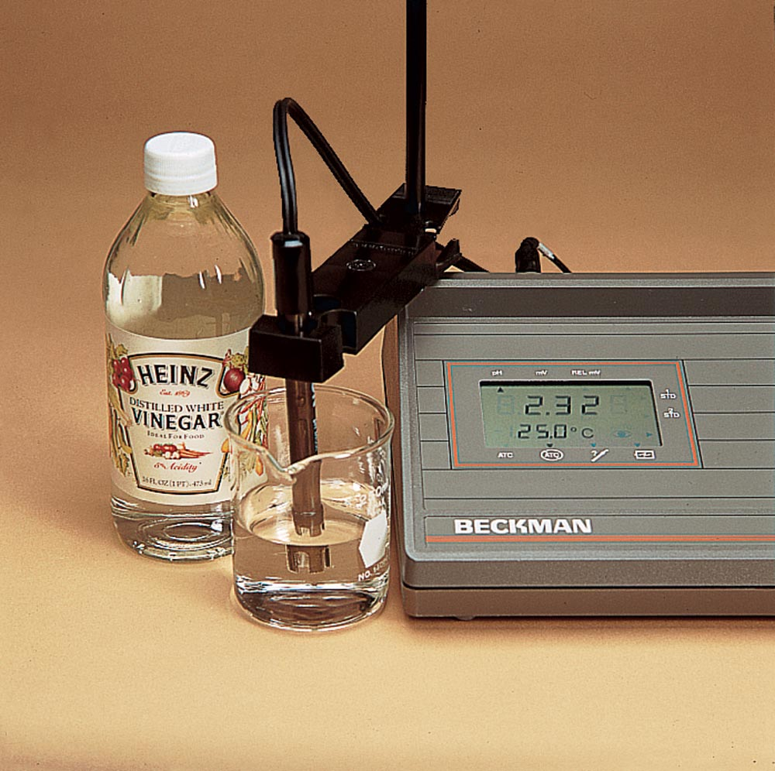
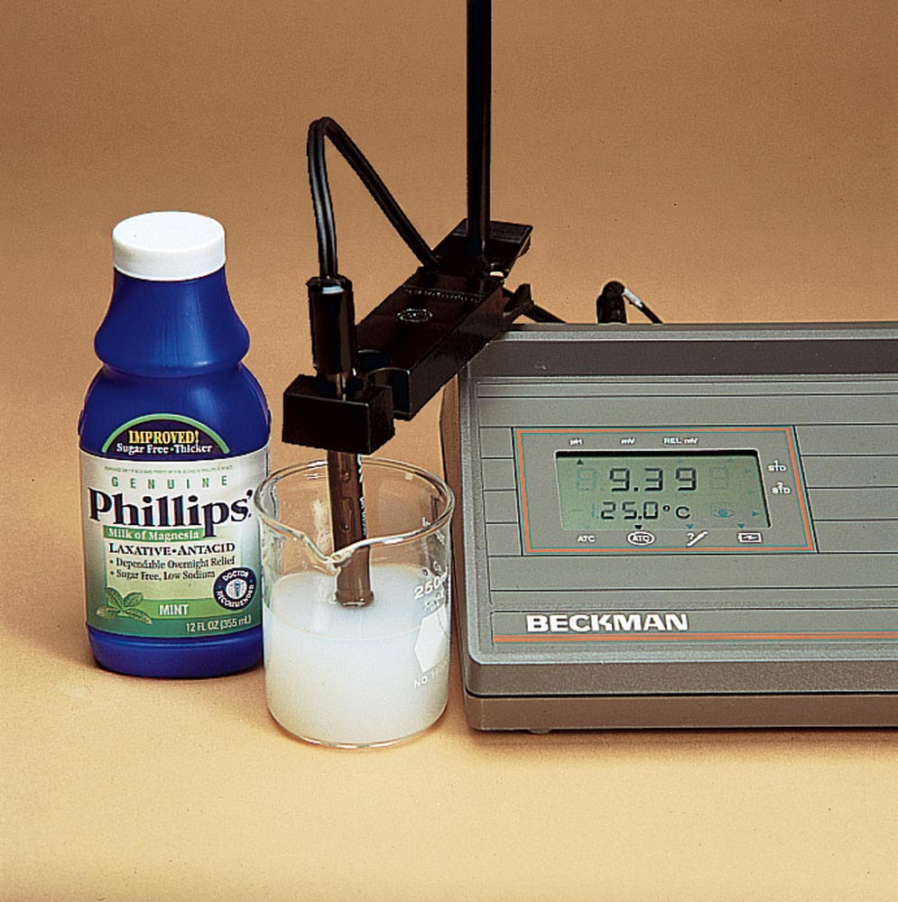
Figure 10.13 A pH meter gives an accurate measurement of pH values. The pH of vinegar is 2.32 (left). The pH of milk of magnesia in water is 9.39 (right).

Slide 19
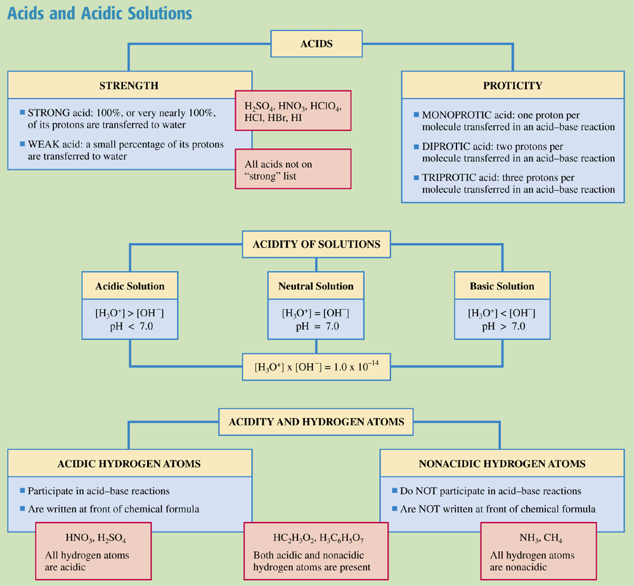
Chemistry at a Glance:
Acids and Acidic Solutions

Slide 20
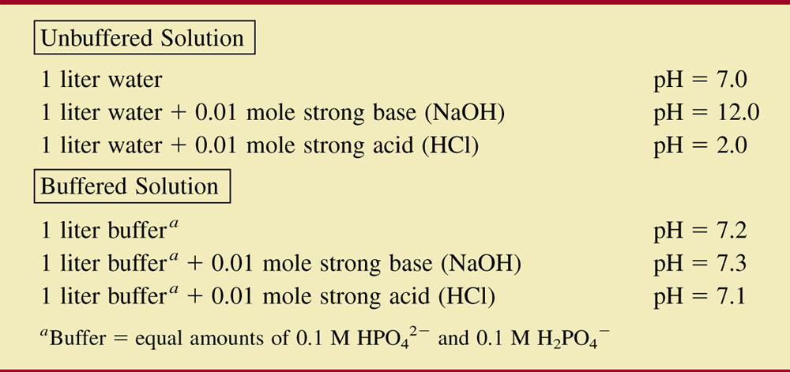
Table 10.9 A Comparison of pH Changes in Buffered and Unbuffered Solutions.

Slide 21
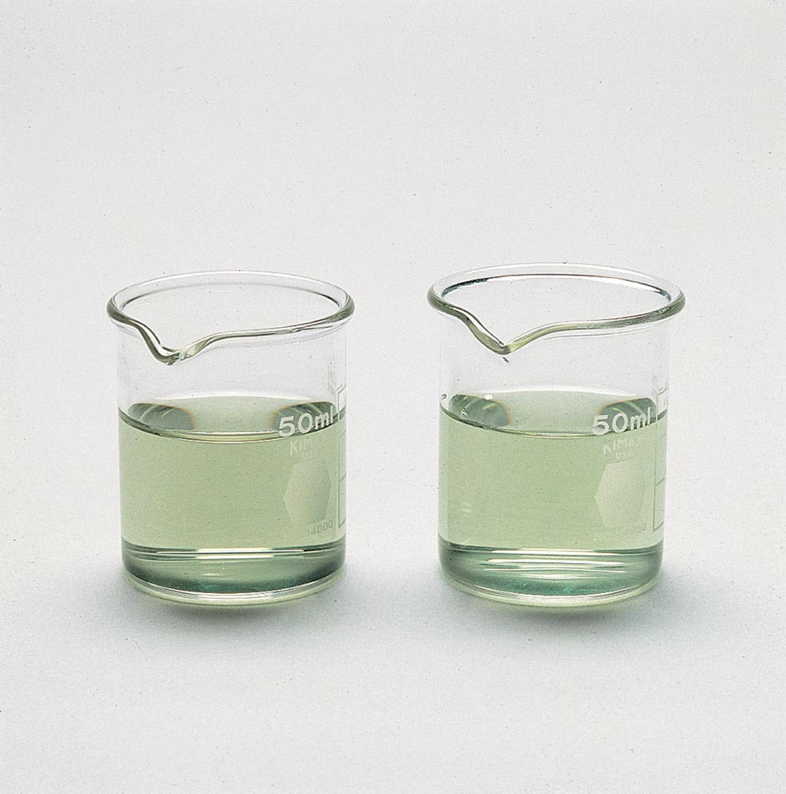
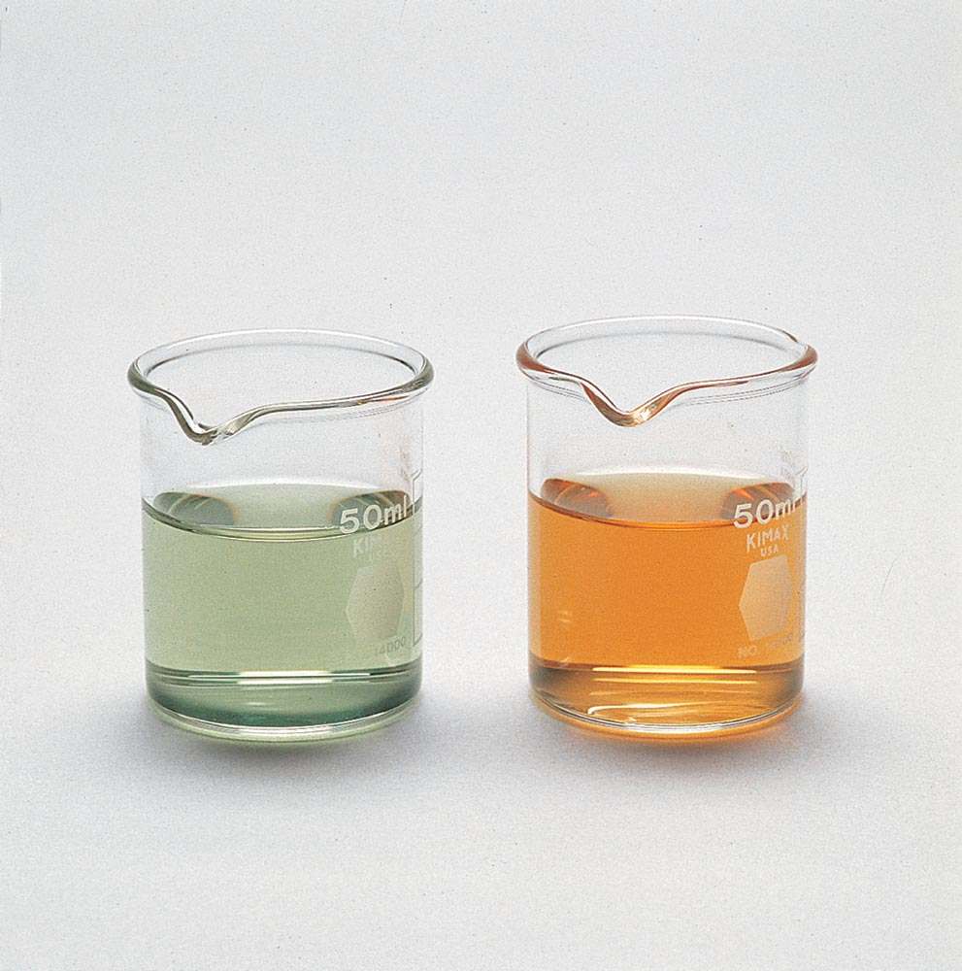
Figure 10.14 (a)The buffered solution on the left and the unbuffered solution on the right have the same pH (pH 8). (b) After the addition of 1 mL of a 0.01 M HCl solution, the pH of the buffered solution has not perceptibly changed, but the unbuffered solution has become acidic, as indicated by the change in the color of the acid-base indicator present.
Source: Ken O’Donoghue

Slide 22
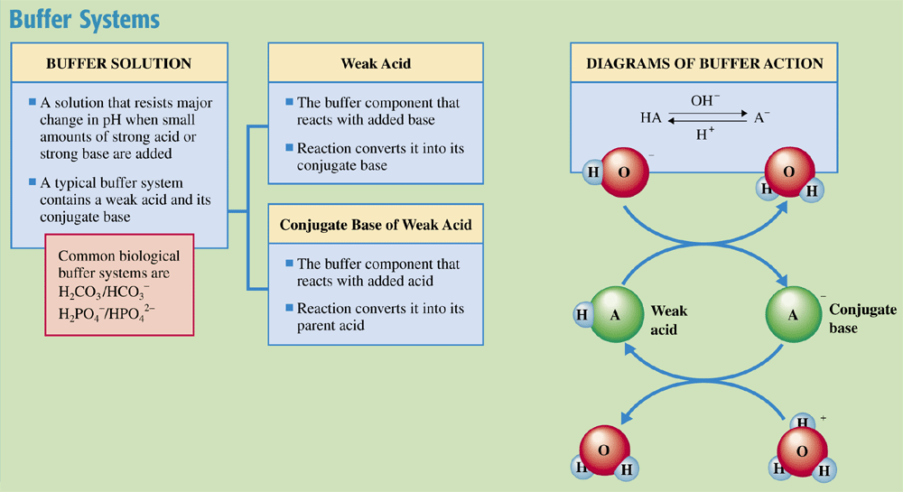
Chemistry at a Glance:
Buffer Systems

Slide 23
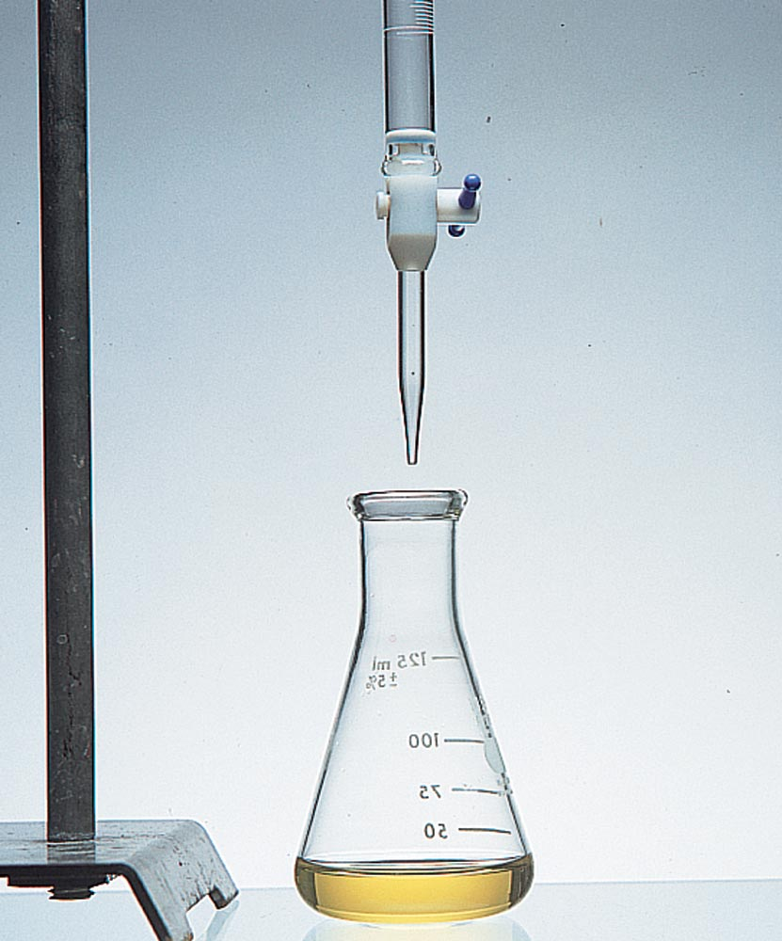
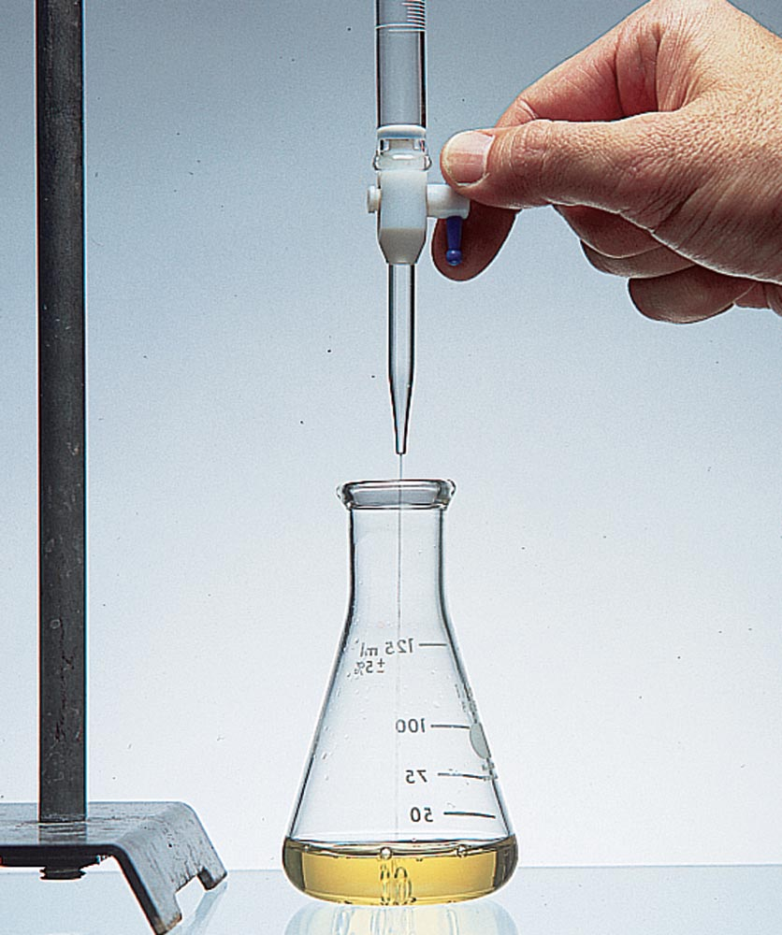
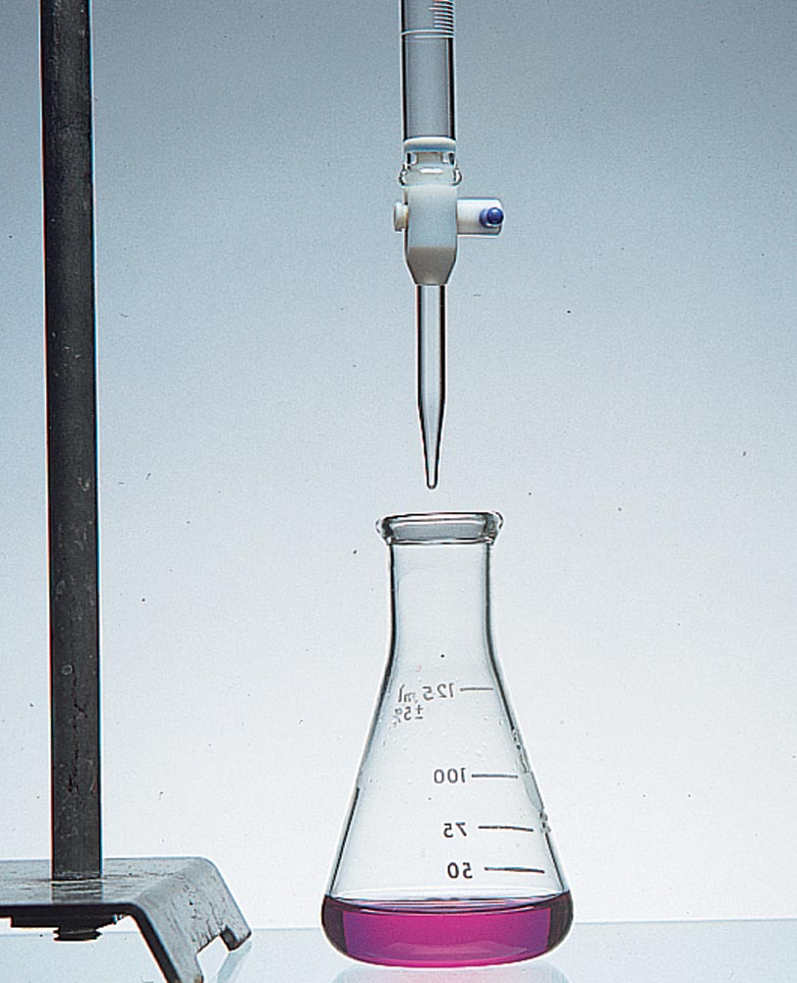
Figure 10.17 An acid-base titration using an indicator that is yellow in acidic solution and red in basic solution.

