Slide 1
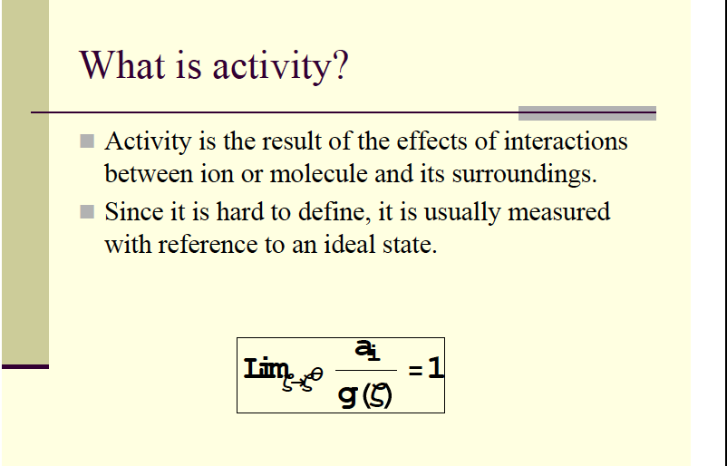
ACTIVITY
Notes:
Dance analogy…

Slide 2
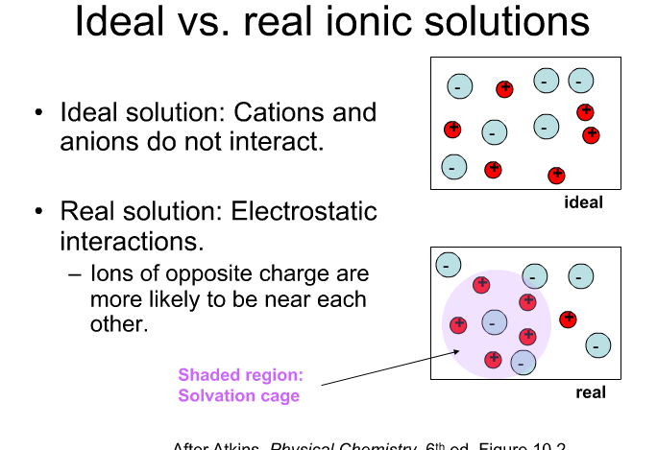

Slide 3
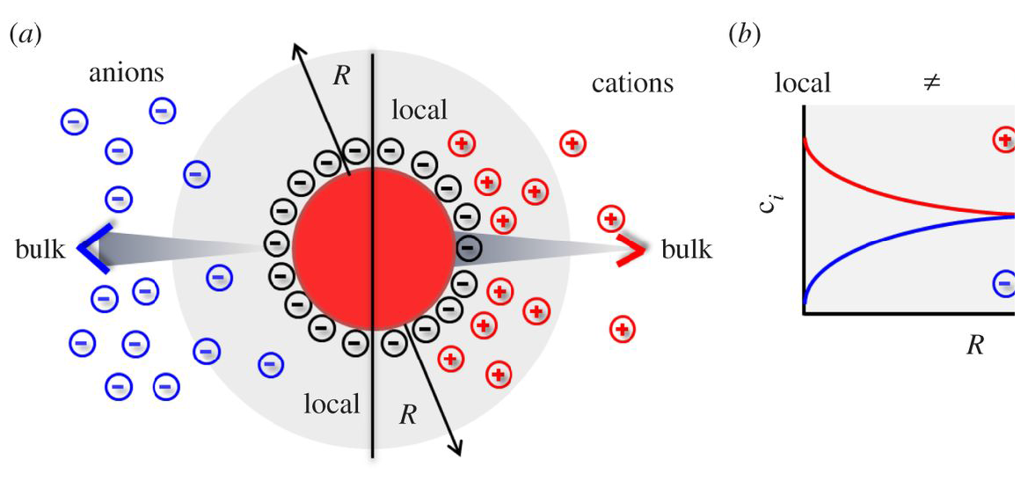

Slide 4
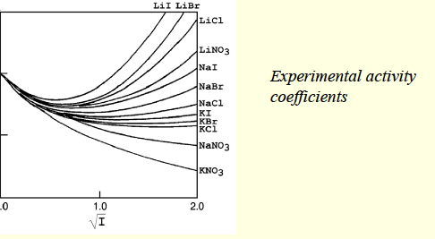

Slide 5
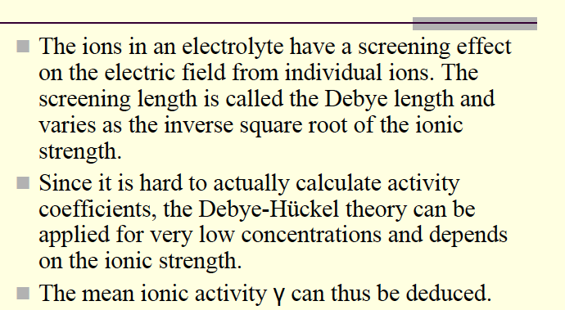
Principles behind Debye Huckel Theory

Slide 6
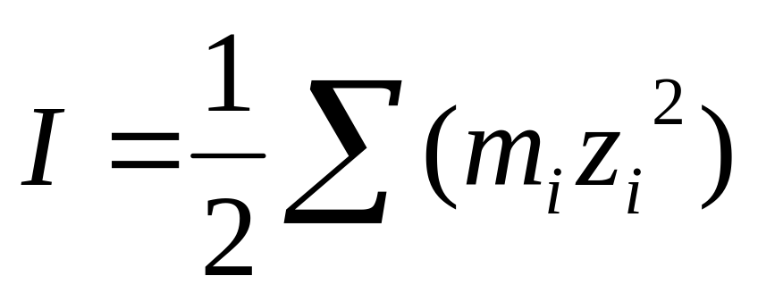
Ionic Strength
Dealing with coulombic interaction of selected ions to each other in a matrix (solution) of many ions
Ionic strength is a measure of how many of those ions are in the matrix which affect how selected ions interact
Ionic strength (I):
Where m is the molality of species i and z is the charge of species i

Slide 7
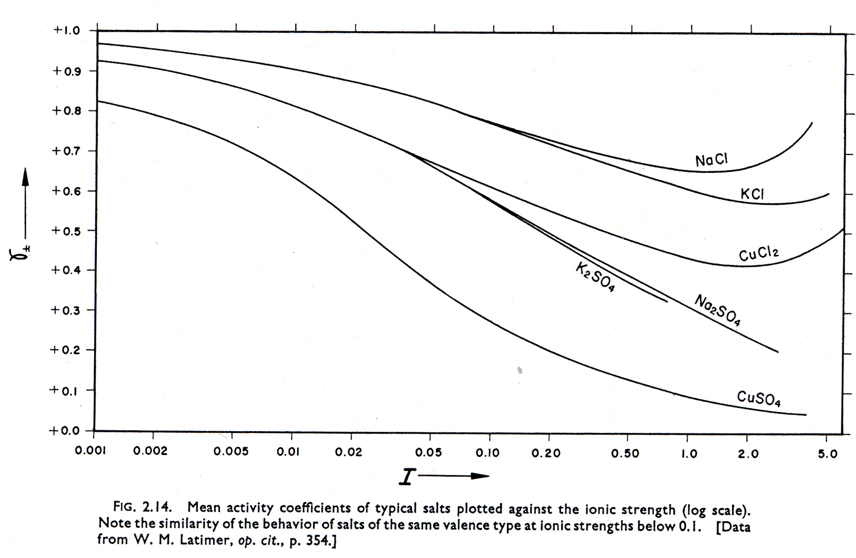
Mean Ion Activity Coefficients versus Ionic Strength

Slide 8
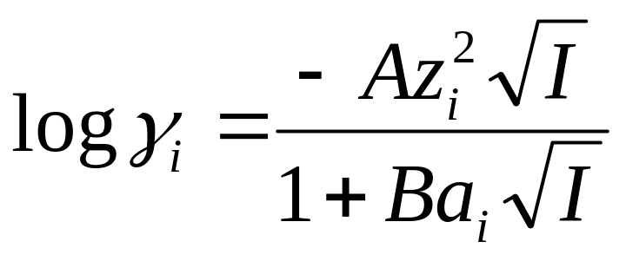
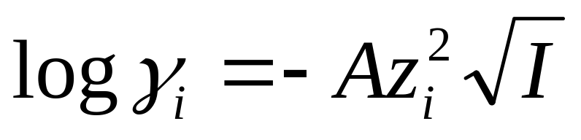
Debye-Hückel
Assumes ions interaction Coulombic
Ion size does not vary with ionic strength,
Ions of same sign do not interact

Slide 9

Ionic Strength

Slide 10
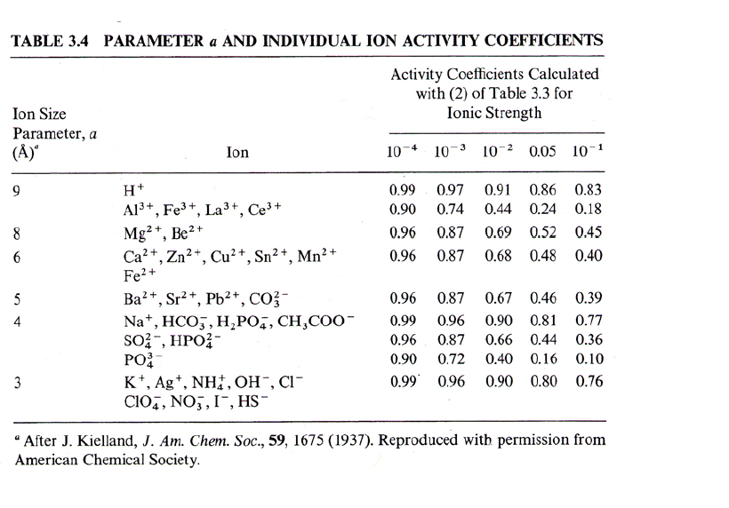

Slide 11
Extended Debye Huckel Equation
log γ = - 0.51 z² √I .
1 + (α √I/305)
I is the Ionic Strength of SOLUTION
SPECIFIC ION:
z is the charge
α is the Ionic Size (pm)

Slide 12
Higher Ionic Strengths
Activity coefficients decrease to minimal values around 1 – 10 M, then increase
the fraction of water molecules surrounding ions in hydration spheres becomes significant
Activity and dielectric constant of water decreases → in a 5 M NaCl solution, ~1/2 of the H₂O is complexed, decreasing the activity Ion pairing increases, increasing the activity effects

Slide 13
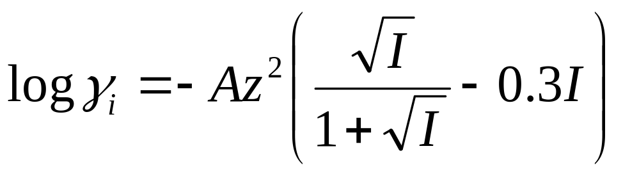
Davies Equation
Lacks ion size parameter –only really accurate for monovalent ions
Often used for Ocean waters, working range up to 0.7 M (avg ocean water I)

Slide 14
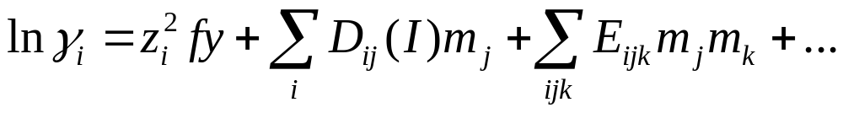
Pitzer Model
At ionic strengths above 2-3.5, one gets multiple +/- complex layers
Terms above describe binary term, fy describes interaction between same or opposite sign layers, terms to do this are called binary virial coefficients
Ternary terms and virial coefficients refine this for the activity coefficient

Slide 15
Protein Solubility
Salting in refers to the effect where increasing the ionic strength of a solution increases the solubility of some solute such as a protein). This effect tends to be observed at lower ionic strengths.
Protein solubility is ALSO a complex function of the physicochemical nature of the protein, pH, temperature, and the concentration of the salt used.
It also depends on whether the salt is kosmotropic (stabilizes water structure) or chaotropic (disrupts water structure).

Slide 16
Salting out Proteins
At low concentrations of salt, solubility of the proteins usually increases slightly (salting in).
But at high concentrations of salt, the solubility of the proteins drop sharply “Salting out”.
This is the most common way to precipitate protein

Slide 17
Setchenow Equation
log γ_{i}=K_{i} I
For molecular species (uncharged) such as dissolved gases, weak acids, and organic molecules and proteins
K_{i} is determined for a number of effective molecules, generally they are low, below 0.2
Activity coefficients are higher, meaning concentrations values must decline if a reaction is at equilibrium → “salting out” effect

