Slide 1

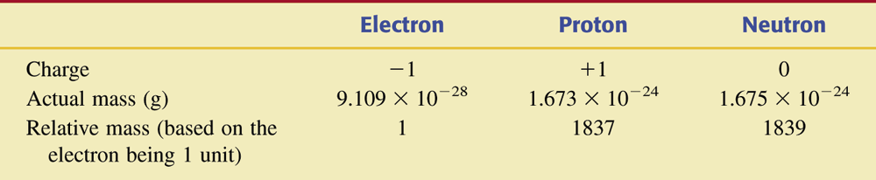
Table 3.1 Charge and Mass Characteristics of Electrons, Protons, and Neutrons.

Slide 2
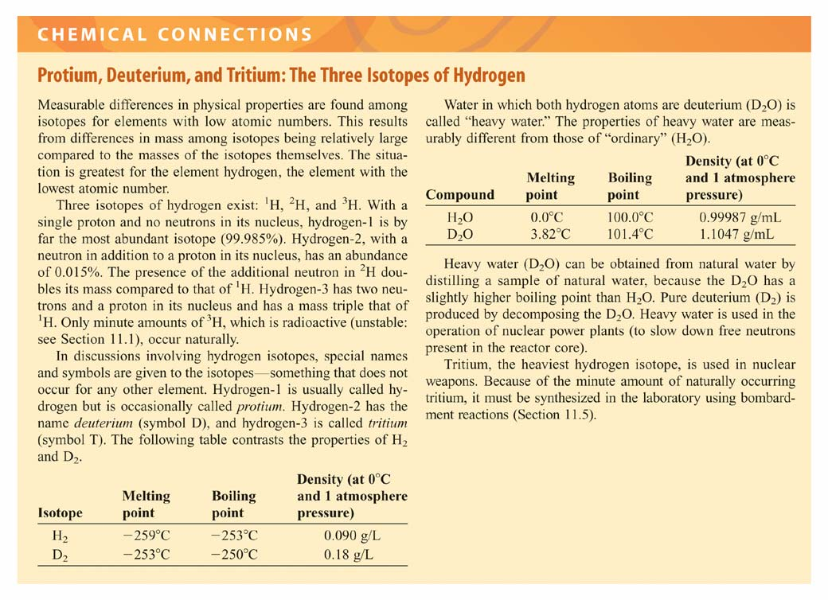

Slide 3
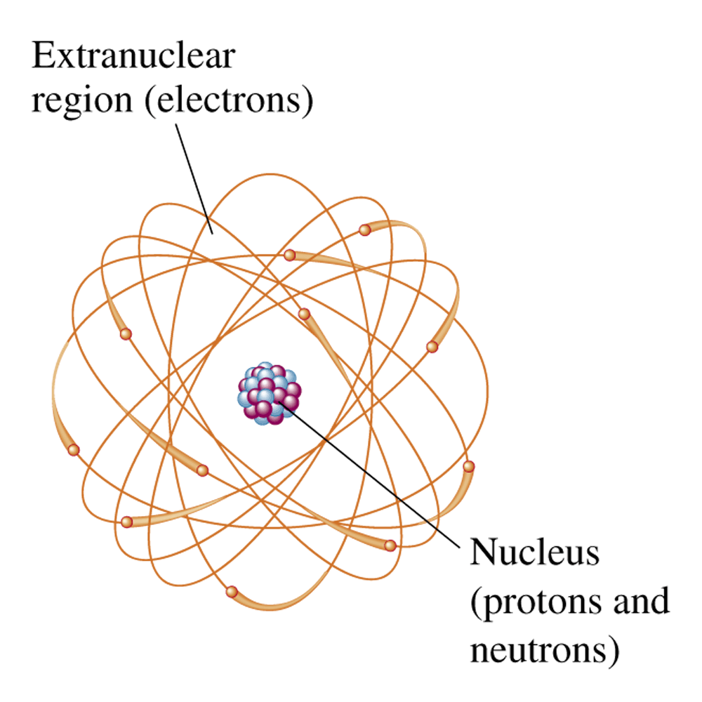
Figure 3.1 The protons and neutrons of an atom are found in the central nuclear region, or nucleus, and the electrons are found in an electron cloud outside the nucleus.

Slide 4
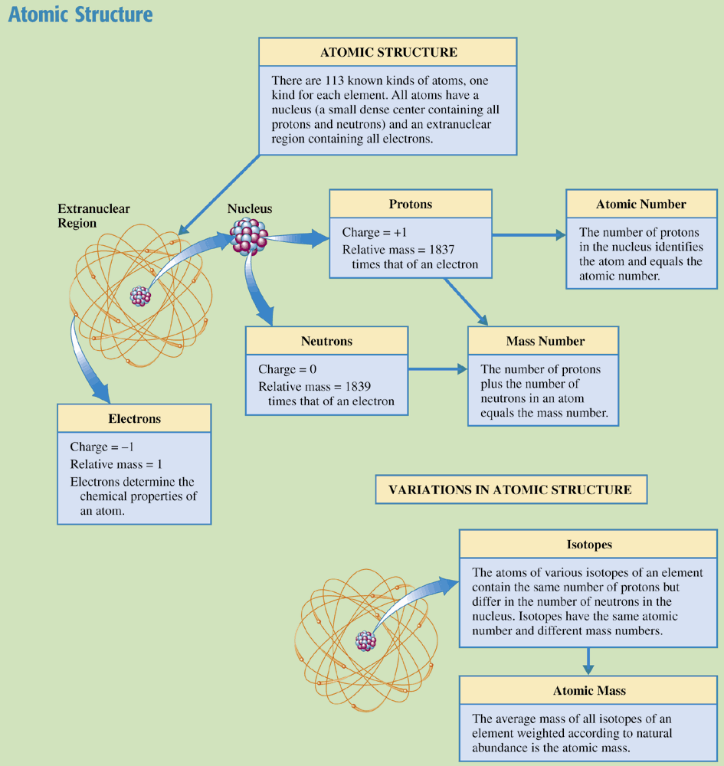
Chemistry at a Glance:
Atomic Structure

Slide 5
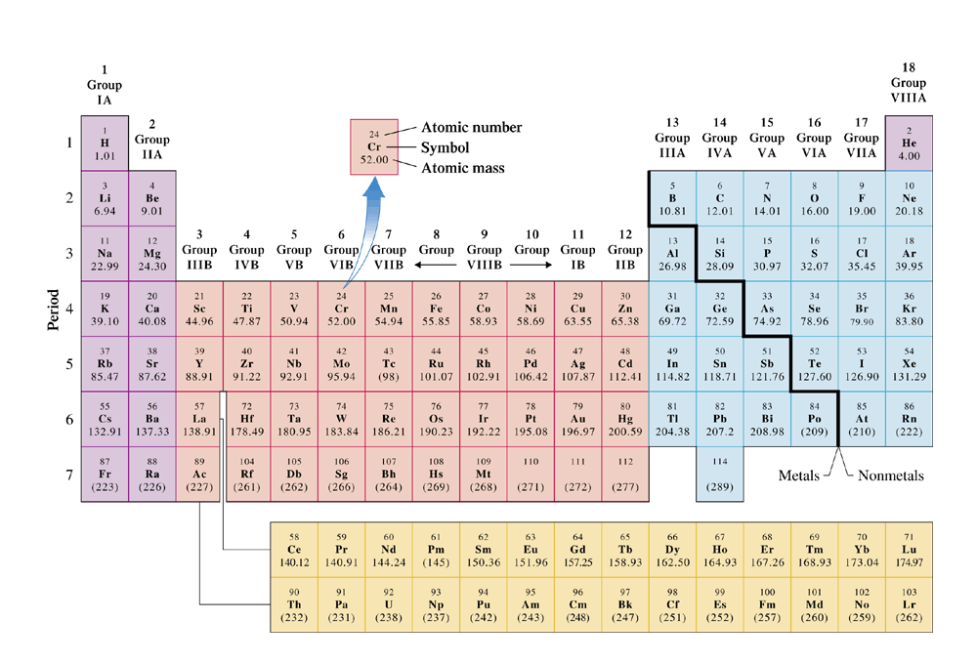
Figure 3.3 The periodic table of the elements is a graphical way to show relationships among the elements. Elements with similar chemical properties fall in the same vertical column.

Slide 6
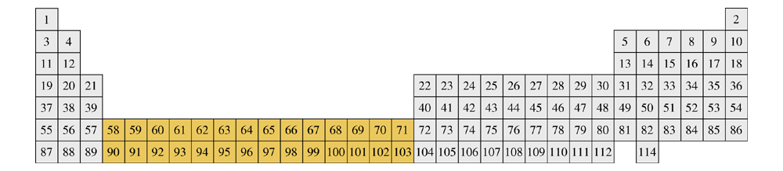
Figure 3.4 In this periodic table, elements 58 through 71 and 90 through 13 (in color) are shown in their proper positions.

Slide 7
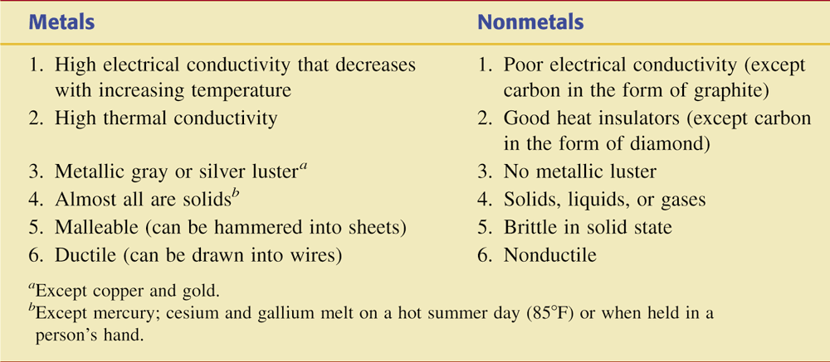
Table 3.3 Selected Physical Properties of
Metals and Nonmetals.

Slide 8
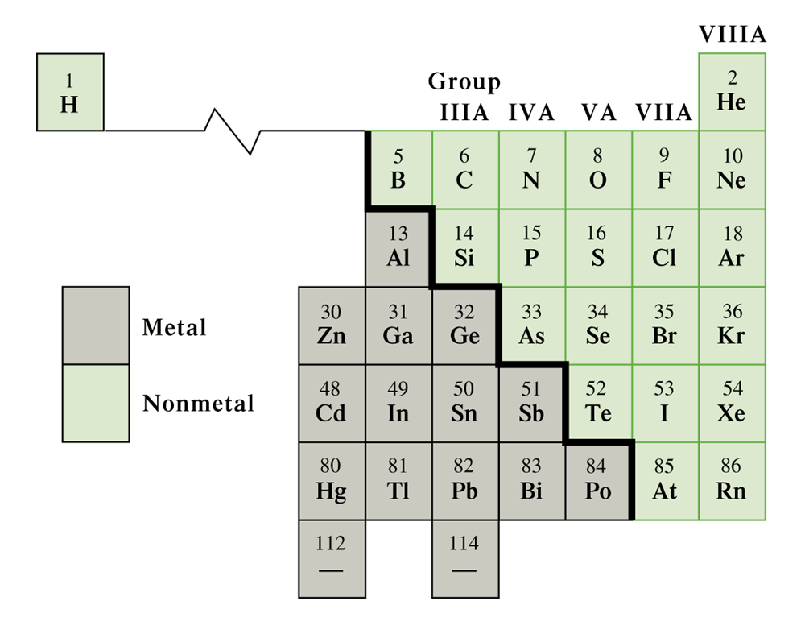
Figure 3.6 This portion of the periodic table shows the dividing line between metals and nonmetals. All elements that are not shown are metals.

Slide 9
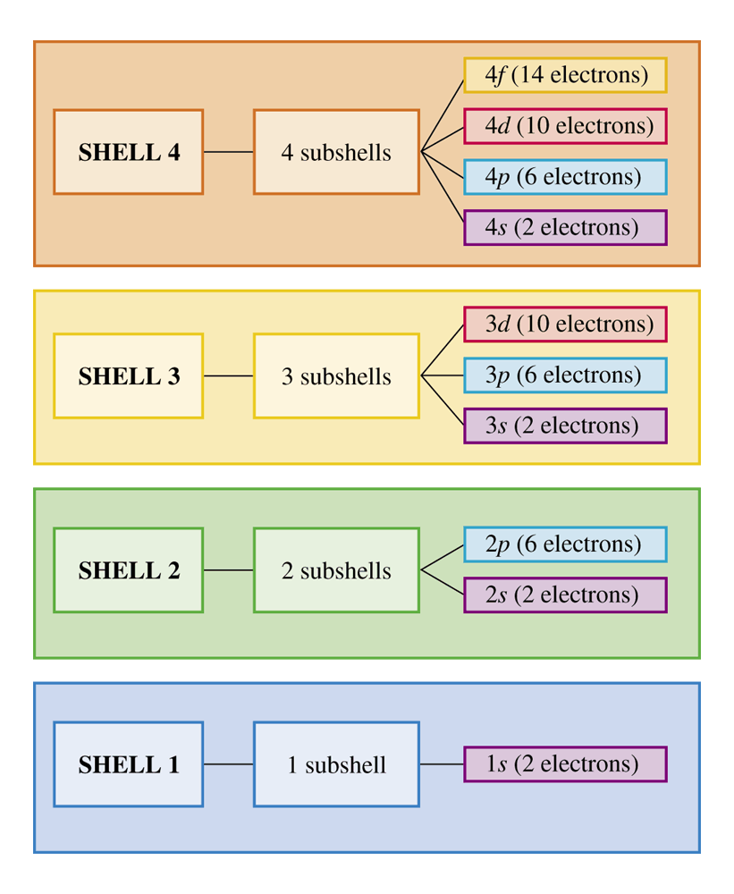
Figure 3.7
The number of subshells within a shell is equal to the shell number, as shown here for the first four shells. Each individual subshell is denoted with both a number (its shell) and a letter (the type of subshell it is in).

Slide 10
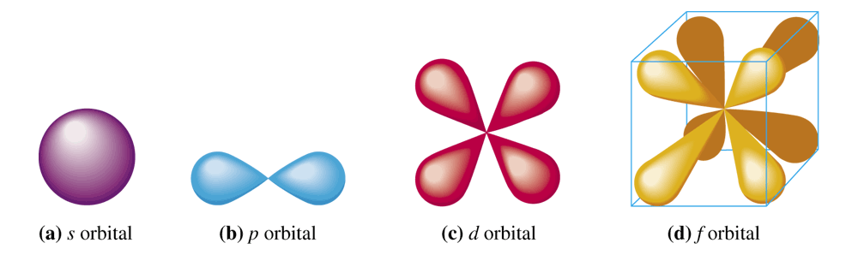
Figure 3.8 An s orbital has a shperical shape, a p orbital has two lobes, a d orbital has four lobes, and an f orbital has eight lobes.

Slide 11
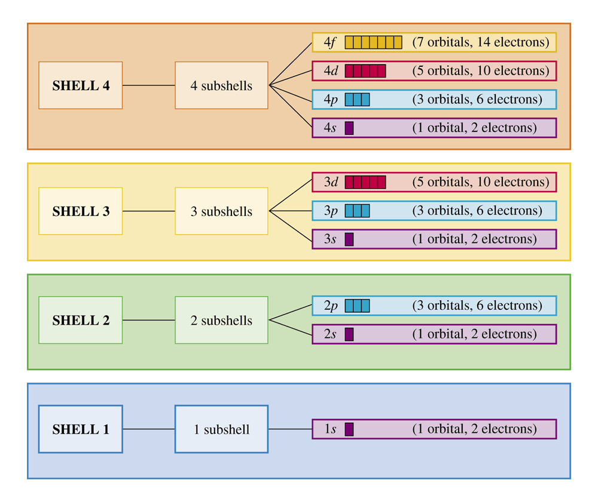
Figure 3.10 A summary of the interrelationships among electron shells, electron subshells, and electron orbitals for the first four shells. Similar relationship patterns exist for higher-numbered shells.

Slide 12
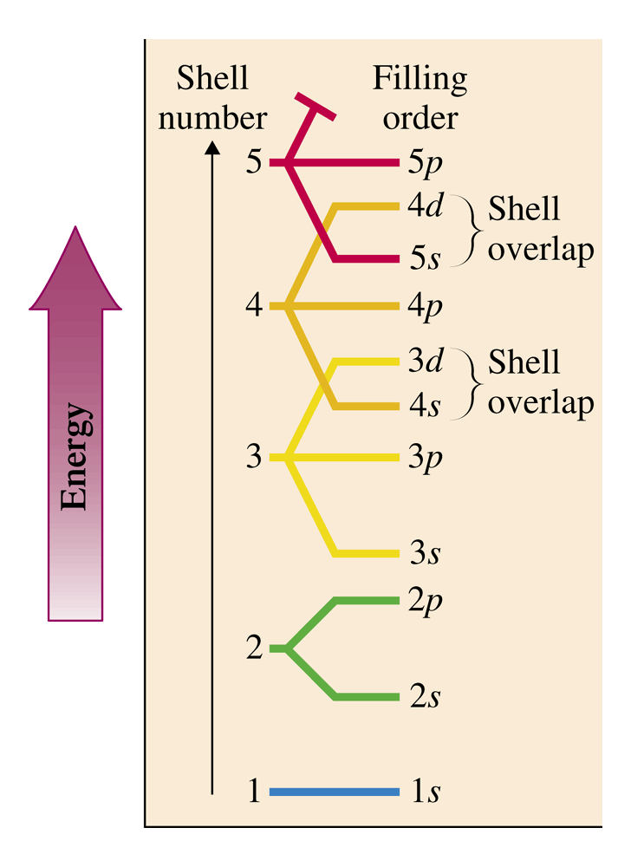
Figure 3.11
The order of filling of various electron subshells is shown on the right-hand side of this diagram. Above the 3p subshell, subshells of different shells "overlap".

Slide 13
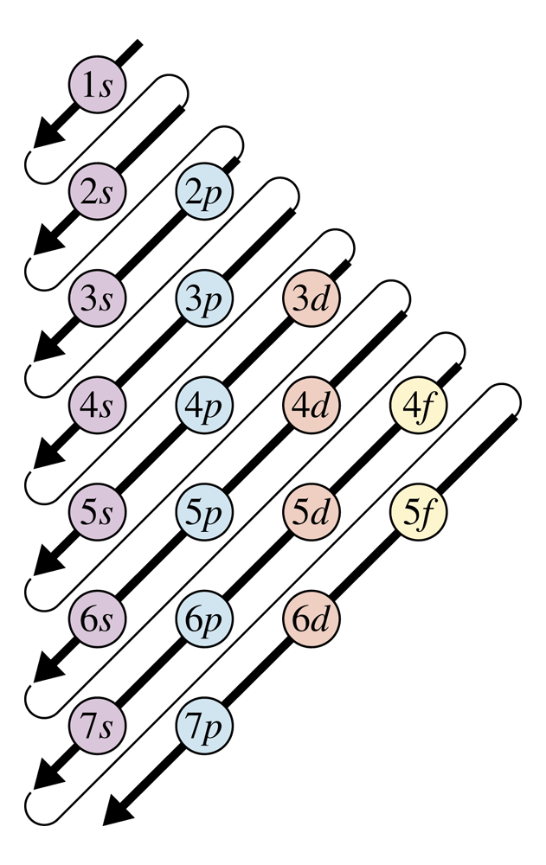
Figure 3.12 The order for filling electron subshells with electrons follows the order given by the arrows in this diagram. Start with the arrow at the top of the diagram and work toward the bottom of the diagram, moving from the bottom of one arrow to the top o the next-lower arrow.

Slide 14
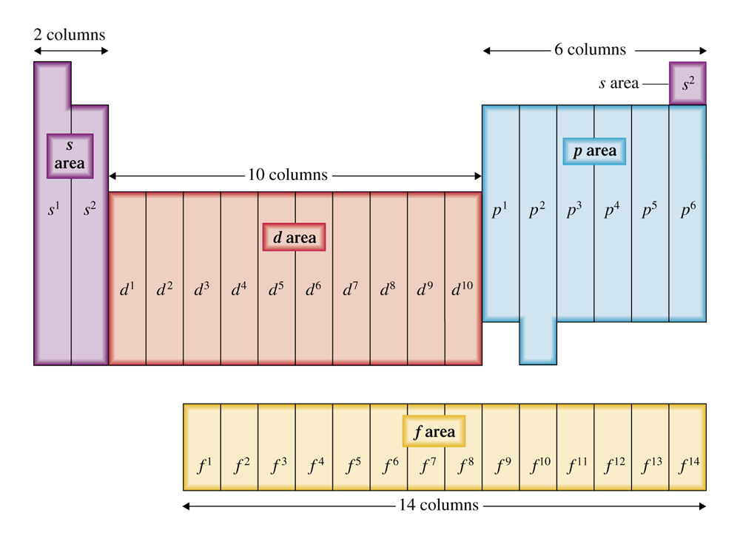
Figure 3.13 Electron configurations and the positions of elements in the periodic table.

Slide 15
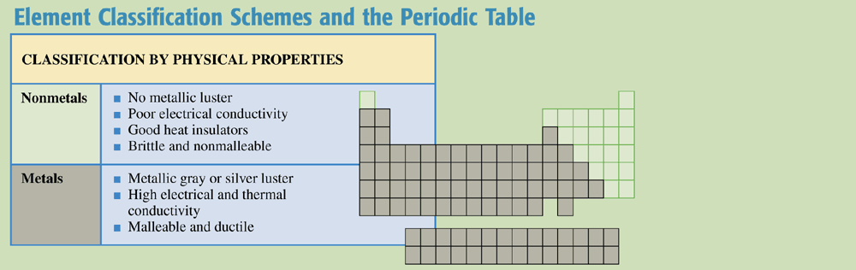
Chemistry at a Glance:
Element Classification Schemes and the
Periodic Table

Slide 16
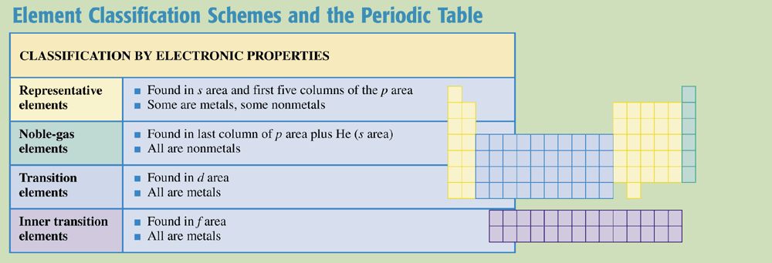
Chemistry at a Glance:
Element Classification Schemes and the
Periodic Table (cont’d)

Slide 17
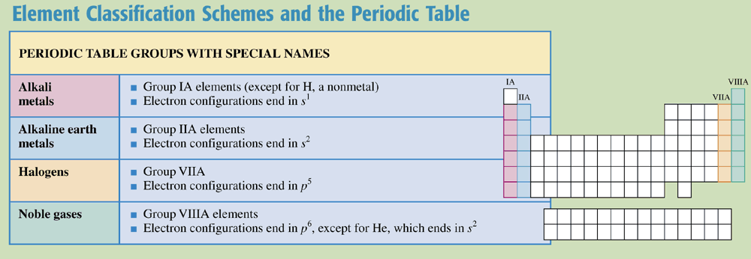
Chemistry at a Glance:
Element Classification Schemes and the
Periodic Table (cont’d)

