Slide 1
Boiling-Point Elevation and Freezing-Point Depression
Boiling-Point Elevation (∆T_{b}): The boiling point of the solution (T_{b}) minus the boiling point of the pure solvent (T°_{b}):
∆T_{b} = T_{b} – T°_{b}
  ∆T_{b} is proportional to concentration:
  ∆T_{b} = K_{b} m
  K_{b} = molal boiling-point elevation constant.

Slide 2
Boiling-Point Elevation and Freezing-Point Depression
Freezing-Point Depression (∆T_{f}): The freezing point of the pure solvent (T°_{f}) minus the freezing point of the solution (T_{f}).
∆T_{f} = T°_{f} – T_{f}
  ∆T_{f} is proportional to concentration:
  ∆T_{f} = K_{f} m
  K_{f} = molal freezing-point depression constant.

Slide 3
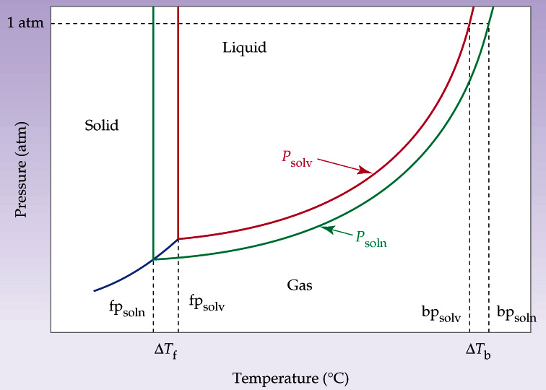
Boiling-Point Elevation and Freezing-Point Depression

Slide 4
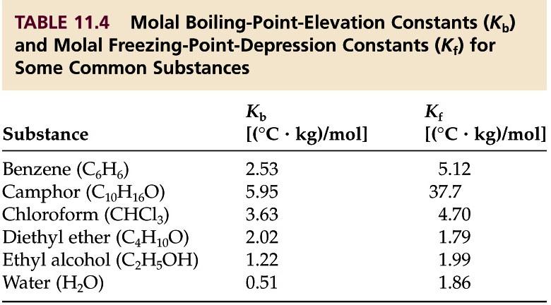
Boiling-Point Elevation and Freezing-Point Depression

Slide 5
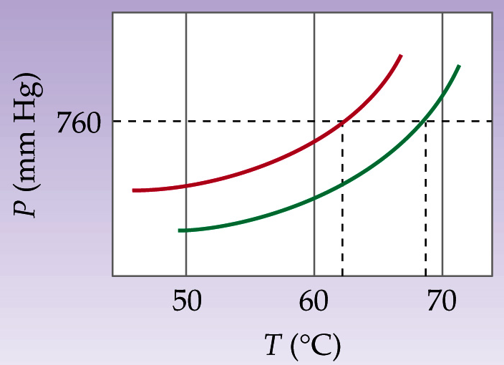
Boiling-Point Elevation and Freezing-Point Depression
The phase diagram shows a close-up of the liquid–vapor phase transition boundaries for pure chloroform.
  Estimate the boiling
  point of pure
  chloroform.
  Estimate the molal
  concentration of the
  nonvolatile solute.

Slide 6
Boiling-Point Elevation and Freezing-Point Depression
van’t Hoff Factor, i: This factor equals the number of ions produced from each molecule of a compound upon dissolving.
  i = 1 for CH₃OH i = 3 for CaCl₂
  i = 2 for NaCl i = 5 for Ca₃(PO₄)₂
For compounds that dissociate on dissolving, use:
  ∆T_{b} = i⋅K_{b} m ∆T_{f} = i⋅K_{f} m ∆P = i⋅x₂ P°₁

