Slide 1

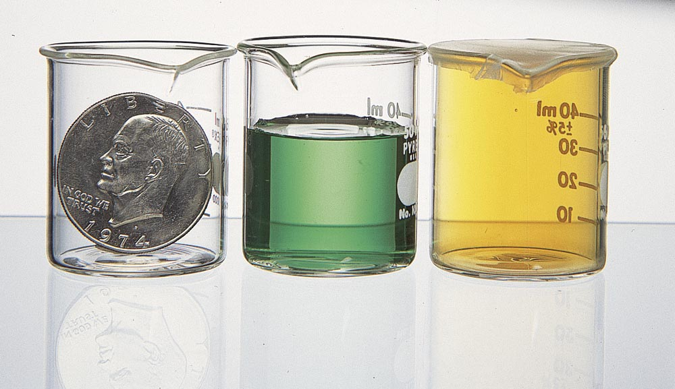
Figure 1.2 (a) A solid has a definite shape and a definite volume. (b) A liquid has an indefinite shape - it takes the shape of its container - a definite volume. (c) A gas has an indefinite shape and an indefinite volume.

Slide 2
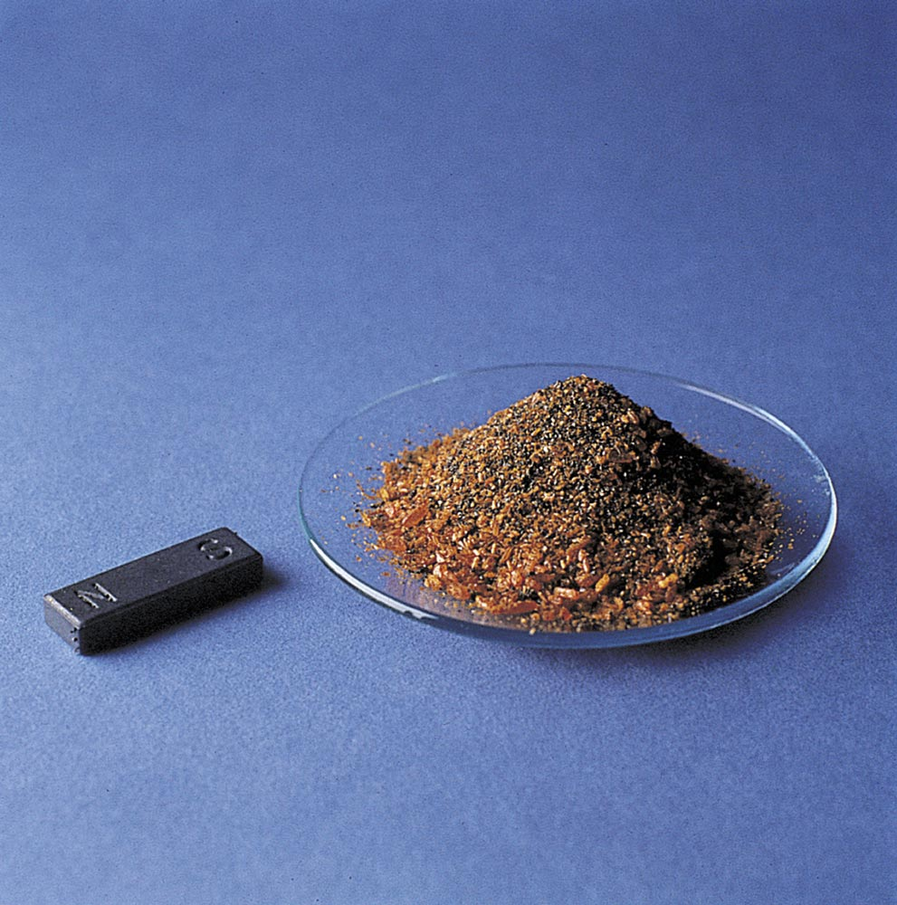
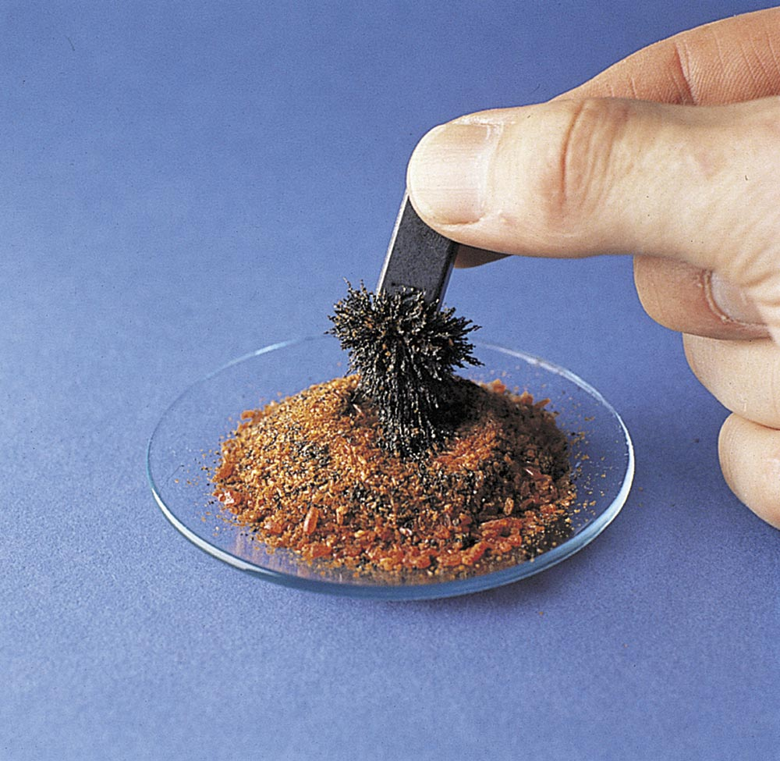
Figure 1.7 (a) A magnet (on the left) and a mixture consisting of potassium dichromate (the orange crystals) and iron fillings. (b) The magnet can be used to separate the iron fillings from the potassium dichromate.

Slide 3
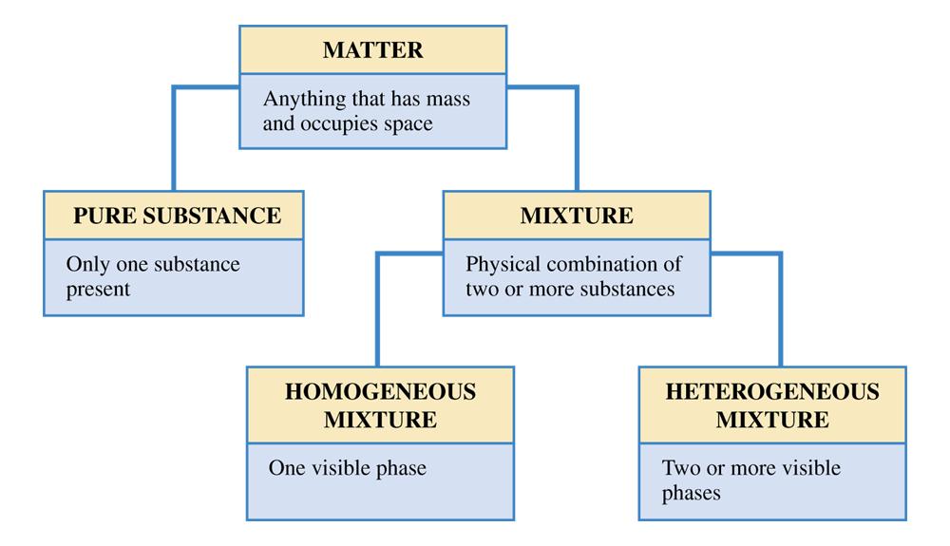
Figure 1.8 Matter falls into two basic classes; pure substances and mixtures. Mixtures, in turn, may be homogeneous or heterogeneous.

Slide 4
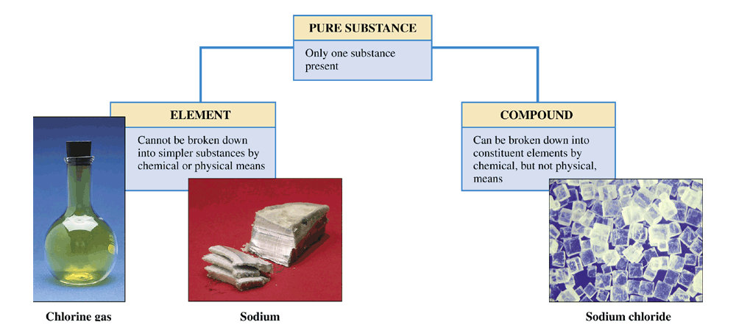
Figure 1.9 A pure substance can be either an element or a compound.

Slide 5
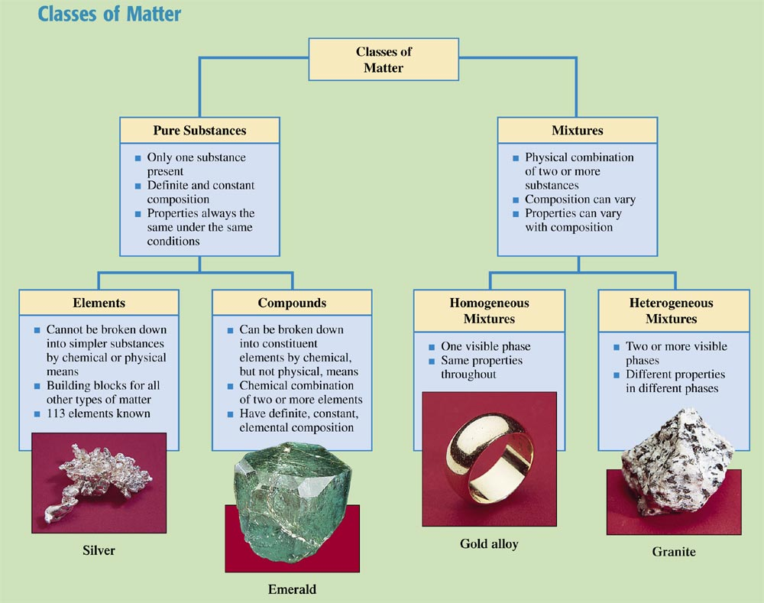
Chemistry at a Glance Box
Classes of Matter

Slide 6
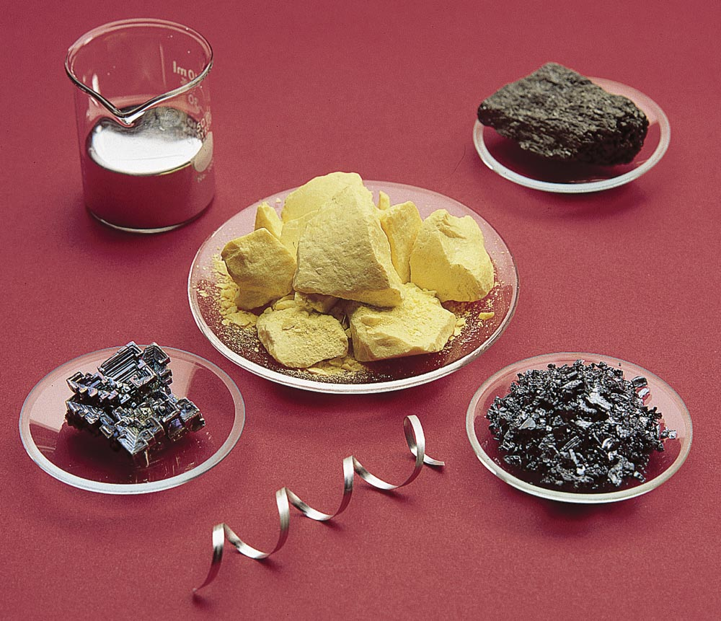
Figure 1.10 Outward physical appearance of selected naturally occurring elements. Center: Sulfer. From upper right, clockwise: Arsenic, iodine, magnesium, bismuth, and mercury.

Slide 7
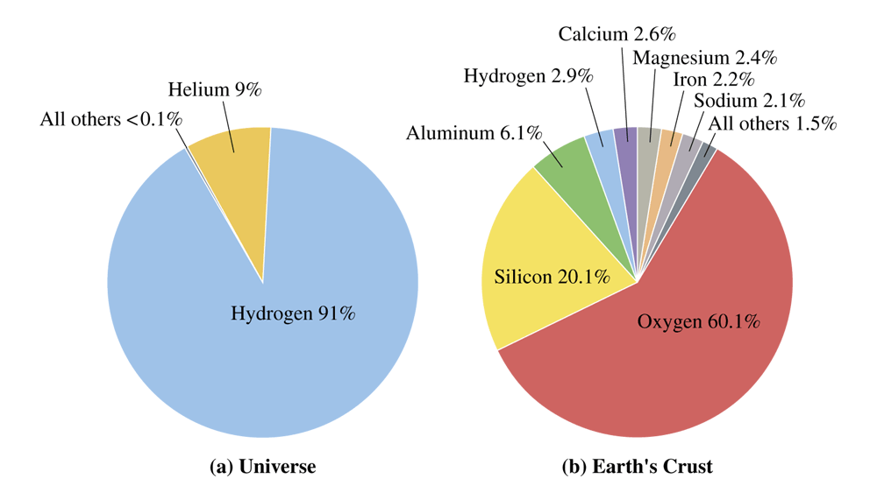
Figure 1.12 Abundance of elements in the universe and in Earth's crust (in atom percent).

Slide 8
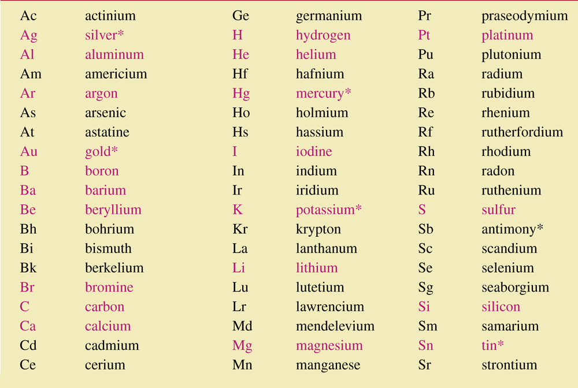
Table 1.1 The Chemical Symbols for the Elements. The symbols and names of the more frequently encountered elements are shown in red.

Slide 9
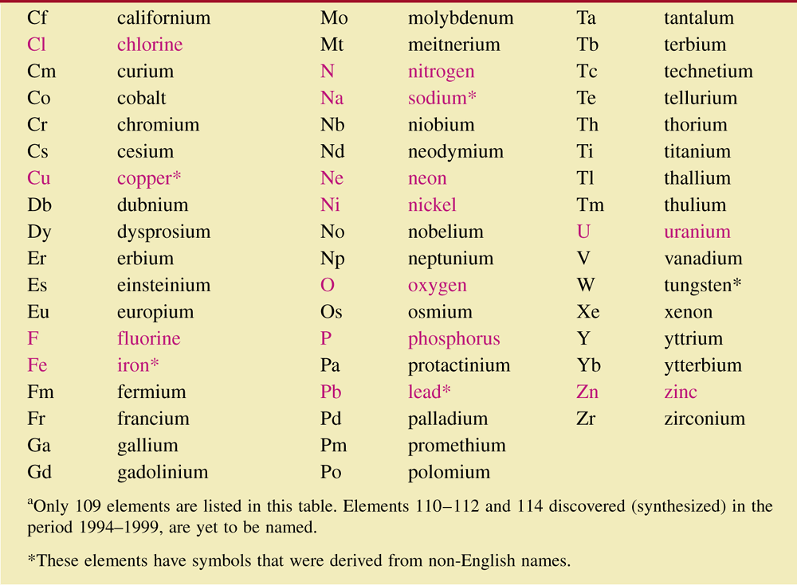
Table 1.1 The Chemical Symbols for the Elements. The symbols and names of the more frequently encountered elements are shown in red. (cont’d)

Slide 10
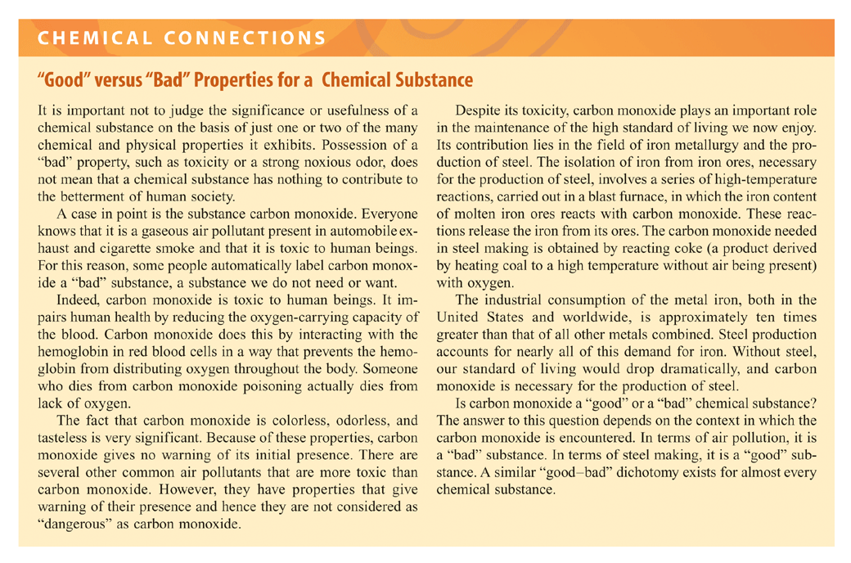

Slide 11
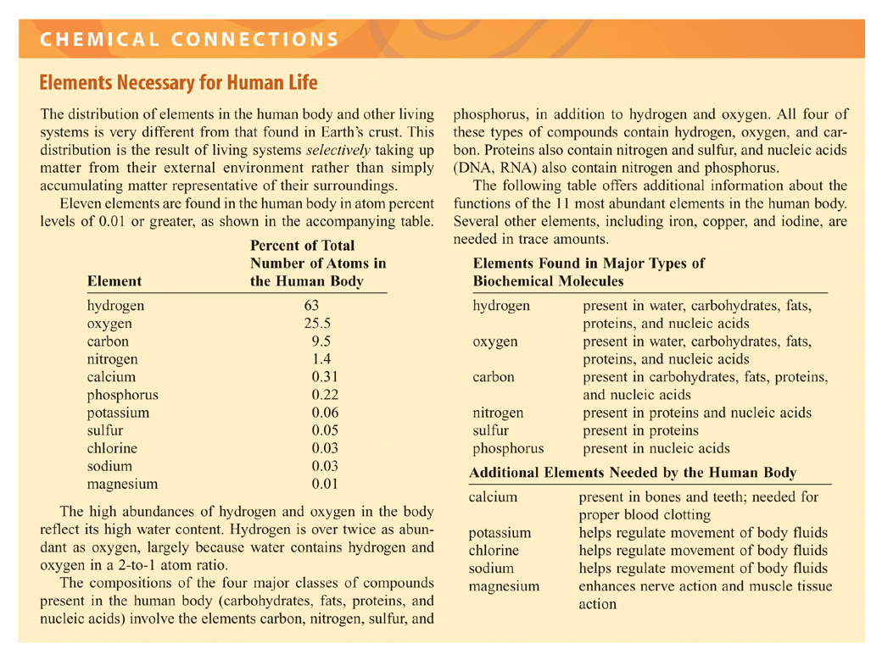

Slide 12
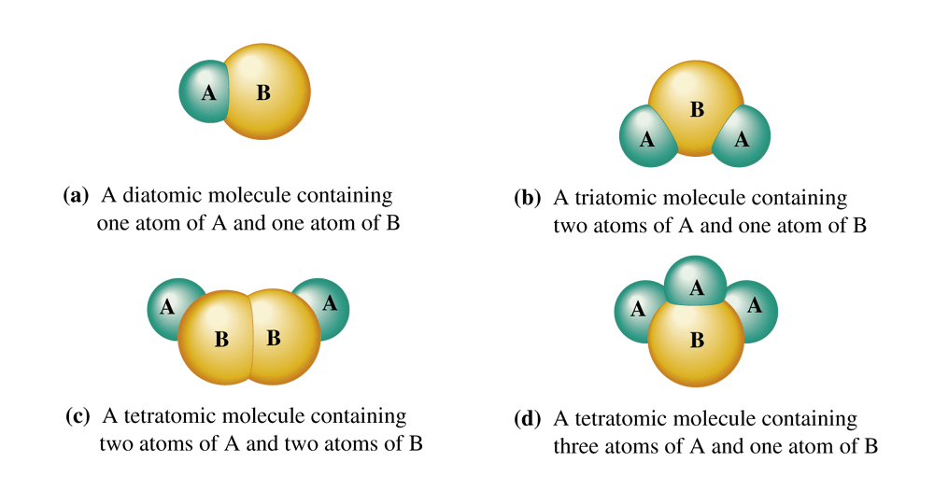
Figure 1.16 Depictions of various simple heteroatomic molecules using models. Spheres of different sizes and colors represent different kinds of atoms.

