Slide 1
The Concept of Equilibrium
Consider colorless frozen N₂O₄. At room temperature, it decomposes to brown NO₂:
N₂O₄(g) → 2NO₂(g).
At some time, the color stops changing and we have a mixture of N₂O₄ and NO₂.
Chemical equilibrium is the point at which the concentrations of all species are constant.

Slide 2
The Concept of Equilibrium
Using the collision model:
  as the amount of NO₂ builds up, there is a chance that two NO₂ molecules will collide to form NO₂.
  At the beginning of the reaction, there is no NO₂ so the reverse reaction (2NO₂(g) → N₂O₄(g)) does not occur.

Slide 3
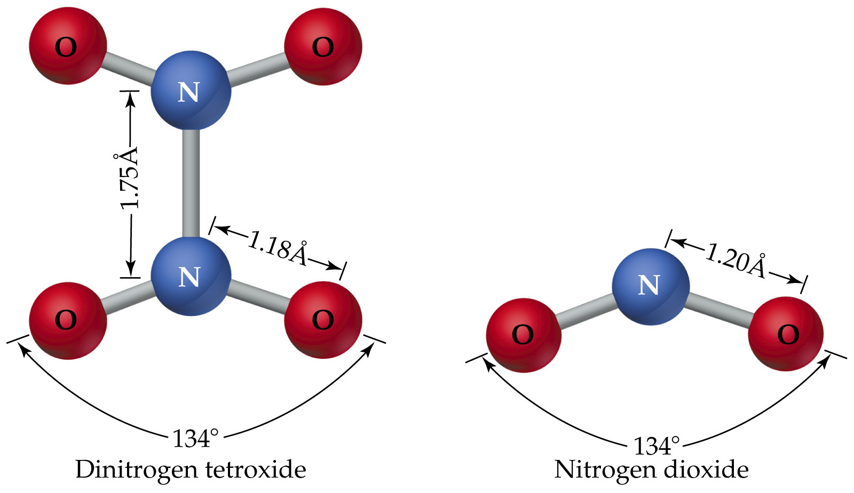
The Concept of Equilibrium

Slide 4
The Concept of Equilibrium
The point at which the rate of decomposition:
N₂O₄(g) → 2NO₂(g)
equals the rate of dimerization:
2NO₂(g) → N₂O₄(g).
  is dynamic equilibrium.
The equilibrium is dynamic because the reaction has not stopped: the opposing rates are equal.
Consider frozen N₂O₄: only white solid is present. On the microscopic level, only N₂O₄ molecules are present.

Slide 5
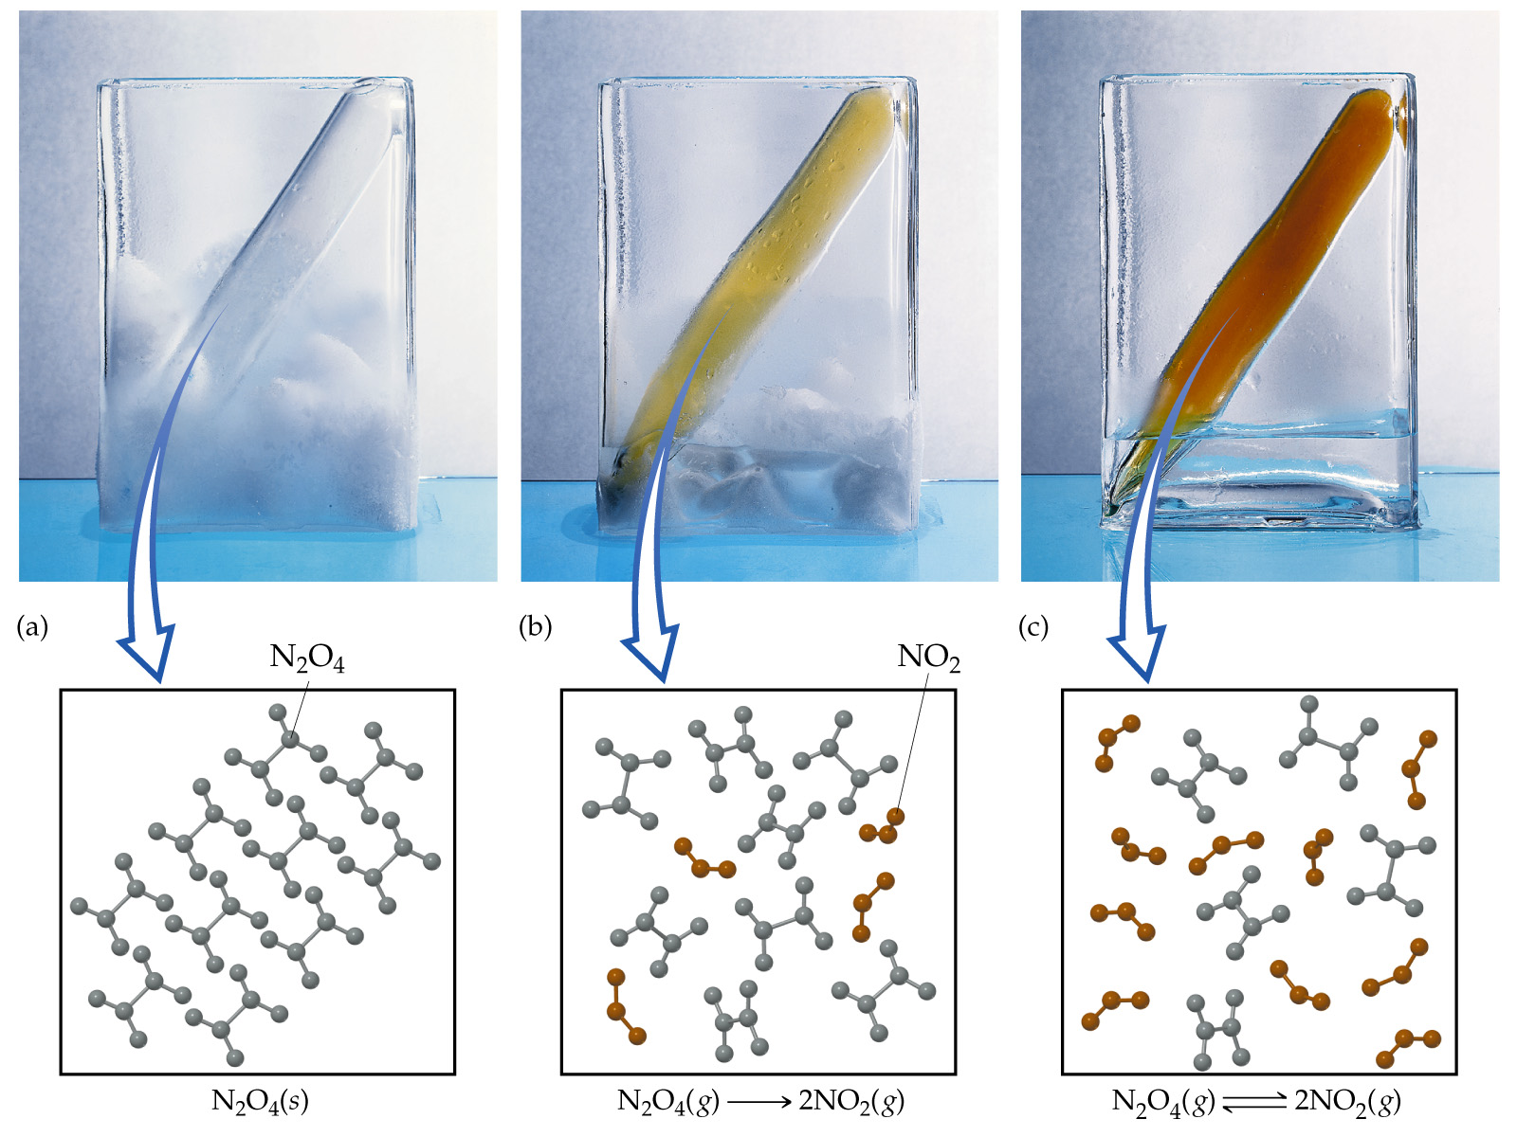

Slide 6
The Concept of Equilibrium
As the substance warms it begins to decompose:
N₂O₄(g) → 2NO₂(g)
A mixture of N₂O₄ (initially present) and NO₂ (initially formed) appears light brown.
When enough NO₂ is formed, it can react to form N₂O₄:
2NO₂(g) → N₂O₄(g).

Slide 7
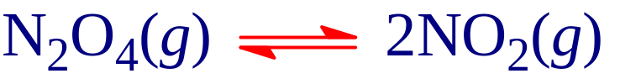
The Concept of Equilibrium
At equilibrium, as much N₂O₄ reacts to form NO₂ as NO₂ reacts to re-form N₂O₄:
The double arrow implies the process is dynamic.
Consider
Forward reaction: A → B Rate = k_{f}[A]
Reverse reaction: B → A Rate = k_{r}[B]
At equilibrium k_{f}[A] = k_{r}[B].

Slide 8

The Concept of Equilibrium
For an equilibrium we write
As the reaction progresses
  [A] decreases to a constant,
  [B] increases from zero to a constant.
  When [A] and [B] are constant, equilibrium is achieved.
Alternatively:
  k_{f}[A] decreases to a constant,
  k_{r}[B] increases from zero to a constant.
  When k_{f}[A] = k_{r}[B] equilibrium is achieved.

Slide 9
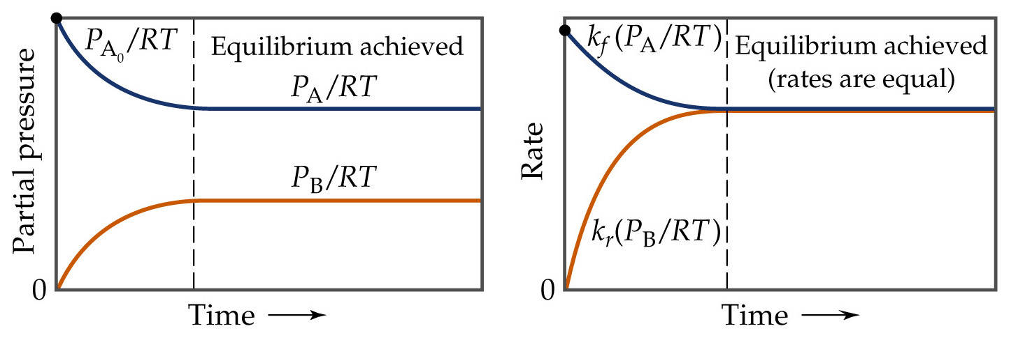
The Concept of Equilibrium

Slide 10
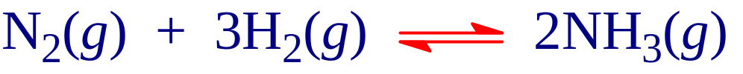
The Equilibrium Constant
Consider the Haber Process:
If we start with a mixture of nitrogen and hydrogen (in any proportions), the reaction will reach equilibrium with a constant concentration of nitrogen, hydrogen and ammonia.
However, if we start with just ammonia and no nitrogen or hydrogen, the reaction will proceed and N₂ and H₂ will be produced until equilibrium is achieved.

Slide 11
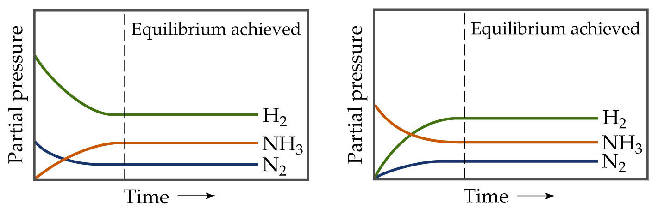
The Equilibrium Constant
No matter the starting composition of reactants and products, the same ratio of concentrations is achieved at equilibrium.

Slide 12

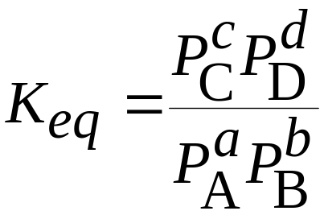
The Equilibrium Constant
For a general reaction in the gas phase
the equilibrium constant expression is
where K_{eq} is the equilibrium constant.

