Slide 1

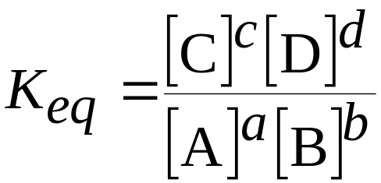
The Equilibrium Constant
For a general reaction
the equilibrium constant expression for everything in solution is
where K_{eq} is the equilibrium constant.

Slide 2
The Equilibrium Constant
K_{eq} is based on the molarities of reactants and products at equilibrium.
We generally omit the units of the equilibrium constant.
Note that the equilibrium constant expression has products over reactants.
The same equilibrium is established not matter how the reaction is begun.

Slide 3
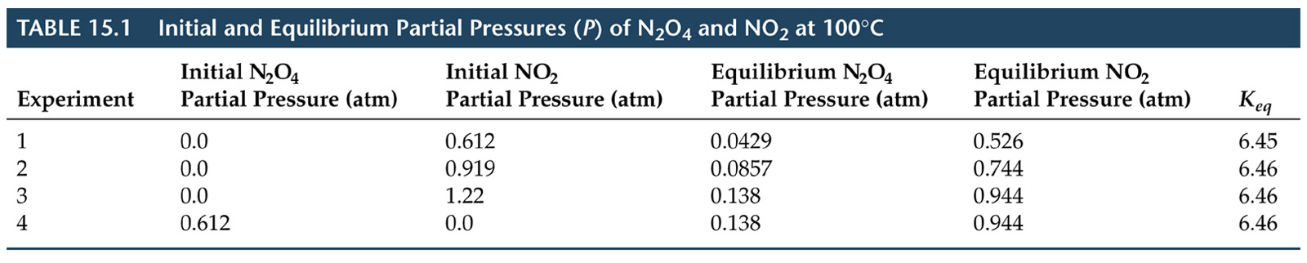
The Equilibrium Constant

Slide 4
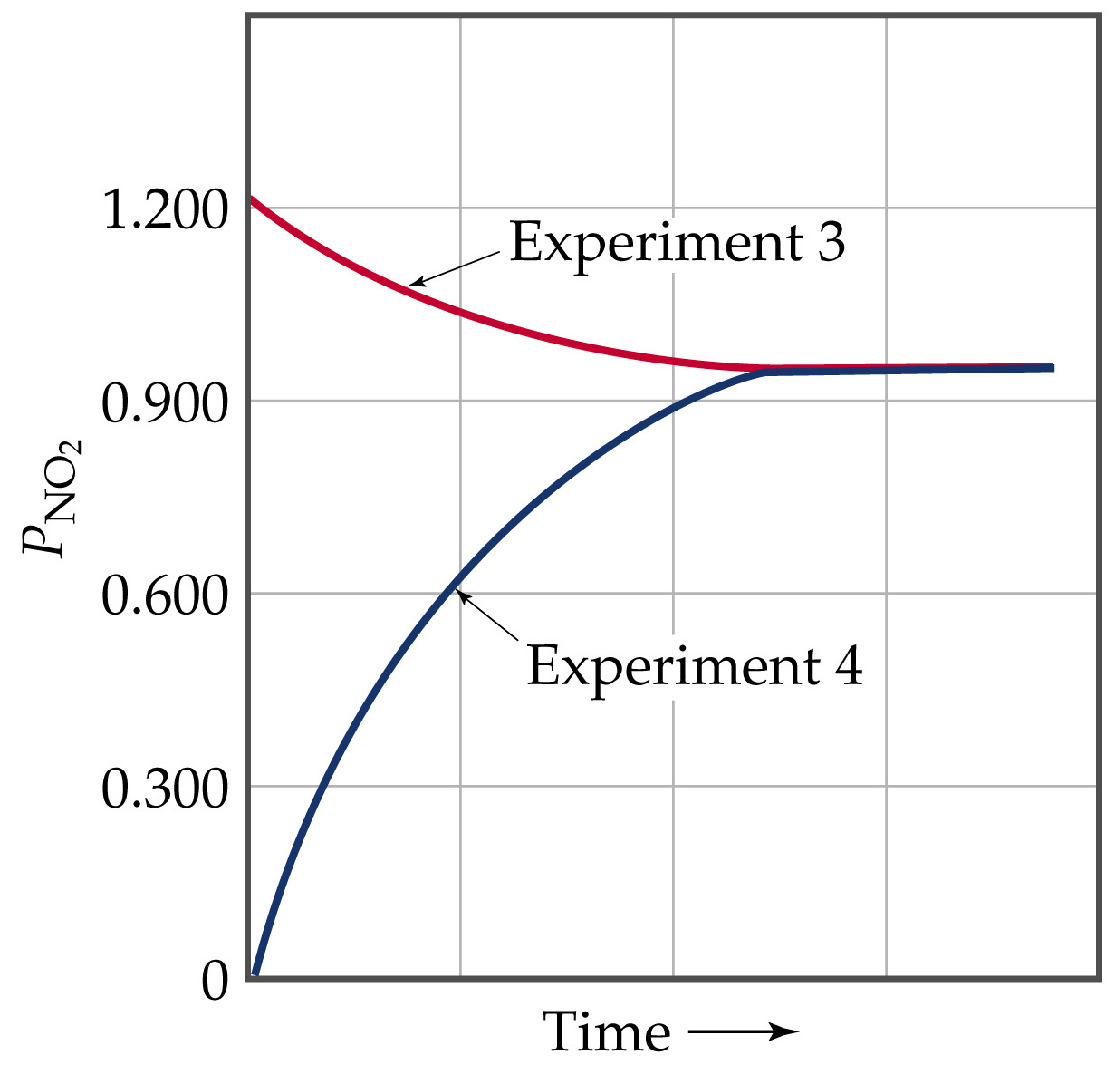

Slide 5
The Equilibrium Constant
The Magnitude of Equilibrium Constants
The equilibrium constant, K, is the ratio of products to reactants.
Therefore, the larger K the more products are present at equilibrium.
Conversely, the smaller K the more reactants are present at equilibrium.
If K >> 1, then products dominate at equilibrium and equilibrium lies to the right.

Slide 6
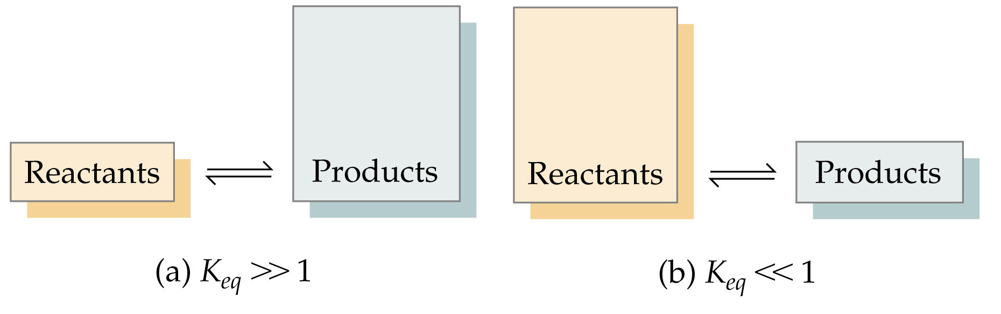
The Equilibrium Constant
The Magnitude of Equilibrium Constants
If K << 1, then reactants dominate at equilibrium and the equilibrium lies to the left.

Slide 7
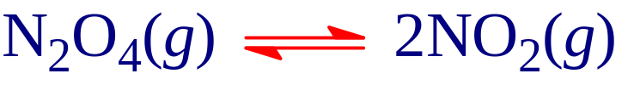
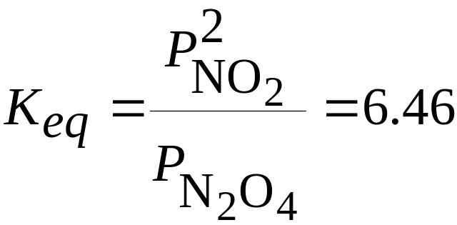
The Equilibrium Constant
The Direction of the Chemical Equation and K_{eq}
An equilibrium can be approached from any direction.
Example:
has

Slide 8
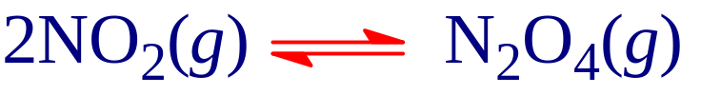
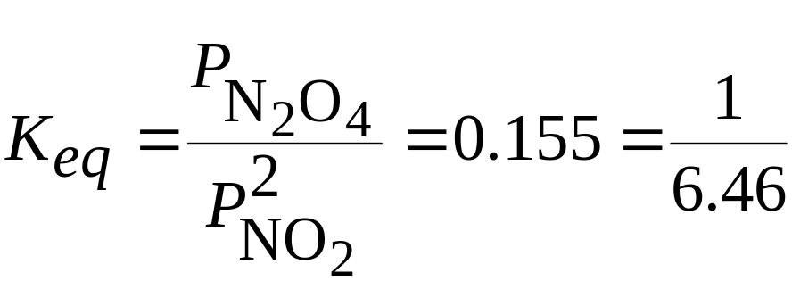

The Equilibrium Constant
The Direction of the Chemical Equation and K_{eq}
In the reverse direction:

Slide 9
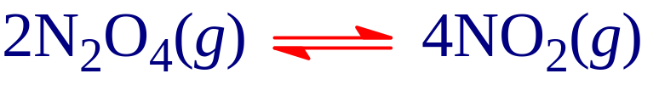
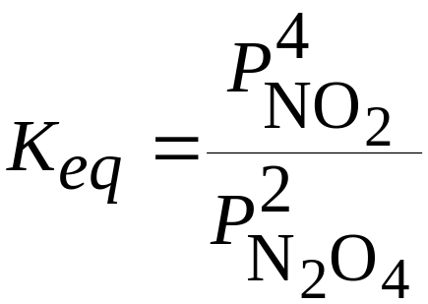
The Equilibrium Constant
Other Ways to Manipulate Chemical Equations and K_{eq} Values
The reaction
  has
  which is the square of the equilibrium constant for

Slide 10
The Equilibrium Constant
Other Ways to Manipulate Chemical Equations and K_{eq} Values
Equilibrium constant for the reverse direction is the inverse of that for the forward direction.
When a reaction is multiplied by a number, the equilibrium constant is raised to that power.
The equilibrium constant for a reaction which is the sum of other reactions is the product of the equilibrium constants for the individual reactions.

Slide 11
Heterogeneous Equilibria
When all reactants and products are in one phase, the equilibrium is homogeneous.
If one or more reactants or products are in a different phase, the equilibrium is heterogeneous.
Consider:
  experimentally, the amount of CO₂ does not seem to depend on the amounts of CaO and CaCO₃. Why?

Slide 12
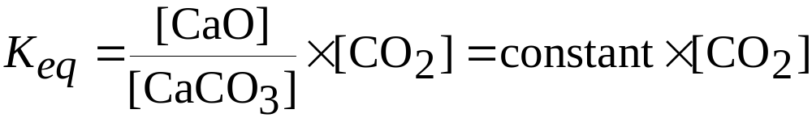
Heterogeneous Equilibria
The concentration of a solid or pure liquid is its density divided by molar mass.
Neither density nor molar mass is a variable, the concentrations of solids and pure liquids are constant.
For the decomposition of CaCO₃:

