Slide 1
Heterogeneous Equilibria
We ignore the concentrations of pure liquids and pure solids in equilibrium constant expressions.
The amount of CO₂ formed will not depend greatly on the amounts of CaO and CaCO₃ present.

Slide 2
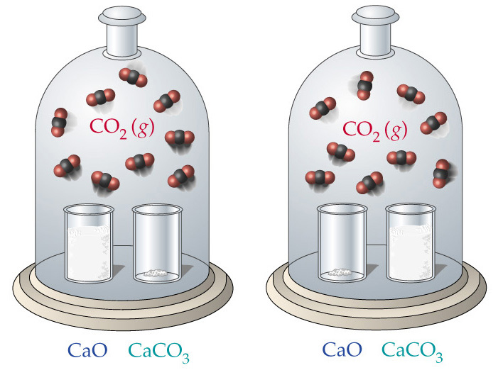

Slide 3
Calculating Equilibrium Constants
Proceed as follows:
  Tabulate initial and equilibrium concentrations (or partial pressures) given.
  If an initial and equilibrium concentration is given for a species, calculate the change in concentration.
  Use stoichiometry on the change in concentration line only to calculate the changes in concentration of all species.
  Deduce the equilibrium concentrations of all species.
Usually, the initial concentration of products is zero. (This is not always the case.)

Slide 4

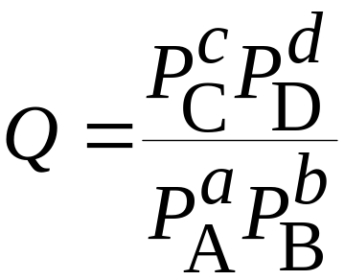
Applications of Equilibrium Constants
Predicting the Direction of Reaction
We define Q, the reaction quotient, for a general reaction
as
Q = K only at equilibrium.

Slide 5
Applications of Equilibrium Constants
Predicting the Direction of Reaction
If Q > K then the reverse reaction must occur to reach equilibrium (i.e., products are consumed, reactants are formed, the numerator in the equilibrium constant expression decreases and Q decreases until it equals K).
If Q < K then the forward reaction must occur to reach equilibrium.

Slide 6
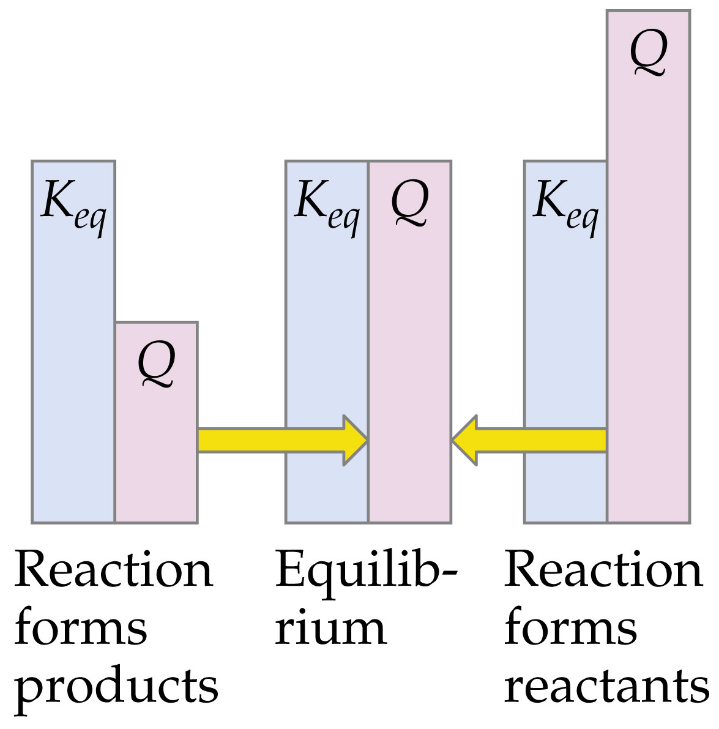

Slide 7
Applications of Equilibrium Constants
Calculating Equilibrium Constants
The same steps used to calculate equilibrium constants are used.
Generally, we do not have a number for the change in concentration line.
Therefore, we need to assume that x mol/L of a species is produced (or used).
The equilibrium concentrations are given as algebraic expressions.

Slide 8
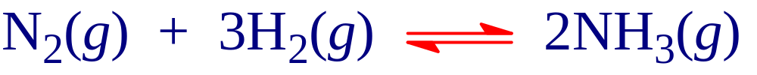
Le Châtelier’s Principle
Change in Reactant or Product Concentrations
Consider the Haber process
If H₂ is added while the system is at equilibrium, the system must respond to counteract the added H₂ (by Le Châtelier).
The system must consume the H₂ and produce products until a new equilibrium is established.
So, [H₂] and [N₂] will decrease and [NH₃] increases.

Slide 9
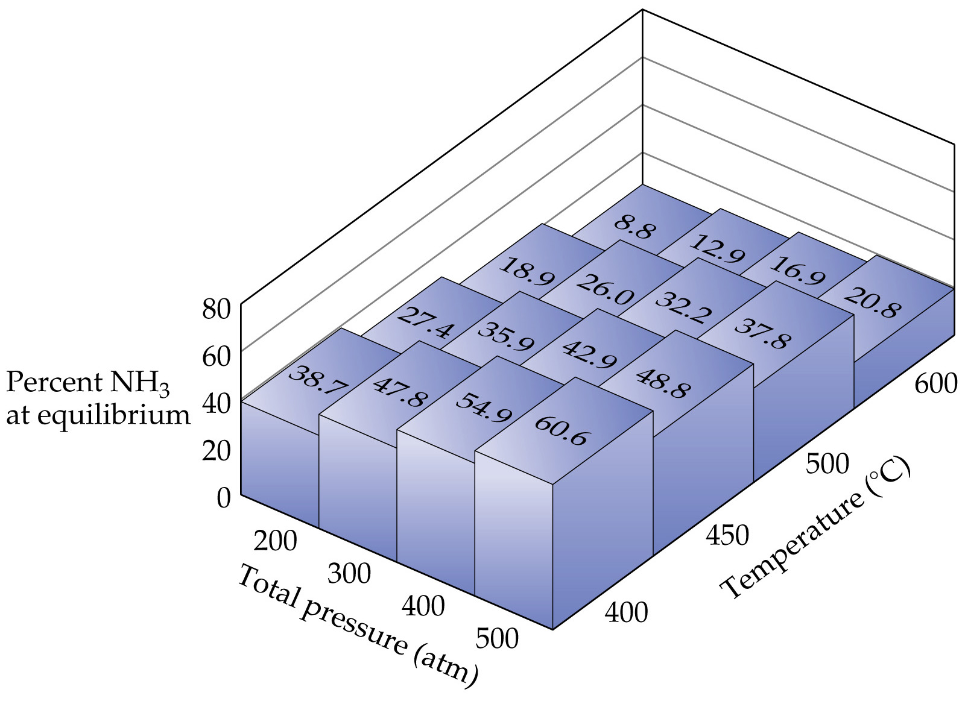
Le Châtelier’s Principle
Consider the production of ammonia
As the pressure increases, the amount of ammonia present at equilibrium increases.
As the temperature decreases, the amount of ammonia at equilibrium increases.
Can this be predicted?

Slide 10
Le Châtelier’s Principle
Le Châtelier’s Principle: if a system at equilibrium is disturbed, the system will move in such a way as to counteract the disturbance.

Slide 11
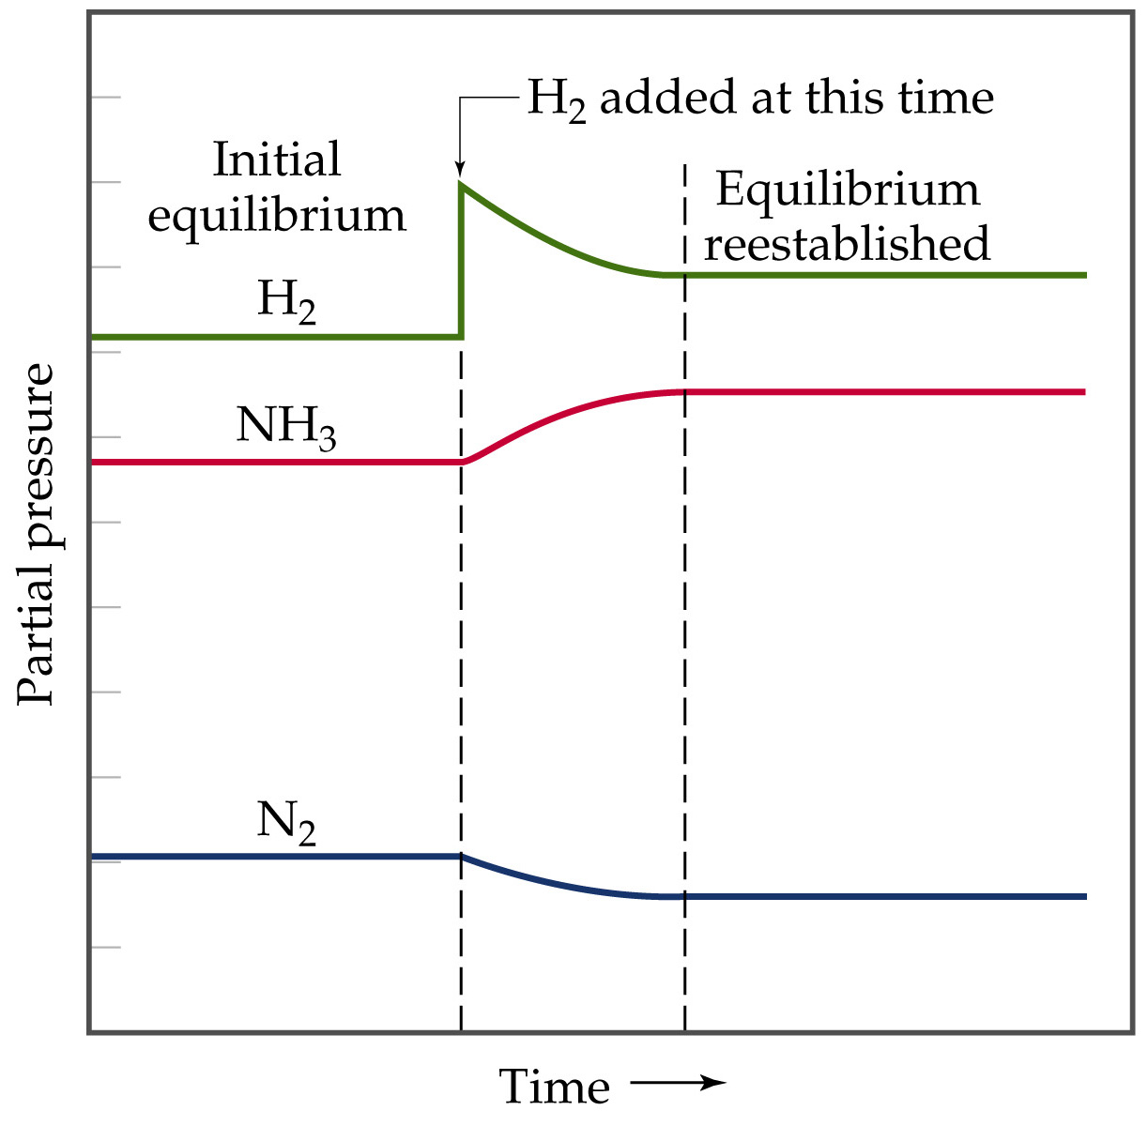

Slide 12
Le Châtelier’s Principle
Change in Reactant or Product Concentrations
Adding a reactant or product shifts the equilibrium away from the increase.
Removing a reactant or product shifts the equilibrium towards the decrease.
To optimize the amount of product at equilibrium, we need to flood the reaction vessel with reactant and continuously remove product (Le Châtelier).
We illustrate the concept with the industrial preparation of ammonia.

