Slide 1
Le Châtelier’s Principle
Change in Reactant or Product Concentrations
Adding a reactant or product shifts the equilibrium away from the increase.
Removing a reactant or product shifts the equilibrium towards the decrease.
To optimize the amount of product at equilibrium, we need to flood the reaction vessel with reactant and continuously remove product (Le Châtelier).
We illustrate the concept with the industrial preparation of ammonia.

Slide 2
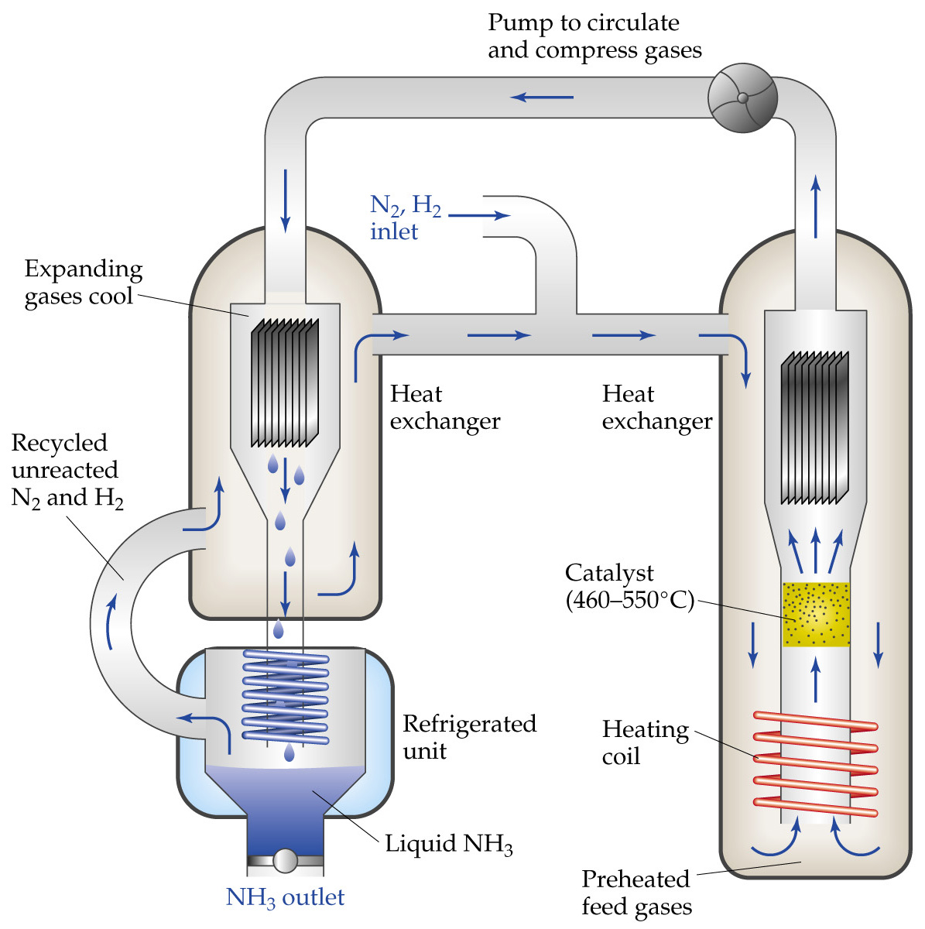

Slide 3
Le Châtelier’s Principle
Change in Reactant or Product Concentrations
N₂ and H₂ are pumped into a chamber.
The pre-heated gases are passed through a heating coil to the catalyst bed.
The catalyst bed is kept at 460 - 550 °C under high pressure.
The product gas stream (containing N₂, H₂ and NH₃) is passed over a cooler to a refrigeration unit.
In the refrigeration unit, ammonia liquefies not N₂ or H₂.

Slide 4
Le Châtelier’s Principle
Change in Reactant or Product Concentrations
The unreacted nitrogen and hydrogen are recycled with the new N₂ and H₂ feed gas.
The equilibrium amount of ammonia is optimized because the product (NH₃) is continually removed and the reactants (N₂ and H₂) are continually being added.
Effects of Volume and Pressure Changes
As volume is decreased pressure increases.

Slide 5
Le Châtelier’s Principle
Effects of Volume and Pressure Changes
Le Châtelier’s Principle: if pressure is increased the system will shift to counteract the increase.
That is, the system shifts to remove gases and decrease pressure.
An increase in pressure favors the direction that has fewer moles of gas.
In a reaction with the same number of product and reactant moles of gas, pressure has no effect.

Slide 6
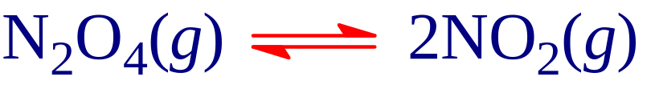

Le Châtelier’s Principle
Effects of Volume and Pressure Changes
An increase in pressure (by decreasing the volume) favors the formation of colorless N₂O₄.
The instant the pressure increases, the system is not at equilibrium and the concentration of both gases has increased.
The system moves to reduce the number moles of gas (i.e. the forward reaction is favored).

Slide 7

Le Châtelier’s Principle
Effects of Volume and Pressure Changes
A new equilibrium is established in which the mixture is lighter because colorless N₂O₄ is favored.
Effect of Temperature Changes
The equilibrium constant is temperature dependent.
For an endothermic reaction, ΔH > 0 and heat can be considered as a reactant.
For an exothermic reaction, ΔH < 0 and heat can be considered as a product.

Slide 8
Le Châtelier’s Principle
Effect of Temperature Changes
Adding heat (i.e. heating the vessel) favors away from the increase:
  if ΔH > 0, adding heat favors the forward reaction,
  if ΔH < 0, adding heat favors the reverse reaction.
Removing heat (i.e. cooling the vessel), favors towards the decrease:
  if ΔH > 0, cooling favors the reverse reaction,
  if ΔH < 0, cooling favors the forward reaction.

Slide 9
Le Châtelier’s Principle
Effect of Temperature Changes
Consider
for which ΔH > 0.
  Co(H₂O)₆²⁺ is pale pink and CoCl₄²⁻ is blue.
  If a light purple room temperature equilibrium mixture is placed in a beaker of warm water, the mixture turns deep blue.
  Since ΔH > 0 (endothermic), adding heat favors the forward reaction, i.e. the formation of blue CoCl₄²⁻.

Slide 10
Le Châtelier’s Principle
Effect of Temperature Changes
Consider:
  If the room temperature equilibrium mixture is placed in a beaker of ice water, the mixture turns bright pink.
  Since ΔH > 0, removing heat favors the reverse reaction which is the formation of pink Co(H₂O)₆²⁺.

Slide 11
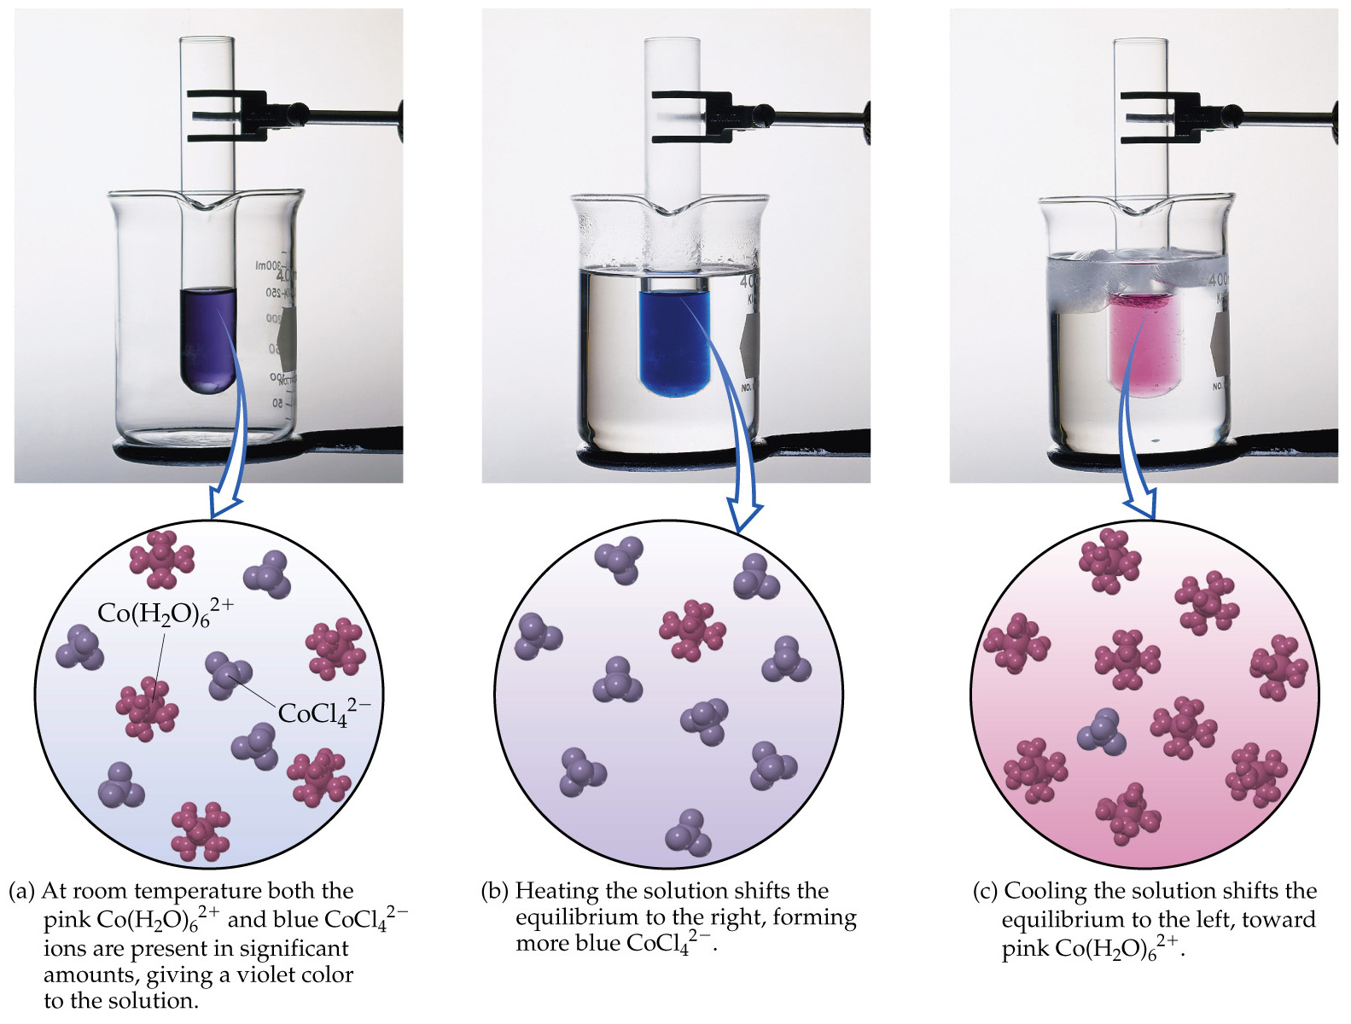

Slide 12
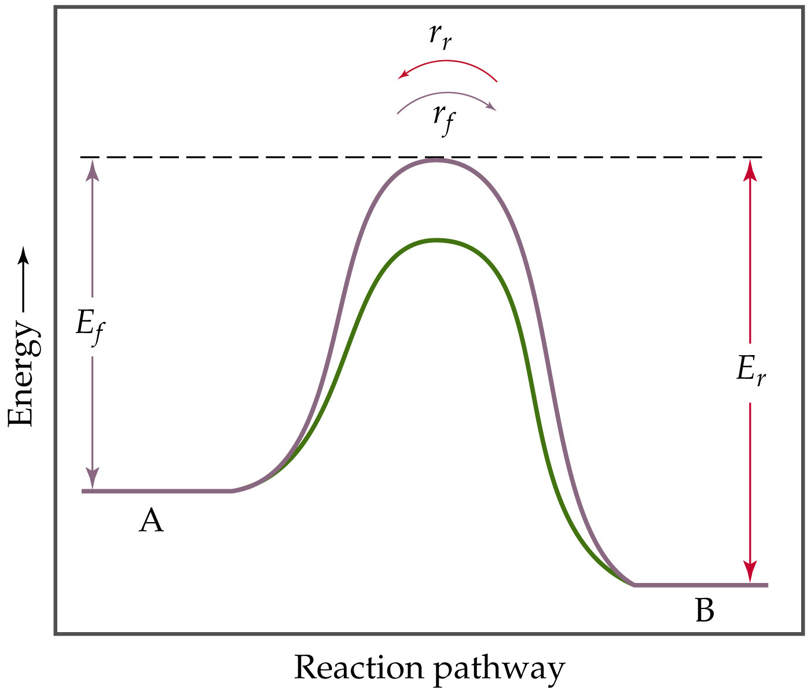
Le Châtelier’s Principle
The Effect of Catalysis
A catalyst lowers the activation energy barrier for the reaction.
Therefore, a catalyst will decrease the time taken to reach equilibrium.
A catalyst does not effect the composition of the equilibrium mixture.

