Slide 1


Acids and Bases: A Brief Review
Acids: taste sour and cause dyes to change color.
Bases: taste bitter and feel soapy.
Arrhenius: acids increase [H⁺] bases increase [OH⁻] in solution.
Arrhenius: acid + base → salt + water.
Problem: the definition confines us to aqueous solution.

Slide 2
Brønsted-Lowry
Acids and Bases
The H⁺ Ion in Water
The H⁺(aq) ion is simply a proton with no electrons. (H has one proton, one electron, and no neutrons.)
In water, the H⁺(aq) form clusters.
The simplest cluster is H₃O⁺(aq). Larger clusters are H₅O₂⁺ and H₉O₄⁺.
Generally we use H⁺(aq) and H₃O⁺(aq) interchangeably.

Slide 3
Brønsted-Lowry
Acids and Bases
Proton Transfer Reactions
Focus on the H⁺(aq).
Brønsted-Lowry: acid donates H⁺ and base accepts H⁺.
Brønsted-Lowry base does not need to contain OH⁻.
Consider HCl(aq) + H₂O(l) → H₃O⁺(aq) + Cl⁻(aq):
  HCl donates a proton to water. Therefore, HCl is an acid.
  H₂O accepts a proton from HCl. Therefore, H₂O is a base.
Water can behave as either an acid or a base.
Amphoteric substances can behave as acids and bases.

Slide 4
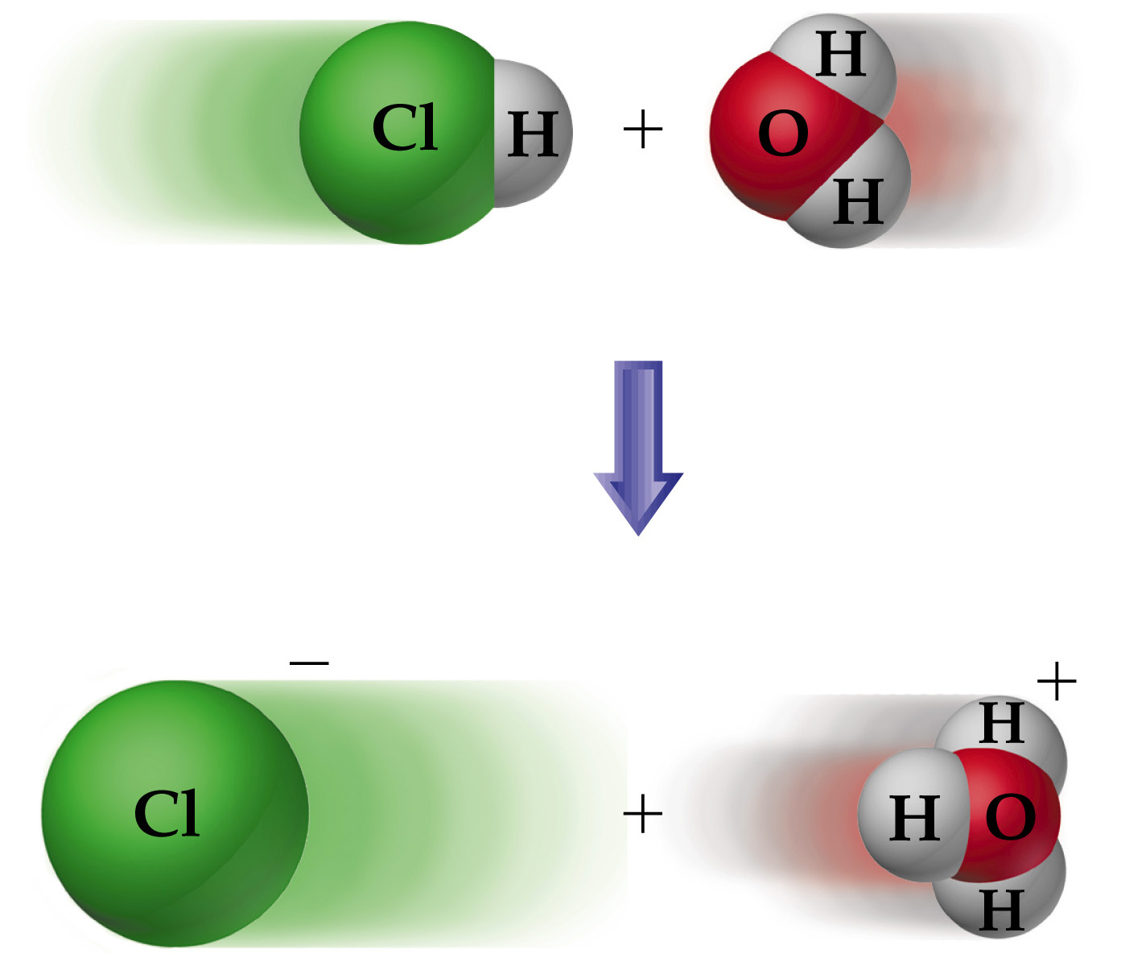

Slide 5
Brønsted-Lowry Acids and Bases
Conjugate Acid-Base Pairs
Whatever is left of the acid after the proton is donated is called its conjugate base.
Similarly, whatever remains of the base after it accepts a proton is called a conjugate acid.
Consider
  After HA (acid) loses its proton it is converted into A⁻ (base). Therefore HA and A⁻ are conjugate acid-base pairs.
  After H₂O (base) gains a proton it is converted into H₃O⁺ (acid). Therefore, H₂O and H₃O⁺ are conjugate acid-base pairs.
Conjugate acid-base pairs differ by only one proton.

Slide 6
Brønsted-Lowry Acids and Bases
Relative Strengths of Acids and Bases
The stronger the acid, the weaker the conjugate base.
H⁺ is the strongest acid that can exist in equilibrium in aqueous solution.
OH⁻ is the strongest base that can exist in equilibrium in aqueous solution.

Slide 7
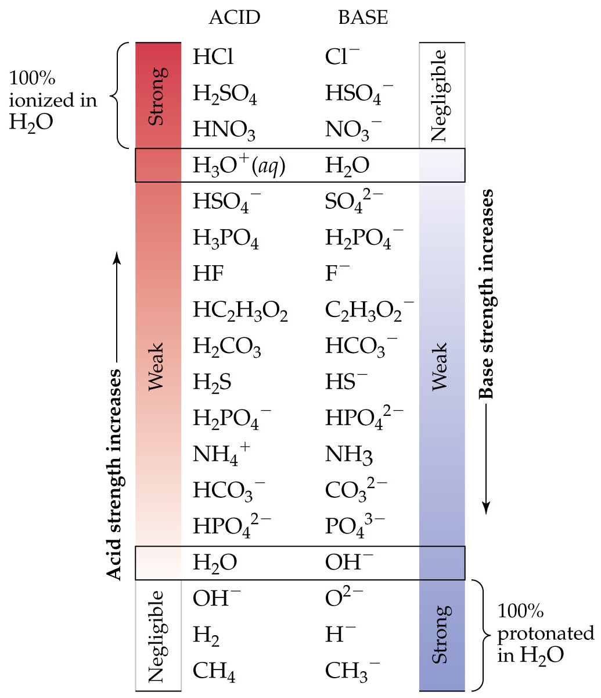

Slide 8
Brønsted-Lowry Acids and Bases
Relative Strengths of Acids and Bases
Any acid or base that is stronger than H⁺ or OH⁻ simply reacts stoichiometrically to produce H⁺ and OH⁻.
The conjugate base of a strong acid (e.g. Cl⁻) has negligible acid-base properties.
Similarly, the conjugate acid of a strong base has negligible acid-base properties.

Slide 9
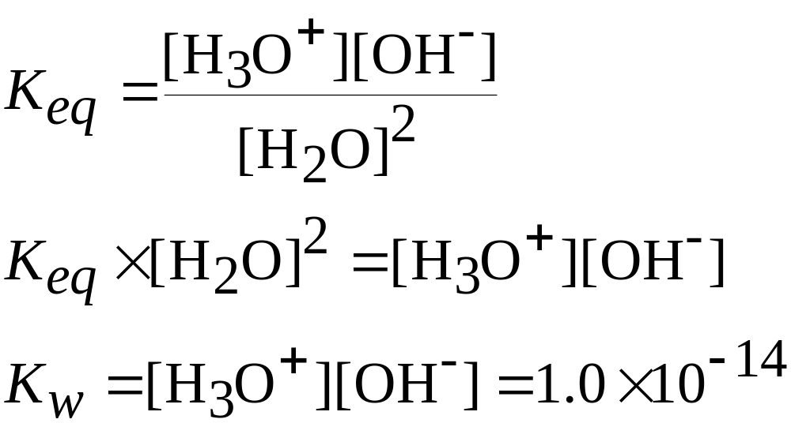
The Autoionization of Water
The Ion Product of Water
In pure water the following equilibrium is established
at 25 °C
The above is called the autoionization of water.

Slide 10
The pH Scale
In most solutions [H⁺(aq)] is quite small.
We define
In neutral water at 25 °C, pH = pOH = 7.00.
In acidic solutions, [H⁺] > 1.0 × 10⁻⁷, so pH < 7.00.
In basic solutions, [H⁺] < 1.0 × 10⁻⁷, so pH > 7.00.
The higher the pH, the lower the pOH, the more basic the solution.

Slide 11
The pH Scale
Most pH and pOH values fall between 0 and 14.
There are no theoretical limits on the values of pH or pOH. They can even be NEGATIVE
(e.g. pH of 2.0 M HCl is -0.301.)

Slide 12
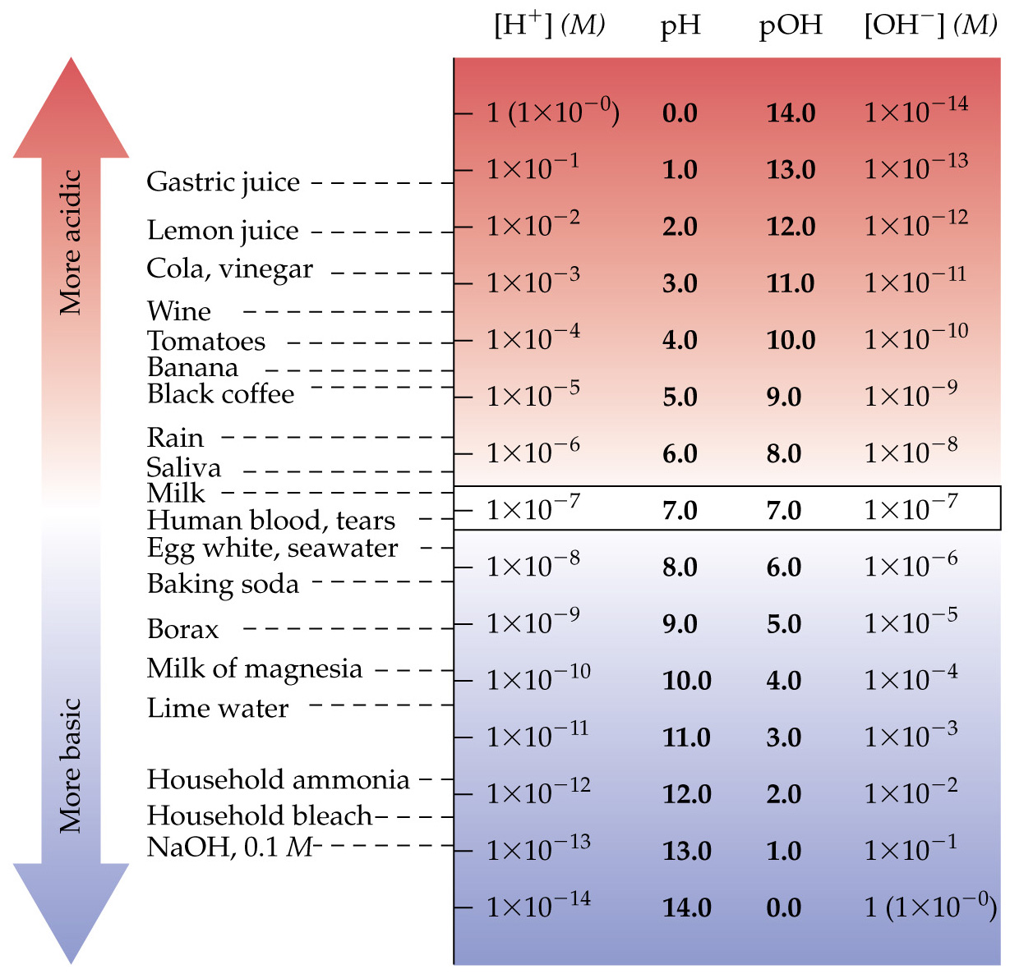

Slide 13

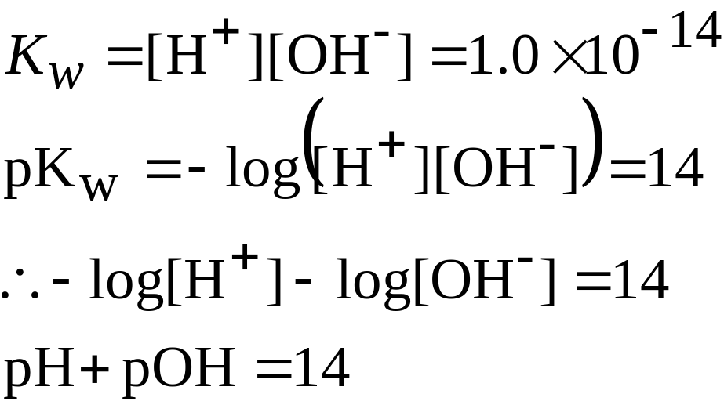
The pH Scale
Other “p” Scales
In general for a number X,
For example, pK_{w} = -log K_{w}.

Slide 14

The pH Scale
Measuring pH
Most accurate method to measure pH is to use a pH meter.
However, certain dyes change color as pH changes. These are indicators.
Indicators are less precise than pH meters.
Many indicators do not have a sharp color change as a function of pH.
Most indicators tend to be red in more acidic solutions.

Slide 15
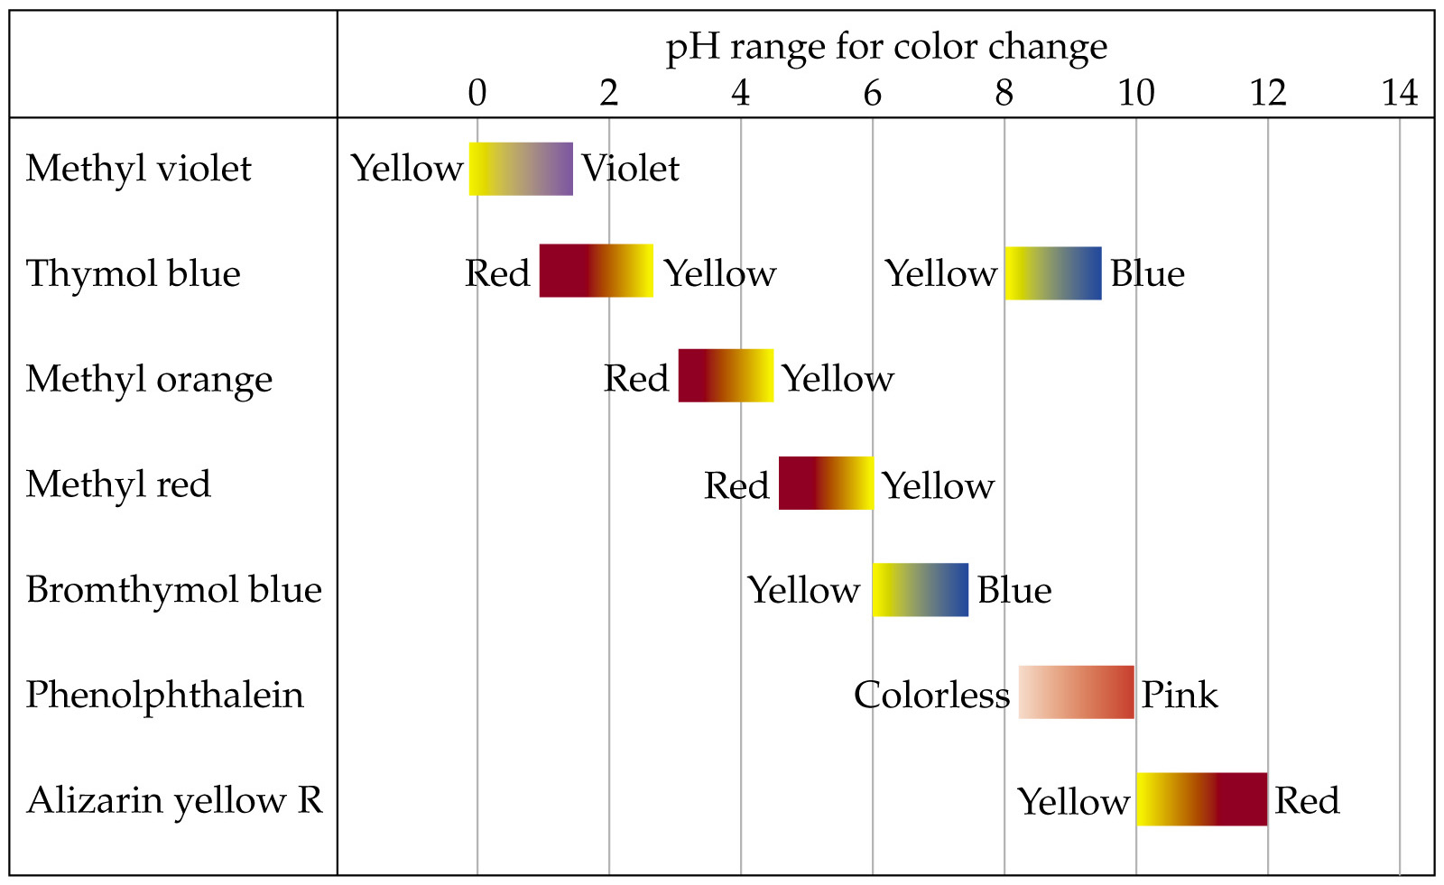
The pH Scale

