Slide 1
Strong Acids and Bases
Strong Acids
The strongest common acids are HCl, HBr, HI, HNO₃, HClO₃, HClO₄, and H₂SO₄.
Strong acids are strong electrolytes.
All strong acids ionize completely in solution:
HNO₃(aq) + H₂O(l) → H₃O⁺(aq) + NO₃⁻(aq)
Since H⁺ and H₃O⁺ are used interchangeably, we write
HNO₃(aq) → H⁺(aq) + NO₃⁻(aq)

Slide 2

Strong Acids and Bases
Strong Acids
In solutions the strong acid is usually the only source of H⁺. (If the molarity of the acid is less than 10⁻⁶ M then the autoionization of water needs to be taken into account.)
Therefore, the pH of the solution is the initial molarity of the acid.
Strong Bases
Most ionic hydroxides are strong bases (e.g. NaOH, KOH, and Ca(OH)₂).

Slide 3
Strong Acids and Bases
Strong Bases
Strong bases are strong electrolytes and dissociate completely in solution.
The pOH (and hence pH) of a strong base is given by the initial molarity of the base. Be careful of stoichiometry.
In order for a hydroxide to be a base, it must be soluble.
Bases do not have to contain the OH⁻ ion:
O²⁻(aq) + H₂O(l) → 2OH⁻(aq)
H⁻(aq) + H₂O(l) → H₂(g) + OH⁻(aq)
N₃⁻(aq) + H₂O(l) → NH₃(aq) + 3OH⁻(aq)

Slide 4
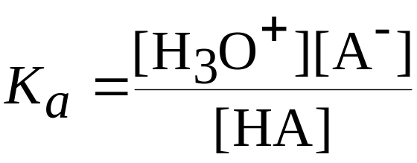

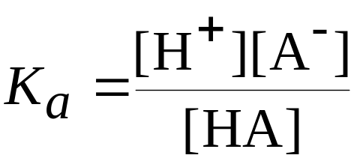
Weak Acids
Weak acids are only partially ionized in solution.
There is a mixture of ions and unionized acid in solution.
Therefore, weak acids are in equilibrium:

Slide 5
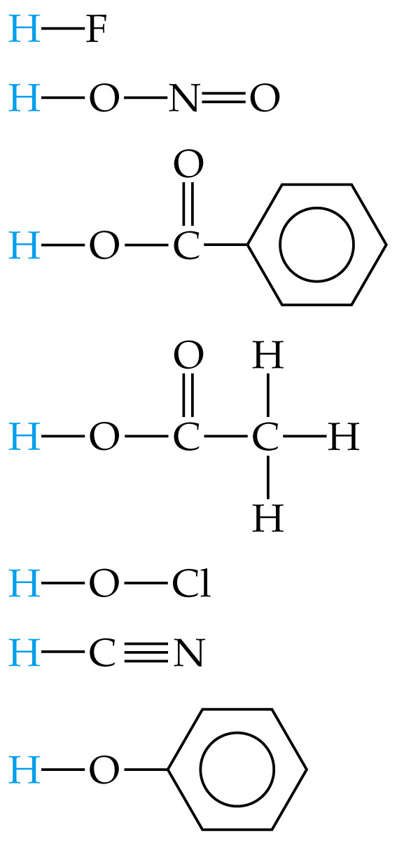
Weak Acids
K_{a} is the acid dissociation constant.
Note [H₂O] is omitted from the K_{a} expression. (H₂O is a pure liquid.)
The larger the K_{a} the stronger the acid (i.e. the more ions are present at equilibrium relative to unionized molecules).
If K_{a} >> 1, then the acid is completely ionized and the acid is a strong acid.

Slide 6
Weak Acids
Calculating K_{a} from pH
Weak acids are simply equilibrium calculations.
The pH gives the equilibrium concentration of H⁺.
Using K_{a}, the concentration of H⁺ (and hence the pH) can be calculated.
  Write the balanced chemical equation clearly showing the equilibrium.
  Write the equilibrium expression. Find the value for K_{a}.
  Write down the initial and equilibrium concentrations for everything except pure water. We usually assume that the change in concentration of H⁺ is x.

Slide 7
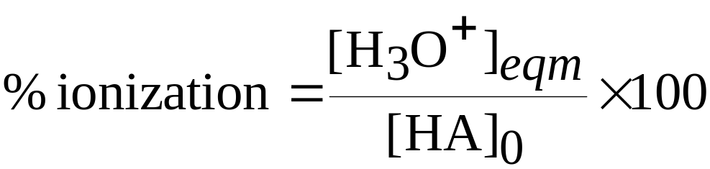
Weak Acids
Calculating K_{a} from pH
Substitute into the equilibrium constant expression and solve. Remember to turn x into pH if necessary.
Using K_{a} to Calculate pH
Percent ionization is another method to assess acid strength.
For the reaction

Slide 8
Weak Acids
Using K_{a} to Calculate pH
Percent ionization relates the equilibrium H⁺ concentration, [H⁺]_{eqm}, to the initial HA concentration, [HA]₀.
The higher percent ionization, the stronger the acid.
Percent ionization of a weak acid decreases as the molarity of the solution increases.
For acetic acid, 0.05 M solution is 2.0 % ionized whereas a 0.15 M solution is 1.0 % ionized.

Slide 9
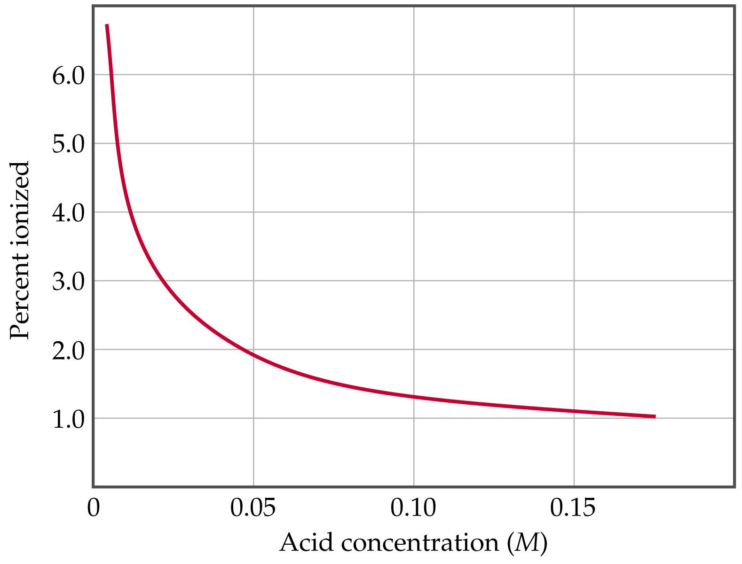

Slide 10
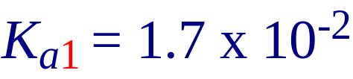
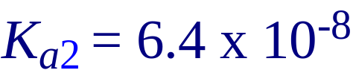
Weak Acids
Polyprotic Acids
Polyprotic acids have more than one ionizable proton.
The protons are removed in steps not all at once:
It is always easier to remove the first proton in a polyprotic acid than the second.
Therefore, K_{a1} > K_{a2} > K_{a3} etc.

Slide 11
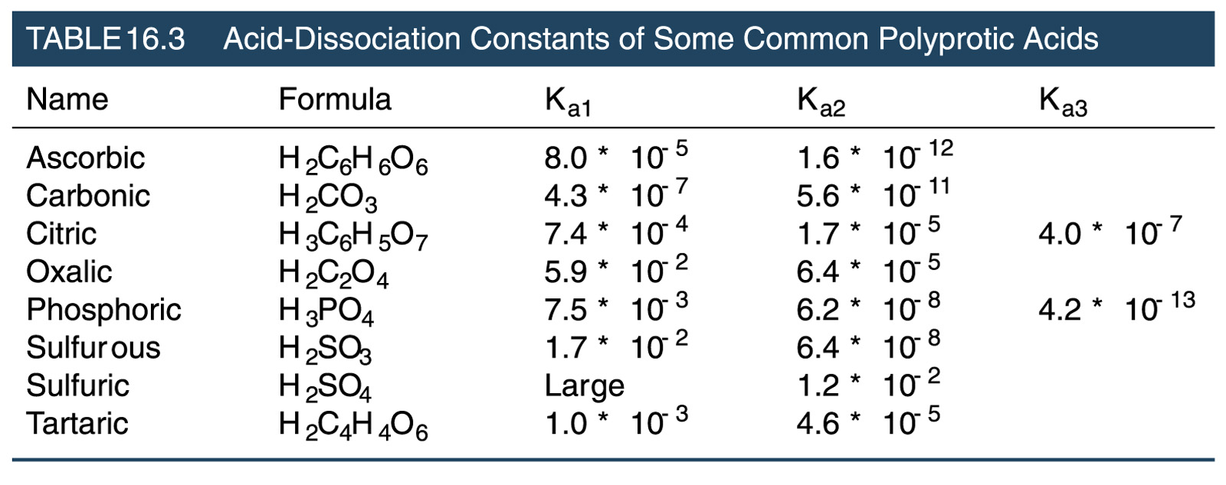
Weak Acids
Polyprotic Acids

Slide 12
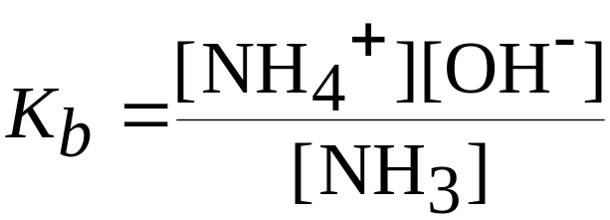
Weak Bases
Weak bases remove protons from substances.
There is an equilibrium between the base and the resulting ions:
Example:
The base dissociation constant, K_{b}, is defined as

Slide 13
Weak Bases
Types of Weak Bases
Bases generally have lone pairs or negative charges in order to attack protons.
Most neutral weak bases contain nitrogen.
Amines are related to ammonia and have one or more N-H bonds replaced with N-C bonds (e.g., CH₃NH₂ is methylamine).
Anions of weak acids are also weak bases. Example: OCl⁻ is the conjugate base of HOCl (weak acid):

Slide 14

Relationship Between K_{a} and K_{b}
We need to quantify the relationship between strength of acid and conjugate base.
When two reactions are added to give a third, the equilibrium constant for the third reaction is the product of the equilibrium constants for the first two:
Reaction 1 + reaction 2 = reaction 3
has

Slide 15


Relationship Between K_{a} and K_{b}
For a conjugate acid-base pair
Therefore, the larger the K_{a}, the smaller the K_{b}. That is, the stronger the acid, the weaker the conjugate base.
Taking negative logarithms:

Slide 16
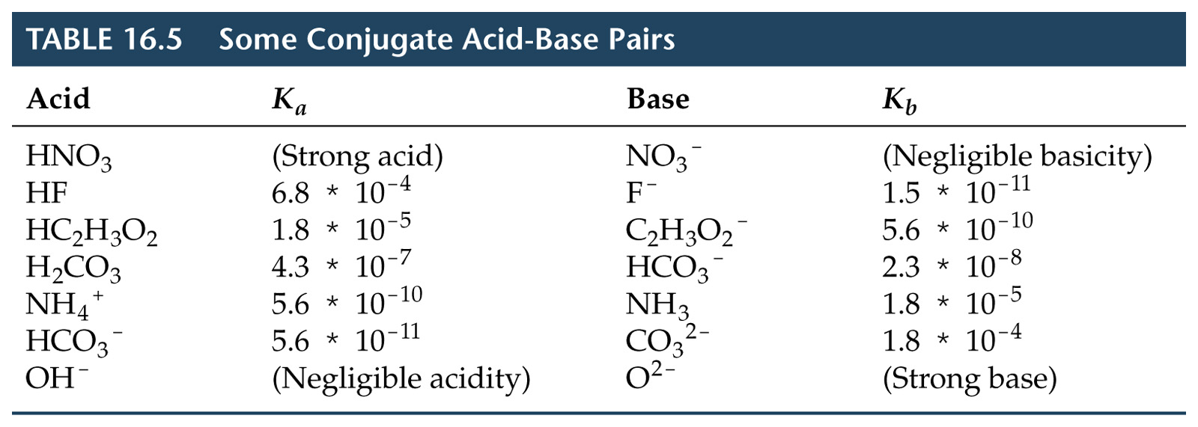
Relationship Between K_{a} and K_{b}

