Slide 1
Acid-Base Properties of Salt Solutions
Nearly all salts are strong electrolytes.
Therefore, salts exist entirely of ions in solution.
Acid-base properties of salts are a consequence of the reaction of their ions in solution.
The reaction in which ions produce H⁺ or OH⁻ in water is called hydrolysis.
Anions from weak acids are basic.
Anions from strong acids are neutral.

Slide 2
Acid-Base Properties of Salt Solutions
An Anion’s Ability to React with Water
Anions, X⁻, can be considered conjugate bases from acids, HX.
For X⁻ comes from a strong acid, then it is neutral.
If X⁻ comes from a weak acid, then
The pH of the solution can be calculated using equilibrium!

Slide 3
Acid-Base Properties of Salt Solutions
An Cation’s Ability to React with Water
Polyatomic cations with ionizable protons can be considered conjugate acids of weak bases.
Some metal ions react in solution to lower pH.
Combined Effect of Cation and Anion in Solution
An anion from a strong acid has no acid-base properties.
An anion that is the conjugate base of a weak acid will cause an increase in pH.

Slide 4
Acid-Base Properties of Salt Solutions
Combined Effect of Cation & Anion in Solution
A cation that is the conjugate acid of a weak base will cause a decrease in the pH of the solution.
Metal ions will cause a decrease in pH except for the alkali metals and alkaline earth metals.
When a solution contains both cations and anions from weak acids and bases, use K_{a} and K_{b} to determine the final pH of the solution.

Slide 5
Acid-Base Behavior and Chemical Structure
Factors that Affect Acid Strength
Consider H-X. For this substance to be an acid we need:
H-X bond to be polar with Hδ+ and Xδ- (if X is a metal then the bond polarity is Hδ-, Xδ+ and the substance is a base),
the H-X bond must be weak enough to be broken,
the conjugate base, X⁻, must be stable.

Slide 6
Acid-Base Behavior and Chemical Structure
Binary Acids
Acid strength increases across a period and down a group.
Conversely, base strength decreases across a period and down a group.
HF is a weak acid because the bond energy is high.
The electronegativity difference between C and H is so small that the C-H bond is non-polar and CH₄ is neither an acid nor a base.

Slide 7
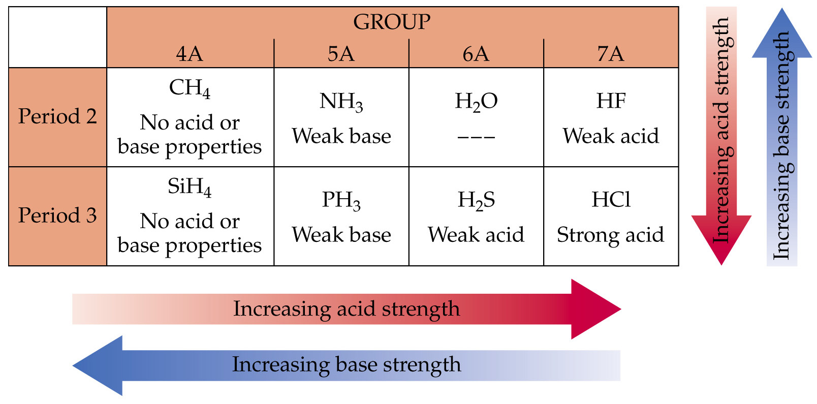
Acid-Base Behavior and Chemical Structure
Binary Acids

Slide 8
Acid-Base Behavior and Chemical Structure
Oxyacids
Oxyacids contain O-H bonds.
All oxyacids have the general structure Y-O-H.
The strength of the acid depends on Y and the atoms attached to Y.
  If Y is a metal (low electronegativity), then the substances are bases.
  If Y has intermediate electronegativity (e.g. I, EN = 2.5), the electrons are between Y and O and the substance is a weak oxyacid.

Slide 9
Acid-Base Behavior and Chemical Structure
Oxyacids
  If Y has a large electronegativity (e.g. Cl, EN = 3.0), the electrons are located closer to Y than O and the O-H bond is polarized to lose H⁺.
  The number of O atoms attached to Y increase the O-H bond polarity and the strength of the acid increases (e.g. HOCl is a weaker acid than HClO₂ which is weaker than HClO₃ which is weaker than HClO₄ which is a strong acid).

Slide 10
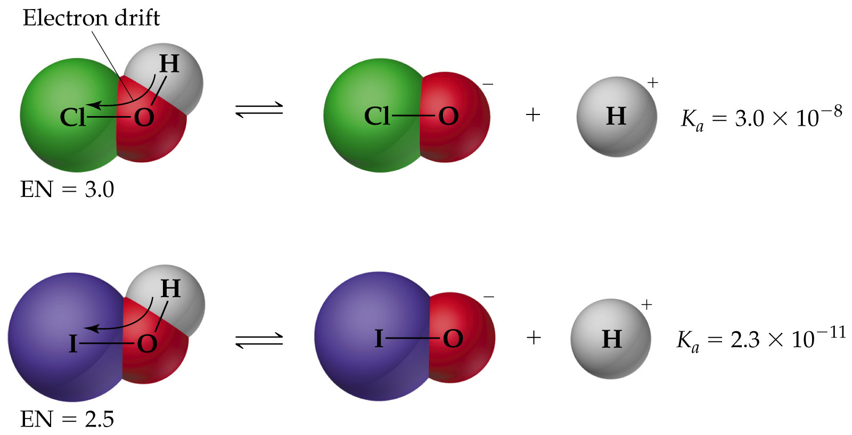
Acid-Base Behavior and Chemical Structure
Oxyacids

Slide 11
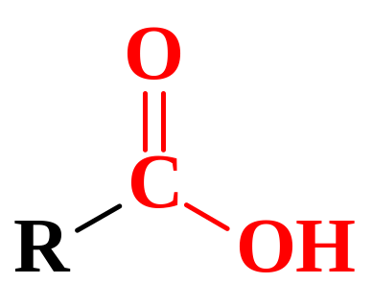
Acid-Base Behavior and Chemical Structure
Carboxylic Acids
Carboxylic acids all contain the COOH group.
All carboxylic acids are weak acids.
When the carboxylic acid loses a proton, it generate the carboxylate anion, COO⁻.

Slide 12
Lewis Acids and Bases
Brønsted-Lowry acid is a proton donor.
Focusing on electrons: a Brønsted-Lowry acid can be considered as an electron pair acceptor.
Lewis acid: electron pair acceptor.
Lewis base: electron pair donor.
Note: Lewis acids and bases do not need to contain protons.
Therefore, the Lewis definition is the most general definition of acids and bases.

Slide 13

Lewis Acids and Bases
Lewis acids generally have an incomplete octet (e.g. BF₃).
Transition metal ions are generally Lewis acids.
Lewis acids must have a vacant orbital (into which the electron pairs can be donated).
Compounds with π-bonds can act as Lewis acids:
H₂O(l) + CO₂(g) → H₂CO₃(aq)

Slide 14
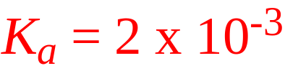
Lewis Acids and Bases
Hydrolysis of Metal Ions
Metal ions are positively charged and attract water molecules (via the lone pairs on O).
The higher the charge, the smaller the metal ion and the stronger the M-OH₂ interaction.
Hydrated metal ions act as acids:
The pH increases as the size of the ion increases (e.g. Ca²⁺ vs. Zn²⁺) and as the charge increases (Na⁺ vs. Ca²⁺ and Zn²⁺ vs. Al³⁺).

Slide 15
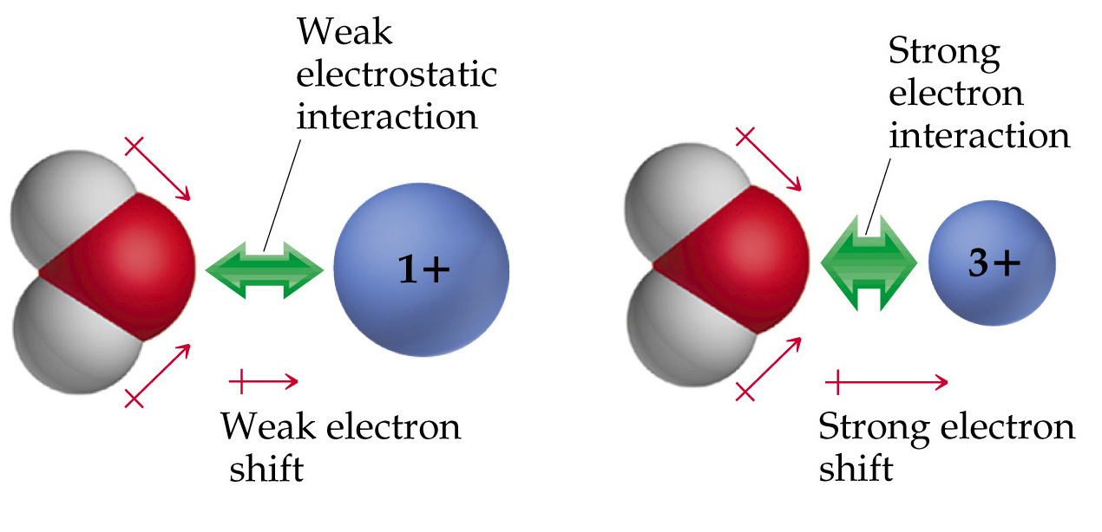
Lewis Acids and Bases
Hydrolysis of Metal Ions

