Slide 1
The Common Ion Effect
The solubility of a partially soluble salt is decreased when a common ion is added.
Consider the equilibrium established when acetic acid, HC₂H₃O₂, is added to water.
At equilibrium H⁺ and C₂H₃O₂⁻ are constantly moving into and out of solution, but the concentrations of ions is constant and equal.

Slide 2

The Common Ion Effect
Consider the addition of C₂H₃O₂⁻, which is a common ion. (The source of acetate could be a strong electrolyte such as NaC₂H₃O₂.)
Therefore, [C₂H₃O₂⁻] increases and the system is no longer at equilibrium.
So, [H⁺] must decrease.

Slide 3

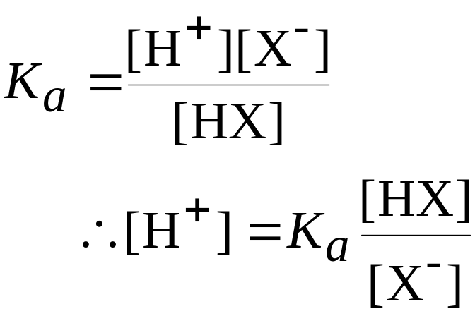
Buffered Solutions
Composition and Action of Buffered Solutions
A buffer consists of a mixture of a weak acid (HX) and its conjugate base (X⁻):
The K_{a} expression is

Slide 4
Buffered Solutions
Composition and Action of Buffered Solutions
A buffer resists a change in pH when a small amount of OH⁻ or H⁺ is added.
When OH⁻ is added to the buffer, the OH⁻ reacts with HX to produce X⁻ and water. But, the [HX]/[X⁻] ratio remains more or less constant, so the pH is not significantly changed.
When H⁺ is added to the buffer, X⁻ is consumed to produce HX. Once again, the [HX]/[X⁻] ratio is more or less constant, so the pH does not change significantly.

Slide 5
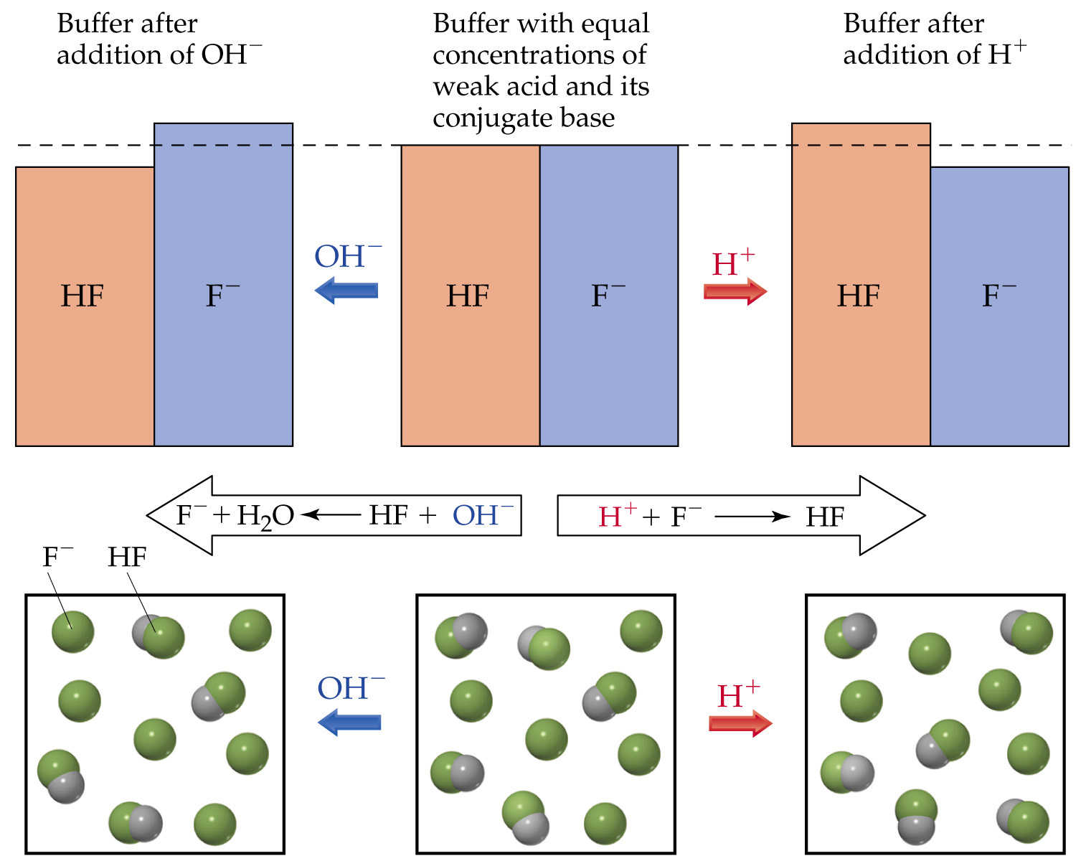

Slide 6
Buffered Solutions
Buffer Capacity and pH
Buffer capacity is the amount of acid or base neutralized by the buffer before there is a significant change in pH.
Buffer capacity depends on the composition of the buffer.
The greater the amounts of conjugate acid-base pair, the greater the buffer capacity.
The pH of the buffer depends on K_{a}.
If K_{a} is small (i.e., if the equilibrium concentration of undissociated acid is close to the initial concentration), then

Slide 7
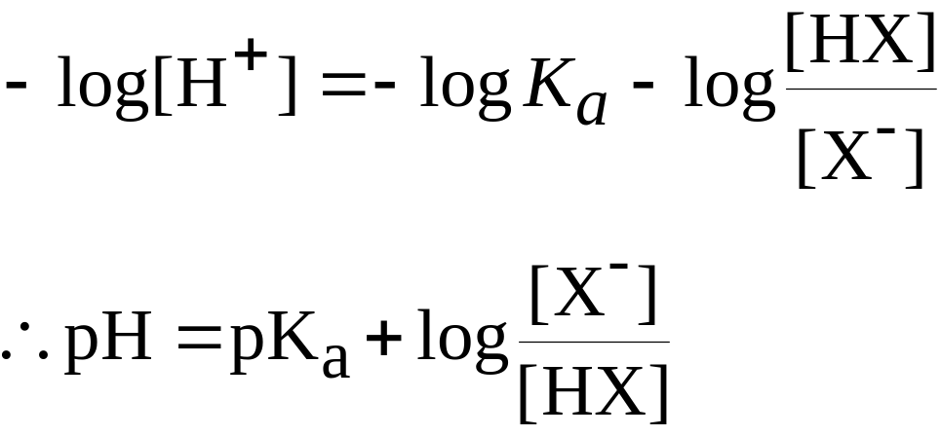
Buffered Solutions
Buffer Capacity and pH
Addition of Strong Acids or Bases to Buffers
We break the calculation into two parts: stoichiometric and equilibrium.

Slide 8
Buffered Solutions
Addition of Strong Acids or Bases to Buffers
The amount of strong acid or base added results in a neutralization reaction:
X⁻ + H₃O⁺ → HX + H₂O
HX + OH⁻ → X⁻ + H₂O.
By knowing how must H₃O⁺ or OH⁻ was added (stoichiometry) we know how much HX or X⁻ is formed.
With the concentrations of HX and X⁻ (note the change in volume of solution) we can calculate the pH from the Henderson-Hasselbalch equation.

Slide 9
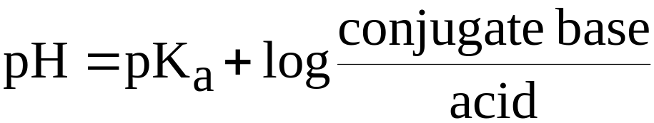
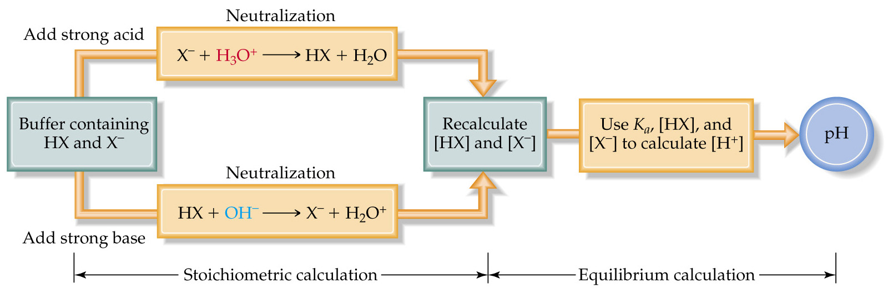
Buffered Solutions
Addition of Strong Acids or Bases to Buffers

Slide 10

Acid-Base Titrations
Strong Acid-Strong Base Titrations
A plot of pH versus volume of acid (or base) added is called a titration curve.
Consider adding a strong base (e.g. NaOH) to a solution of a strong acid (e.g. HCl).
  Before any base is added, the pH is given by the strong acid solution. Therefore, pH < 7.
  When base is added, before the equivalence point, the pH is given by the amount of strong acid in excess. Therefore, pH < 7.

Slide 11
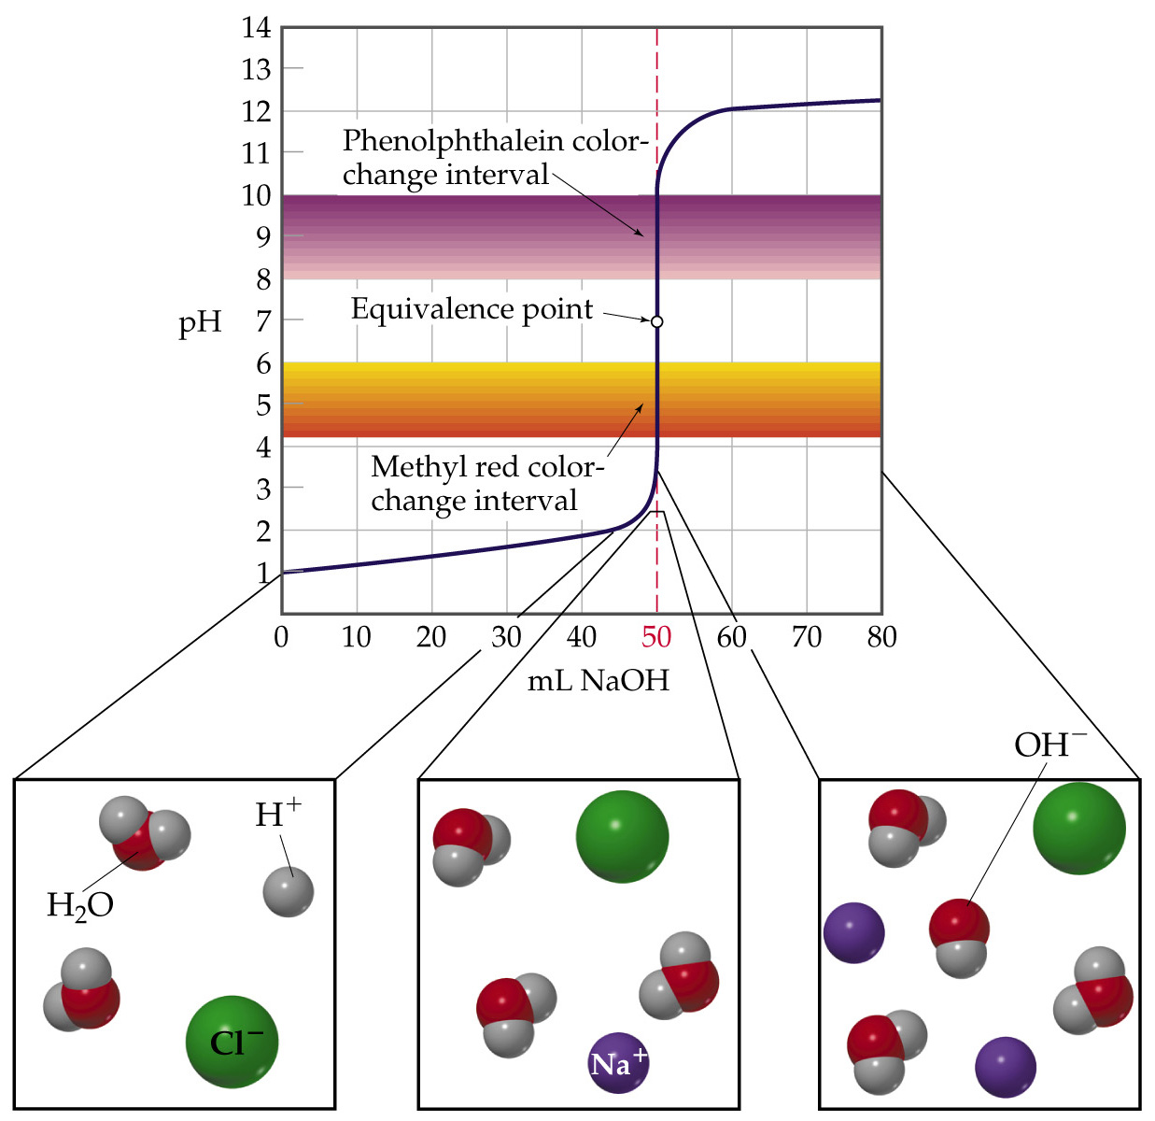

Slide 12
Acid-Base Titrations
Strong Acid-Strong Base Titrations
  At equivalence point, the amount of base added is stoichiometrically equivalent to the amount of acid originally present. Therefore, the pH is determined by the salt solution. Therefore, pH = 7.
Consider adding a strong base (e.g. NaOH) to a solution of a strong acid (e.g. HCl).
We know the pH at equivalent point is 7.00.
To detect the equivalent point, we use an indicator that changes color somewhere near 7.00.

