Slide 1
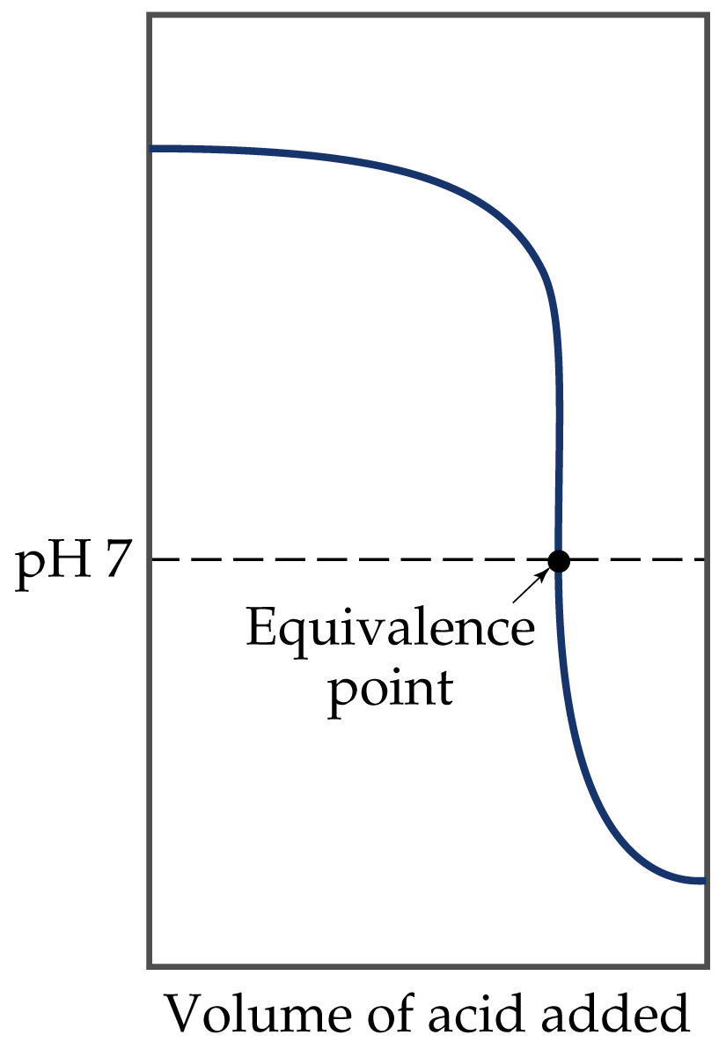
Acid-Base Titrations
Strong Base-Strong Acid Titrations

Slide 2
Acid-Base Titrations
Strong Acid-Strong Base Titrations
The equivalence point in a titration is the point at which the acid and base are present in stoichiometric quantities.
The end point in a titration is the observed point.
The difference between equivalence point and end point is called the titration error.
The shape of a strong base-strong acid titration curve is very similar to a strong acid-strong base titration curve.
Initially, the strong base is in excess, so the pH > 7.

Slide 3
Acid-Base Titrations
Strong Acid-Strong Base Titrations
As acid is added, the pH decreases but is still greater than 7.
At equivalence point, the pH is given by the salt solution (i.e. pH = 7).
After equivalence point, the pH is given by the strong acid in excess, so pH < 7.

Slide 4
Acid-Base Titrations
Weak Acid-Strong Base Titrations
Consider the titration of acetic acid, HC₂H₃O₂ and NaOH.
Before any base is added, the solution contains only weak acid. Therefore, pH is given by the equilibrium calculation.
As strong base is added, the strong base consumes a stoichiometric quantity of weak acid:
HC₂H₃O₂(aq) + NaOH(aq) → C₂H₃O₂⁻(aq) + H₂O(l)

Slide 5
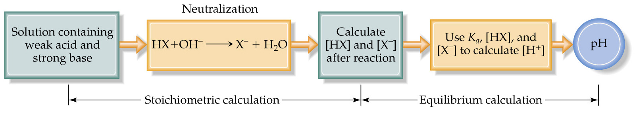
Acid-Base Titrations
Weak Acid-Strong Base Titrations
There is an excess of acid before the equivalence point.
Therefore, we have a mixture of weak acid and its conjugate base.
  The pH is given by the buffer calculation.
    First the amount of C₂H₃O₂⁻ generated is calculated, as well as the amount of HC₂H₃O₂ consumed. (Stoichiometry.)
    Then the pH is calculated using equilibrium conditions. (Henderson-Hasselbalch.)

Slide 6
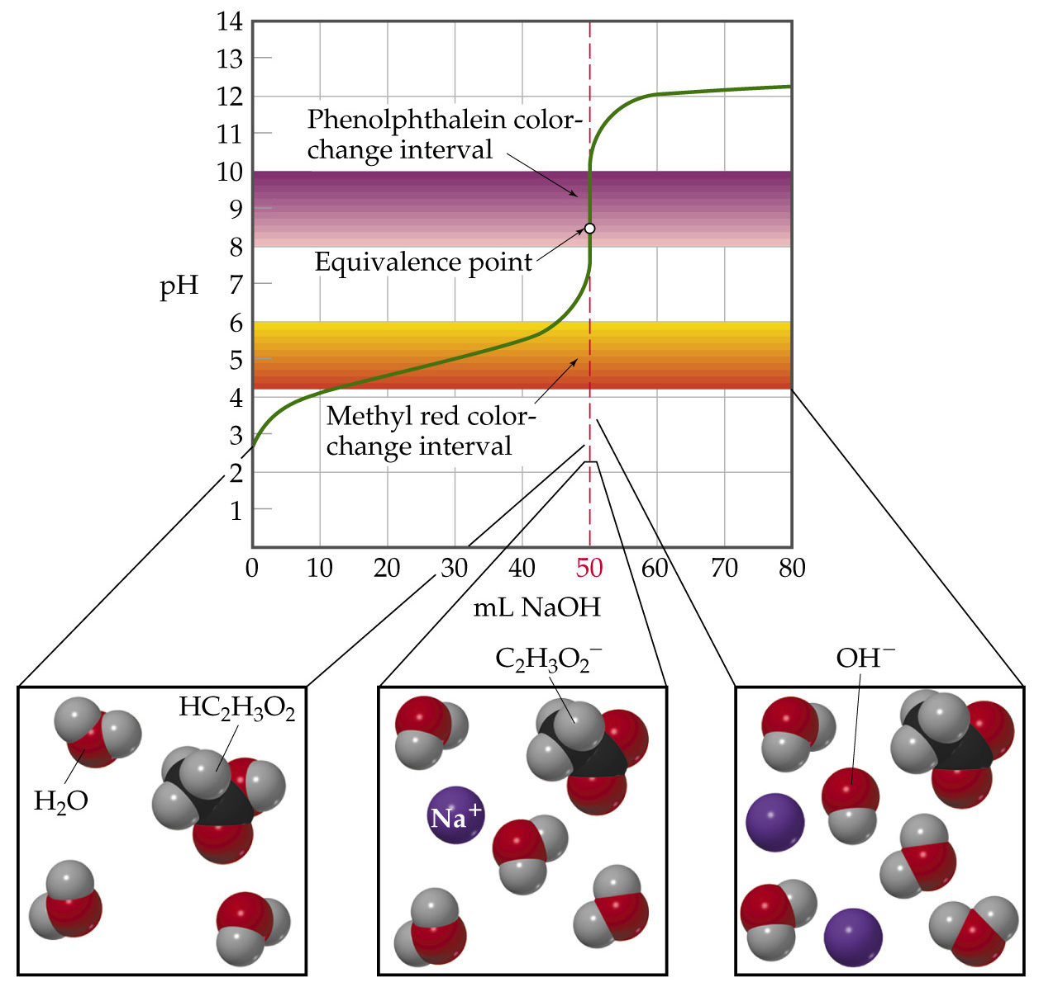

Slide 7
Acid-Base Titrations
Weak Acid-Strong Base Titrations
At the equivalence point, all the acetic acid has been consumed and all the NaOH has been consumed. However, C₂H₃O₂⁻ has been generated.
  Therefore, the pH is given by the C₂H₃O₂⁻ solution.
  This means pH > 7.
    More importantly, pH ≠ 7 for a weak acid-strong base titration.
After the equivalence point, the pH is given by the strong base in excess.
The equivalence point is determined by K_{a} of the acid.

Slide 8
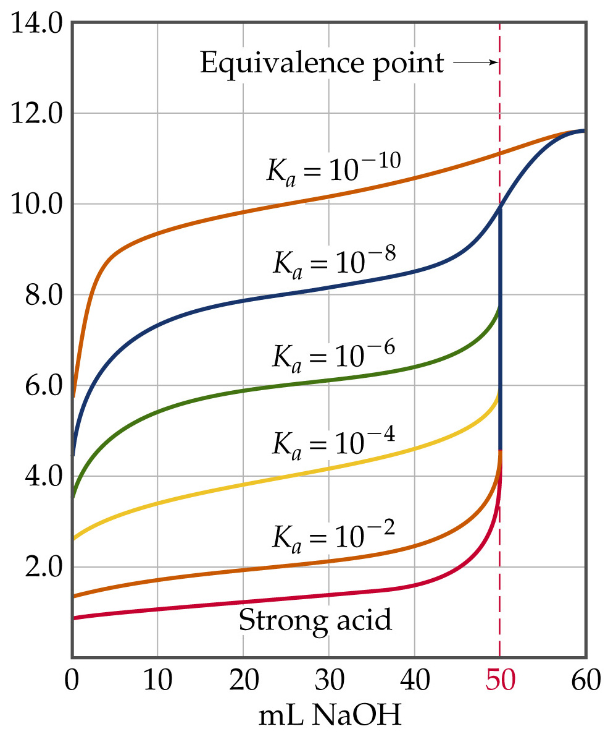

Slide 9
Acid-Base Titrations
Weak Acid-Strong Base Titrations
For a strong acid-strong base titration, the pH begins at less than 7 and gradually increases as base is added.
Near the equivalence point, the pH increases dramatically.
For a weak acid-strong base titration, the initial pH rise is more steep than the strong acid-strong base case.
However, then there is a leveling off due to buffer effects.

Slide 10
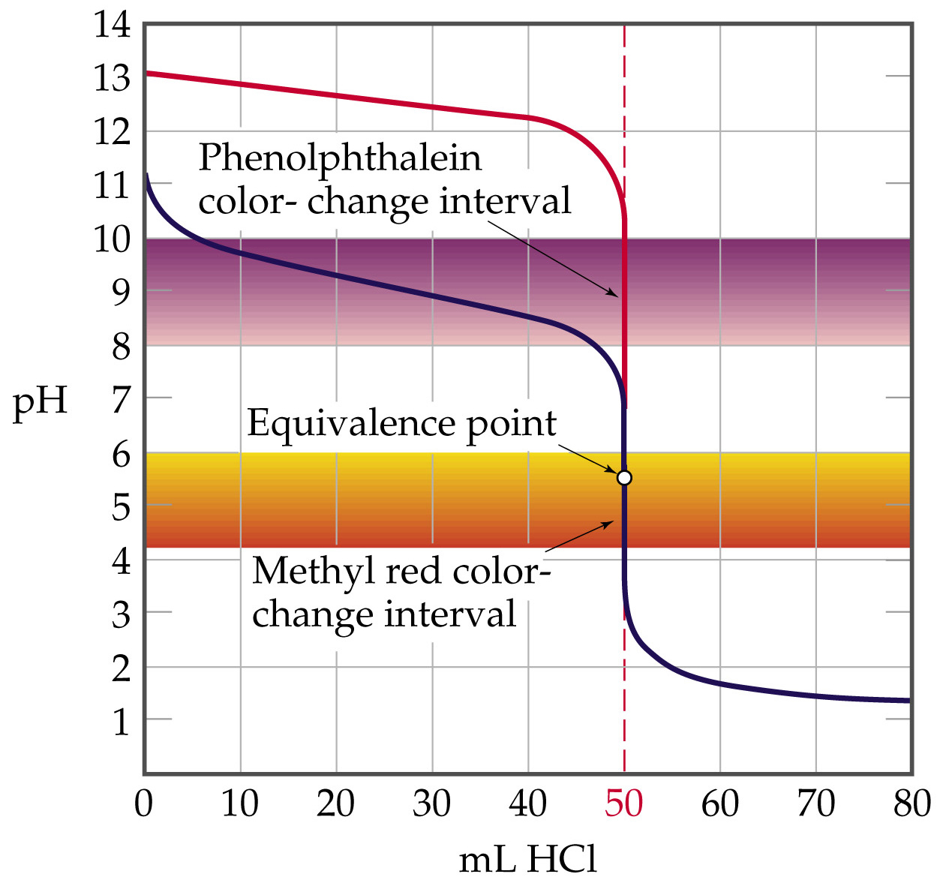

Slide 11
Acid-Base Titrations
Weak Acid-Strong Base Titrations
The inflection point is not as steep for a weak acid-strong base titration.
The shape of the two curves after equivalence point is the same because pH is determined by the strong base in excess.
Two features of titration curves are affected by the strength of the acid:
  the amount of the initial rise in pH, and
  the length of the inflection point at equivalence.

Slide 12
Acid-Base Titrations
Titrations of Polyprotic Acids
In polyprotic acids, each ionizable proton dissociates in steps.
Therefore, in a titration there are n equivalence points corresponding to each ionizable proton.
In the titration of H₃PO₃ with NaOH.
  The first proton dissociates to form H₂PO₃⁻.
  Then the second proton dissociates to form HPO₃²⁻.

