Slide 1
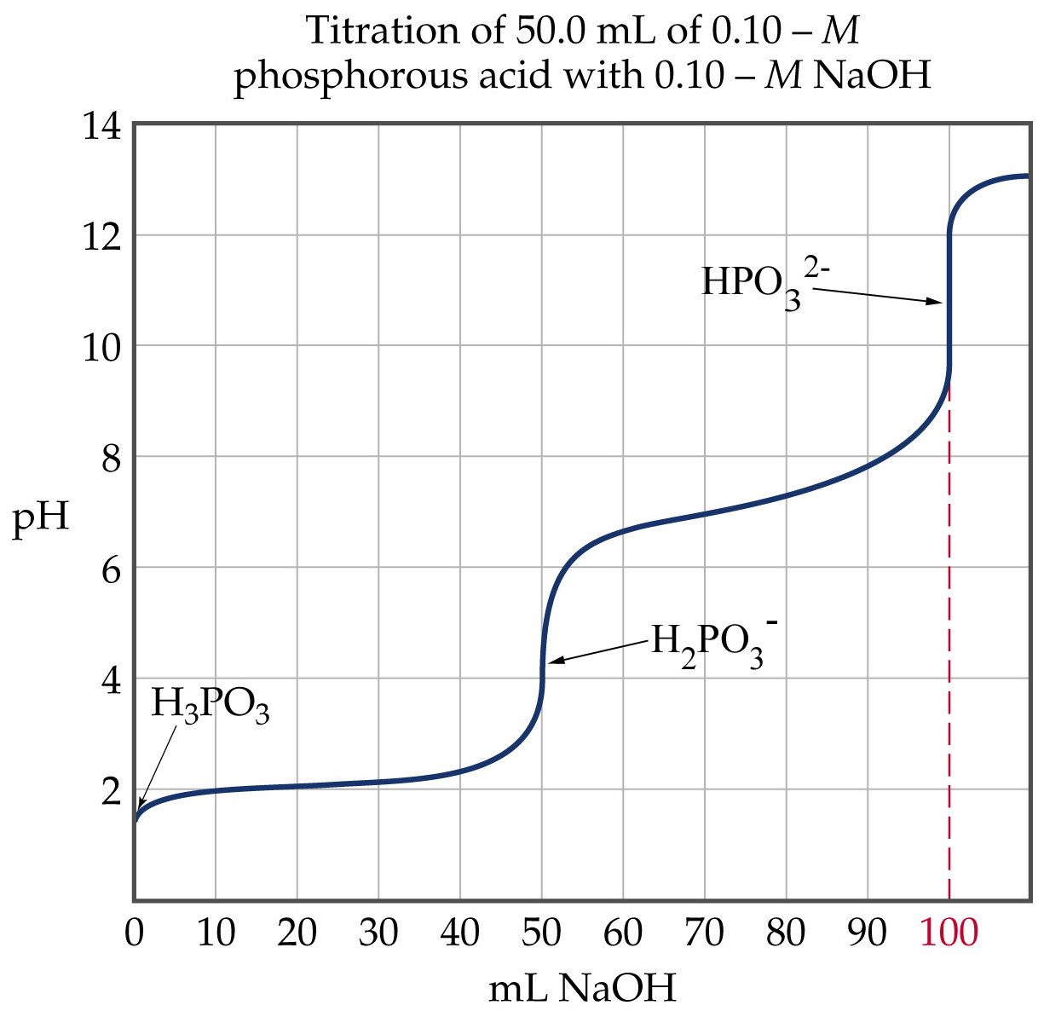

Slide 2
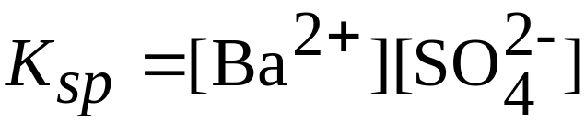
Solubility Equilibria
The Solubility-Product Constant, K_{sp}
Consider
for which
K_{sp} is the solubility product. (BaSO₄ is ignored because it is a pure solid so its concentration is constant.)

Slide 3
Solubility Equilibria
The Solubility-Product Constant, K_{sp}
In general: the solubility product is the molar concentration of ions raised to their stoichiometric powers.
Solubility is the amount (grams) of substance that dissolves to form a saturated solution.
Molar solubility is the number of moles of solute dissolving to form a liter of saturated solution.

Slide 4
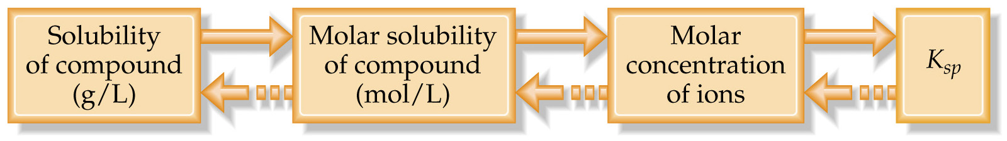
Solubility Equilibria
Solubility and K_{sp}
To convert solubility to K_{sp}
solubility needs to be converted into molar solubility (via molar mass);
molar solubility is converted into the molar concentration of ions at equilibrium (equilibrium calculation),
K_{sp} is the product of equilibrium concentration of ions.

Slide 5
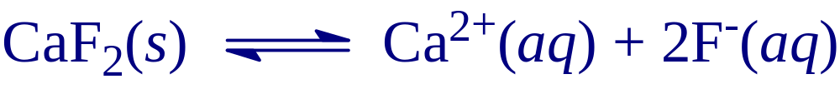
Factors that Affect Solubility
The Common Ion Effect
Solubility is decreased when a common ion is added.
This is an application of Le Châtelier’s principle:
as F⁻ (from NaF, say) is added, the equilibrium shifts away from the increase.
Therefore, CaF₂(s) is formed and precipitation occurs.
As NaF is added to the system, the solubility of CaF₂ decreases.

Slide 6


Factors that Affect Solubility
Solubility and pH
Again we apply Le Châtelier’s principle:
  If the F⁻ is removed, then the equilibrium shifts towards the decrease and CaF₂ dissolves.
  F⁻ can be removed by adding a strong acid:
  As pH decreases, [H⁺] increases and solubility increases.
The effect of pH on solubility is dramatic.

