Slide 1
Dissolution Process PowerPoint: Chapter 13

Slide 2
The Solution Process
A Solution is a homogeneous mixture of Solute (present in smallest amount) and Solvent (present in largest amount).
Solutes and solvent are components of the solution.
In the process of making solutions with condensed phases, intermolecular forces become rearranged.

Slide 3
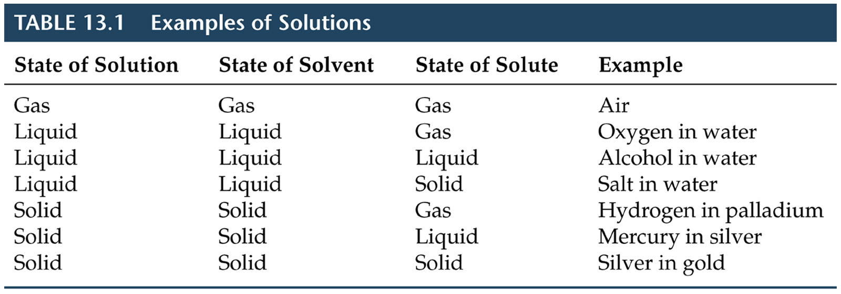
The Solution Process

Slide 4

The Solution Process
Consider NaCl (solute) dissolving in water (solvent):
  the water H-bonds have to be interrupted,
  NaCl dissociates into Na⁺ and Cl⁻,
  ion-dipole forces form: Na⁺ … δ-OH₂ and Cl^{- …} δ+H₂O.
  We say the ions are solvated by water.
  If water is the solvent, we say the ions are hydrated.

Slide 5
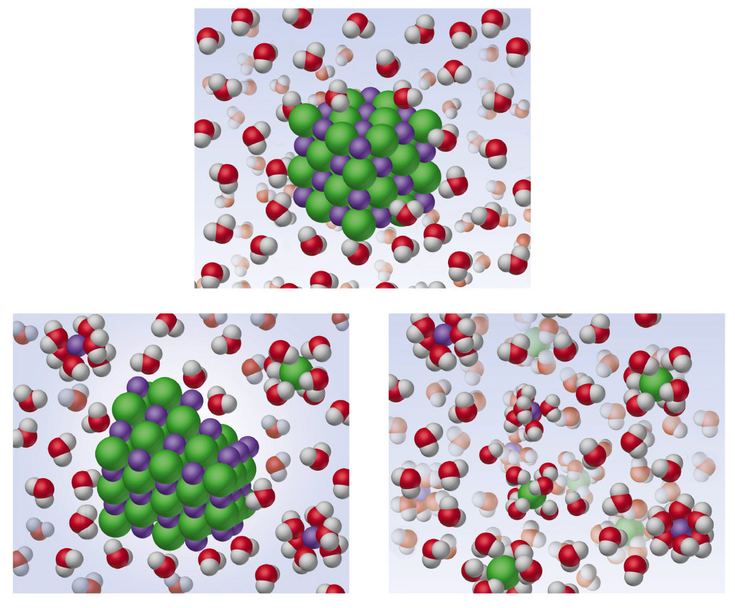

Slide 6
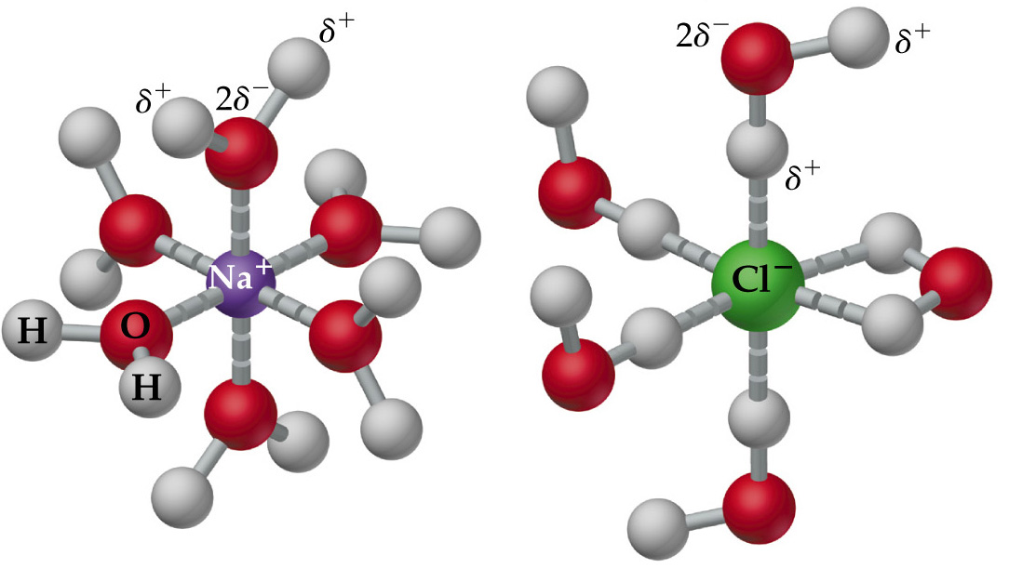
The Solution Process

Slide 7
The Solution Process
Energy Changes and Solution Formation
There are three energy steps in forming a solution:
  separation of solute molecules (ΔH₁),
  separation of solvent molecules (ΔH₂),
  And formation of solute-solvent interactions (ΔH₃).
We define the enthalpy change in the solution process as
ΔH_{soln} = ΔH₁ + ΔH₂ + ΔH₃.
ΔH_{soln} can either be positive(+) or negative(-) depending on the intermolecular forces.

Slide 8
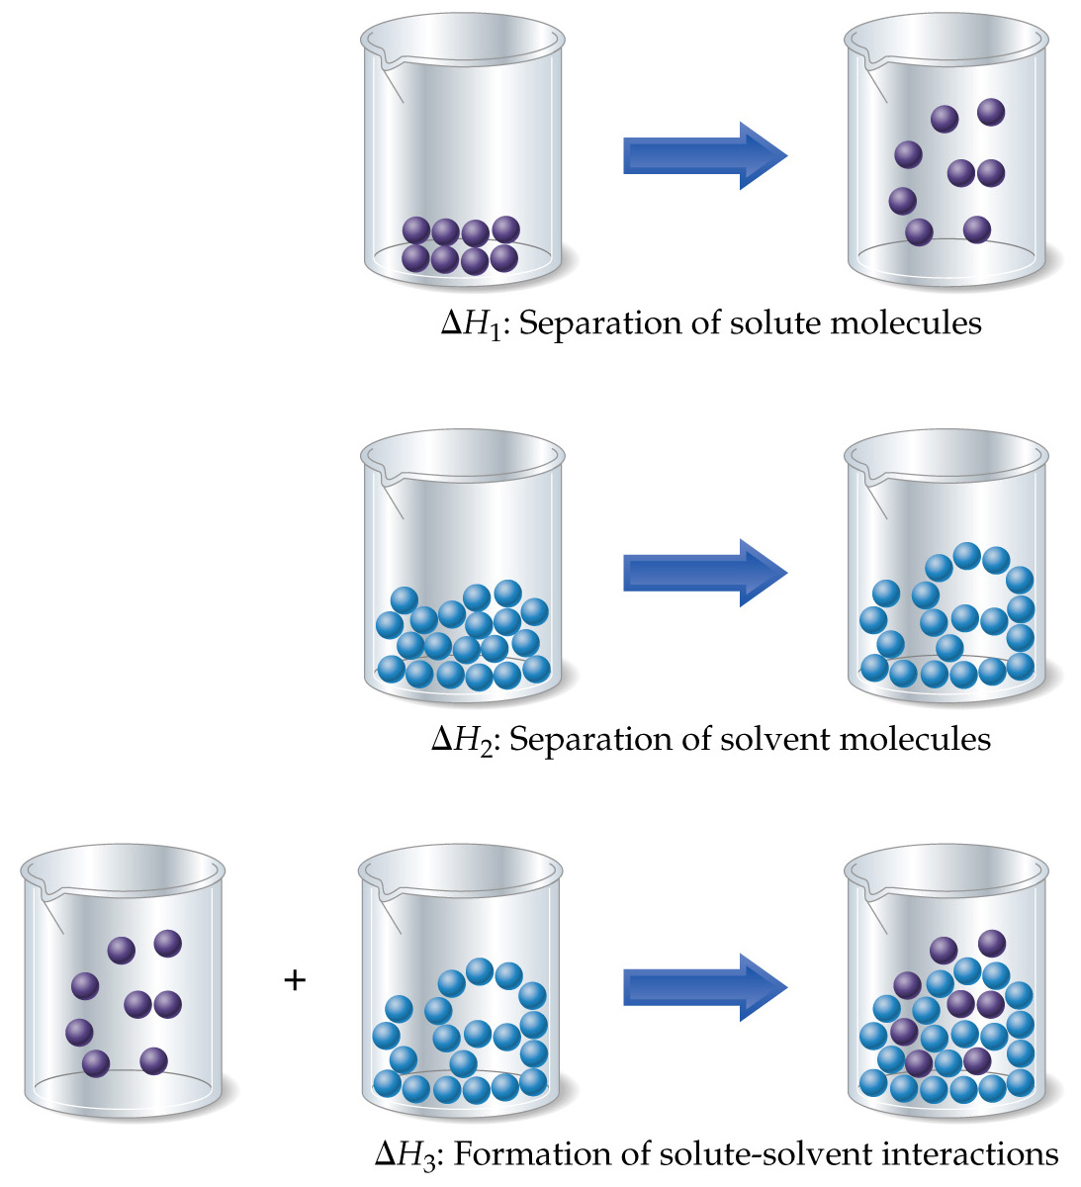

Slide 9
The Solution Process
Energy Changes and
Solution Formation
Breaking attractive intermolecular forces is always Endothermic. ΔH=(+)
Forming attractive intermolecular forces is always Exothermic. ΔH=(-)

Slide 10
The Solution Process
Energy Changes and Solution Formation
To determine whether ΔH_{soln} is positive or negative, we consider the strengths of all solute-solute and solute-solvent interactions: ΔH_{soln} = ΔH₁ + ΔH₂ + ΔH₃.
  ΔH₁ and ΔH₂ are both Positive.(Breaking Intermolecular Bonds)
  ΔH₃ is always Negative (Solvation of Solute Ions)
  It is possible to have either
  ΔH3 > (ΔH₁ + ΔH₂) or
  ΔH₃ < (ΔH₁ + ΔH₂).

Slide 11
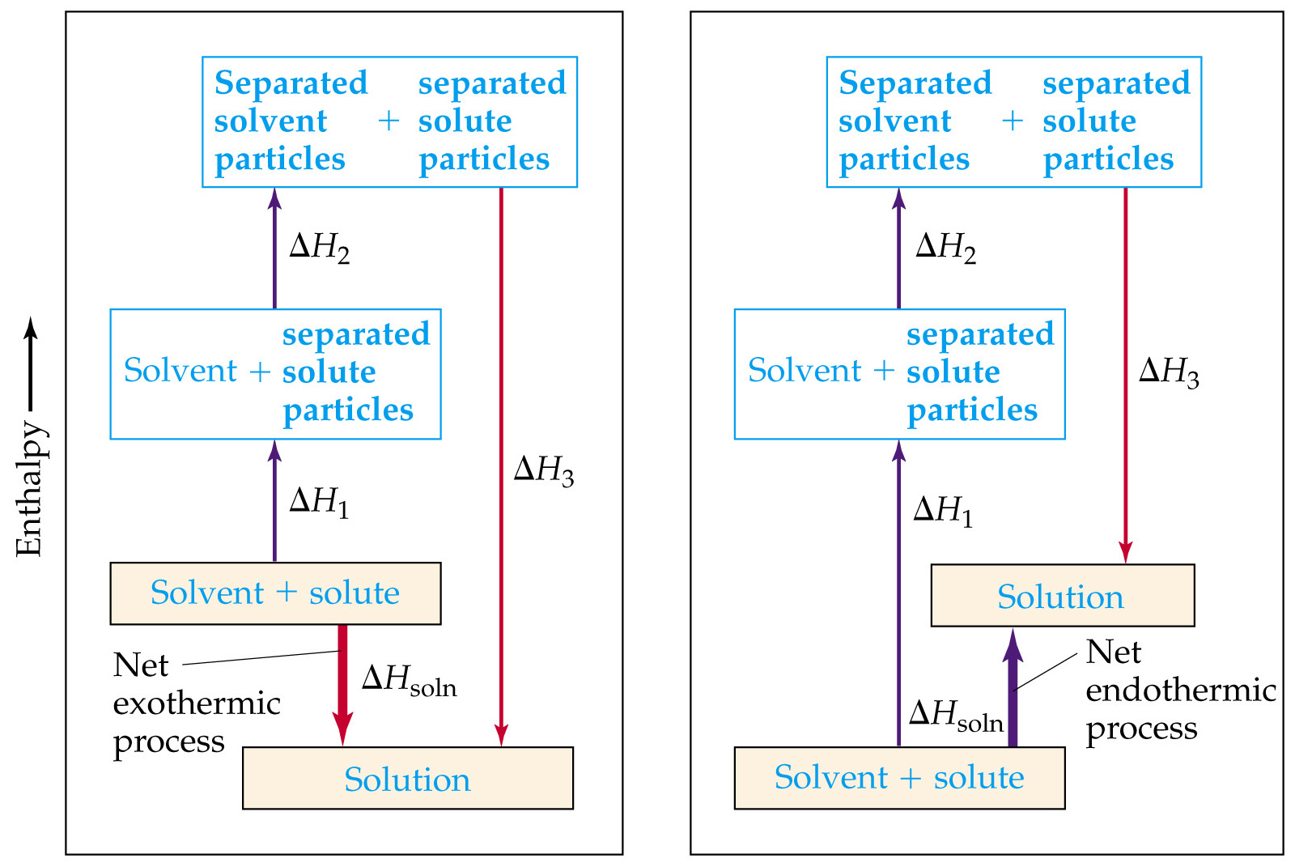

Slide 12
The Solution Process
Energy Changes and Solution Formation
Examples:
  NaOH added to water has ΔH_{soln} = -44.48 kJ/mol.
  NH₄NO₃ added to water has ΔH_{soln} = + 26.4 kJ/mol.
“Like with Like Rule”:
POLAR solvents dissolve POLAR solutes.
NON-POLAR solvents dissolve NON-POLAR solutes.
Why?

Slide 13
The Solution Process
Energy Changes and Solution Formation
If ΔHsoln is too endothermic a solution will not form.
NaCl in gasoline: the ion-dipole forces are weak because gasoline is non-polar. Therefore, the ion-dipole forces do not compensate for the separation of ions.
Water in octane: water has strong H-bonds. There are no attractive forces between water and octane to compensate for the H-bonds.

Slide 14
The Solution Process
Solution Formation, Spontaneity, and Disorder
A spontaneous process occurs without outside intervention.
When energy of the system decreases (e.g. dropping a book and allowing it to fall to a lower potential energy), the process is spontaneous.
Some spontaneous processes DO NOT involve the system moving to a lower energy state (e.g. an endothermic reaction)
This is because there are TWO Driving Forces in Nature

Slide 15
The Solution Process
Solution Formation, Spontaneity, and Disorder
The Process by which nature moves towards greater disorder is call Entropy
If the process leads to a greater state of disorder, then the process is spontaneous (Entropy Increases)
Example: a mixture of CCl₄ and C₆H₁₄ is less ordered than the two separate liquids. Therefore, they spontaneously mix even though ΔH_{soln} is very close to zero.
There are solutions that form by physical processes and those by chemical processes.

Slide 16
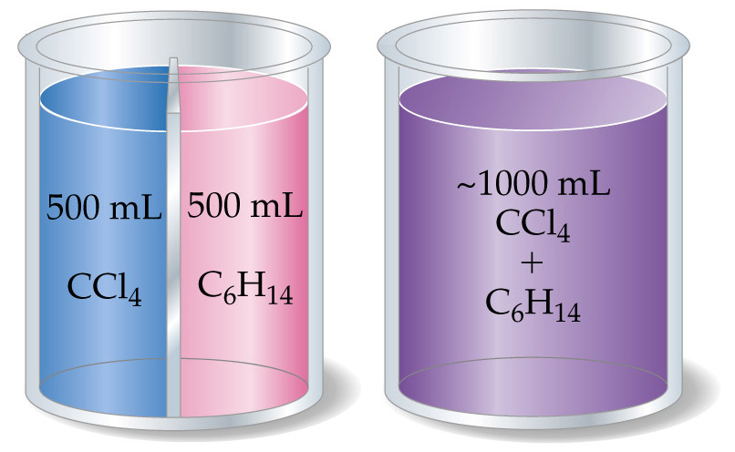
The Solution Process
Solution Formation, Spontaneity, and Disorder

Slide 17
The Solution Process
Solution Formation and Chemical Reactions
Example: a mixture of CCl₄ and C₆H₁₄ is less ordered
Consider:
Ni(s) + 2HCl(aq) → NiCl₂(aq) + H₂(g).
Note the chemical form of the substance being dissolved has changed (Ni → NiCl₂).
When all the water is removed from the solution, no Ni is found only NiCl₂·6H₂O. Therefore, Ni dissolution in HCl is a chemical process.

Slide 18
The Solution Process
Solution Formation and Chemical Reactions
Example:
NaCl(s) + H₂O (l) → Na⁺(aq) + Cl⁻(aq).
When the water is removed from the solution, NaCl is found. Therefore, NaCl dissolution is a physical process.

Slide 19
Saturated Solutions and Solubility
Dissolution: solute + solvent → solution.
Crystallization: solution → solute + solvent.
Saturation: crystallization and dissolution are in equilibrium.
Solubility: amount of solute required to form a saturated solution.
Supersaturated: a solution formed when more solute is dissolved than in a saturated solution.

Slide 20
