Slide 1
Chapter 13
Set 2

Slide 2
Factors Affecting Solubility
Solute-Solvent Interaction
Polar liquids tend to dissolve in polar solvents.
Miscible liquids: mix in any proportions.
Immiscible liquids: do not mix.
Intermolecular forces are important: water and ethanol are miscible because the broken hydrogen bonds in both pure liquids are re-established in the mixture.
The number of carbon atoms in a chain affect solubility: the more C atoms the less soluble in water.

Slide 3
Factors Affecting Solubility
Solute-Solvent Interaction
The number of -OH groups within a molecule increases solubility in water.
Generalization: “like dissolves like”.
The more polar bonds in the molecule, the better it dissolves in a polar solvent.
The less polar the molecule the less it dissolves in a polar solvent and the better is dissolves in a non-polar solvent.

Slide 4
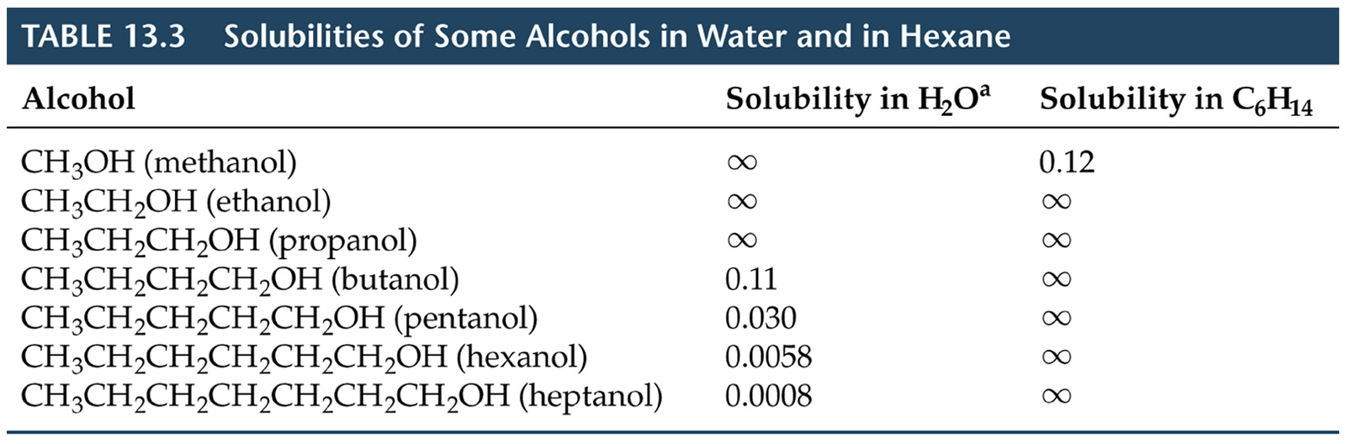
Factors Affecting Solubility
Solute-Solvent Interaction

Slide 5
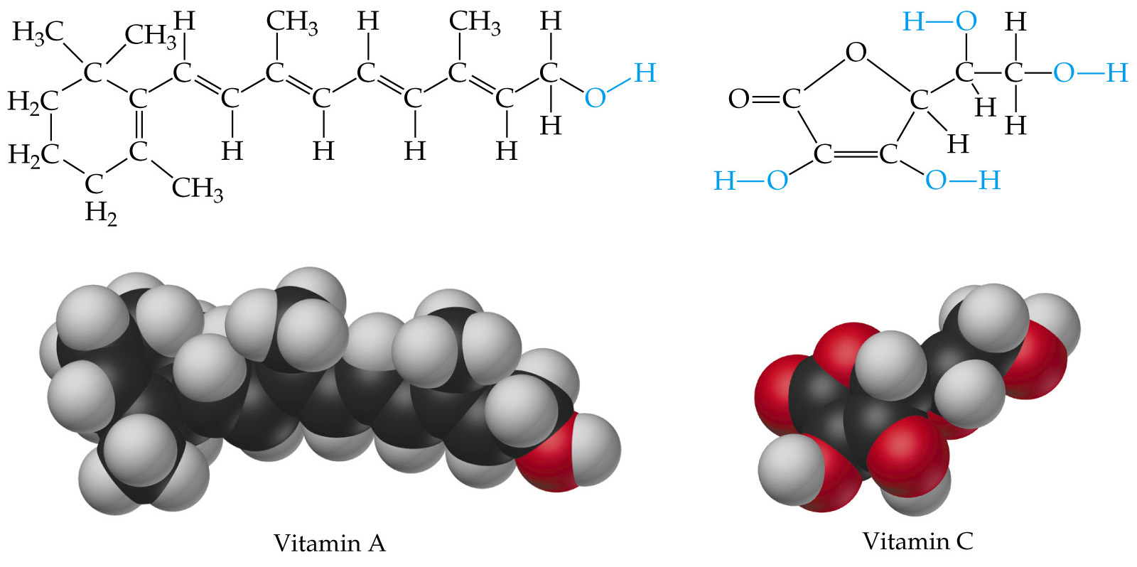
Factors Affecting Solubility
Solute-Solvent Interaction

Slide 6
Factors Affecting Solubility
Solute-Solvent Interaction
Network solids do not dissolve because the strong intermolecular forces in the solid are not re-established in any solution.
Pressure Effects
Solubility of a gas in a liquid is a function of the pressure of the gas.

Slide 7
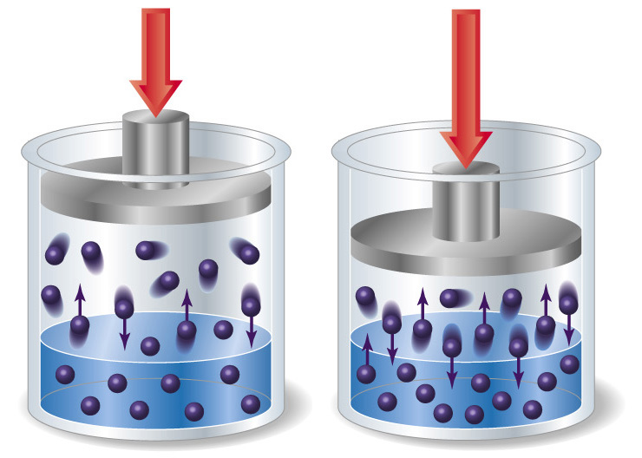
Factors Affecting Solubility
Pressure Effects

Slide 8
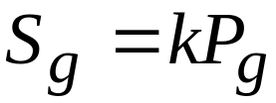
Factors Affecting Solubility
Pressure Effects
The higher the pressure, the more molecules of gas are close to the solvent and the greater the chance of a gas molecule striking the surface and entering the solution.
  Therefore, the higher the pressure, the greater the solubility.
  The lower the pressure, the fewer molecules of gas are close to the solvent and the lower the solubility.
If S_{g} is the solubility of a gas, k is a constant, and P_{g} is the partial pressure of a gas, then Henry’s Law gives:

Slide 9

Factors Affecting Solubility
Pressure Effects
Carbonated beverages are bottled with a partial pressure of CO₂ > 1 atm.
As the bottle is opened, the partial pressure of CO₂ decreases and the solubility of CO₂ decreases.
Therefore, bubbles of CO₂ escape from solution.

Slide 10
Factors Affecting Solubility
Temperature Effects
Experience tells us that sugar dissolves better in warm water than cold.
As temperature increases, solubility of solids generally increases.
Sometimes, solubility decreases as temperature increases (e.g. Ce₂(SO₄)₃).

Slide 11
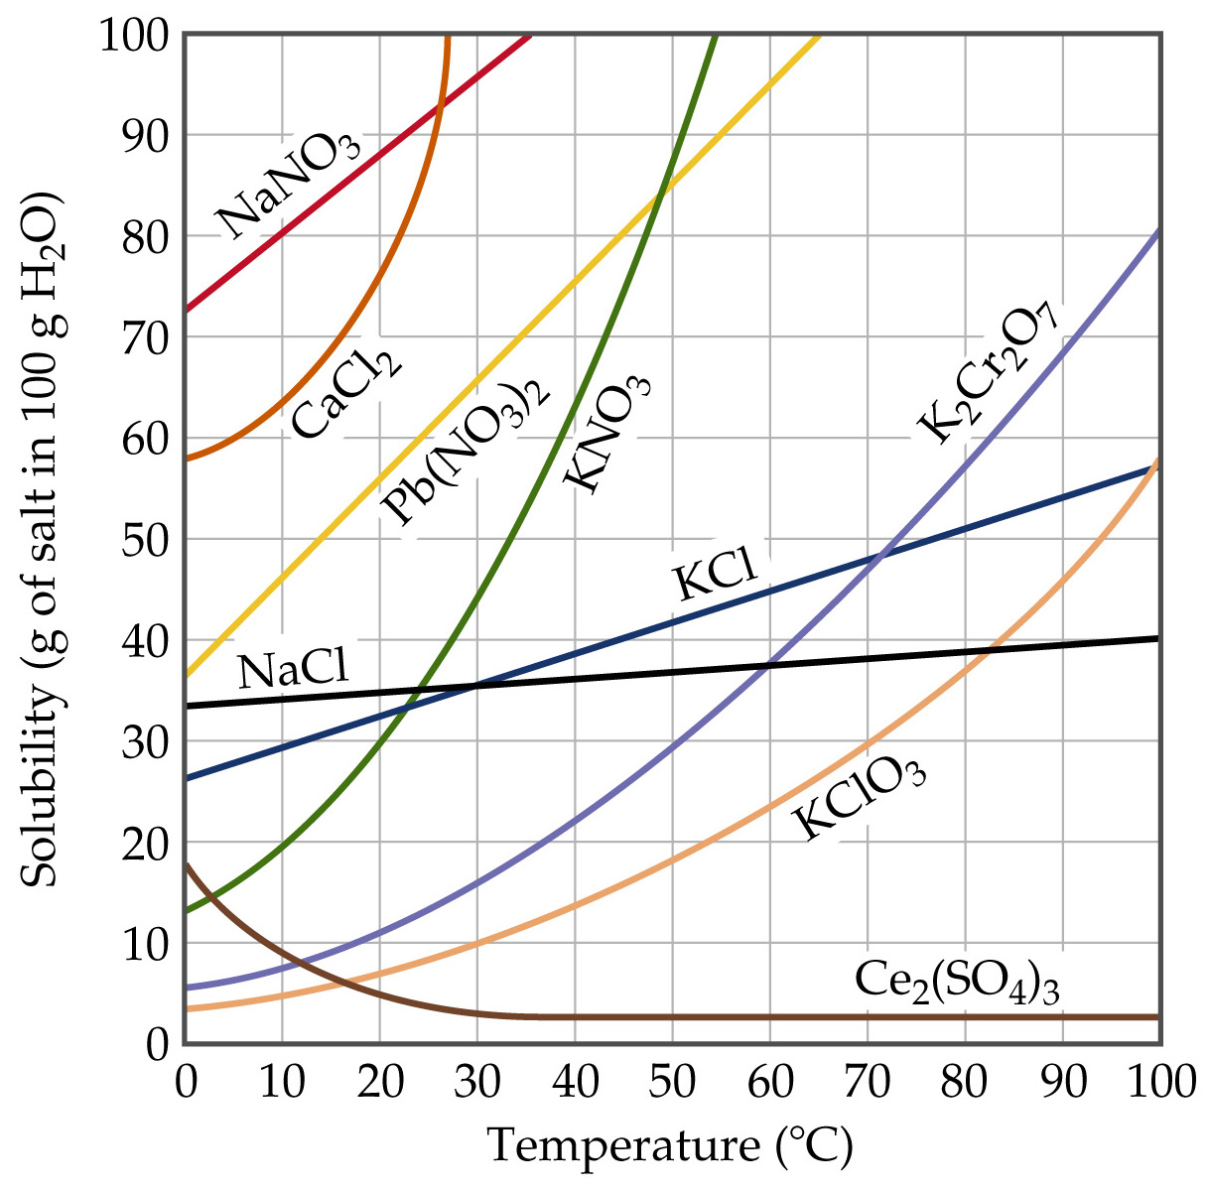

Slide 12
Factors Affecting Solubility
Temperature Effects
Experience tells us that carbonated beverages go flat as they get warm.
Therefore, gases get less soluble as temperature increases.
Thermal pollution: if lakes get too warm, CO₂ and O₂ become less soluble and are not available for plants or animals.

Slide 13
