Slide 1
Chapter 13
Set 3

Slide 2
Ways of Expressing Concentration
Mass Percentage, ppm, and ppb
All methods involve quantifying amount of solute per amount of solvent (or solution).
Generally amounts or measures are masses, moles or liters.
Qualitatively solutions are dilute or concentrated.
Definitions:

Slide 3
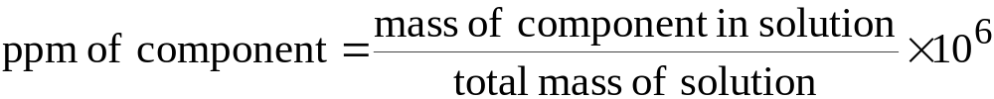
Ways of Expressing Concentration
Mass Percentage, ppm, and ppb
Parts per million (ppm) can be expressed as 1 mg of solute per kilogram of solution.
  If the density of the solution is 1g/mL, then 1 ppm = 1 mg solute per liter of solution.
Parts per billion (ppb) are 1 μg of solute per kilogram of solution.

Slide 4
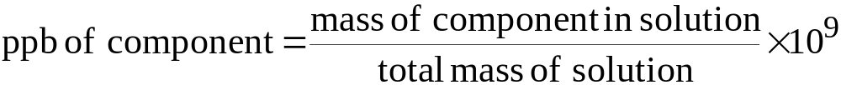
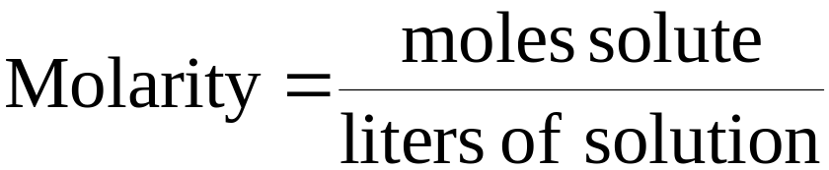
Ways of Expressing Concentration
Mass Percentage, ppm, and ppb
Mole Fraction, Molarity, and Molality
Recall mass can be converted to moles using the molar mass.

Slide 5
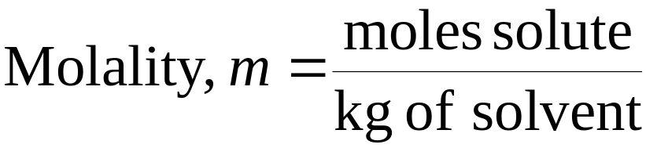
Ways of Expressing Concentration
Mole Fraction, Molarity, and Molality
We define
Converting between molarity (M) and molality (m) requires density.

Slide 6
