Slide 1
Colligative Properties
Colligative properties depend on quantity of solute molecules. (E.g. freezing point depression and melting point elevation.)
Lowering Vapor Pressure
Non-volatile solvents reduce the ability of the surface solvent molecules to escape the liquid.
Therefore, vapor pressure is lowered.
The amount of vapor pressure lowering depends on the amount of solute.

Slide 2
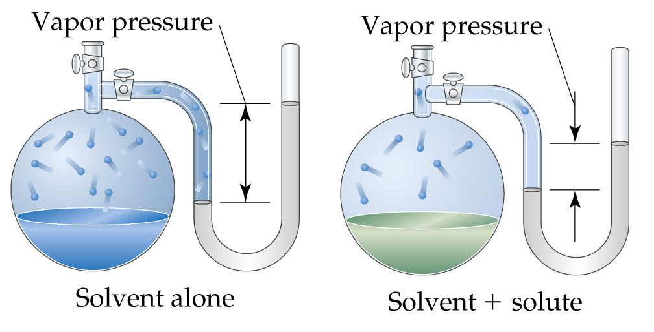
Colligative Properties
Lowering Vapor Pressure

Slide 3


Colligative Properties
Lowering Vapor Pressure
Raoult’s Law: P_{A} is the vapor pressure with solute, P_{A}° is the vapor pressure without solvent, and Χ_{A} is the mole fraction of A, then
Recall Dalton’s Law:

Slide 4
Colligative Properties
Lowering Vapor Pressure
Ideal solution: one that obeys Raoult’s law.
Raoult’s law breaks down when the solvent-solvent and solute-solute intermolecular forces are greater than solute-solvent intermolecular forces.
Boiling-Point Elevation
Goal: interpret the phase diagram for a solution.
Non-volatile solute lowers the vapor pressure.
Therefore the triple point - critical point curve is lowered.

Slide 5
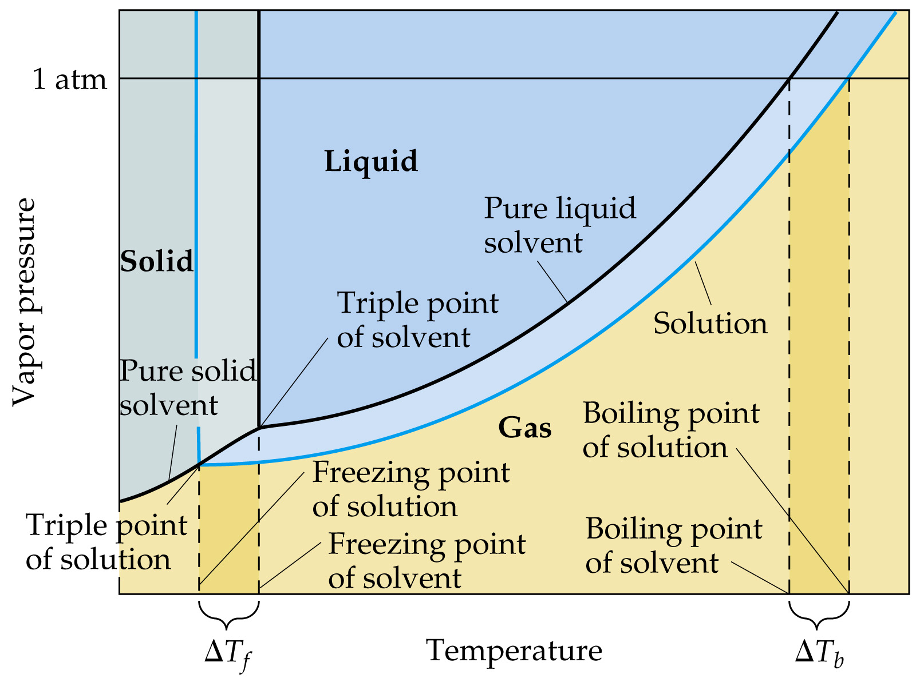

Slide 6

Colligative Properties
Boiling-Point Elevation
At 1 atm (normal boiling point of pure liquid) there is a lower vapor pressure of the solution. Therefore, a higher temperature is required to teach a vapor pressure of 1 atm for the solution (ΔT_{b}).
Molal boiling-point-elevation constant, K_{b}, expresses how much ΔT_{b} changes with molality, m:

Slide 7
Colligative Properties
Osmosis
Semipermeable membrane: permits passage of some components of a solution. Example: cell membranes and cellophane.
Osmosis: the movement of a solvent from low solute concentration to high solute concentration.
There is movement in both directions across a semipermeable membrane.
As solvent moves across the membrane, the fluid levels in the arms becomes uneven.

Slide 8
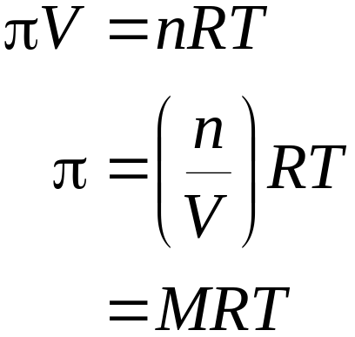
Colligative Properties
Osmosis
Osmotic pressure, π, is the pressure required to stop osmosis:
Isotonic solutions: two solutions with the same π separated by a semipermeable membrane.

Slide 9
Colligative Properties
Osmosis
Hypotonic solutions: a solution of lower π than a hypertonic solution.
Osmosis is spontaneous.
Red blood cells are surrounded by semipermeable membranes.

Slide 10
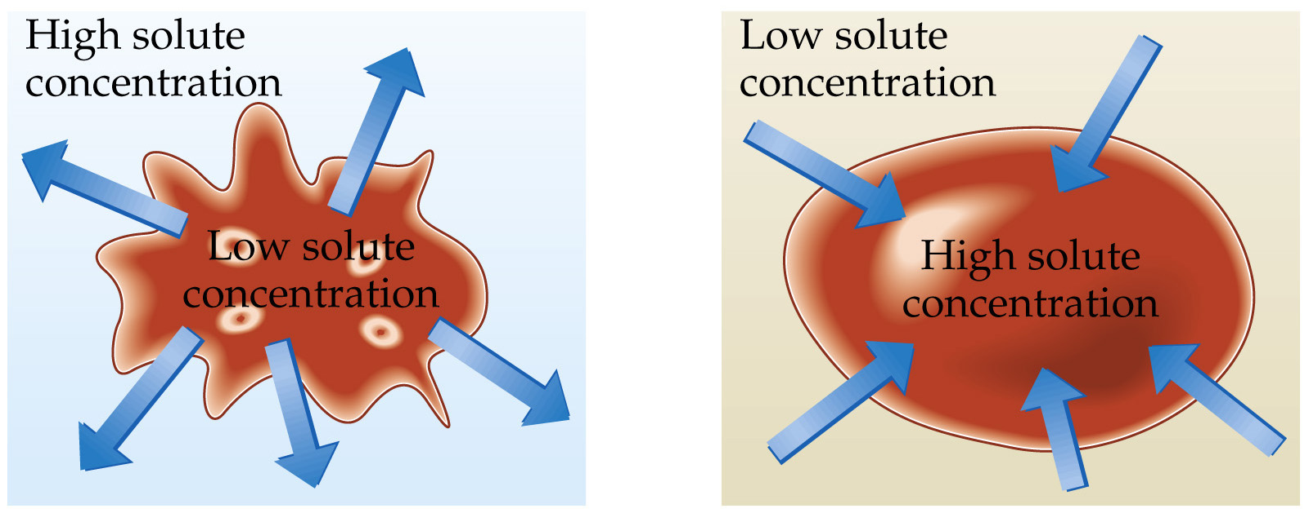
Colligative Properties
Osmosis

