Slide 1
Chem 102 Solubility
Review

Slide 2
Solubility product constant
K_{sp} are Unitless
CaF_{2(s)} ⇔ Ca²⁺_{(aq)} + 2F⁻_{(aq)}
K_{sp} = [Ca²⁺][F⁻]²
[Ca²⁺] = molar solubility (in Molarity)
Get K_{sp} values from Handout Ksp = 10^{-pKsp}

Slide 3
We have problems
pK_{sp}[BasSO4] = 9.95 thus
K_{sp} for BaSO₄ = 1.1 x 10⁻¹⁰ @ 25°C
  NOW
  Calculate this salt’s solubility in water in moles per liter and g/L.

Slide 4
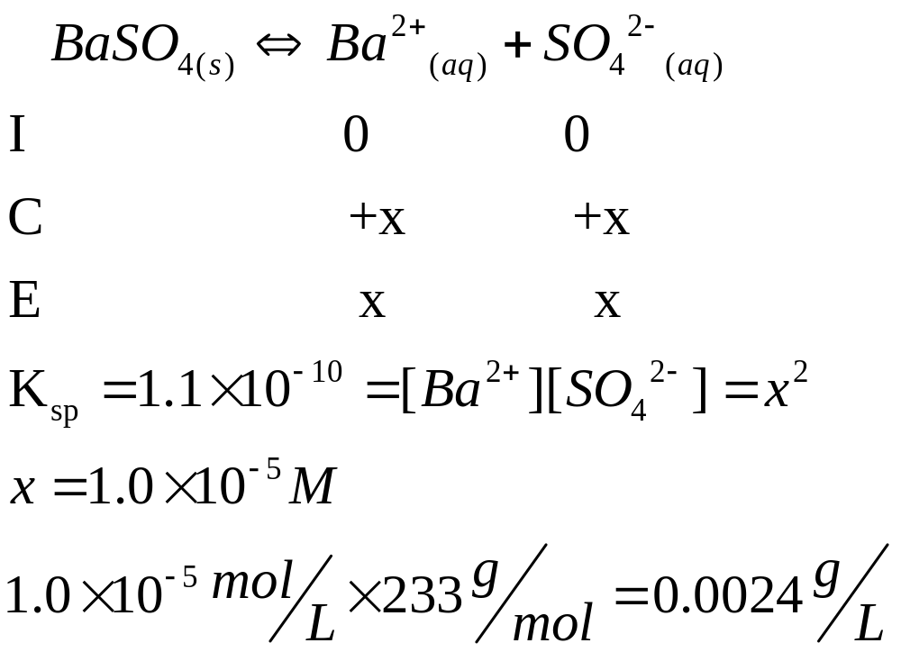
Solution
2.4 mg/L

Slide 5
Problem
If a saturated solution of CaF₂ is found to contain [Ca²⁺] = 2.4 x 10⁻⁴ M, what is the K_{sp} value of CaF₂?

Slide 6
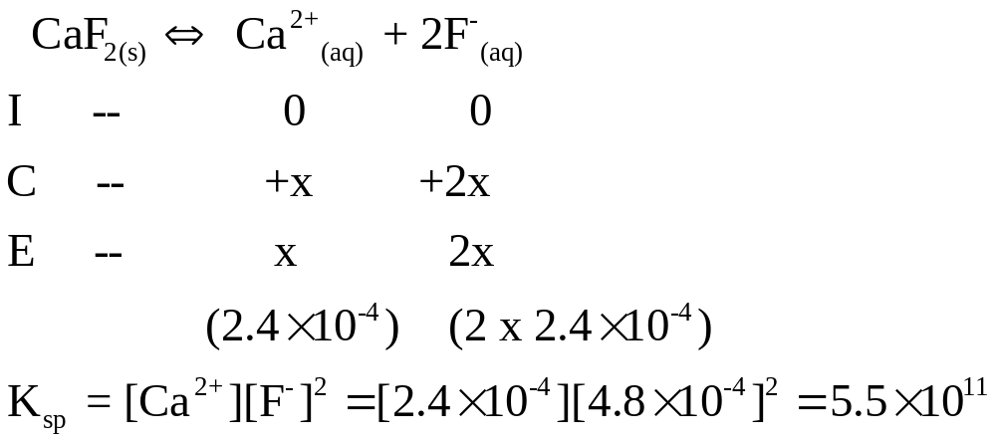
Solution
-
pKsp = 10.26

Slide 7
Solubility and the Common Ion Effect
Problem: How much AgCl (g/L) would dissolve in water given K_{sp}= 1.8 x 10⁻¹⁰?

Slide 8
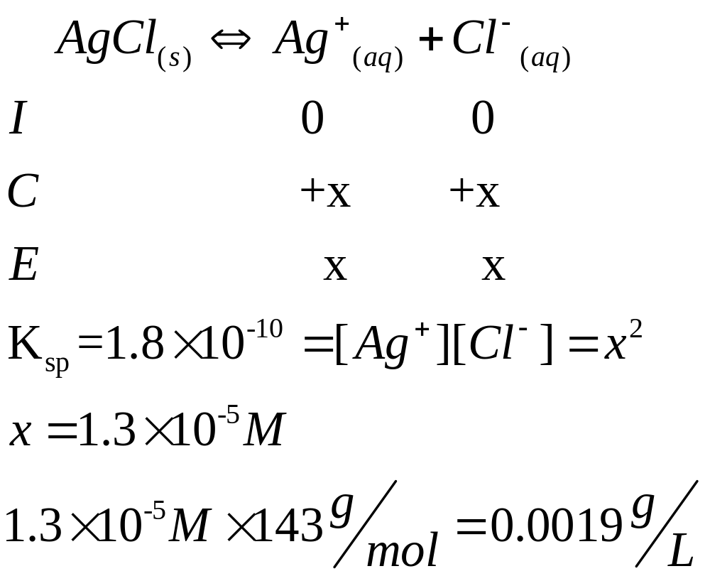
1.9 mg/L

Slide 9
Solubility and the Common Ion Effect
If solid AgCl is placed in 1.00L of 0.55M NaCl, what mass of AgCl (g/L) would dissolve?
Before solving this, would you expect it to be lesser or greater than in pure water?
  (Think back to Le Châtelier’s Principle and the pH of buffers)

Slide 10
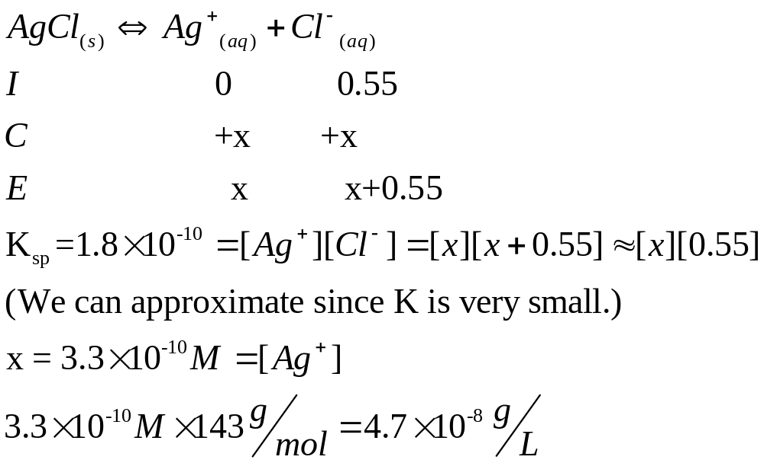
Without extra Cl -- 1.9 milligrams /L
With -- 47 nanograms/L

Slide 11
Basic anions and salt solubility
Do we recall what a conjugate acid/conjugate base?
If salt has conjugate base of weak acid, then salt more soluble than value given by K_{sp}
  Why?
PbS_{(s)}  Pb²⁺_{(aq)} + S²⁻_{(aq)}
S²⁻_{(aq)} + H₂O_{(l)}  HS⁻_{(aq)} + OH⁻_{(aq)};
Where solubility is GREATER than K_{sp}

Slide 12
Effect of pH on solubility
Mg(OH)_{2 (s)}  Mg²⁺_{(aq)} + 2OH⁻_{(aq)}
If one adds base, OH⁻, which way will the equilibrium shift?
  Will more solid form or dissolve?
If one adds acid, H₃O⁺, which way will the equilibrium shift?
  Will more solid form or dissolve?

Slide 13
Effect of pH on solubility
Ca₃(PO₄)_{2 (s)}  3Ca²⁺_{(aq)} + 2PO₄⁻³_{(aq)}
If one adds base, OH⁻, which way will the equilibrium shift?
  Will more solid form or dissolve? Hint: Ca(OH)₂
If one adds acid, H₃O⁺, which way will the equilibrium shift?
  Will more solid form or dissolve? Hint: H₃PO₄

Slide 14
Effect of pH on solubility
MgCl_{2 (s)}  Mg²⁺_{(aq)} + 2Cl⁻_{(aq)}
If one adds base, OH⁻, which way will the equilibrium shift?
  Will more solid form or dissolve?
If one adds acid, H₃O⁺, which way will the equilibrium shift?
  Will more solid form or dissolve?

Slide 15
General Observation
Consider ALL possible reactions between PRIMARY reactants and ADDED reactants.
pH effects (H₃O⁺/OH⁻ ) may influence conjugate acids and bases
If Concentrations are high enough than Precipitations can occur Q> Ksp
Also Possibility of Complex Ions being formed which will influence Solubility

Slide 16
The reaction quotient, Q
Q tells us:
  Whether it’s at equilibrium
    If not, which way it’ll shift
CaF_{2(s)} ⇔ Ca²⁺_{(aq)}+ 2F⁻_{(aq)}
K_{sp} = [Ca²⁺][F⁻]²
Q = [Ca²⁺][F⁻]²
If Q = K_{sp}, then @ eq. & soln is Saturated
If Q < K_{sp}, then will shift to right (dissolve more) & soln is unsaturated
If Q > K_{sp}, then will shift to left (not dissolve anymore, ppt out) & soln is supersaturated (will ppt out)

Slide 17
Problem
AgCl placed in water. After a certain amount of time, concentration= 1.2 x 10⁻⁵ M.
Has the system reached equilibrium?
If not, will more solid dissolve?
If so how much more?
(K_{sp} = 1.8 x 10⁻¹⁰)

Slide 18
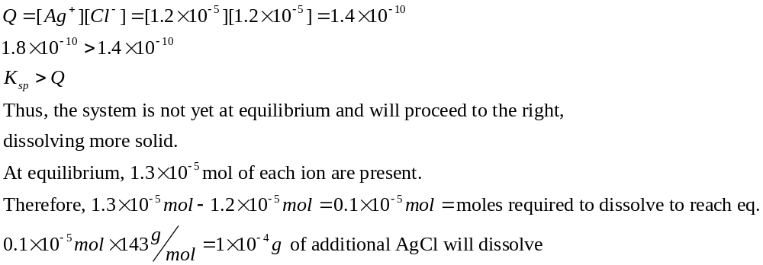

Slide 19
Selective precipitation
Will a precipitate form, given the ion concentrations?
What concentrations of ions are needed to bring about precipitation?
Basically, compare Q to K_{sp}

Slide 20
Problem
If [Mg²⁺] = 1.5x10⁻⁶ M, and enough hydroxide ions are added to make the solution 1.0 x 10⁻⁴ M of hydroxide ions, will Mg(OH)₂ precipitate?
If not, will it occur if the concentration of hydroxide ions is increased to 1.0 x 10⁻² M?
K_{sp} = 5.6 x 10⁻¹²

Slide 21
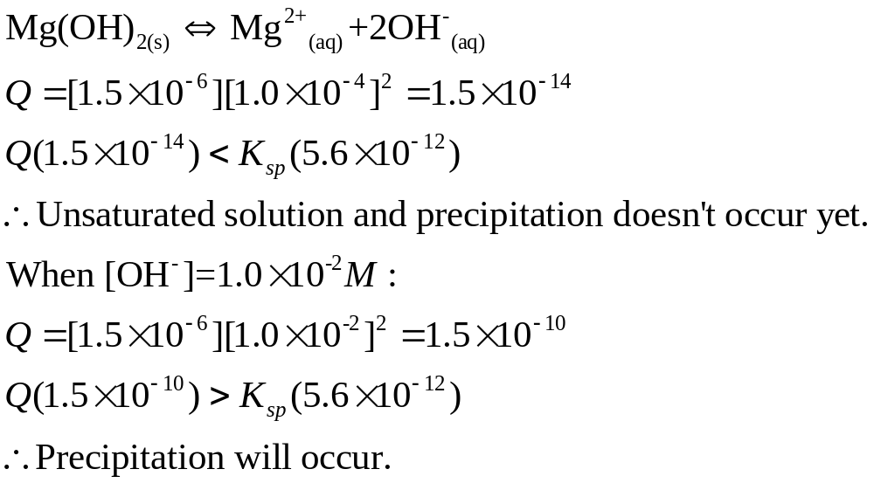
That is, pH = 10 or greater

Slide 22
Complex Ion Equilibrium
Complex ion = a central metal ion (e⁻ acceptor = Lewis acid) bound to 1 or more ligands
[Ag(NH₃)₂]⁺¹
Ligand = neutral molecule or ion that acts as Lewis base (e⁻ donor) with the central metal ion
CuCl₄⁻² and EDTA-Ca or -Mg

