Slide 1
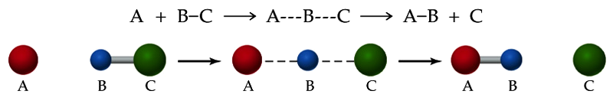
The Arrhenius Equation
Collision Theory: A bimolecular reaction occurs when two correctly oriented molecules collide with sufficient energy.
Activation Energy (E_{a}): The potential energy barrier that must be surmounted before reactants can be converted to products.

Slide 2
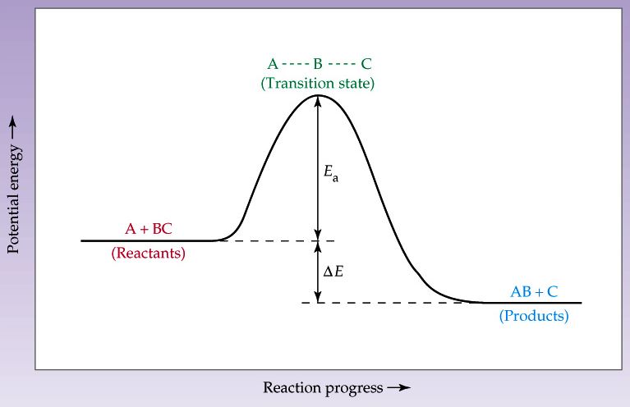
The Arrhenius Equation

Slide 3
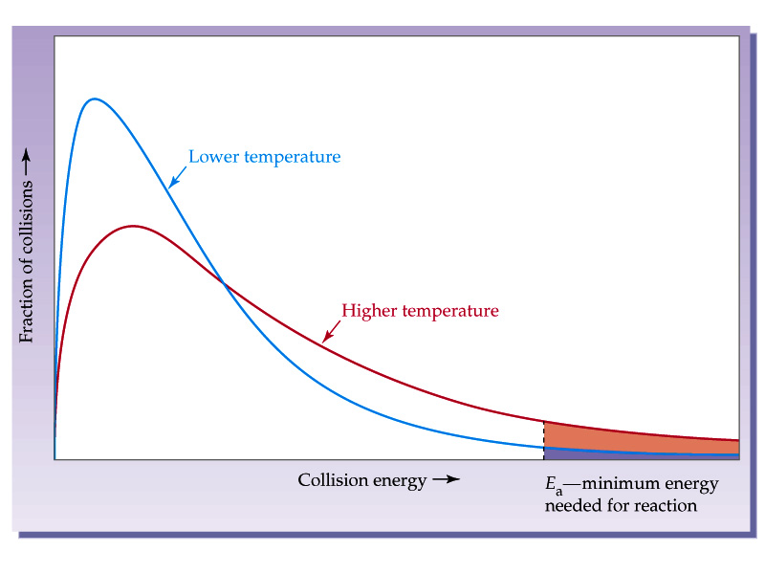
The Arrhenius Equation

Slide 4
The Arrhenius Equation
This relationship is summarized by the Arrhenius equation.
Taking logs and rearranging, we get:
⎛
E
⎞
k
=
−
⎜
a
⎟
RT
Ae
⎝
⎠
⎛
E
⎞
⎛
1
⎞
ln
k
=
−
a
+
ln
A
⎝
⎠
⎝
⎠
R
T

Slide 5
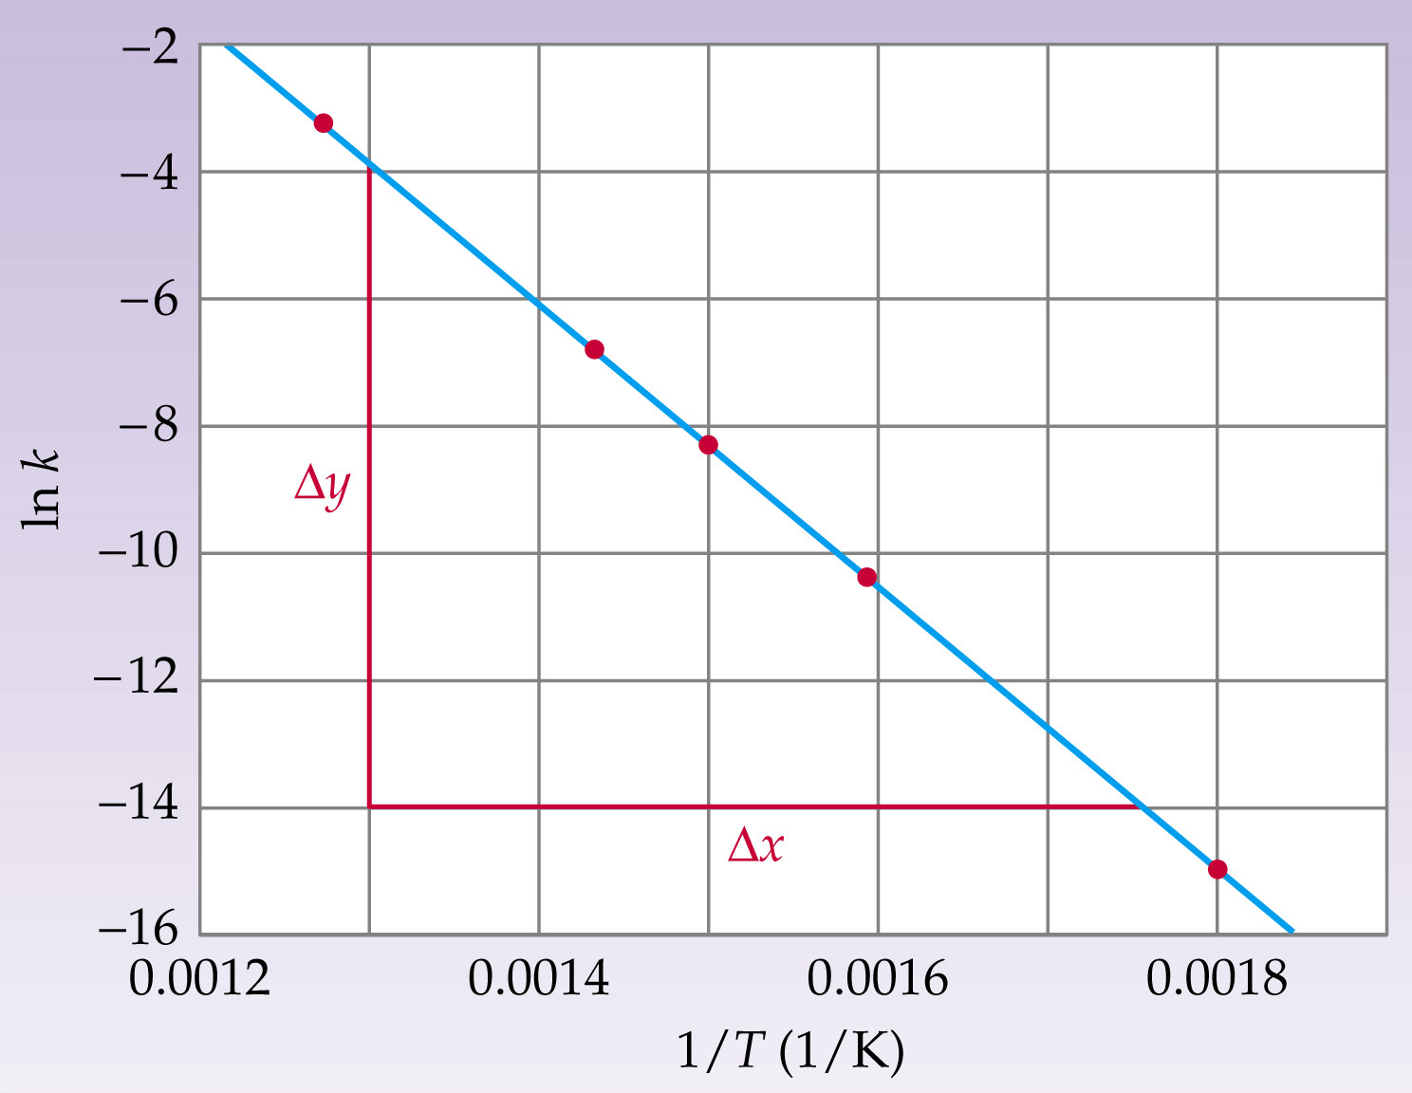
The Arrhenius Equation
Temp (°C) | k (M⁻¹ s⁻¹)
283 | 3.52e-7
356 | 3.02e5
393 | 2.19e-4
427 | 1.16e-3
508 | 3.95e-2

Slide 6
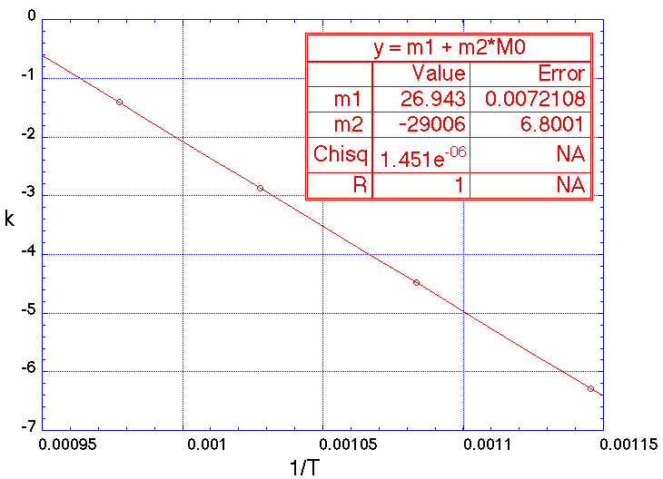
The Arrhenius Equation
The second-order rate constant for the decomposition of nitrous oxide (N₂O) into nitrogen molecule and oxygen atom has been measured at different temperatures:
Determine graphically
the activation energy
for the reaction.
The second-order rate constant for the decomposition of nitrous oxide (N₂O) into nitrogen molecule and oxygen atom has been measured at different temperatures:
Determine graphically
the activation energy
for the reaction.
-
-
1
1
-
-
1
1
t
t
(
(
°
°
C
C
k
)
)
k
(M
(M
s
s
)
)
-
-
1
3
3
1
.8
.8
7
7
x
x
1
1
0
0
6
6
0
0
0
0
0
0
.0
.0
1
1
1
1
3
3
6
6
5
5
0
0
0
0
.0
.0
5
5
6
6
9
9
7
7
0
0
0
0
0
0
.2
.2
4
4
4
4
7
7
5
5
0
0

Slide 7
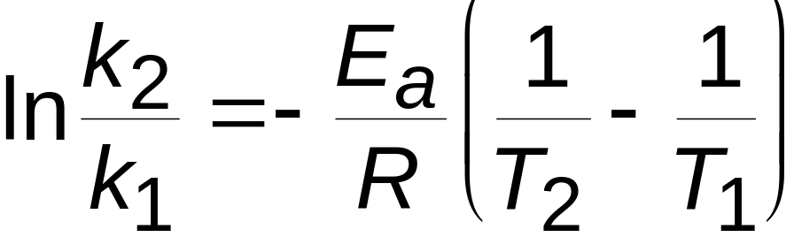
The Arrhenius Equation
A simpler way to use this is by comparing the rate constant at just two temperatures:
If the rate of a reaction doubles by increasing the temperature by 10°C from 298.2 K to 308.2 K, what is the activation energy of the reaction?

