Slide 1
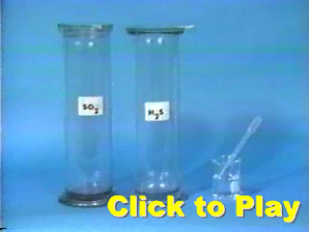
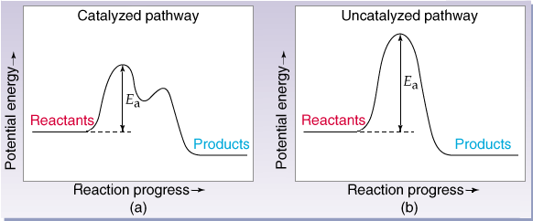
Catalysis
A catalyst is a substance that increases the rate of a reaction without being consumed in the reaction.

Slide 2
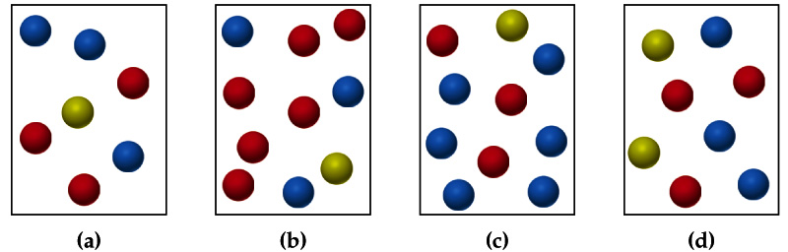
Catalysis
The relative rates of the reaction A + B → AB in vessels a–d are 1:2:1:2. Red = A, blue = B, yellow = third substance C.
  (a) What is the order of reaction in A, B, and C?
  (b) Write the rate law.
  (c) Write a mechanism that agrees with the rate law.
  (d) Why doesn’t C appear in the overall reaction?

Slide 3
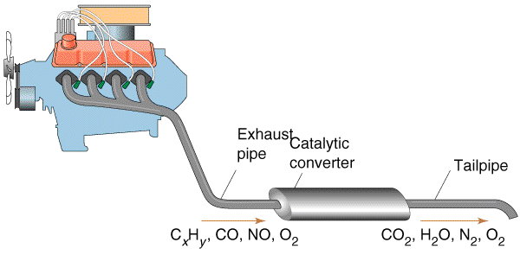
Catalysis
Homogeneous Catalyst: Exists in the same phase as the reactants.
Heterogeneous Catalyst: Exists in different phase to the reactants.

Slide 4
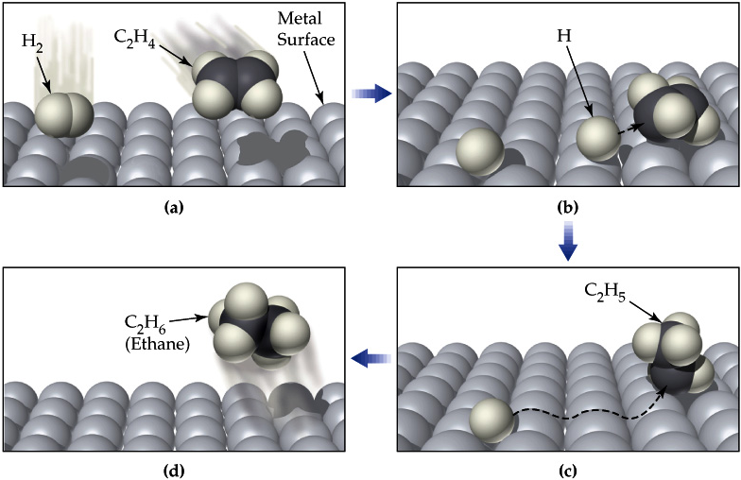
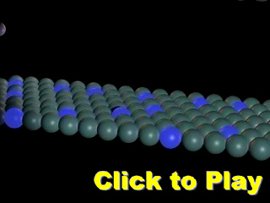
Catalysis
Catalytic Hydrogenation:

Slide 5
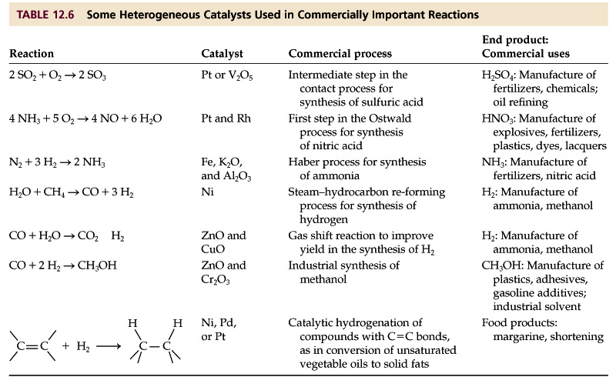
Catalysis

